Slide 1
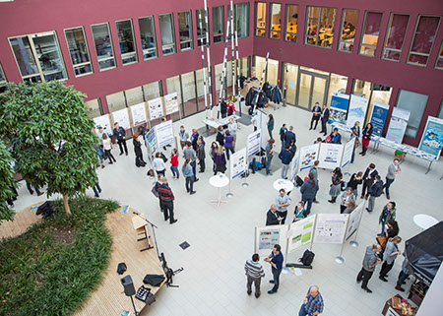
Please put the logo of your institution here!
Poster title (max. 100 characters incl. spaces)
First author¹, second author, third author…
¹Adress Institution first author
Poster Format: DIN A0 (portrait orientation, 841 x 1189 mm)
Language: English
The poster should be clearly legible from a distance of 2 meters.
Poster Title
Font: Veranda
Font Size: min. 66 pt.
max. 100 characters (including spaces)
List of authors
Font: Verdana italic
Font Size: min. 44 pt. (Address of the first author min. 32 pt.)
Please underline the name of the presenting author and give the address of the first author.
Poster Content
The text should be limited to brief statements.
Font: Arial Narrow
Font Size: min. 44 pt.
max. 4.000 characters (including spaces)
Structure: Introduction, Objective, Material & Methods, Results, Discussion, Conclusion
The use of figures as well as tables is very welcome. Please make sure that the font size of their description is sufficient.
Tagging
Please list the professional and popular science keywords from your application for a hashtag line in the footer of your poster. Write an double cross in front of each keyword without a space character (see the examples below).
Font: Verdana
Font Size: 44 pt.
Figure 1. Poster session at the Forschungscamp 2016 in the Atrium of the Konrad-Zuse-Haus.
forschungscamp2017 – postersession – posterguidelines – sciene – research – scientificcommunication – visibility – youngscientists

