Slide 1



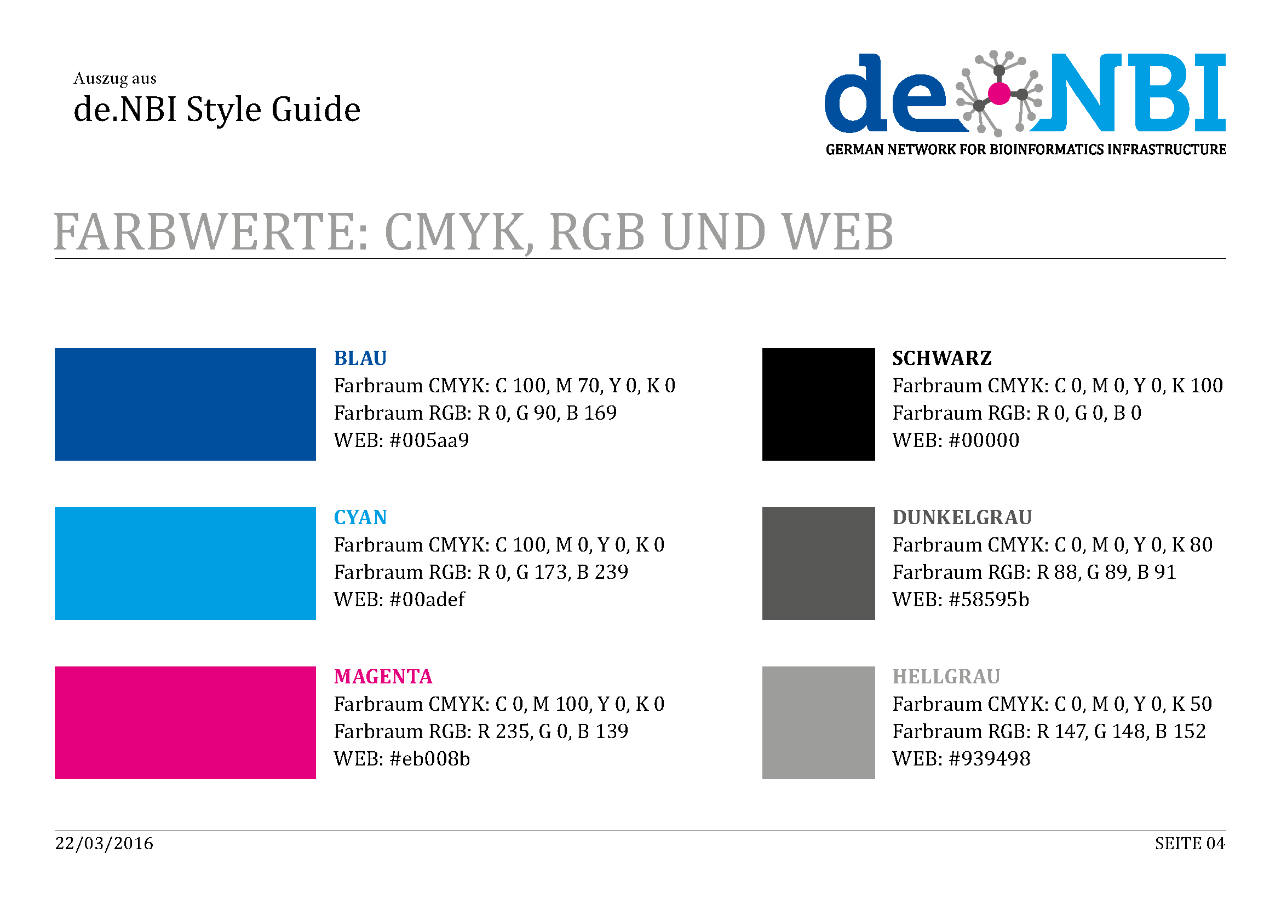

BiGi
Bioinformatics Services for Microbial Genome and Metagenome Research
at the Center for Biotechnology
Fkz XXXXXX
Firstname Name, Firstname Name, Firstname Name, Firstname Name, Firstname Name, Firstname Name, Firstname Name
Center for Biotechnology, Bielefeld University, Germany
Short description of the project
Progress report
Tasks performed during project runtime
Hint: Standard font: Cambria
de.NBI cloud activities
(If applicable )
de.NBI services
de.NBI Training and education
Description of de.NBI services and tools
Include metrics of tools (KPI, user monitoring)
Optionally: Testimonials
Description of de.NBI training -- training courses
-summer schools
- symposia
Include metrics if applicable
Optionally: Testimonials
General information on the project
Publications
No. of staff paid from de.NBI grant (FTE)
Other staff involved
www.denbi.de
Notes:
<number>

