Slide 1

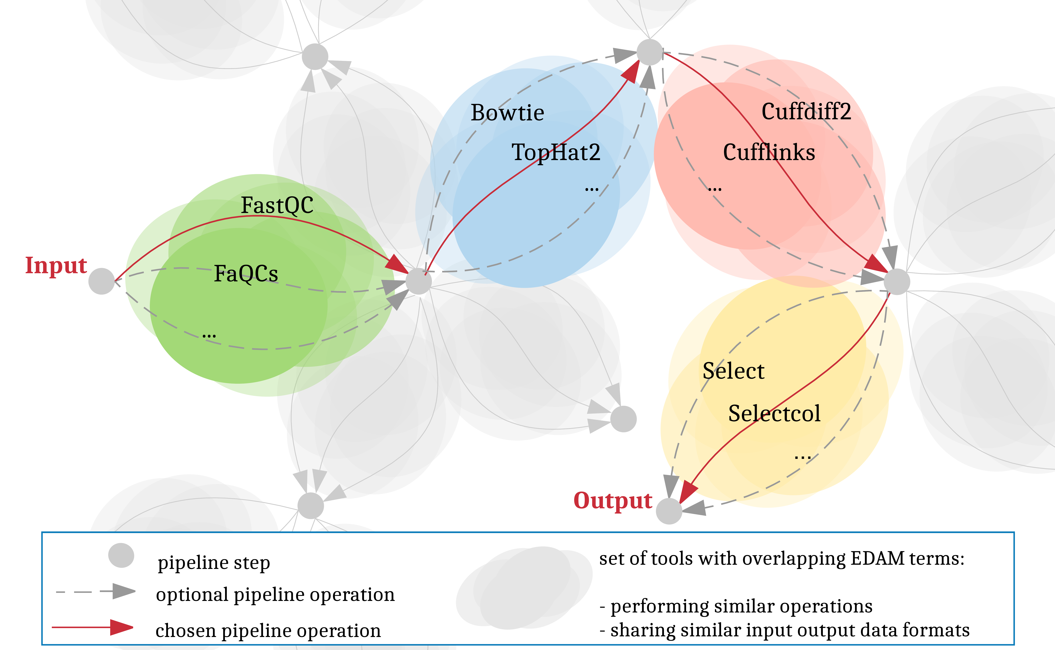

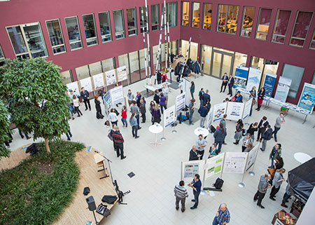




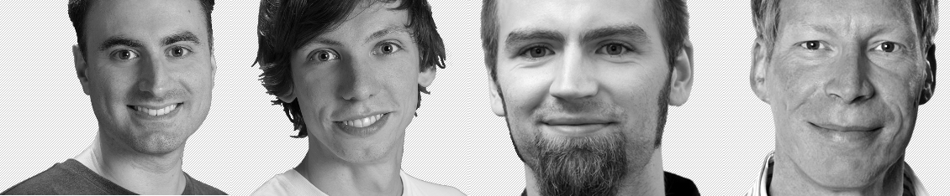


Towards automating workflow analyses in Galaxy
Andrea Bagnacani¹, Markus Wolfien¹, Martin Scharm¹, Olaf Wolkenhauer¹
¹Systems Biology and Bioinformatics, University of Rostock, Ulmenstr. 69, 18051 Rostock
Introduction
The Galaxy community is promoting RNA-Seq protocols and best practices through the reuse of existing tools, and the consolidation of a Training Network to provide guidance to researchers through example datasets, tutorials, and interactive tours. However, the more tools and techniques are showcased, the more complex the options for tool chaining and parametrization become.
Objectives
Assist researchers in carrying out their analyses
Integrate the Galaxy framework with an interactive recommendation system leveraging on community consolidated best practices as well as EDAM-annotated tools
Promote the adoption of well established pipelines
Allow room for experimental tools
Consolidate protocols and reproducibility
Materials and Methods
Results
Galaxy tools are grouped by function
Each tool function bridges two different states of data
Tools are chained on their input / output data formats
Galaxy tours recommends pertinent tools step by step
Users decide which tool to select and parametrize
Font: Arial Narrow
Font Size: min. 44 pt.
max. 4.000 characters (including spaces)
Structure: Introduction, Objective, Material & Methods, Results, Discussion, Conclusion
The use of figures as well as tables is very welcome. Please make sure that the font size of their description is sufficient.
Tagging
Please list the professional and popular science keywords from your application for a hashtag line in the footer of your poster. Write an double cross in front of each keyword without a space character (see the examples below).
Font: Verdana
Font Size: 44 pt.
Tool chaining and parametrization through Galaxy’s interactive tours
galaxyproject.org
Tool operations and input / output formats through Elixir’s bio.tools
edamontology.org
Figure 1. Poster session at the Forschungscamp 2016 in the Atrium of the Konrad-Zuse-Haus.
Best practices and user-tracked data of RBC’s Galaxy instance
denbi.de/rbc
destairdenbi
destair.bioinf.uni-leipzig.de
Systems Biology and Bioinformatics
University of Rostock
Ulmenstr. 69, 18051 Rostock
www.sbi.uni-rostock.de
#forschungscamp2017 #galaxy #elixir #RNA #EDAM #AI #de.NBI

