Slide 1







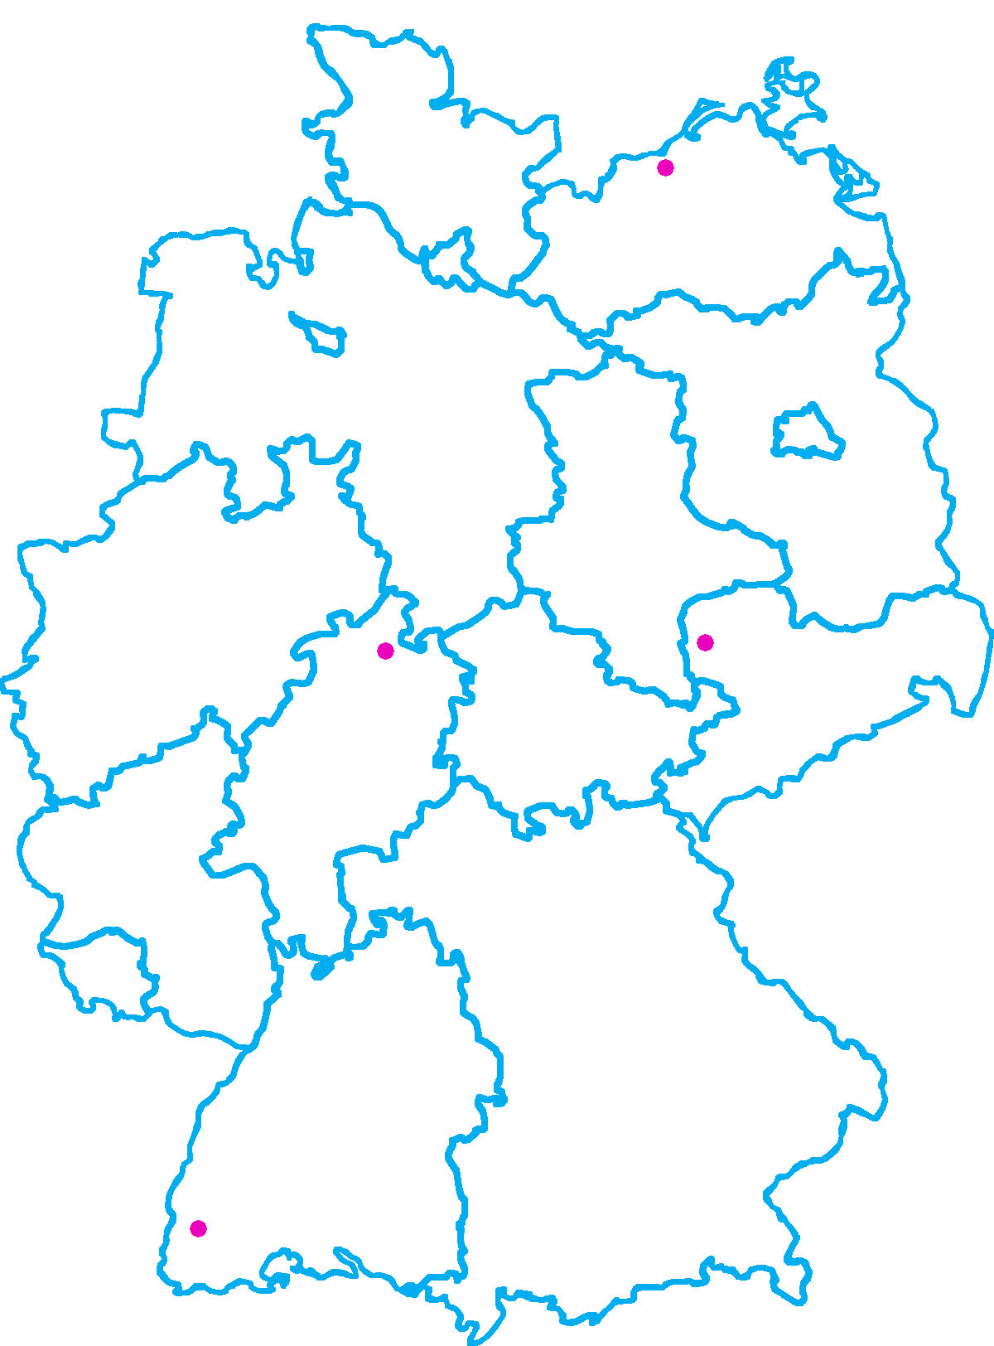
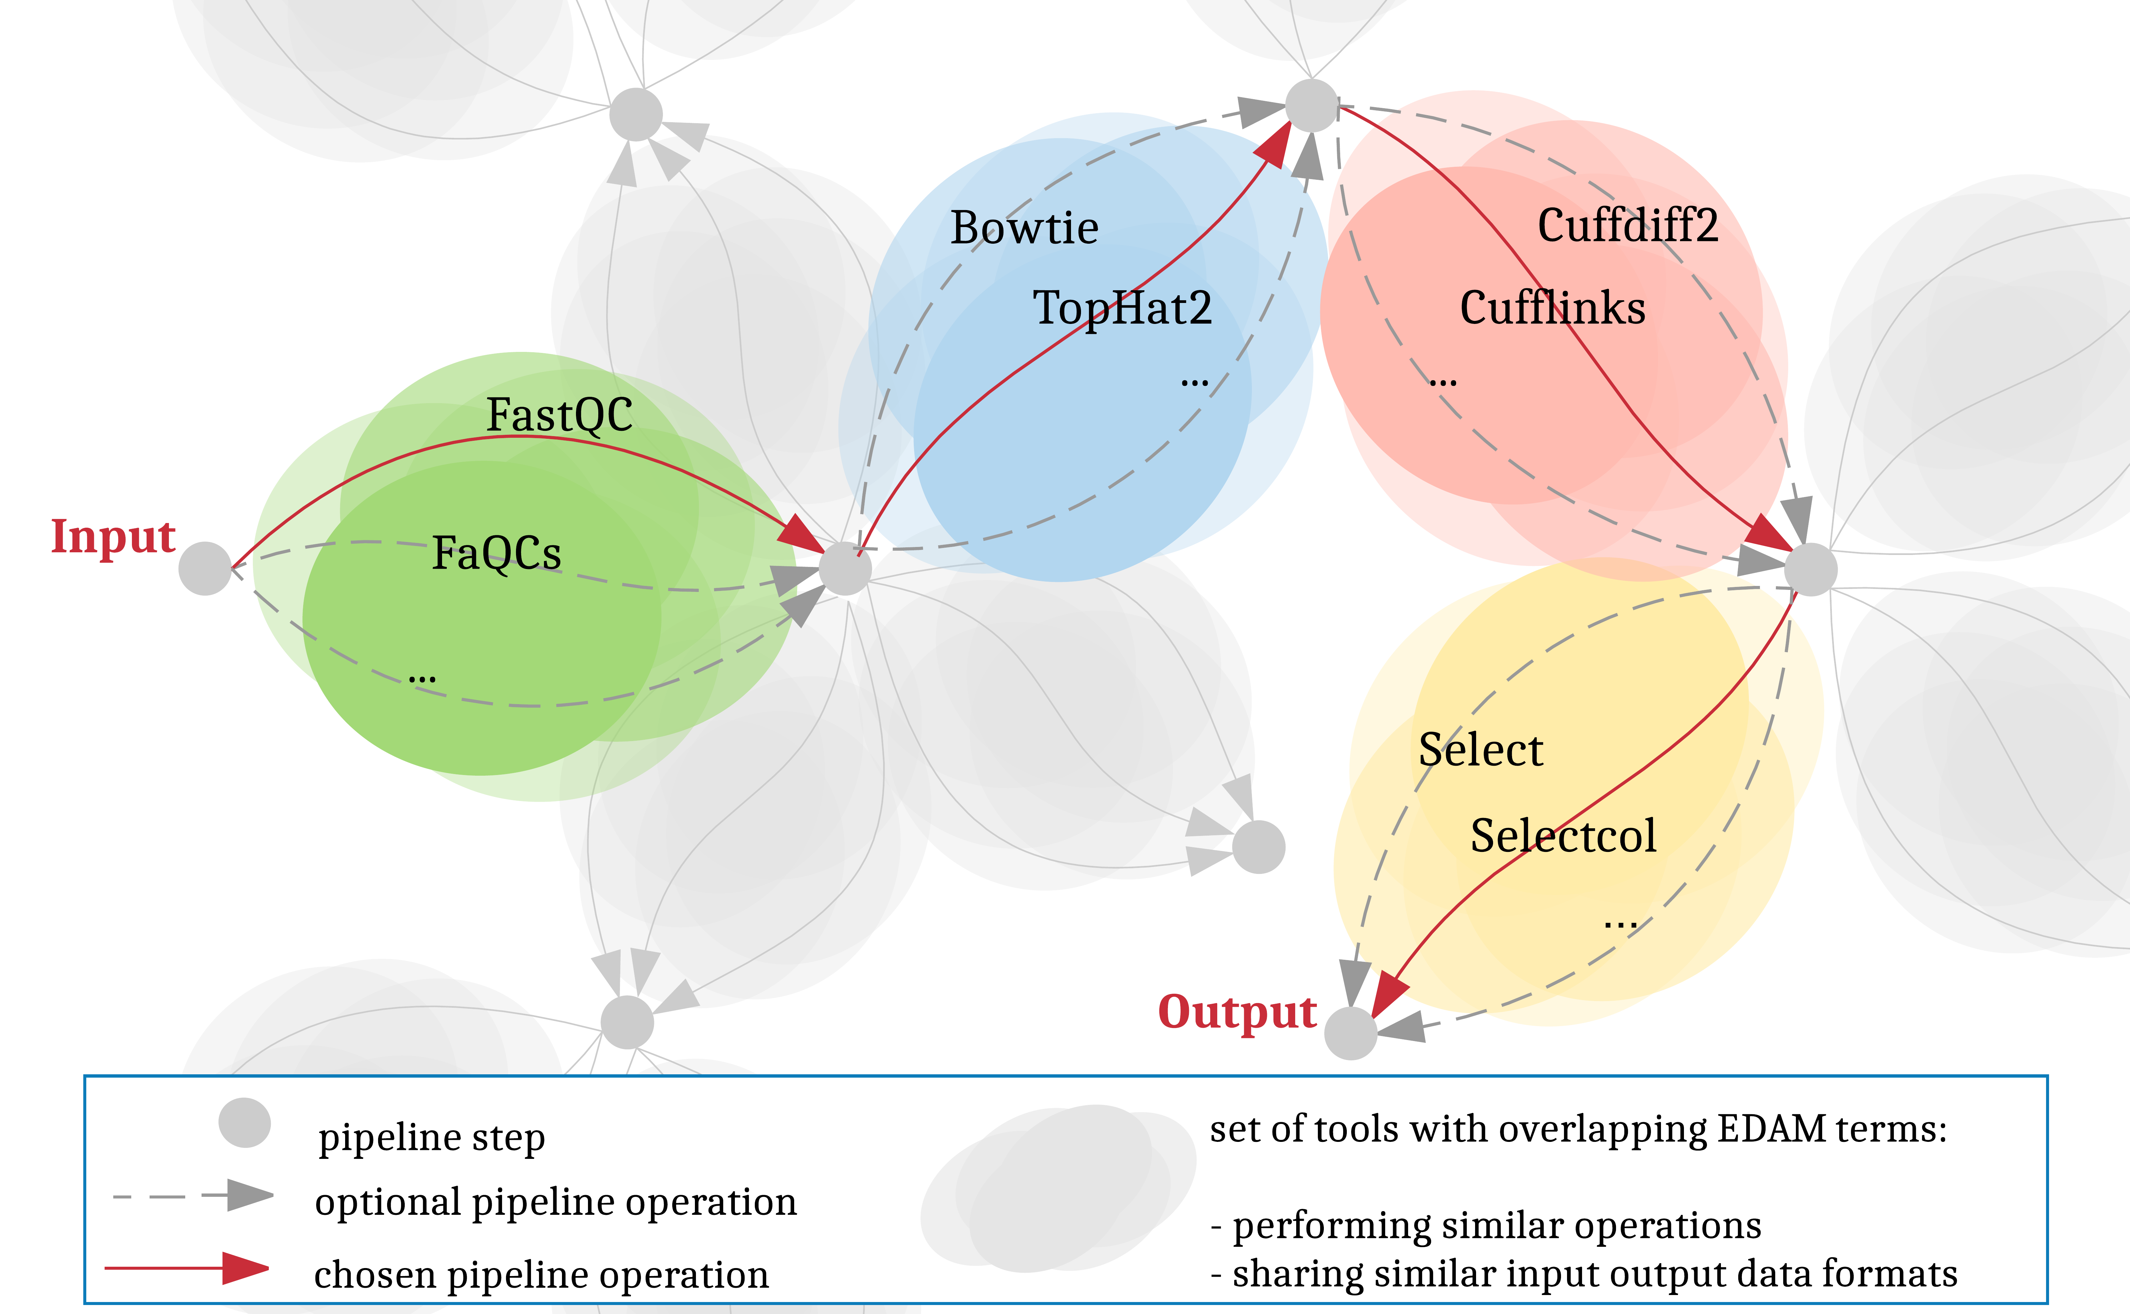

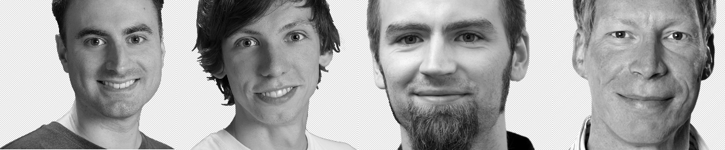


Towards automating and publishing workflow
analyses in Galaxy
Andrea Bagnacani, Markus Wolfien, Martin Scharm, Olaf Wolkenhauer
Research gaps and objectives for the present work
Towards the automation of workflow construction
The Galaxy community is promoting RNA-Seq protocols and best practices through the reuse of existing tools, and the consolidation of a Training Network to provide guidance to researchers through example datasets, tutorials, and interactive tours. However, the more tools and techniques are showcased, the more complex the options for tool chaining and parametrization become. And as more material is gathered to illustrate approaches on the analysis of Life Science data, the higher the risk to overwhelm users. To assist researchers in carrying out their investigations, we propose to integrate the Galaxy framework with an interactive recommendation system that leverages on community consolidated best practices as well as EDAM-annotated tools. Such a system would promote the adoption of well established pipelines, while at the same time allow room for testing further experimental tools, easing reuse, and consolidating protocols and reproducibility.
Leverage on the Galaxy interactive tours
to provide users interchangeable tools
galaxyproject.org
Gather EDAM ontology terms describing
each tool in terms of operations, input,
and output formats
edamontology.org
Mine Galaxy instances for user-tracked
data: tool chaining, parametrization, formats
Bridging the gap of tool chaining and parametrization
denbi.de/rbc
Dockerized Galaxy flavor
Integration within Galaxy RNA Workbench
Provide interactive guidance on designing RNA-Seq experiments
Test of novel and experimental tools
destairdenbi
Training events
destair.bioinf.uni-leipzig.de
Galaxy Tours
Galaxy Interactive
Recommendation system
Training events
Hackathon
Galaxy Flavor
Hackathon
The de.STAIR Galaxy interactive recommendation system. The recommendation system traces a path from the beginning of a Life Science data analysis to its end. Here, researchers can decide which path to walk towards the completion of the desired analysis by providing an input dataset and an analysis goal.
Tools are recommended step by step, based on both tool’s pertinence within the scope of the requested analysis goal and existing best practices within the current analysis step.
Best practice approaches are shared among the scientific community through the Galaxy platform as reusable workflows.
Tool pertinence is inferred from the provided EDAM ontology terms, associated to its operations and input/output data formats.
Galaxy Tours
Training events
denbi.de
References
Wolfien M et al. TRAPLINE: A standardized and automated pipeline
for RNA sequencing data analysis, evaluation and annotation.
BMC Bioinformatics, 2016. 10.1186/s12859-015-0873-9
Lott SC et al. Customized workflow development and data
modularization concepts for RNA-Sequencing and
metatranscriptome experiments. Journal of Biotechnology, 2017.
10.1016/j.jbiotec.2017.06.1203
Grüning BA et al. The RNA workbench: best practices for RNA
and high-throughput sequencing bioinformatics in Galaxy.
Nucleic Acids Research, 2017. 10.1093/nar/gkx409
Andrea Bagnacani
andrea.bagnacani@uni-rostock.de
Systems Biology and Bioinformatics
University of Rostock
www.sbi.uni-rostock.de
Notes:
<number>

