Slide 1

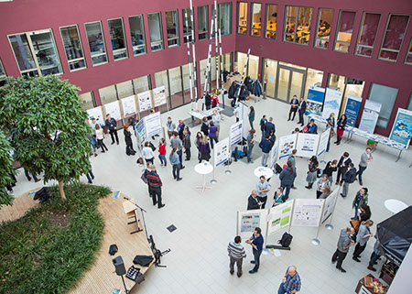
Towards automating workflow analyses in Galaxy
Andrea Bagnacani¹, Markus Wolfien, Martin Scharm, Olaf Wolkenhauer
¹Systems Biology and Bioinformatics, University of Rostock, Rostock
Poster Content
The text should be limited to brief statements.
Font: Arial Narrow
Font Size: min. 44 pt.
max. 4.000 characters (including spaces)
Structure: Introduction, Objective, Material & Methods, Results, Discussion, Conclusion
The use of figures as well as tables is very welcome. Please make sure that the font size of their description is sufficient.
Tagging
Please list the professional and popular science keywords from your application for a hashtag line in the footer of your poster. Write an double cross in front of each keyword without a space character (see the examples below).
Font: Verdana
Font Size: 44 pt.
Figure 1. Poster session at the Forschungscamp 2016 in the Atrium of the Konrad-Zuse-Haus.
forschungscamp2017 – postersession – posterguidelines – sciene – research – scientificcommunication – visibility – youngscientists

