Slide 1

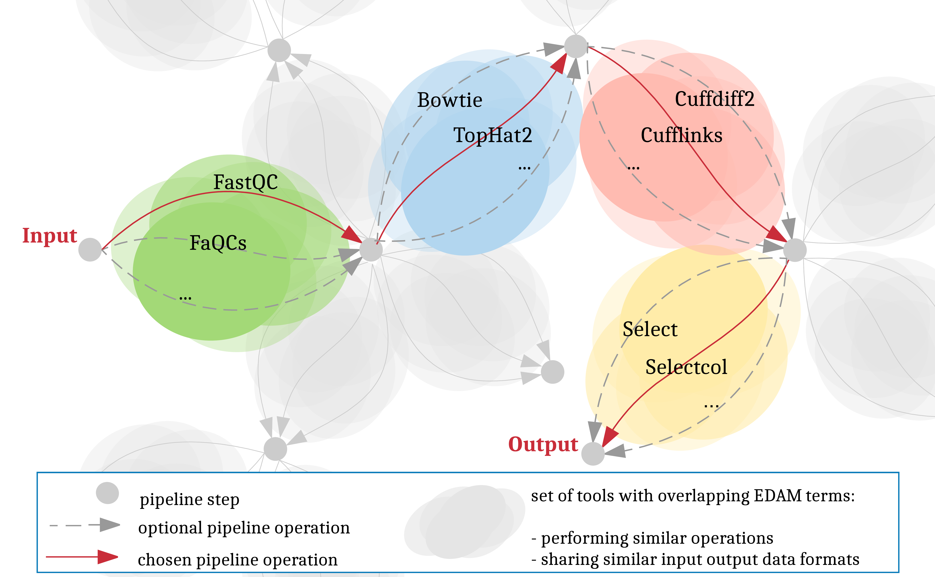


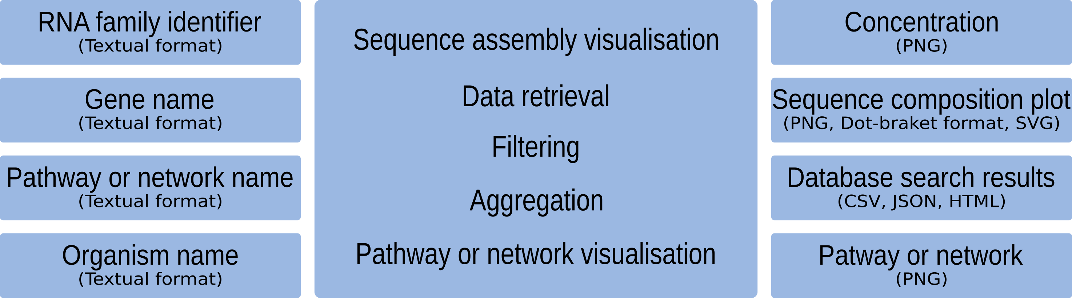



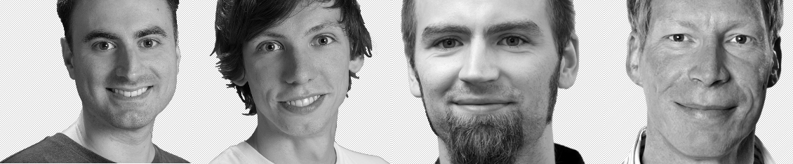



Towards automating workflow analyses in Galaxy
Andrea Bagnacani¹, Markus Wolfien¹, Martin Scharm¹, Olaf Wolkenhauer¹
¹Systems Biology and Bioinformatics, University of Rostock, Ulmenstr. 69, 18051 Rostock
Introduction
The Galaxy community is promoting RNA-Seq protocols and best practices through the reuse of existing tools, and the consolidation of a Training Network to provide guidance to researchers through example datasets, tutorials, and interactive tours. However, the more tools and techniques are showcased, the more complex the options for tool chaining and parametrization become.
Objectives
Assist researchers in carrying out their analyses
Integrate the Galaxy framework with an interactive recommendation system leveraging on community consolidated best practices as well as EDAM annotated tools
Promote the adoption of well established pipelines
Allow room for experimental tools
Consolidate protocols and reproducibility
Materials and Methods
Results and discussion
Galaxy tools are grouped by function
Each tool function bridges two different states of data
Tools are chained on their input / output data formats
Galaxy tours recommends pertinent tools step by step
Users decide which tool to select and parametrize
Conclusion
A recommendation system enhances the visibility of each Galaxy tool, relieving the user from browsing tool categories, or sticking to the usual analysis tools
Tool pertinence is inferred from manually curated EDAM annotations, therefore a tool’s pertinence is as accurate as its bio.tools annotation
References
Lott SC et al. Customized workflow development and data modularization concepts for RNA-Sequencing and metatranscriptome experiments. Journal of Biotechnology, 2017. 10.1016/j.jbiotec.2017.06.1203
Tool chaining and parametrization through Galaxy’s interactive tours
galaxyproject.org
Bioinformatics
Transcription factors and regulatory sites > Functional, regulatory, and non-coding RNA > RNA
Tool operations and input / output formats through Elixir’s bio.tools
edamontology.org
Best practices and user-tracked data of RBC’s Galaxy instance
denbi.de/rbc
destairdenbi
destair.bioinf.uni-leipzig.de
Systems Biology and Bioinformatics
University of Rostock
Ulmenstr. 69, 18051 Rostock
www.sbi.uni-rostock.de
#forschungscamp2017 #galaxy #elixir #RNA #EDAM #AI #denbi

