Slide 1



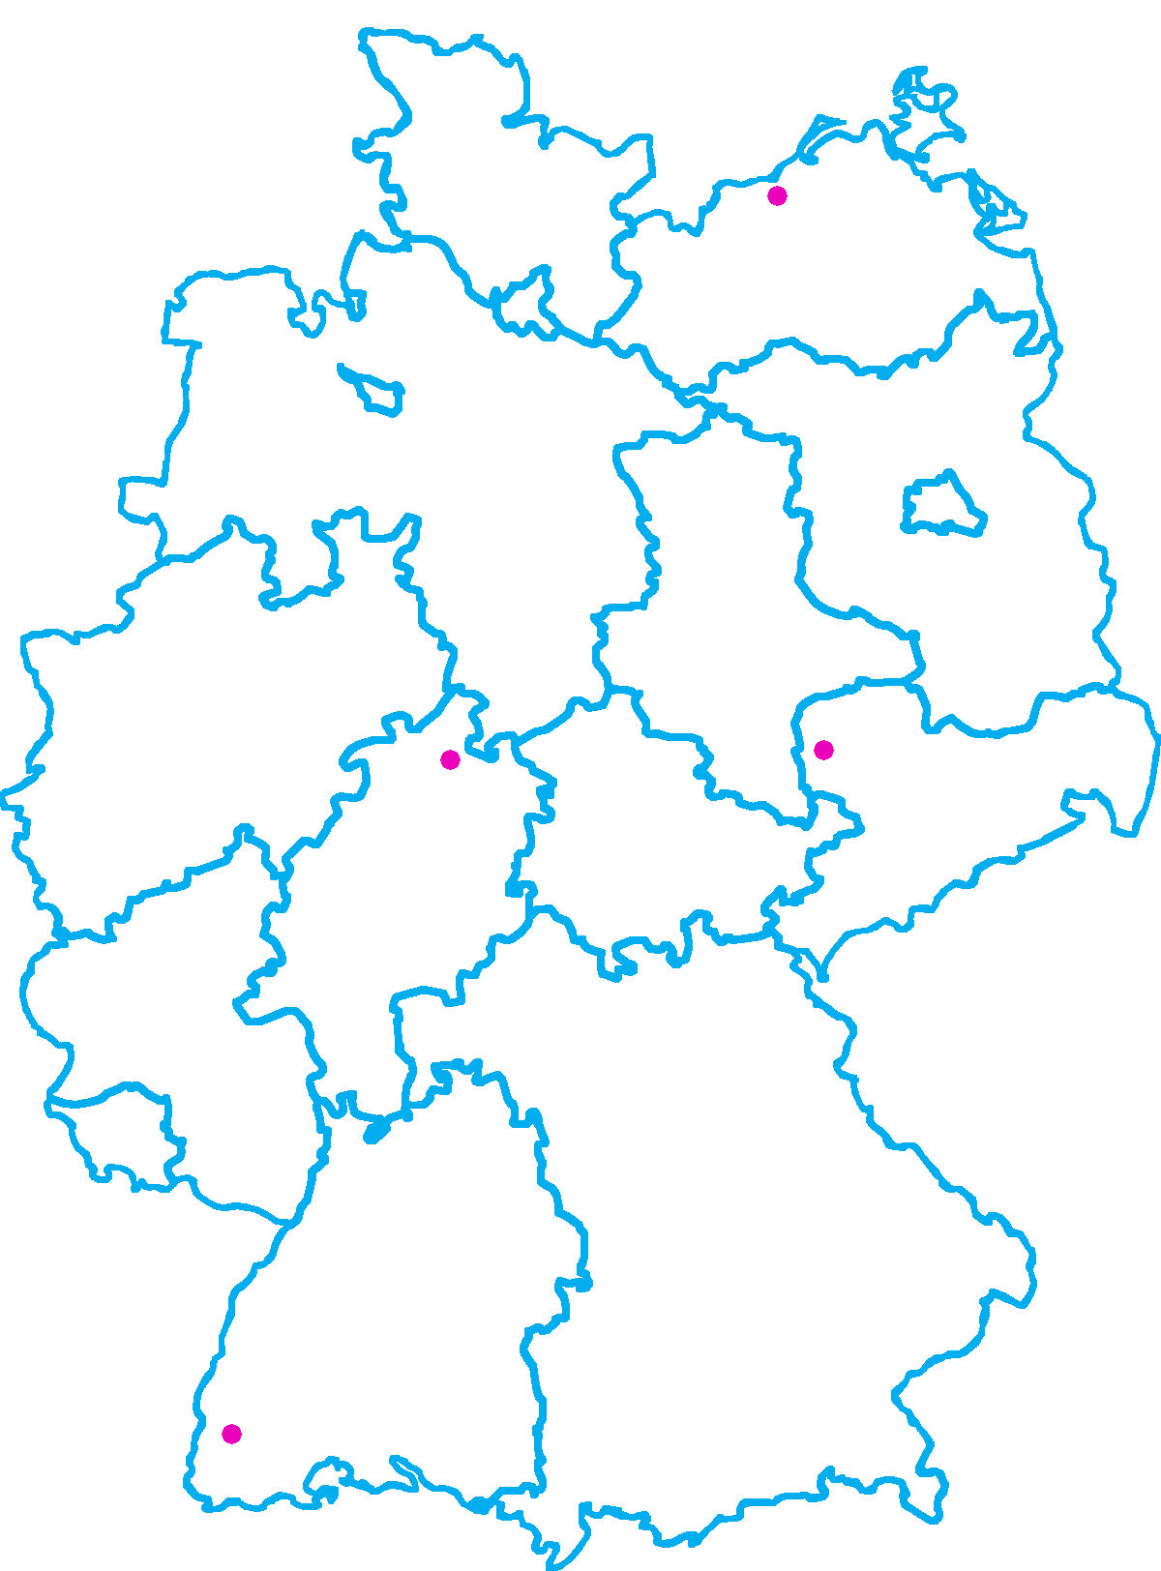
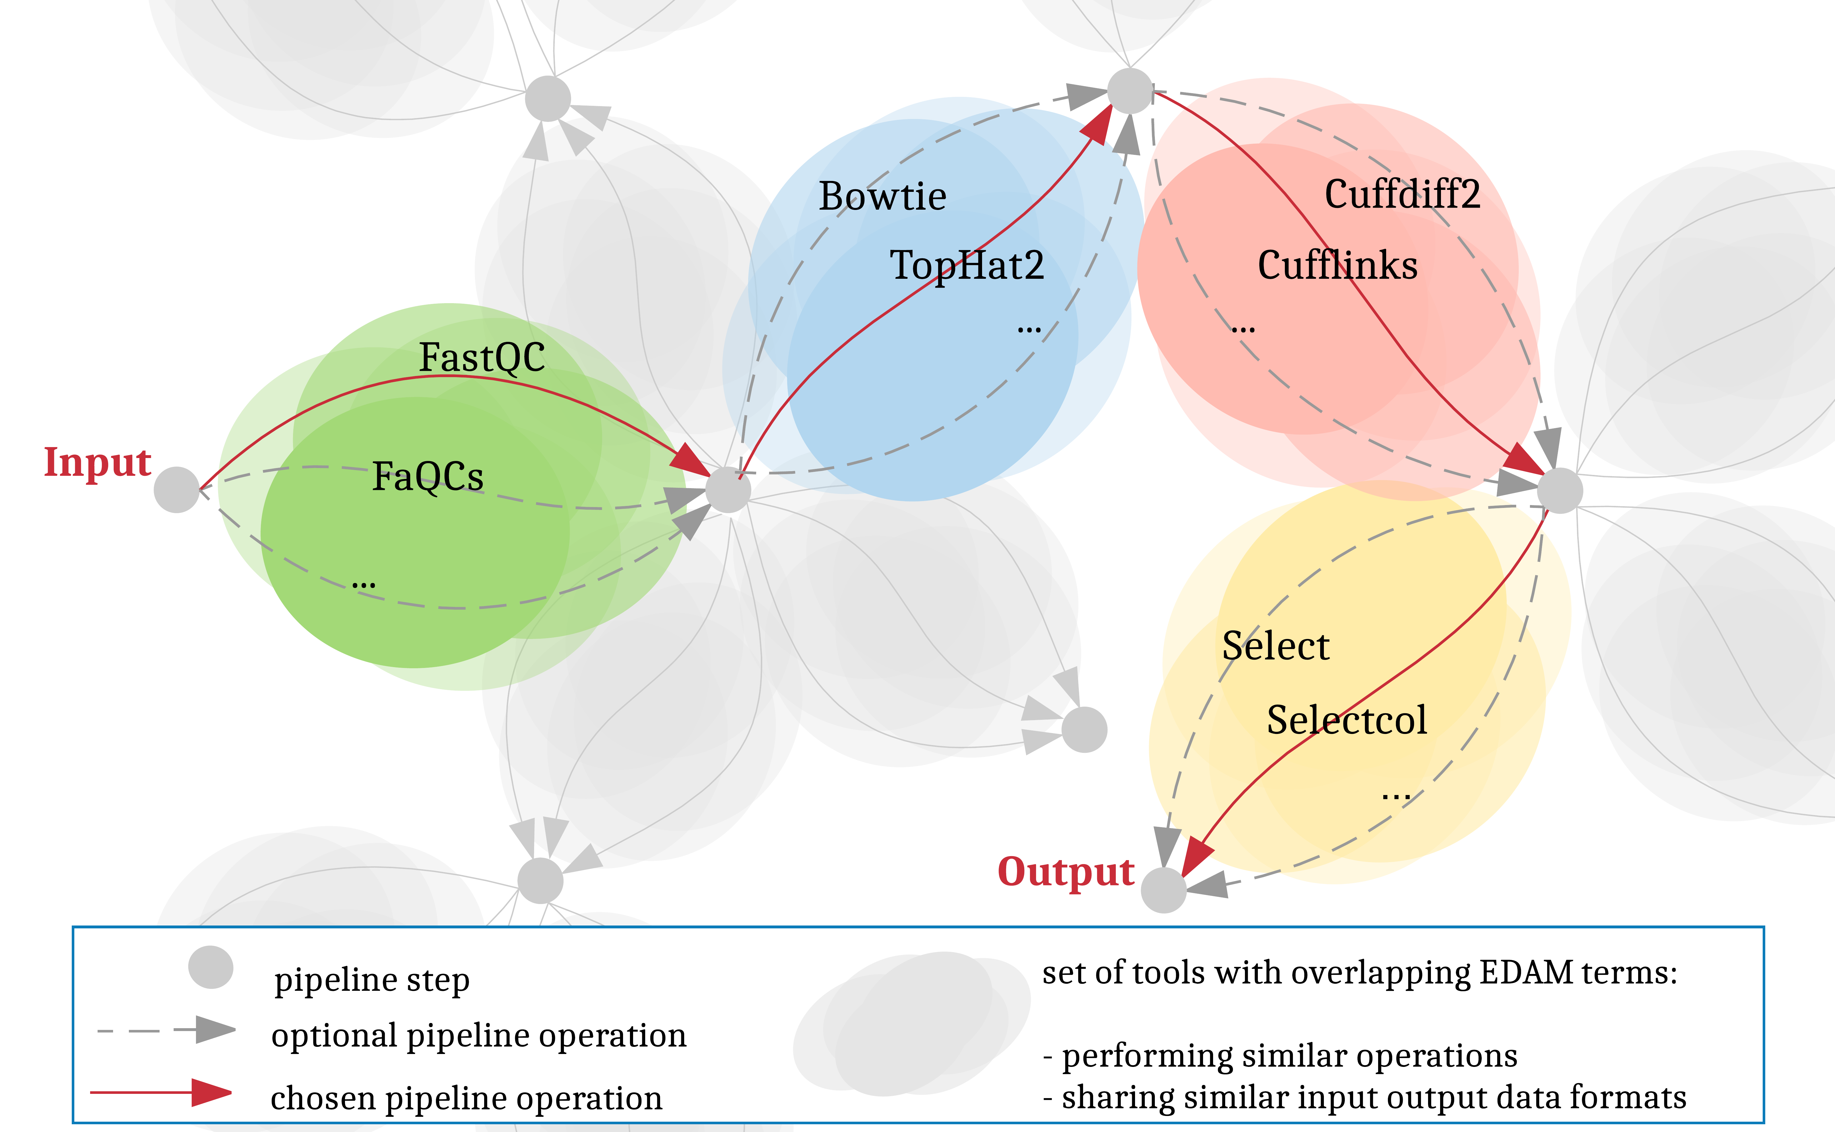

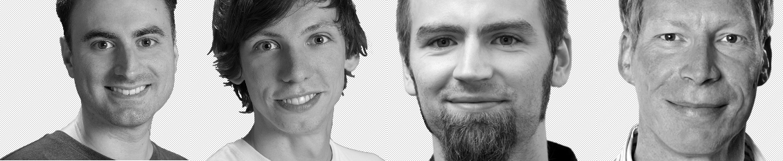



de.STAIR
Structured Analysis and Integration of RNA-Seq Experiments
Andrea Bagnacani, Markus Wolfien, Martin Scharm, Olaf Wolkenhauer
Department of Systems Biology and Bioinformatics, University of Rostock, Germany
Fkz 031L0106C
Short description of the project
Progress report
The Galaxy Community Network is promoting RNA-Seq protocols and best practices through the reuse of existing tools and the consolidation of a Training Network to provide example datasets, tutorials, and interactive tours. However, the more tools are gathered, the more complex the options for tool-chaining and parametrization become. To assist researchers in carrying out their investigations, we propose to integrate the Galaxy framework with an interactive recommendation system that leverages on community consolidated best practices as well as EDAM-annotated tools. Such a system would promote the adoption of well established pipelines, while at the same time allowing room for new and experimental tools, easing reuse, while consolidating protocols and reproducibility.
Contributed to the Galaxy RNA Workbench testing and code-base
Provided interactive Galaxy tours for best practices and training
Took part to de.STAIR and GCC2017 hackathons
Mined Galaxy user interactions data
The Galaxy Community Network is promoting RNA-Seq protocols and best practices through the reuse of existing tools and the consolidation of a Training Network to provide example datasets, tutorials, and interactive tours. However, the more tools are gathered, the more complex the options for tool-chaining and parametrization become. To assist researchers in carrying out their investigations, we propose to integrate the Galaxy framework with an interactive recommendation system that leverages on community consolidated best practices as well as EDAM-annotated tools. Such a system would promote the adoption of well established pipelines, while at the same time allowing room for new and experimental tools, easing reuse, while consolidating protocols and reproducibility.
https://github.com/destairdenbi
Training events
Galaxy tours
de.NBI services
Interactive guidance on the design of RNA-Seq experiments
Workflow design and integration within RBC’s Galaxy RNA Workbench
Dockerized Galaxy flavors
Easing annotation and characterization of transcripts
Galaxy interactive recommendation system
Training events
Hackathon
Galaxy flavor
Hackathon
Galaxy tours
Training events
Project started
on December 2016
de.STAIR’s interactive recommendation system. Users can decide which path to walk towards the completion of the desired analysis by providing an input dataset and an analysis goal. Tools are recommended step by step, based on both tool’s pertinence, and existing best practices within the current analysis step. Best practices are shared among the scientific community through the Galaxy platform as reusable workflows, while tool pertinence is inferred from the provided EDAM ontology terms associated to their operations and input/output data formats.
de.NBI Training and education
EASyM Systems Medicine Conference | Berlin | 26.10.2016 – 28.10.2016
CASyM Systems Medicine Winter School | Ljubljana | 29.03.2017 – 01.04.2017
de.STAIR Training A Primer for RNA-Seq | Freiburg | 04.10.2017 – 06.10.2017
General information on the project
Employees paid by de.NBI funds
Scientist | Andrea Bagnacani
Additional investigators within de.NBI
Scientist Technician Scientist (PI) | Markus Wolfien Martin Scharm Olaf Wolkenhauer
Publications
Wolfien M, Rimmbach R, Schmitz U, Jung JJ, Krebs S, Steinhoff G, David R, Wolkenhauer O.
TRAPLINE: A standardized and automated pipeline for RNA sequencing data analysis,
evaluation and annotation. BMC Bioinformatics, 2016. 10.1186/s12859-015-0873-9
Schmitz U, Lai X, Winter F, Wolkenhauer O, Vera J, Gupta S.
Cooperative gene regulation by microRNA pairs and their identification using a
computational workflow. Nucleic Acid Research, 2014. 10.1093/nar/gku465
Lott SC, Wolfien M, Riege K, Bagnacani A, Wolkenhauer O, Hoffmann S, Hess WR.
Customized workflow development and data modularization concepts for RNA-
Sequencing and metatranscriptome experiments. Journal of Biotechnology.
10.1016/j.jbiotec.2017.06.1203
Gruening BA, Fallmann J, Yusuf D, Will S, Erxleben A, Eggenhofer F, Houwaart T, Batut B,
Videm P, Bagnacani A, Wolfien M, Lott SC, Hoogstrate Y, Hess WR, Wolkenhauer O,
Hoffmann S, Akalin A, Ohler U, Stadler PF, Backofen R. The RNA workbench: best
practices for RNA and high-throughput sequencing bioinformatics in Galaxy. Nucleic
Acids Research. 10.1093/nar/gkx409
Rostock
sbi.uni-rostock.de/destair
www.denbi.de
Notes:
1

