Slide 1
CAPSTONE PROJECT · APPLIED PYTHON FOR DATA ANALYSIS
Driving FY 2026 Revenue Growth
Brittany Agostino · May 20th, 2026
* ppt generated with assistance of Claude Cowork when prompted with key takeaways and select screenshots

Slide 2
CAPSTONE PROJECT · APPLIED PYTHON FOR DATA ANALYSIS
Driving FY 2026 Revenue Growth
PROBLEM STATEMENT
AUDIENCE
As a data analyst for an e-commerce company, I analyzed one year of transaction data to identify the top three factors driving revenue and inform the company's FY 2026 growth plan.
CFO
CMO
Head of Sales
Findings will inform FY 2026 marketing and pricing strategy.
THREE WORKSTREAMS
1. Quantify the variables most strongly correlated with revenue (weekend sales, product category, marketing channel).
2. Segment customers to determine how much to invest in VIPs based on their impact on profitability.
3. Evaluate whether the current pricing strategy and discount practice help or hurt overall revenue and sales volume.
PRIMARY QUESTION
What customer, product, and pricing levers should the company prioritize in FY 2026 to maximize revenue growth without eroding margin?

Slide 3
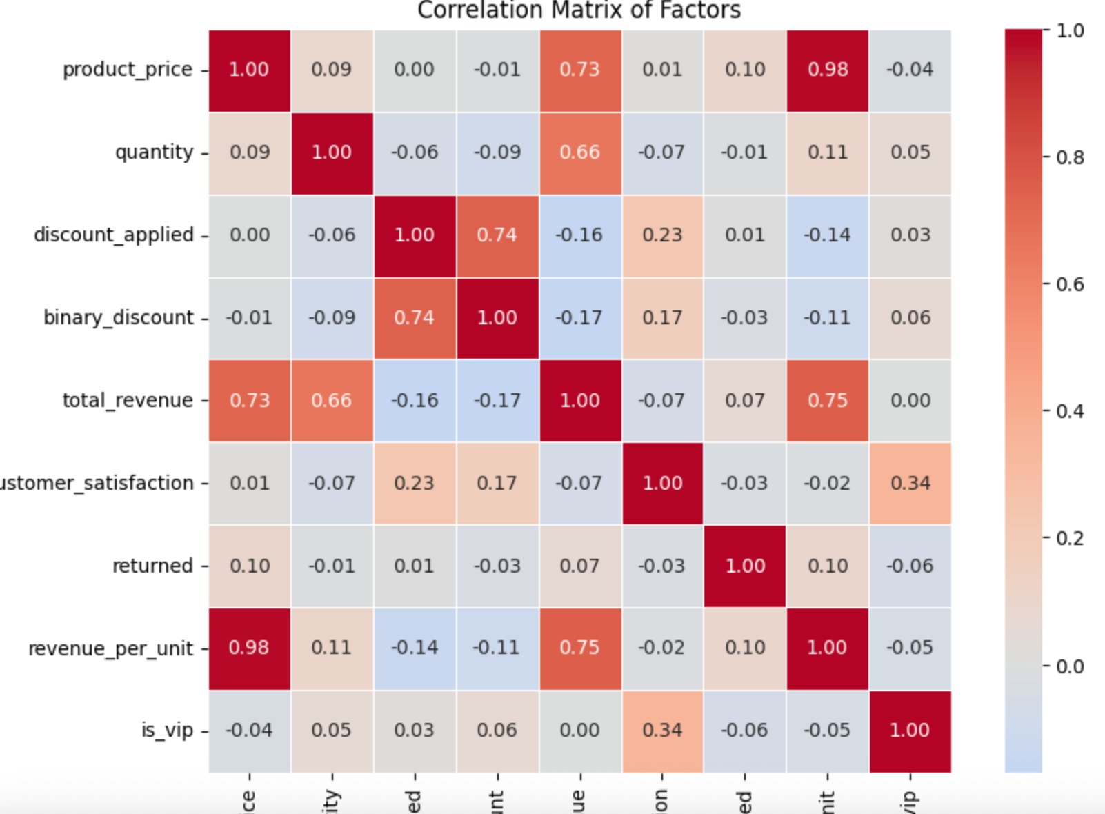
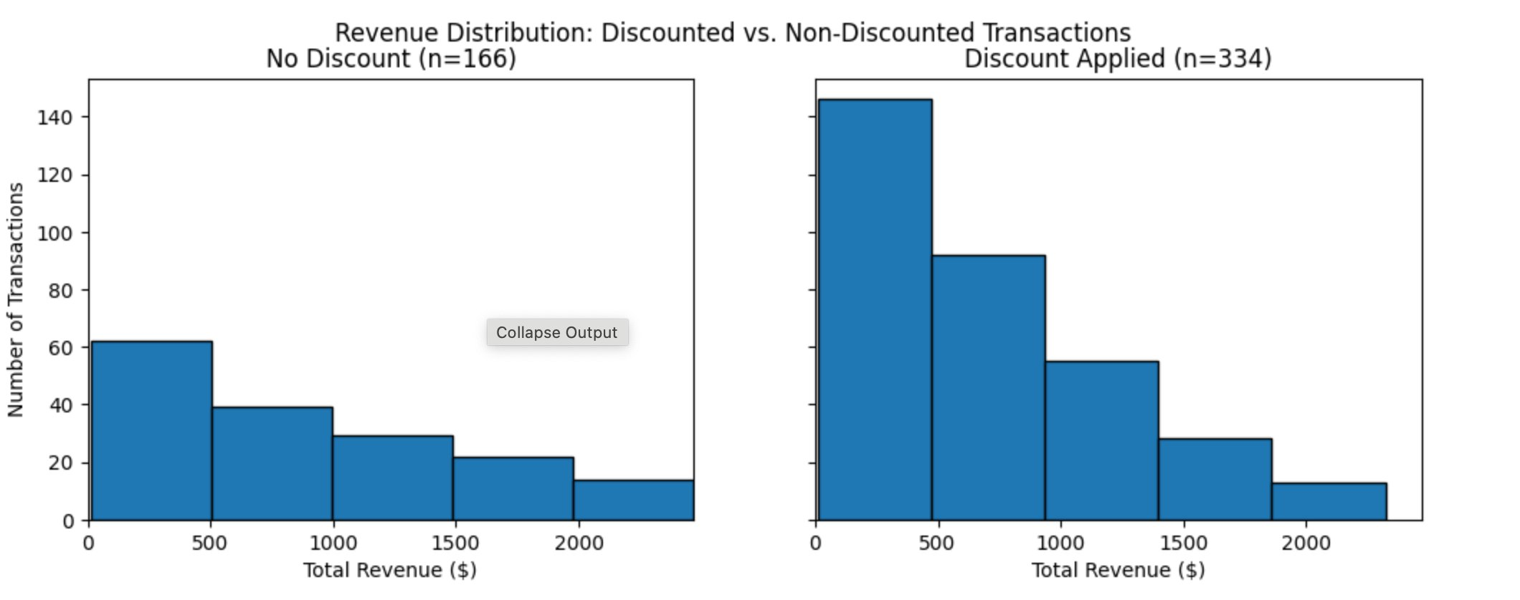
WHAT THE DATA SHOWS
The Evidence - Initial Findings from Visualization
Correlation Matrix: All Variables vs. Revenue
Revenue Distribution: Discounted vs. Non-Discounted
Product price (0.73) and quantity (0.66) are the strongest revenue drivers. Discount status is negatively correlated (−0.17). VIP status correlates 0.00 with revenue. VIP then was discounted once I ran t test.
Discounted transactions (n=334) skew toward lower revenue than non-discounted transactions (n=166). Confirmed by t-test (p = 0.0004).

Slide 4
FOR FY 2026 PLANNING
Insights & Recommendations
01
02
Discounts are destroying revenue
VIPs aren't behaviorally differentiated
INSIGHT 67% of transactions are discounted, reducing per-transaction revenue by 23% ($912 vs. $698). Statistically significant (t-test p = 0.0004) and reinforced by correlation (−0.17).
INSIGHT Two t-tests (p = 0.99) confirmed VIPs do not spend more per transaction OR purchase more often. They average 1.08 transactions/year vs. 1.06 for non-VIPs, with near-identical annual revenue ($816 vs. $814).
RECOMMENDATION CFO should test cutting discount frequency significantly (e.g., from 67% to ~30%), starting with target markets before full rollout. Discounting has become default behavior rather than strategic.
RECOMMENDATION Before allocating FY 2026 VIP budget, conduct market interviews and redefine VIP criteria using behavioral data. Revisit with multi-year historical data before scaling any VIP-specific program.
03
04
Marketing channel is the real lever
Weekend timing is not a lever
INSIGHT Paid Search delivers the highest revenue per transaction ($846) at lowest volume; Social Media combines high value ($821) with high volume (92). Product category showed almost no variation across six categories.
INSIGHT Per-transaction value is essentially identical between weekdays and weekends ($770 vs. $767). Sales were actually slightly lower on weekends, though not meaningfully.
RECOMMENDATION CMO should scale Paid Search (more runway) and lean into Social Media (mature, high-performing). Do not invest in product category rebalancing — the data shows no shift would matter.
RECOMMENDATION Do not invest in weekend-specific campaigns, promotions, or staffing changes. Calendar timing is not a meaningful FY 2026 revenue lever.

