Slide 1
When verification survives
but identification fails
SEMANTIC WATERMARKING BENCHMARK
RTX 3090 | 2,048-WAY ID
WAVES-Core + StirMark-compatible
Five semantic watermarking methods
Fixed-key pilot, N=20

Slide 2
Pilot design
Methods
Tree-Ring, METR, RingID, HSFW-HSTR, and HSFW-HSQR
Conditions
16 WAVES-Core + 8 StirMark-compatible + clean
Decision tasks
Claimed-key verification and exhaustive identification
5
25
2,048

Slide 3
Identification under attack
RingID leads both suites
Its radial construction preserves identity better than the alternatives, but family means conceal a concentrated crop failure.
0.778
0.806
RingID
WAVES top-1
RingID
StirMark top-1

Slide 4
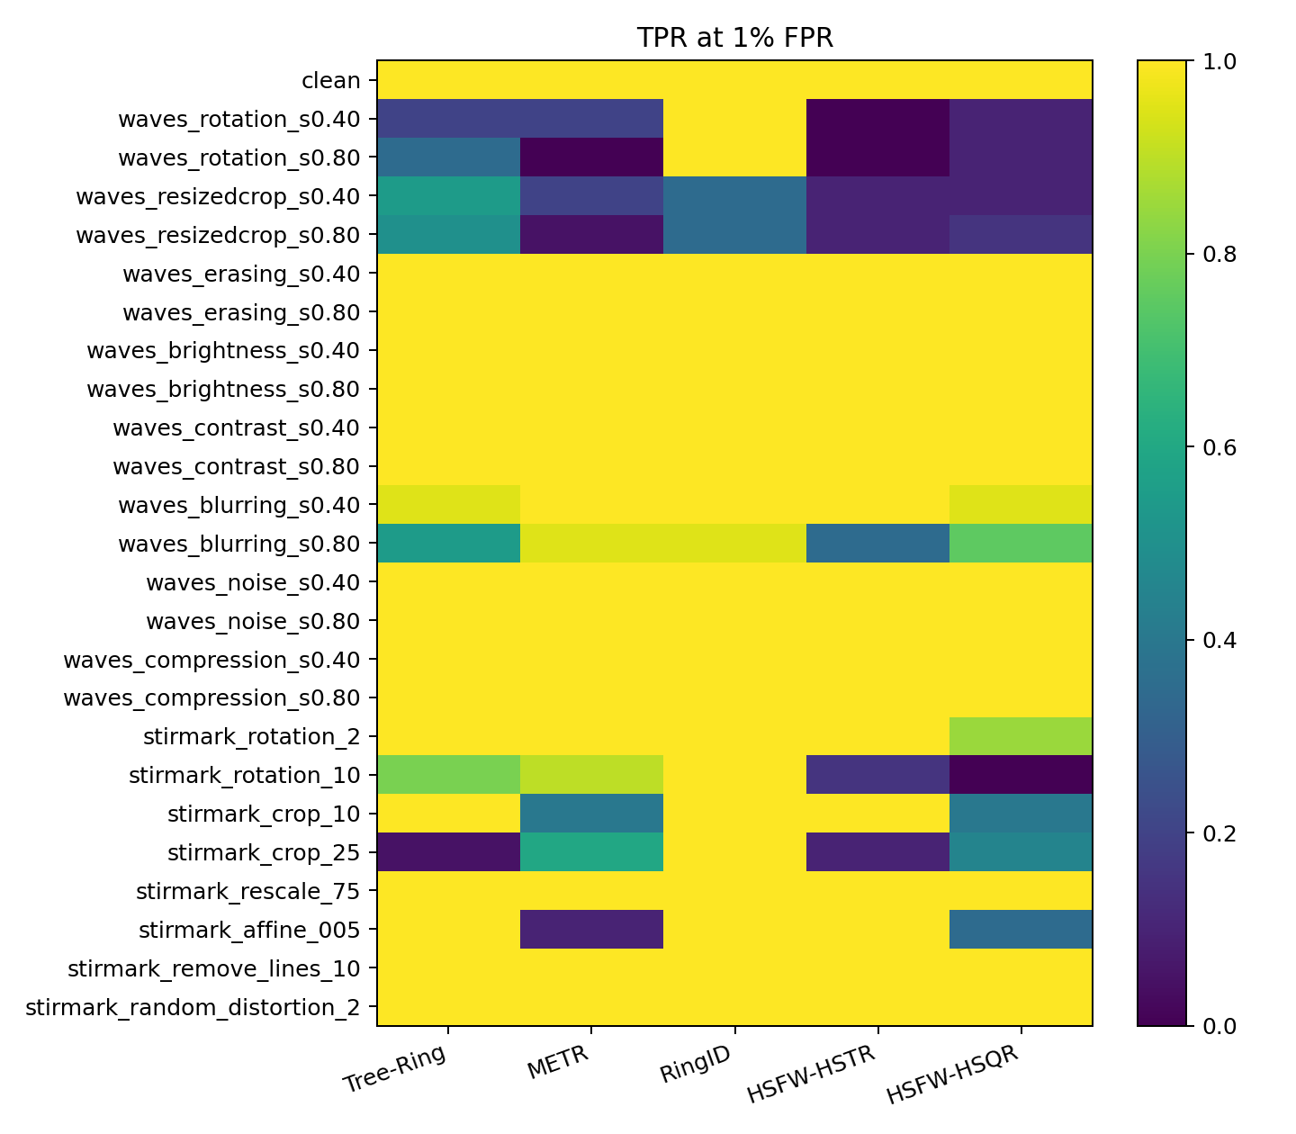
Verification stays strong
across many attacks
Geometry is the verification bottleneck.

Slide 5
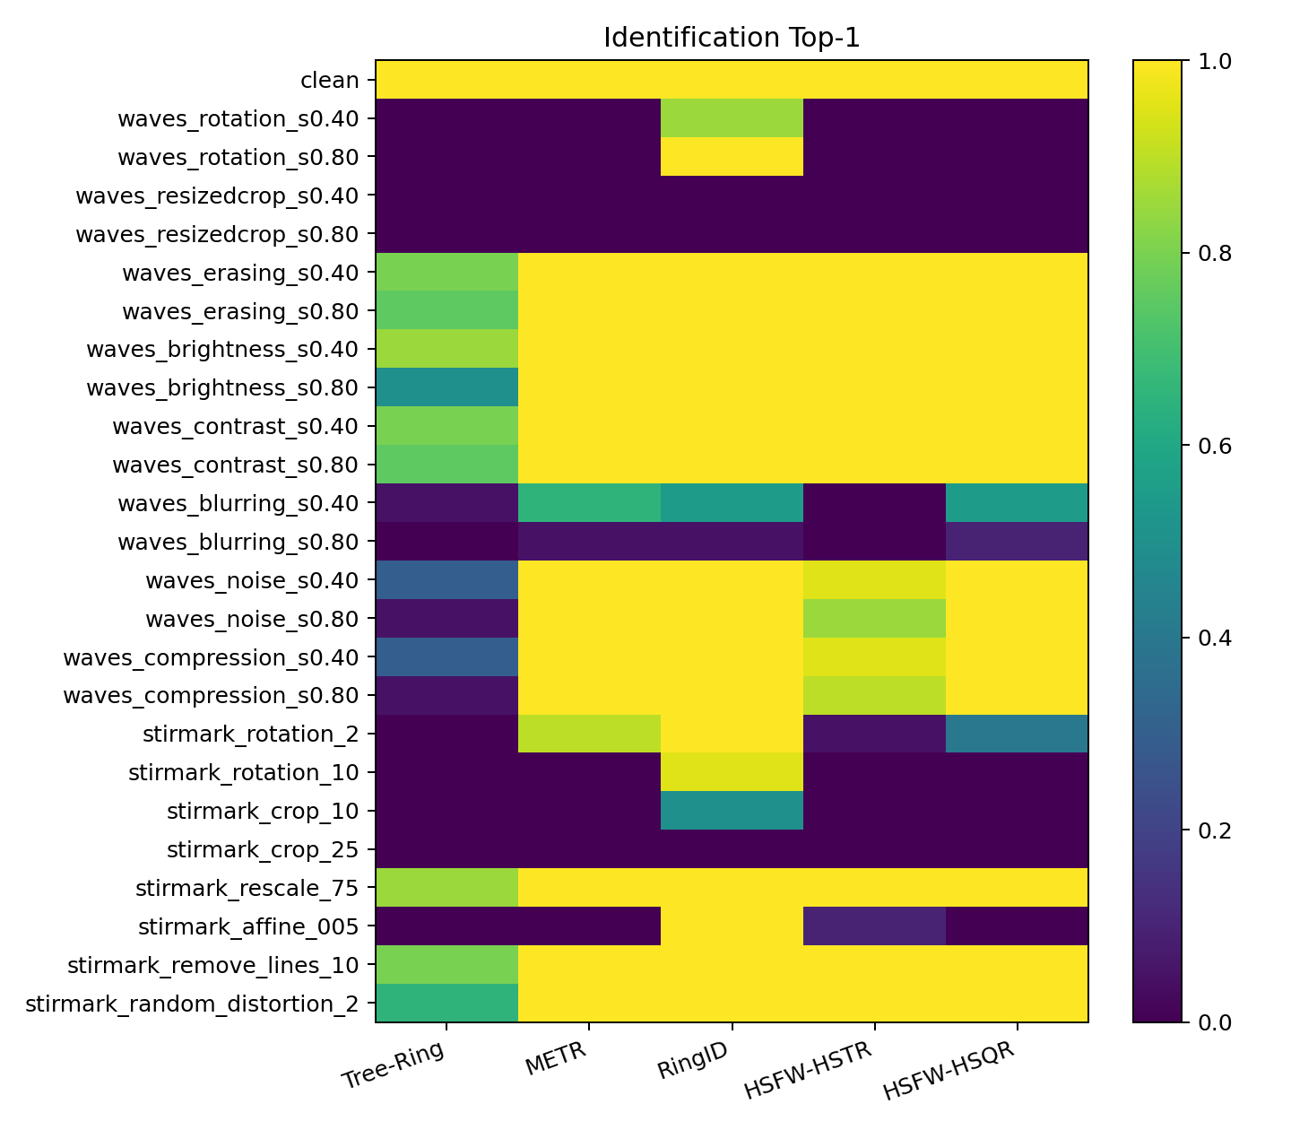
Identification fails
before detection does
Crop-resize drives every method to zero top-1.

Slide 6
Geometric stress cases: TPR@1%FPR / ID Top-1
Method | Rotation 36 deg | Crop-resize | Center crop 25% | Affine 0.05
Tree-Ring | 0.35 / 0.00 | 0.50 / 0.00 | 0.05 / 0.00 | 1.00 / 0.00
METR | 0.00 / 0.00 | 0.05 / 0.00 | 0.60 / 0.00 | 0.10 / 0.00
RingID | 1.00 / 1.00 | 0.35 / 0.00 | 1.00 / 0.00 | 1.00 / 1.00
HSFW-HSTR | 0.00 / 0.00 | 0.10 / 0.00 | 0.10 / 0.00 | 1.00 / 0.10
HSFW-HSQR | 0.10 / 0.00 | 0.15 / 0.00 | 0.45 / 0.00 | 0.35 / 0.00
Read as | verification / identity | verification / identity | verification / identity | verification / identity
Finding | RingID preserves rotation | all IDs collapse | presence can survive | only RingID is robust

Slide 7
RingID detects a cropped watermark,
but cannot recover its identity
Verification survives
25% crop: AUC 1.00 and TPR@1%FPR 1.00.
Identity collapses
Top-1 0.00 and top-5 0.00; bit accuracy remains 0.818.

Slide 8
Recommended next experiment
Target failures
25% crop and randomized crop-resize
Add synchronization
Estimate crop ratio and offset; decode normalized radial coordinates
Confirm at scale
N>=200, multiple keys, paired confidence intervals
01
02
03

Slide 9
What the pilot establishes, and what it does not
Evidence
RingID leads overall, but high crop-resize gives 0/20 correct IDs.
Interpretation
Watermark presence and identity recovery are distinct robustness tasks.
Limits
N=20, fixed key 0, WAVES-Core only, and StirMark-compatible transforms.

