Slide 1

Smart Adaptive Knowledge-based Soil Hydration & Automation Module (SAKSHAM) Project Id : 0612 Theme : Inspired by Nature. For Climate. For Our Future
Project Title :
Powered By
SB.Chetak Innovation
एस.बी. चेतक इनोवेशन
www.bagresearch.co.in/index.php

Slide 2
Introduction To This Project
Water is one of the most important resources for plant growth. Traditional irrigation methods often lead to overwatering, under watering, and wastage of water. Climate variations such as temperature, humidity, rainfall, and sunlight significantly affect plant water requirements.
This project introduces a Climate-Adaptive Smart Plant Water Management System that automatically monitors environmental conditions and provides optimal watering to plants. The system ensures efficient water utilization while maintaining healthy plant growth.

Slide 3
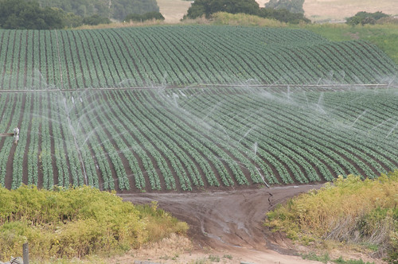
Smart Irrigation System

Slide 4
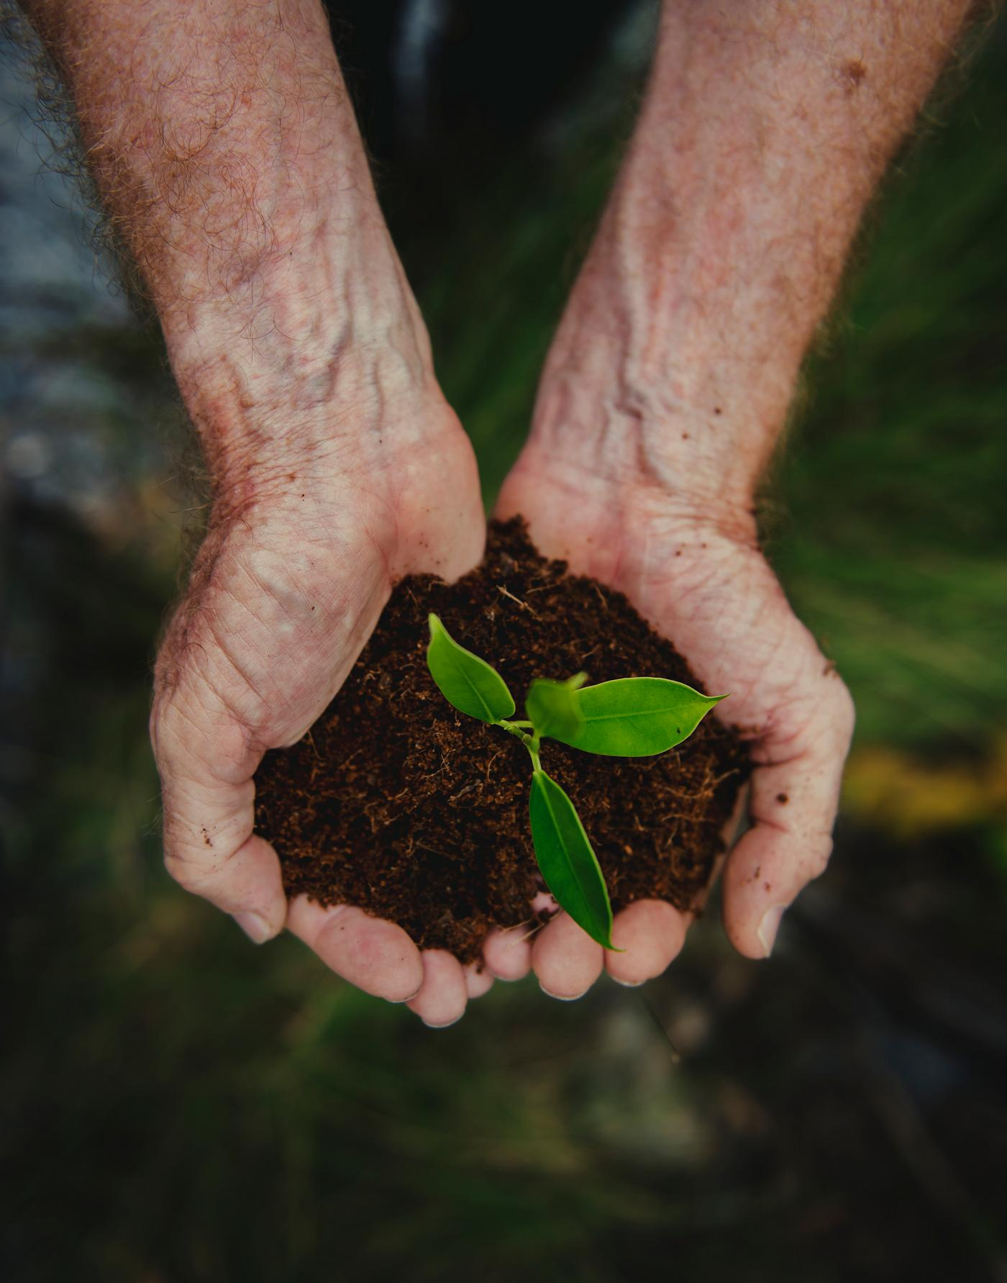
To Automate Plant Watering Based On Soil Conditions

Slide 5

To Conserve Water By Avoiding Unnecessary Irrigation

Slide 6
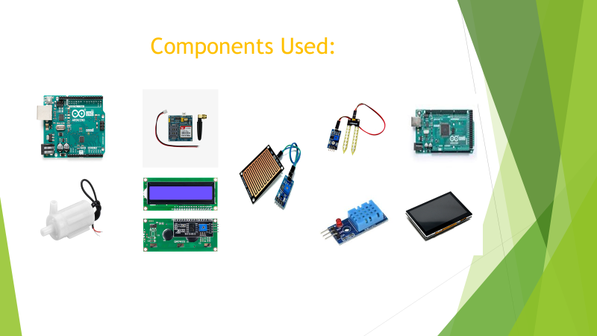

Slide 7
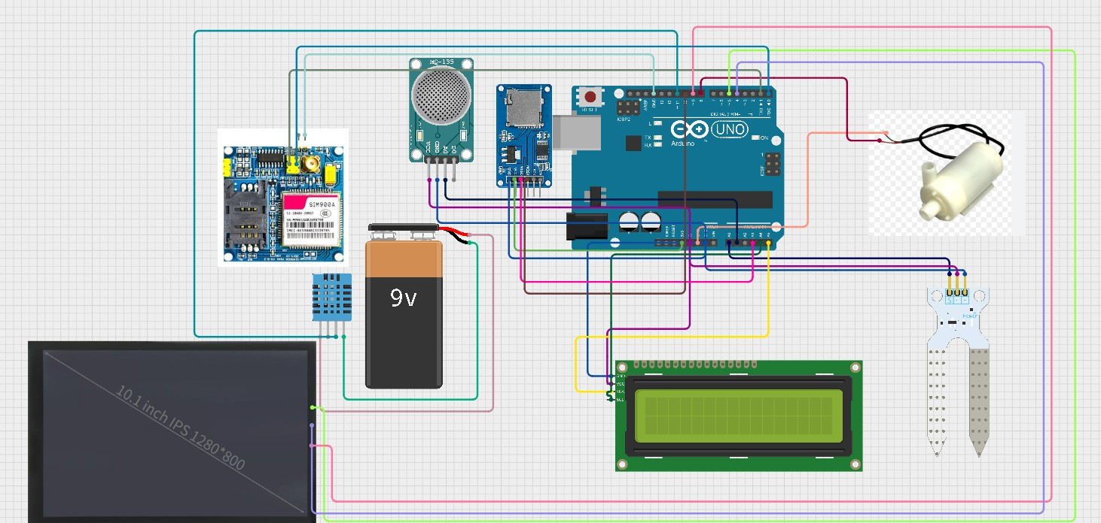
Circuit Diagram
The Original Code & Circuit Diagram Is Available At opensource.bagresearch.co.in

Slide 8
Working Principle
The Smart Irrigation System continuously monitors soil and environmental conditions using various sensors. Based on the sensor readings, the system automatically decides when and how much water should be supplied to the plants.
Soil Moisture Control
0–20%: Soil is very dry → High watering
20–50%: Soil is slightly dry → Pulse watering
50–70%: Moisture is optimal → No watering
Above 70%: Soil is wet → No watering

Slide 9
Rain Detection
If rain is detected, watering stops automatically.
Temperature & Humidity
High temperature → More watering
High humidity → Less watering
Light Monitoring
Watering can be avoided during strong sunlight to reduce water loss.

Slide 10
System Operation Flow
If the tank is empty, the pump is turned off and an alert is generated
.
System Operation Flow
Initialize sensors and modules.
Read sensor data.
Check water tank level.
Apply irrigation decision logic.
Control the water pump.
Display data on LCD.
Store data in SD card.
Send alerts if required.
Repeat the process continuously.

Slide 11
Thank You
“Neither there is a plan B
Nor there is a planet B”

