Slide 1
BLUESTOCK MUTUAL FUND ANALYTICS
Comprehensive Industry Capstone Report & Performance Dashboard
ETL Pipeline • Quantitative Risk Modeling • Power BI Visual Analytics • Investor Behavior

Slide 2
BLUESTOCK ANALYTICS | PROBLEM STATEMENT & OBJECTIVES
Aligning Quantitative Analytics with Retail Investor Growth
Business Problem
• Rapid retail mutual fund adoption requires automated data pipelines.
• Lack of unified performance & risk scorecards across AMCs.
• High investor churn and gap between SIP registration and fulfillment.
• Need for data-driven risk management (Sharpe, Sortino, VaR/CVaR).
Strategic Objectives
• Build automated SQLite ETL pipeline importing 10 raw datasets.
• Compute 1yr/3yr/5yr CAGR, Sharpe, Sortino, Alpha, Beta, & Max Drawdown.
• Construct 0-100 Composite Fund Scorecard across 40 schemes.
• Design 4-page interactive Power BI dashboard & risk recommender.

Slide 3
BLUESTOCK ANALYTICS | DATA SOURCES & AMFI DATASET OVERVIEW
Comprehensive Financial & Demographic Data Integration
Fund Metadata & NAV
• 40 AMFI Scheme Master (`dim_fund`).
• 46,000 daily NAV observations (2022–2026).
• Expense ratios & benchmark mappings.
Industry Metrics
• Industry AUM history by AMC (`fact_aum`).
• Monthly SIP inflows (`fact_monthly_sip`).
• Category net inflows & Folio counts.
Investor & Holdings
• 32,778 anonymized investor transactions.
• Demographic state & city tier splits.
• 322 stock-level portfolio holdings.

Slide 4
BLUESTOCK ANALYTICS | ETL ARCHITECTURE & DATA PIPELINE DESIGN
Star-Schema Warehouse & Automated Data Validation
1. Ingestion Layer
• Automated extraction from CSV sources.
• Live NAV API fetch integration.
• Data type standardization & parsing.
2. Quality & Clean
• Forward-filling non-trading NAV gaps.
• Expense ratio validation (0.1%-2.5%).
• Positive transaction value validation.
3. Star-Schema Storage
• `bluestock_mf.db` SQLite database.
• Foreign key constraints on amfi_code & date.
• Optimized indexes for fast analytics.

Slide 5
BLUESTOCK ANALYTICS | EDA HIGHLIGHTS: AUM & SIP GROWTH TRAJECTORY
Surging Retail Inflows & Industry Expansion
Industry AUM Expansion
• Total Industry AUM reached ₹81 Lakh Crore by 2026.
• SBI MF, ICICI Prudential, and HDFC MF lead AUM share.
• Consistent positive quarterly compounding despite market swings.
Monthly SIP Record Inflows
• Monthly SIP inflows scaled from ₹11,500 Cr to >₹31,000 Cr.
• YoY SIP growth exceeds 35% annually.
• Active SIP accounts expanded to over 7.2 Crore.

Slide 6
BLUESTOCK ANALYTICS | EDA HIGHLIGHTS: INVESTOR DEMOGRAPHICS & FOLIOS
Geographic & Generational Asset Allocations
Folio Expansion Trends
• Total industry folios surpassed 26.12 Crore.
• Equity category accounts for >70% of total folios.
• Passive ETF and Index folios expanded at 45% CAGR.
Investor Demographic Insights
• Top investment states: Maharashtra, Karnataka, Gujarat.
• Age group 25–44 accounts for 62% of all SIP transactions.
• Tier-2 & Tier-3 cities contribute 41% of new SIP registrations.

Slide 7
BLUESTOCK ANALYTICS | PERFORMANCE & FUND SCORECARD MODEL
Multi-Factor Composite Ranking Engine (0–100)
Scorecard Weighting Formula
• 30% × 3-Year CAGR Return Rank
• 25% × Sharpe Ratio Rank (Rf = 6.5%)
• 20% × Alpha Rank (OLS vs Nifty 100)
• 15% × Expense Ratio Rank (Inverse / Lower is better)
• 10% × Max Drawdown Rank (Inverse / Smaller loss is better)
Top 5 Scorecard Leaders
• #1 Mirae Asset Large Cap Fund — Score: 85.1 (3yr CAGR 18.1%, Sharpe 0.94)
• #2 ICICI Pru Midcap Fund — Score: 83.1 (3yr CAGR 22.9%, Sharpe 1.09)
• #3 Kotak Flexicap Fund — Score: 80.7 (3yr CAGR 19.4%, Sharpe 0.97)
• #4 HDFC Mid-Cap Opportunities — Score: 80.1 (3yr CAGR 21.8%, Sharpe 1.04)
• #5 ICICI Pru Bluechip Fund — Score: 77.7 (3yr CAGR 17.5%, Sharpe 0.89)

Slide 8
BLUESTOCK ANALYTICS | OLS REGRESSION & TAIL RISK (VAR / CVAR)
Systematic Risk (Beta), Excess Return (Alpha), & Tail Downside
OLS Regression vs NIFTY 100
• Single-index market model using scipy.stats.linregress.
• Beta values range from 0.22 (Gilt funds) to 1.04 (Small Cap).
• Top Alpha generators: ICICI Midcap (2.14%) & Kotak Flexicap (2.15%).
• Results exported to `alpha_beta.csv`.
Historical VaR (95%) & CVaR (95%)
• VaR 95% measures 5th percentile worst daily return.
• CVaR (Expected Shortfall) measures average loss below VaR.
• Small Cap schemes display highest VaR (-2.61%) and CVaR (-3.25%).
• Results exported to `var_cvar_report.csv`.

Slide 9
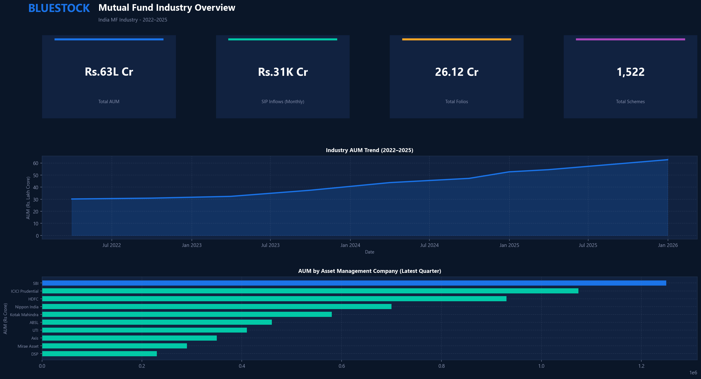
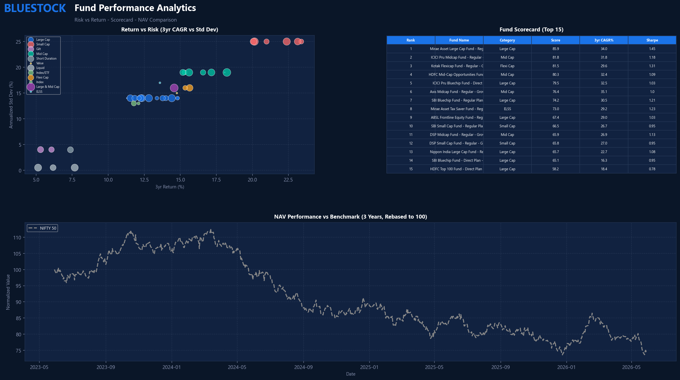
BLUESTOCK ANALYTICS | POWER BI DASHBOARD: INDUSTRY & PERFORMANCE
Interactive Executive Visual Reports (Pages 1 & 2)

Slide 10
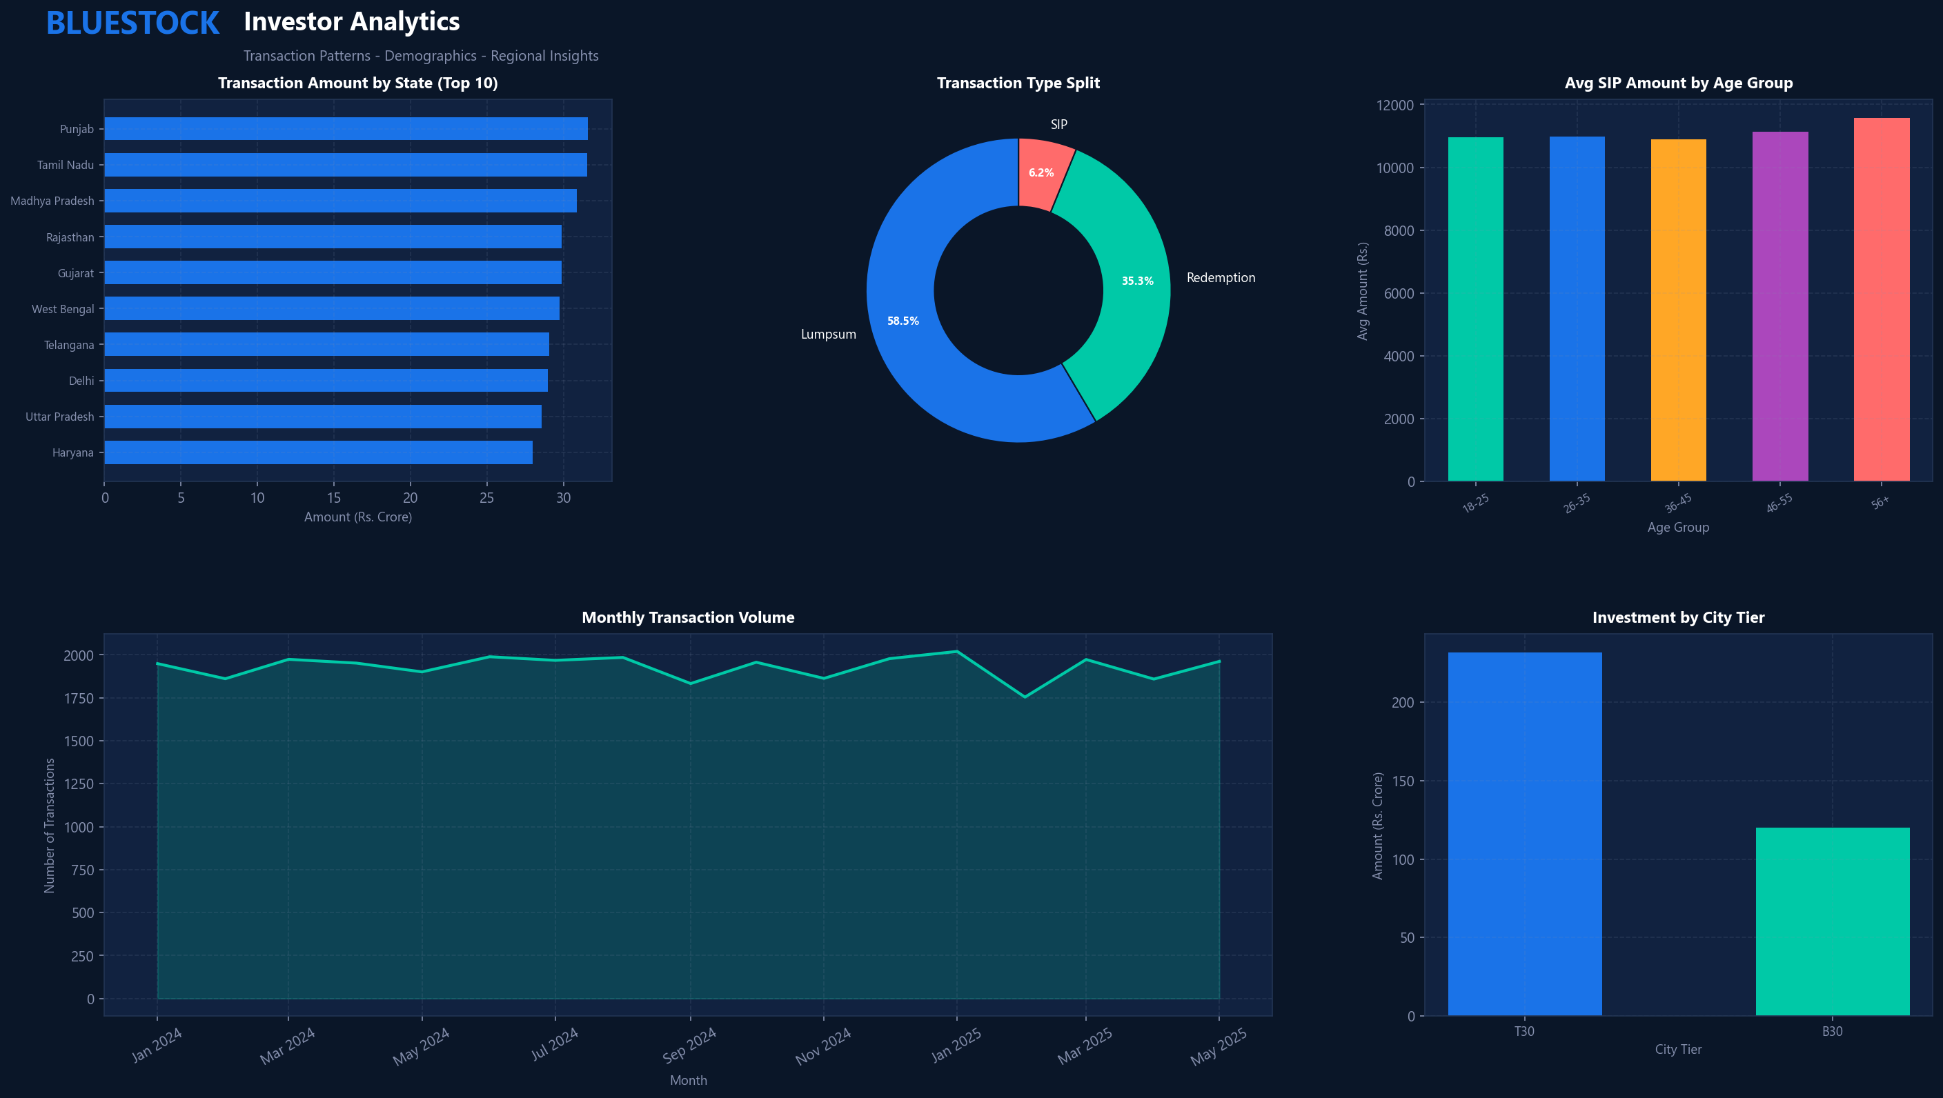
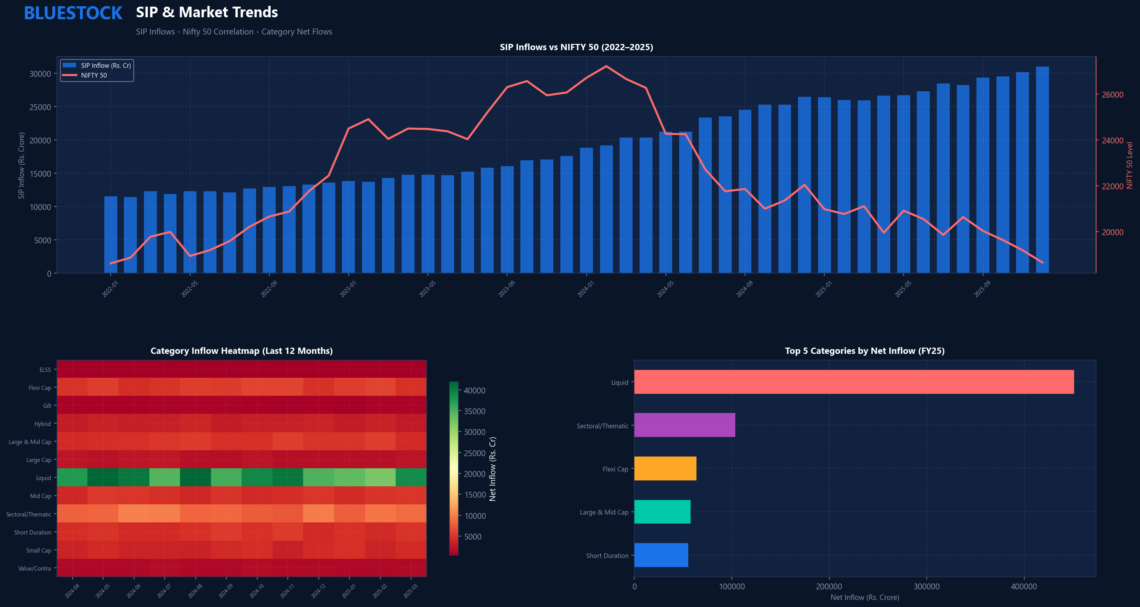
BLUESTOCK ANALYTICS | POWER BI DASHBOARD: INVESTOR & MARKET TRENDS
Demographic Insights & Dual-Axis SIP Correlation (Pages 3 & 4)

Slide 11
BLUESTOCK ANALYTICS | STRATEGIC RECOMMENDATIONS & INSIGHTS
Actionable Directives for AMCs & Wealth Managers
Product & Retention Directives
• Address SIP Gap Latency: 97.8% of 6+ SIP investors show >35 day gaps.
• Promote Flexi-Cap & Mid-Cap Funds: Highest Sharpe ratio risk efficiency.
• Lower Expense Ratios on Direct Plans to boost scorecard competitiveness.
Marketing & Risk Management
• Expand Tier-2 & Tier-3 SIP Outreach (41% growth driver).
• Incorporate VaR/CVaR Tail Risk Warnings on Small Cap offerings.
• Deploy Automated Risk Recommender CLI (`recommender.py`).

Slide 12
THANK YOU
Bluestock Mutual Fund Analytics Capstone Project
Deliverables: Final_Report.pdf | Bluestock_MF_Presentation.pptx | Performance_Analytics.ipynb | Advanced_Analytics.ipynb

