Slide 1
USB Forensics

Slide 2
Examination WorkFlow
1. Preserve
Verify the image, calculate hashes, and document evidence handling.
2. Identify
Determine the image format, partitions, file systems, and operating system.
3. Extract
Enumerate files, metadata, deleted records, and relevant system artifacts.
4. Search
Perform keyword searches, file-signature analysis, carving, and targeted artifact examination.

Slide 3
Examination WorkFlow
5. Correlate
Build a timeline and correlate findings across files, registry records, logs, and devices.
6. Validate
Recheck important findings, confirm hashes, and document alternative explanations.
7. Report
Present evidence, timestamps, methods, limitations, and conclusions with supporting references.

Slide 4
Evidence integrity and acquisition
Record the evidence ID, source device, capacity, serial number (if available), and acquisition date.
Identify the image format: RAW/DD, E01, AFF4, or another format.
Calculate and record a cryptographic hash, preferably SHA-256.
Verify the image hash against the acquisition hash, if available.
Preserve the original image and analyze a working copy.
Record the forensic tools, versions, commands, and examiner actions.
Confirm whether the image includes the entire disk or only a partition or logical file collection.

Slide 5
Disk and partition structure
MBR or GPT partition scheme
Number and size of partitions
Unallocated space between or after partitions
Hidden or unusual partitions
Boot sectors and partition boundaries

Slide 6
File system identification
NTFS, FAT16/FAT32, exFAT, ext4, APFS, or other formats
Volume labels and file-system timestamps
NTFS Master File Table (MFT), if present
FAT directory entries and allocation tables
File-system errors, inconsistencies, or signs of tampering

Slide 7
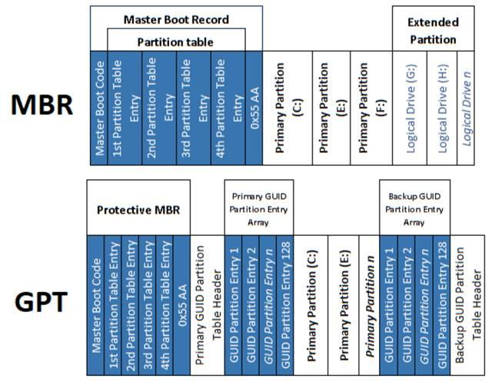

Slide 8
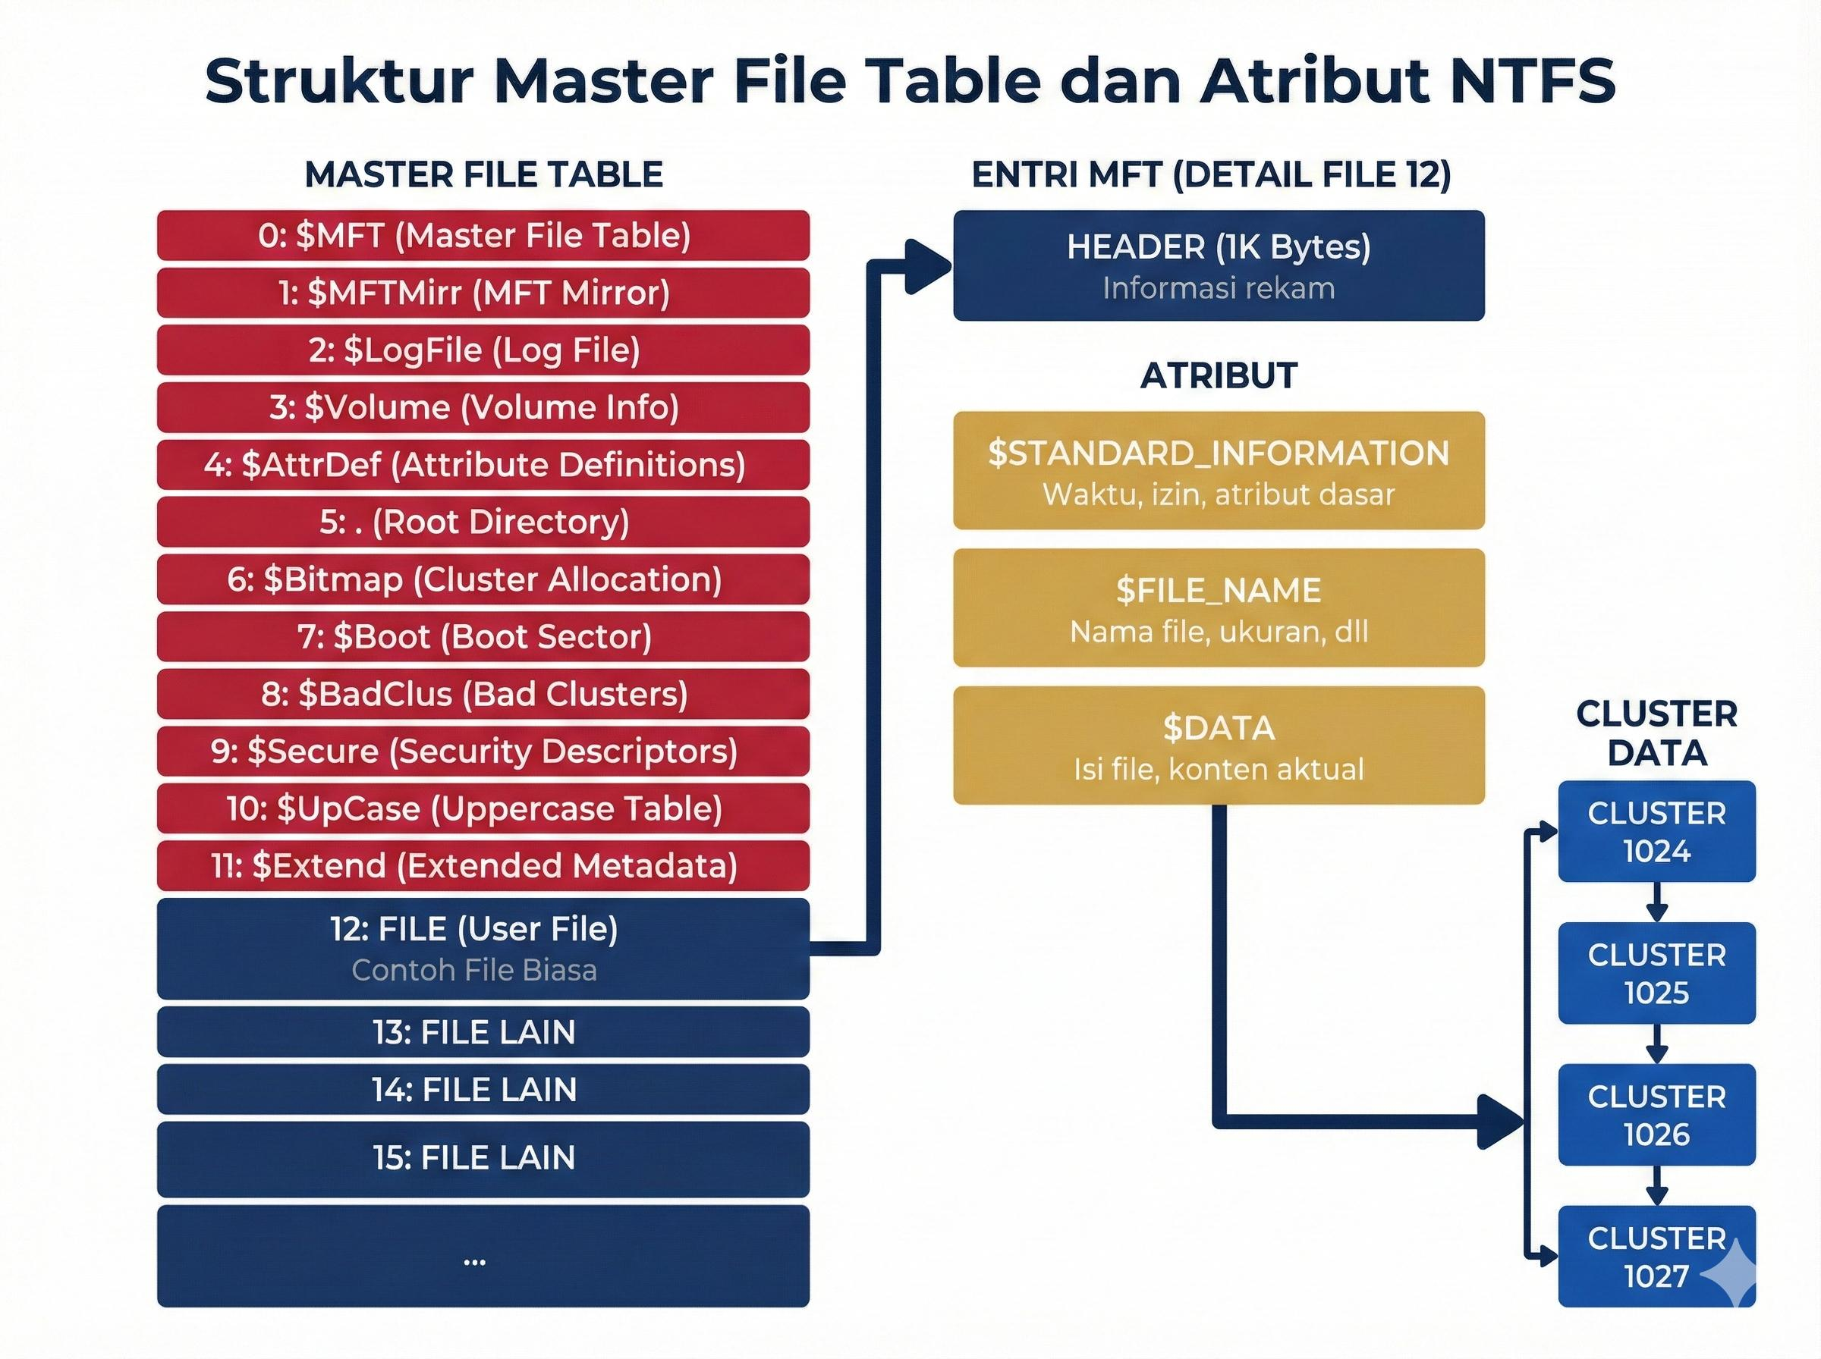

Slide 9
Files and directories
Identify important files and folders, including hidden and system files.
Check file names, extensions, sizes, paths, and timestamps.
Identify files whose extensions do not match their actual file types.
Look for suspicious executables, scripts, archives, documents, and shortcuts.
Search for files with unusual names, random characters, or misleading extensions.
Examine recently created, modified, accessed, or deleted files.
Identify duplicate files and compare their hashes.
Extract metadata from relevant documents, images, videos, and PDFs.

Slide 10
Deleted files and data recovery
Recover deleted files from file-system records where possible.
Search unallocated clusters for remnants of deleted data.
Examine file-system metadata for deleted file names, paths, sizes, and timestamps.
Perform file carving to recover content using file signatures, even when directory records are missing.
Look for partially overwritten files and fragmented data.
Check whether recovered files are complete, corrupted, or only partially recoverable.
Identify evidence of deliberate deletion, wiping, or secure erasure.

Slide 11
Timeline and correlations
Build a timeline of relevant file-system events.
Normalize times carefully and record the source time zone.
Compare file creation, modification, and metadata timestamps.
Correlate related files, directory locations, hashes, and metadata.
Identify conflicting timestamps and plausible alternative explanations.

Slide 12
Suspicious files, malware, and anti-forensics
Executables and scripts: .exe, .dll, .bat, .cmd, .ps1, .vbs, .js, and relevant Linux/macOS executable formats.
Double extensions, such as invoice.pdf.exe.
Files with mismatched signatures and extensions.
Password-protected or suspicious archives.
Malware indicators, persistence mechanisms, and suspicious scheduled tasks.
Evidence of wiping utilities, secure deletion, or log clearing.
Alternate Data Streams (ADS) on NTFS.
Hidden partitions, unusual file-system structures, or concealed data.
Encrypted volumes, containers, or password-protected files.

Slide 13
File content and keyword searches
Names, usernames, email addresses, and account identifiers relevant to the case.
Project names, document titles, or confidential-data labels.
Relevant dates, phone numbers, IP addresses, and domain names.
Case-specific keywords or phrases.
References to file transfers, deletion, concealment, or suspicious activities.

Slide 14
Encryption, partitions, and hidden data
BitLocker, FileVault, LUKS, or other encryption indicators.
Encrypted containers and password-protected archives.
Unallocated space and slack space.
Hidden partitions and unusual partition layouts.
Possible steganography in image, audio, or video files.
Evidence of deleted partition entries or damaged file systems.

