Slide 1
Tell a camel from a dromedary:
Given 5 inputs, and events of 2 types: either 1-2-3-2-1 (+noise) or 0-4-1-4-0 (+noise)
G R O U P
7A
BAGUS – CASPER – FELIX – LUCY – MOUKOUBA – RAYMOND - NEEMA

Slide 2
Lab Session
7. Can you do a better job on sample 3 by separating the events with missing data values and analysing them separately?
No, we cannot, because no missing data values in sample3.
> sample <- read.table("Sample3.txt", header=FALSE)
> which(is.na(sample))
integer(0)

Slide 3
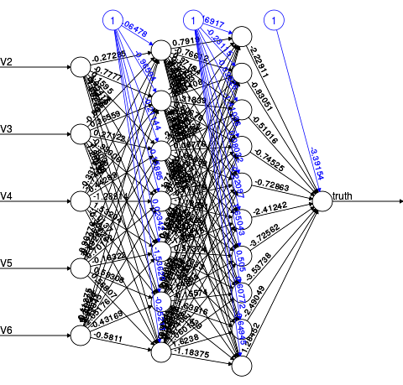
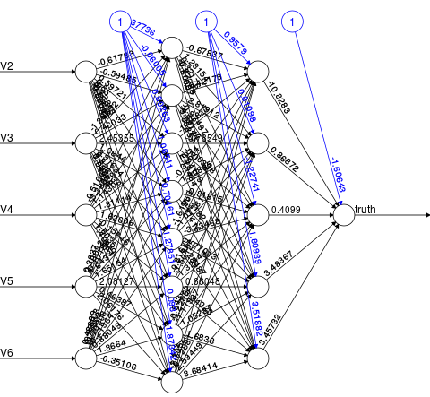
ANN architecture with 2 hidden layers
7 nodes & 10 nodes
8 nodes & 5 nodes

Slide 4
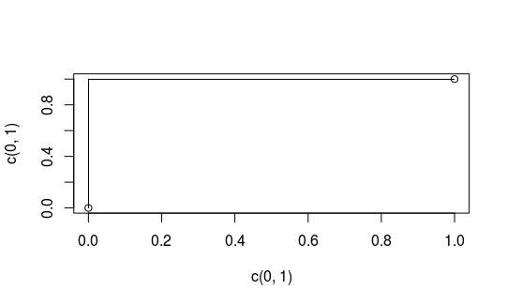
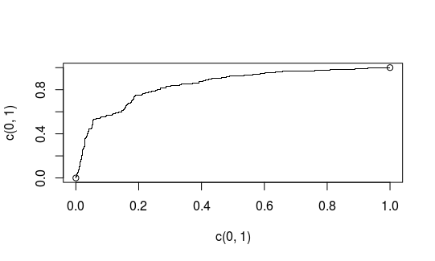
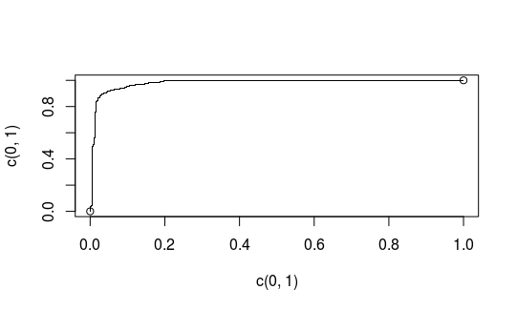
ANN with 2 hidden layers (7 & 10)
Sample 1
Sample 2
Sample 3

Slide 5

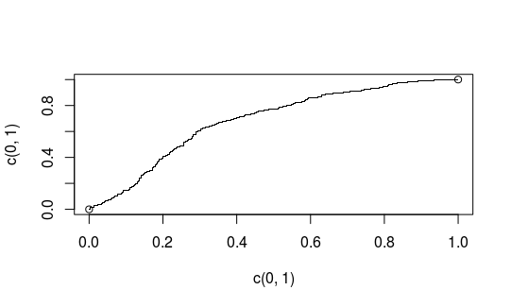
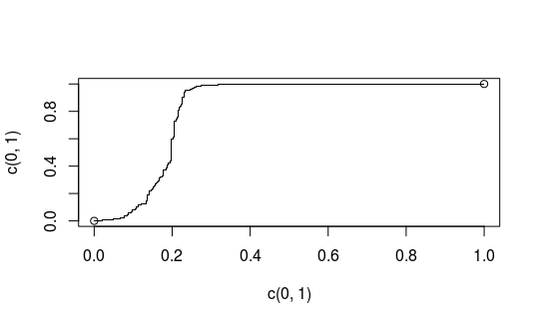
ANN with 2 hidden layers (8 & 5)
Sample 1
Sample 2
Sample 3

