Slide 1
TIK-2b: How data is stored
@btatmaja

Slide 2
How data is stored in...
Hard disk
CD
USB/Flash
Other storage device

Slide 3
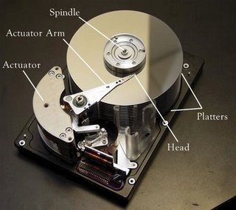
How data stored in Hard disk
Data is stored on the hard disk in the form of 0 & 1
The part of the hard disk that stores the data is known as platter
Platters are further separated in to the tracks and sectors,
  tracks are concentric circles while
  sectors are pie shaped wedges
  on the track.

Slide 4
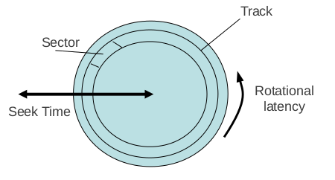
How data is stored in Hard disk
Hard disk stores information in the form of magnetic fields
Data is stored digitally in the form of tiny magnetized regions on the platter where each region represents a bit
To write a data on the hard disk, a magnetic field is placed on the tiny field in one of these two polarities: N-S and S-N

Slide 5
How data is stored in Hard disk
N-S: If North Pole arrives before the south pole [ represent “1”]
S-N: if the south pole arrives before the north pole while the field is accessed [ represent “0”]
This polarity is sensed by integrated controllers built within the hard disk

Slide 6
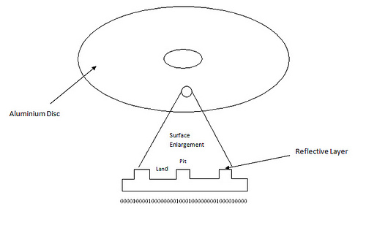
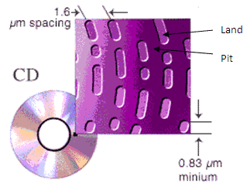
How data is stored in CD
A pre-recorded CD contains raised and lowered areas, called "lands" and "pits" [0 & 1]
The laser in a CD recorder creates marks in the disc's dye layer that have the same reflective properties
Discs are written from the inner portion to the outside

Slide 7
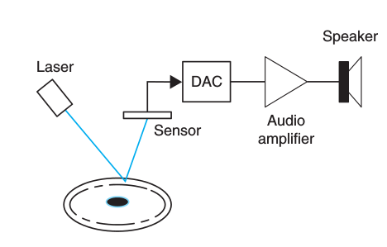
How CD works...
When playing a CD, the CD player follows the tracks in the disc, focusing a laser on them, as the CD is spun.
The laser shines a light that is reflected by the pits and bumps put on the surface of the disc and corresponding to the coded digital signal from an acoustic signal.
A sensor detects the reflected light and converts it into a digital signal, which is then converted into an analog signal by the DAC.
When amplified and fed to the speakers such a signal sounds like the originally recorded acoustic signal.

Slide 8
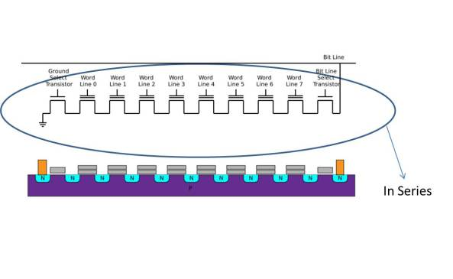
How Flash Drive Works (NAND)
Two types of electronic memories
Volatile (Temporary)
Non-volatile (Semi-Permanent)
Two forms of flash Memory:
Not OR (NOR) --> Parallel
Not AND (NAND) --> Series

Slide 9
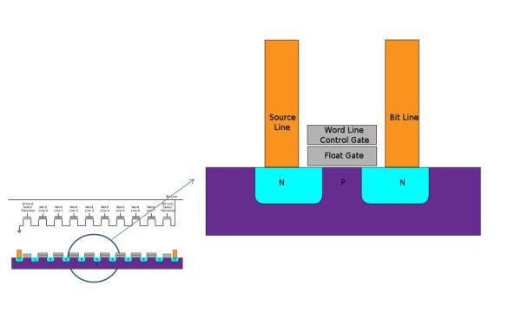
NAND Flash Memory

Slide 10
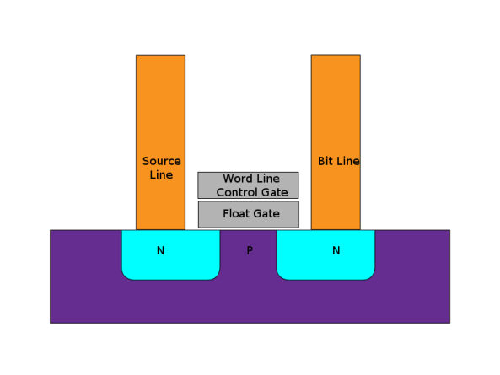
NAND Flash Memory

Slide 11
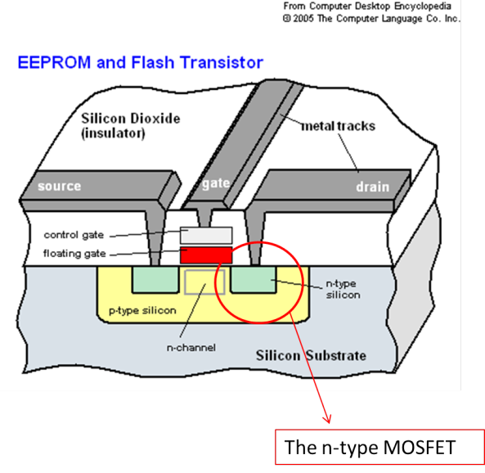
NAND Flash Memory

Slide 12
Saving Data
When saving a file on our flash drive, a voltage is applied to the control gate which then sends electrons from the source to start flowing towards the drain. In the process of the flowing, the electrons gain energy to penetrate the oxide layer and gets stored in the floating gate. As a result, the floating gate forms a negative charge (that is, data is recorded on the gate)
The floating gate is coated with non-conductive material, right? This means that even when we plug out the flash drive, the data is safely stored on the floating gate. Also, remember we talked about the flash drive having non-volatile memory (or semipermanent memory)? Yes, because the floating gate is coated with non-conductive memory, it forms a protective cocoon around our data. As a result, the data will not be lost even when there is no power!

Slide 13
Deleting Data
If the charged floating gate contains our data, then deleting the data on the flash drive is achieved by removing the charge from the floating gate. NAND flash memory technology achieves this: by applying high voltage to the source. The positive charge on the source makes the negative-charged electrons move from the negative-charged floating gate to the source. As a result, the charged floating gate which stores our data loses its charge (and data). Our data on the flash drive is, thus, erased/deleted.

Slide 14
Advantages of Flash Memory
Huge amounts of data can be stored on the floating gate.
The data stored on the floating gate can last for years (some can last for a decade) [non-volatile]
NAND flash can be erased and rewritten up to 1,000,000 cycles (which is more than what the average user needs) Why is this important? Think of the flash memory as a piece of paper. When you write something on it and you want to erase it, you have to use an eraser and remove the marks. This constant repetition of writing and erasing, eventually wears out the paper. So then, when you have 1,000,000 cycles, you can be ensured that your data is safe and secure!

Slide 15
Summary of USB
Data stored on the USB flash drive is secured even without a power source, because of the floating gate’s oxide layer which acts as a safety cocoon. When we save data, we are sending energized electrons/data to the floating gate to be recorded. When we delete data, we are attracting the electrons/data away from the floating gate.

Slide 16
Next
Application Layer
How data is stored: Optical Vs Magnetic
HTML (based on cs50 course)
Hardware of Networking

