Slide 1
TIK-2:
Komputer: Hardware Addressing,
OS, Programming Lang, Apps
@btatmaja

Slide 2
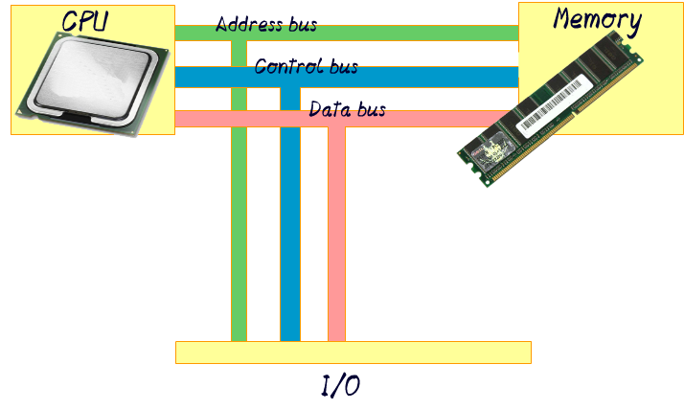
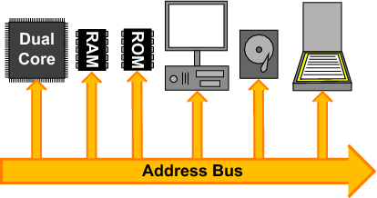
Address Bus

Slide 3
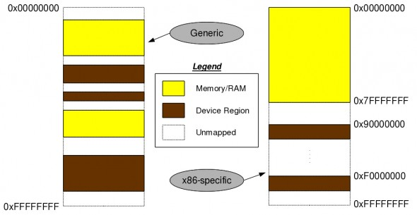
Mac Address
eth0 Link encap:Ethernet HWaddr 3c:97:0e:0d:99:c7
wlan0 Link encap:Ethernet HWaddr 74:e5:43:6f:26:8a
Address Bus
48 bit hexadecimal, unique

Slide 4
I/O Port
0000-0cf7 PCI Bus 0000:00
0060-0060 keyboard
0062-0062 EC data
0064-0064 keyboard
0066-0066 EC cmd
0070-0077 rtc0
0080-008f dma page reg
00a0-00a1 pic2
00c0-00df dma2
00f0-00ff fpu
03c0-03df vesafb
0400-0403 ACPI PM1a_EVT_BLK
0404-0405 pnp 00:06

Slide 5
I/O Port [2]
2000-2fff PCI Bus 0000:03
2000-207f Qualcomm Atheros AR8162 Fast Ethernet (rev 10)
3000-303f Intel Corporation 3rd Gen Core processor Graphics Controller (rev 09)
3060-307f Intel Corporation 7 Series Chipset Family 6-port SATA Controller [AHCI mode]
3060-307f AHCI SATA low-level driver
3080-3087 Intel Corporation 7 Series Chipset Family 6-port SATA Controller [AHCI mode]
3080-3087 AHCI SATA low-level driver
3088-308f Intel Corporation 7 Series Chipset Family 6-port SATA Controller [AHCI mode]
3088-308f AHCI SATA low-level driver
3090-3093 Intel Corporation 7 Series Chipset Family 6-port SATA Controller [AHCI mode]
3090-3093 AHCI SATA low-level driver
3094-3097 Intel Corporation 7 Series Chipset Family 6-port SATA Controller [AHCI mode]
3094-3097 AHCI SATA low-level driver
efa0-efbf Intel Corporation 7 Series/C210 Series Chipset Family SMBus Controller (rev 04)

Slide 6
Memory Address
e0000000-efffffff Intel Corporation 3rd Gen Core processor Graphics Controller (rev 09) (prog-if 00 [VGA controller])
f0000000-f03fffff Intel Corporation 3rd Gen Core processor Graphics Controller (rev 09) (prog-if 00 [VGA controller])
f0400000-f04fffff PCI Bus 0000:03
f0400000-f043ffff Qualcomm Atheros AR8162 Fast Ethernet (rev 10)
f0400000-f043ffff Qualcomm Atheros(R) AR816x/AR817x PCI-E Ethernet Network Driver
f0500000-f05fffff PCI Bus 0000:02
f0500000-f050ffff Qualcomm Atheros AR9285 Wireless Network Adapter (PCI-Express) (rev 01)
f0500000-f050ffff Support for Atheros 802.11n wireless LAN cards.
f0600000-f060ffff Intel Corporation 7 Series/C210 Series Chipset Family USB xHCI Host Controller (rev 04) (prog-if 30 [XHCI])

Slide 7
Memory Address [2]
f0600000-f060ffff xhci_hcd
f0610000-f0613fff Intel Corporation 7 Series/C210 Series Chipset Family High Definition Audio Controller (rev 04)
f0610000-f0613fff ICH HD audio
f0614000-f06140ff Intel Corporation 7 Series/C210 Series Chipset Family SMBus Controller (rev 04)
f0615000-f061500f Intel Corporation 7 Series/C210 Series Chipset Family MEI Controller #1 (rev 04)
f0615000-f061500f Intel(R) Management Engine Interface
f0617000-f06177ff Intel Corporation 7 Series Chipset Family 6-port SATA Controller [AHCI mode] (rev 04) (prog-if 01 [AHCI 1.0])
f0617000-f06177ff AHCI SATA low-level driver
f0618000-f06183ff Intel Corporation 7 Series/C210 Series Chipset Family USB Enhanced Host Controller #1 (rev 04) (prog-if 20 [EHCI])
f0618000-f06183ff ehci_hcd
f0619000-f06193ff Intel Corporation 7 Series/C210 Series Chipset Family USB Enhanced Host Controller #2 (rev 04) (prog-if 20 [EHCI])

Slide 8
Computer Port
Serial ports send and receive one bit at a time via a single wire pair (Ground and +/-)
E.g: USB, DB-15, etc
Parallel ports send multiple bits at the same time over several sets of wires.
E.g: DB-25
Mention other ports available on your PC!

Slide 9
Software
Operating System
Programming language
Utility/Application

Slide 10
Operating System
At the simplest level, an operating system does two things:
Manage hardware and software resources (include such things as the processor, memory, disk space)
It provides a stable & consistent way for applications to deal with the hardware without having to know all the details of the hardware.

Slide 11
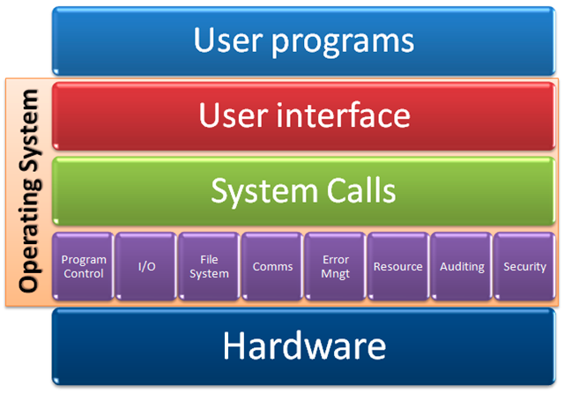
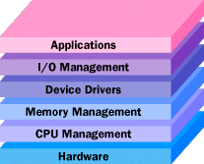
Operating System

Slide 12
OS
Unix
  Mac OS X
  BSD
  Solaris
Windows
Linux
Minix

Slide 13

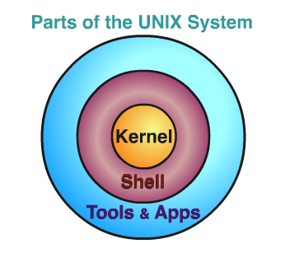

Unix and the like
Unix
Mac OS X
BSD
  FreeBSD
  OpenBSD
Solaris (by Sun/Oracle)
AIX (by IBM)
Minix

Slide 14
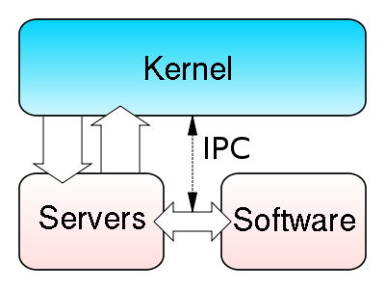
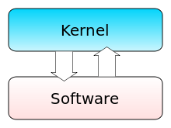
Monolithic Vs Microkernel-based
1
In Monolithic, the whole operating system is a single a.out file that runs in 'kernel mode.'
This binary contains the process management, memory management, file system and the rest.
Examples: UNIX, Linux, MS-DOS, VMS, MVS, OS/360, MULTICS
in Microkernel, most of the OS runs as separate processes, mostly outside the kernel, they communicate by message passing.
The kernel's job is to handle the message passing, interrupt handling, low-level process management, and possibly the I/O.
Examples of this design are the Minix, RC4000, Amoeba, Chorus, Mach, Windows/NT.
Source: Linus Vs Tanenbaum Debate

Slide 15
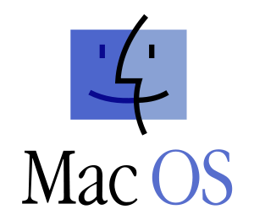
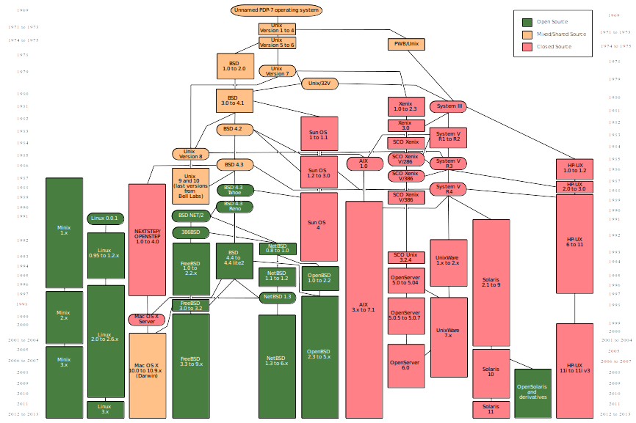

Slide 16
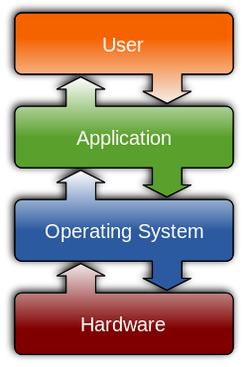
Windows
Windows
  Windows 1.0
  Windows NT
  Windows ME
  Windows XP
  Windows 7
  Windows 8
  Window 10

Slide 17
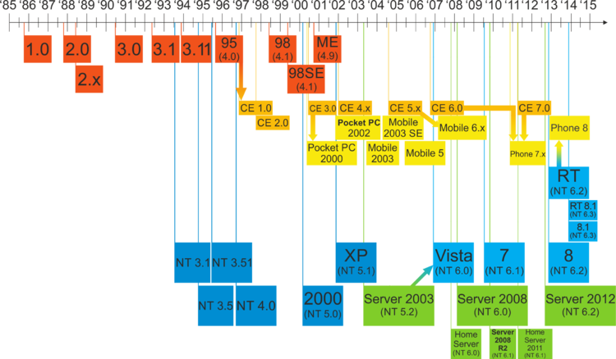
Windows Timeline

Slide 18
Linux-Based OS
Slackware
Redhat
  Fedora
  Centos
  SUSE
Debian
  Ubuntu
  Linux Mint
  Arch Linux

Slide 19
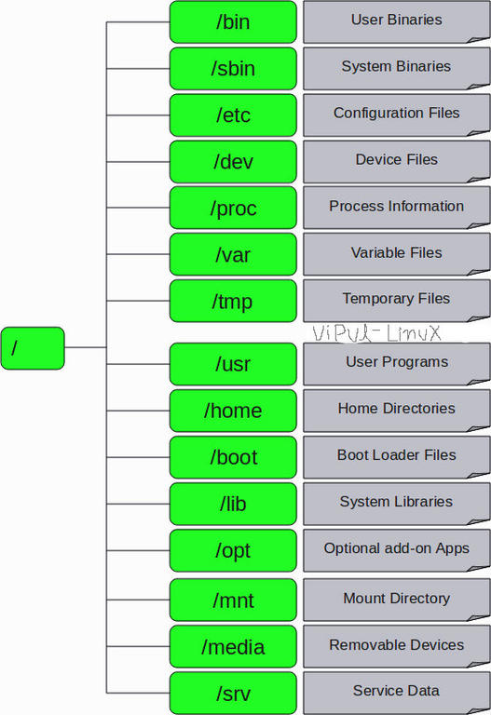
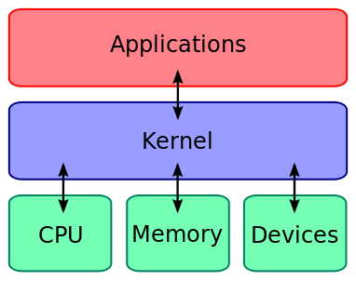
Unix/Linux
Hierarchy

Slide 20
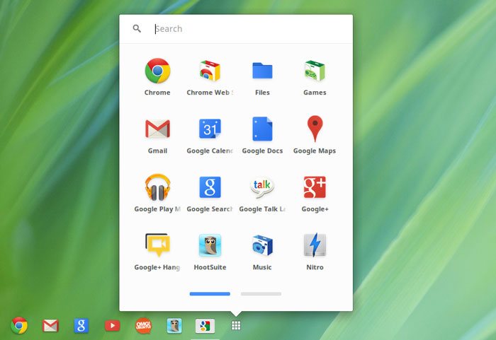
Others
Chrome OS
Android
QNX/Blackberry
Z/OS
Minix
iOS
Palm OS
Symbian

Slide 21
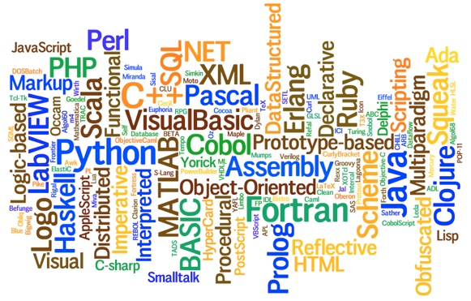
Programming Language

Slide 22
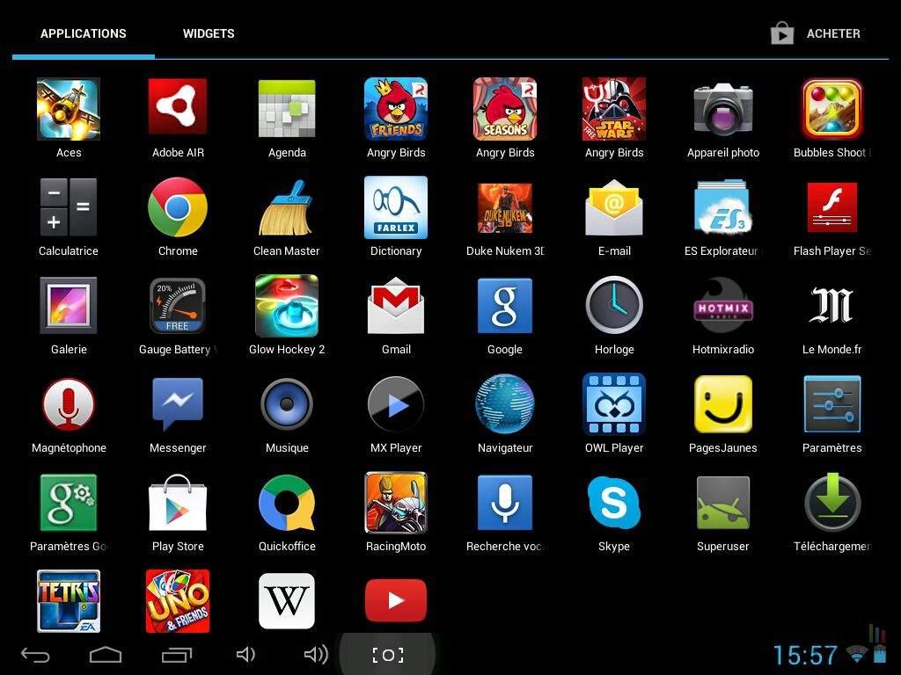
Application

Slide 23

Android System Architecture

