Slide 1
TIK-0:
Komputer, Komunikasi Data, Jaringan
@btatmaja

Slide 2
TIK
Komputer
Komunikasi Data
Jaringan

Slide 3
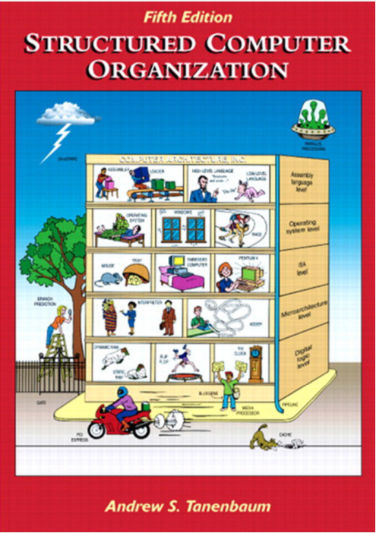
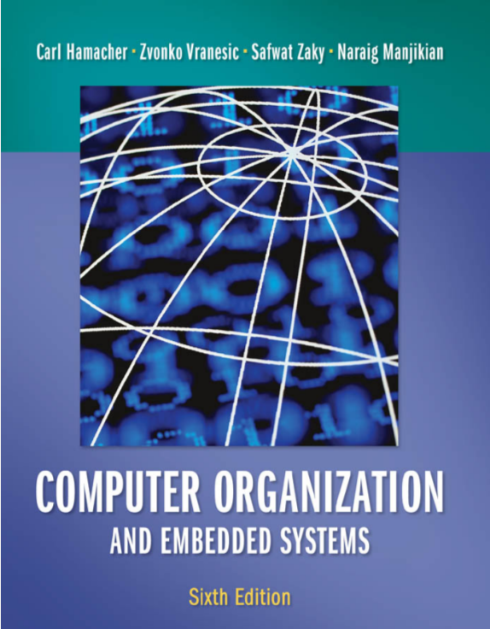
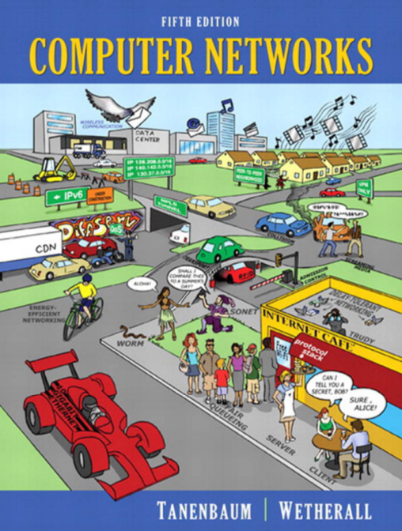
Referensi :
Books: Hammacher & Tanenbaum
Free: ilmukomputer.org, Wikipedia, Google

Slide 4
Komputer
Sistem komputer
  Hardware
  Software
  Brainware
Arsitektur Komputer
Klasifikasi komputer
Sistem Bilangan

Slide 5
Komputer
Data Storage (memory)
Cara kerja memory
  HDD
  CD
  USB, dll
Busses
Hex Editor
ASCII

Slide 6
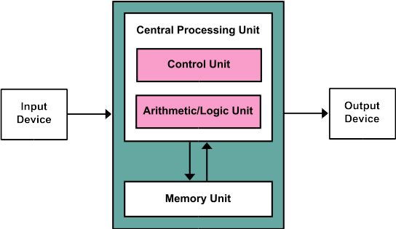
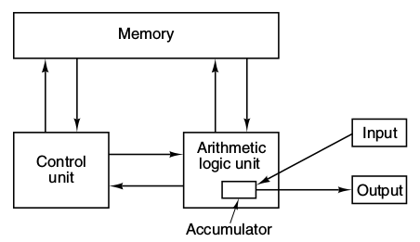
Blok Diagram Komputer
Von Newmann Machine

Slide 7
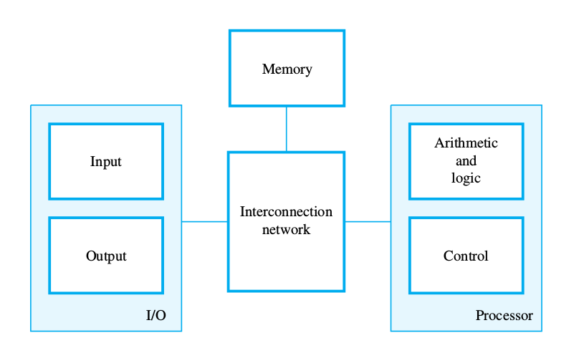
Busses

Slide 8
Von Newmann Architecture
General requirements for electronic computers (1945).
  Main components: Memory, control unit, arithmetic logic unit (ALU), input/output unit.
  Clasically used for designing all computer/CPUs
Proposed stored/changeable programs executed sequentially.
Taken from Onime 2015

Slide 9
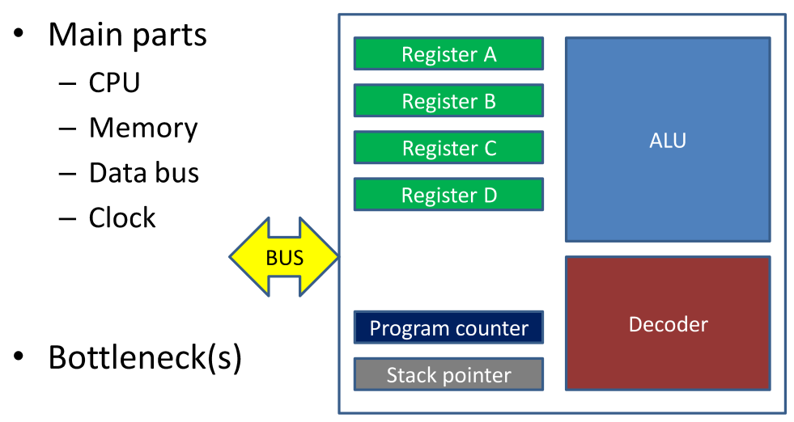
CPU Computer Hardware
Taken from Onime 2015

Slide 10
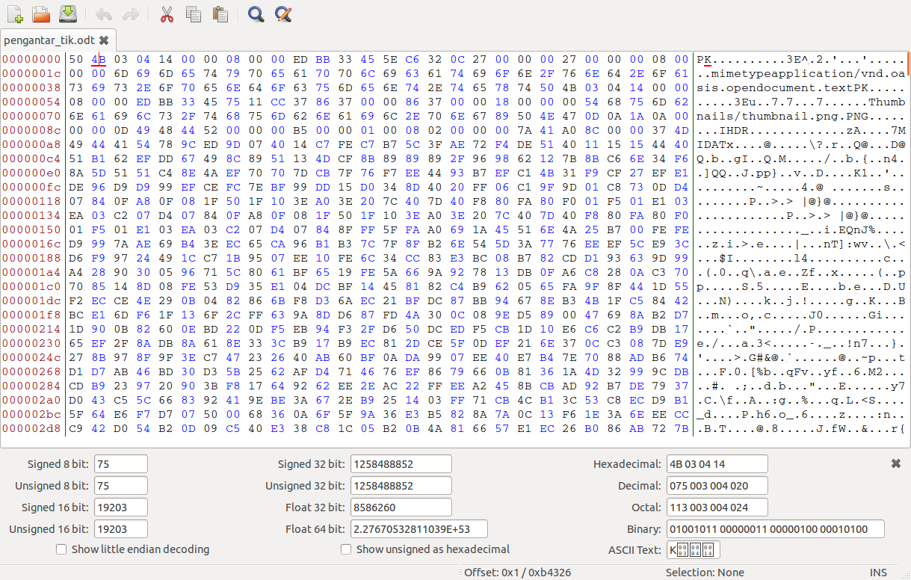
Hex Editor

Slide 11
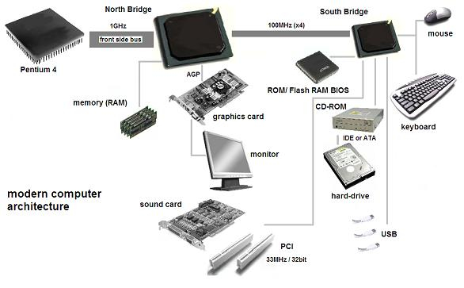
Hardware

Slide 12
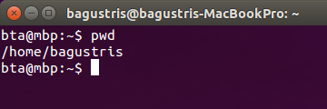
Software
Hex Editor
Word Processor
HTML
Matlab
Windows: XP, 7, 8
Unix/Linux: Ubuntu, Fedora, Android
  Bash/Unix command: cd, mv, pwd, ls, mkdir, dll
Mac OSX (optional)

Slide 13
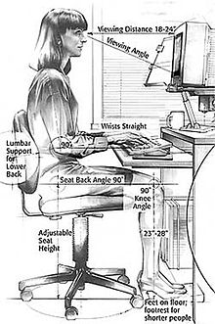
Brainware
Basic skill
  Installation
  Operation
  Problem solver
Medium Skill
  Web building
  Data management
Advance : SysAdmin

Slide 14
Komunikasi Data
Konsep komunikasi data
Komponen komunikasi data
Media transmisi
Mode transmisi
Modulasi
Encoding/Decoding

Slide 15
Jaringan
Topologi
Protocol : TCP, FTP, SSH
Internet
WWW → HTML
Email
Proxy

Slide 16
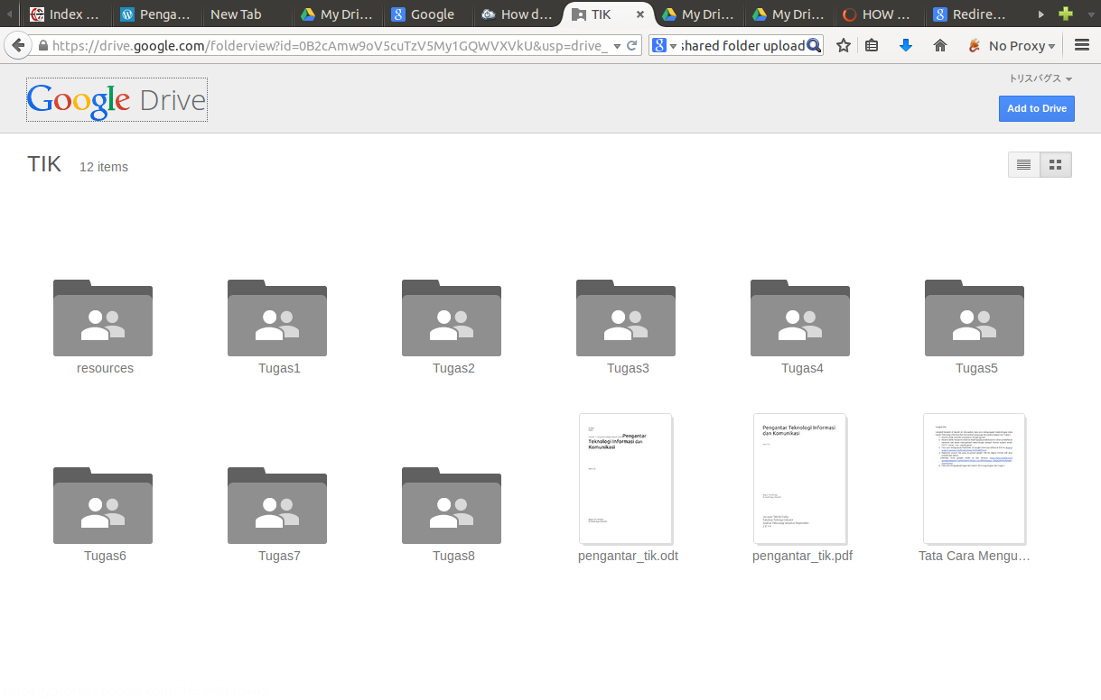
Tugas

Slide 17
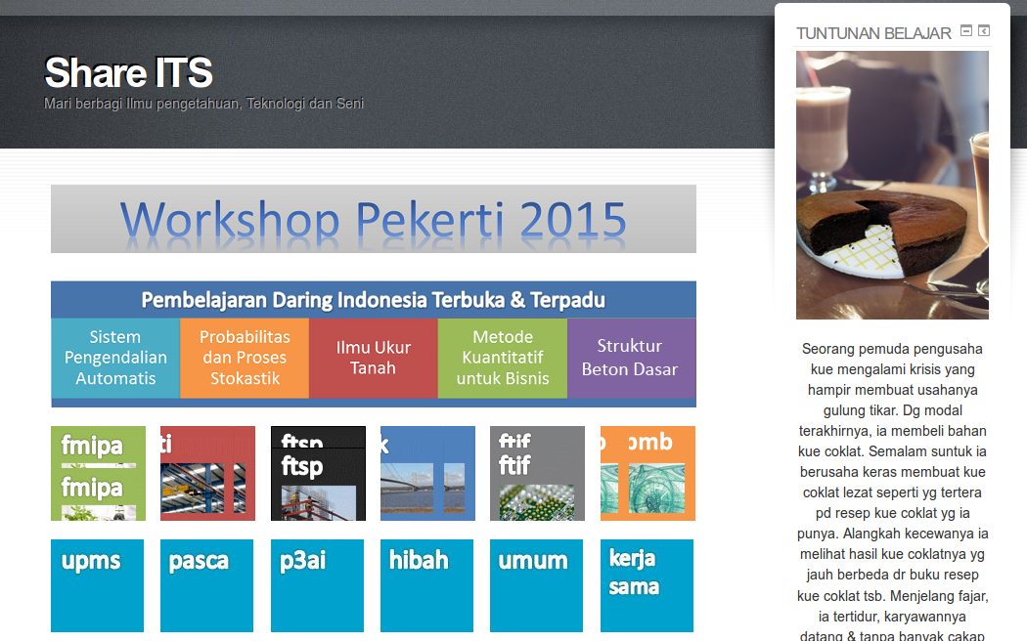
Web: share.its.ac.id

Slide 18
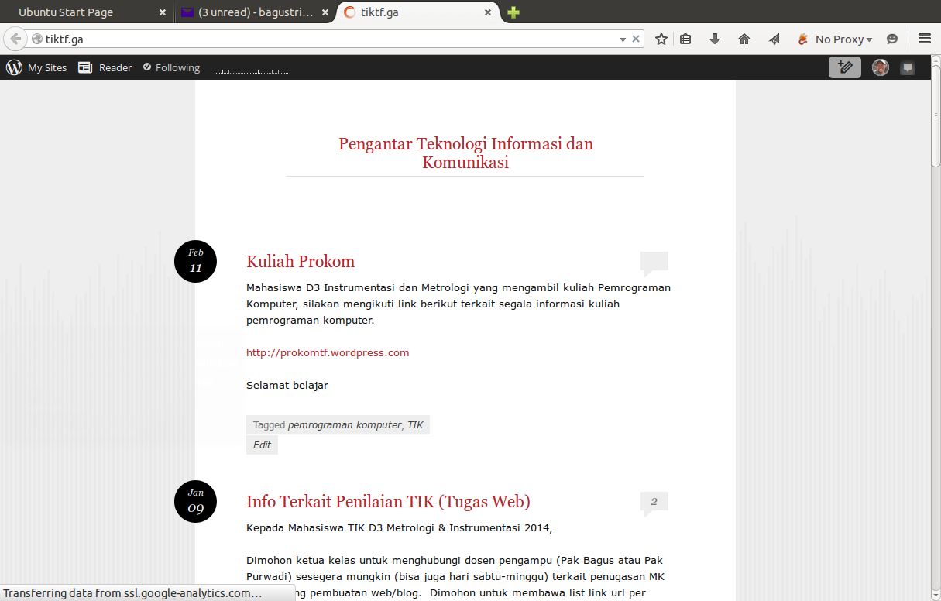
Blog: www.tiktf.ga

Slide 19
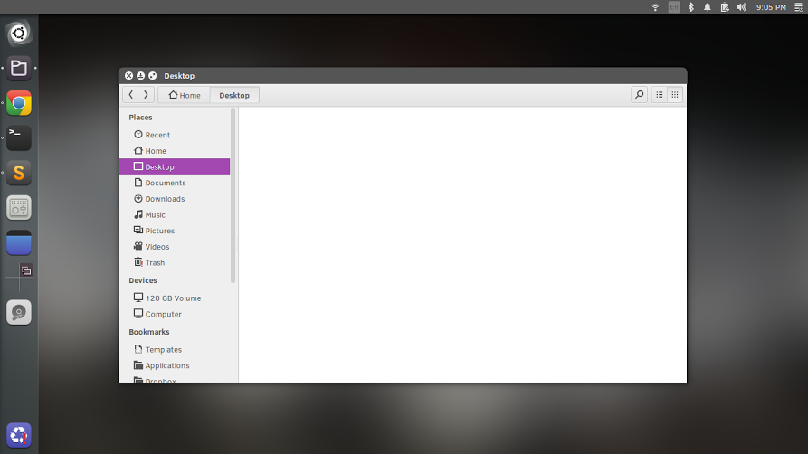
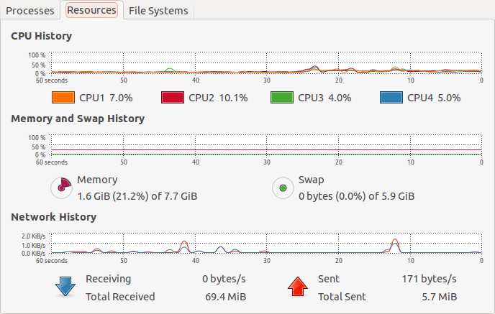
System Monitoring

Slide 20
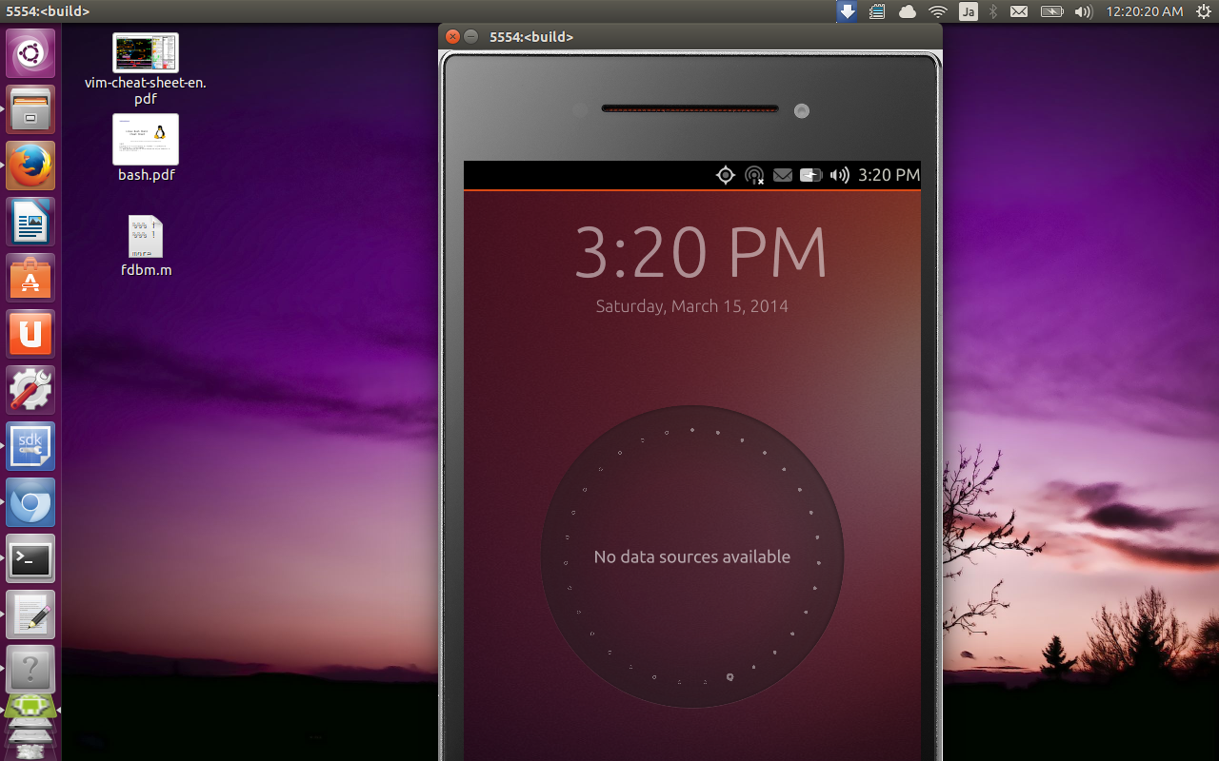
App Developer

Slide 21
Tugas1
Apa perbedaan arsitektur Von Newmann dan Non-Von Newmann? Jelaskan dalam block diagram dan penjelasannya.
Buatlah kajian analisa SWOT (Strength, Weakness, Opportunity, Threats) terhadap perkembangan TIK di Indonesia berdasarkan data & fakta serta pendapat anda.
Strength | Weakness
Opportunity | Threat

