Slide 1
TIK-1 :
Komputer: Hex Editor, Base Conversion, ASCII, Unicode/UTF-8, Keyboard, CPU-INFO
@btatmaja

Slide 2
Hex Editor
Membaca sistem biner, 1 dan 0, dari suatu file, disk, atau partisi dan mengkonversinya pada format desimal. Beberapa editor juga menampilkan file ASCII nya.
Heksadesimal: 0 1 2 3 4 5 6 7 8 9 A B C D E F
Setiap pasang heksadesimal merepresentasikan 8 bits, misal 3F=00111111
1 byte = 8 bits
Hex Editor: Ghex, hexedit, bless, free hex,etc

Slide 3
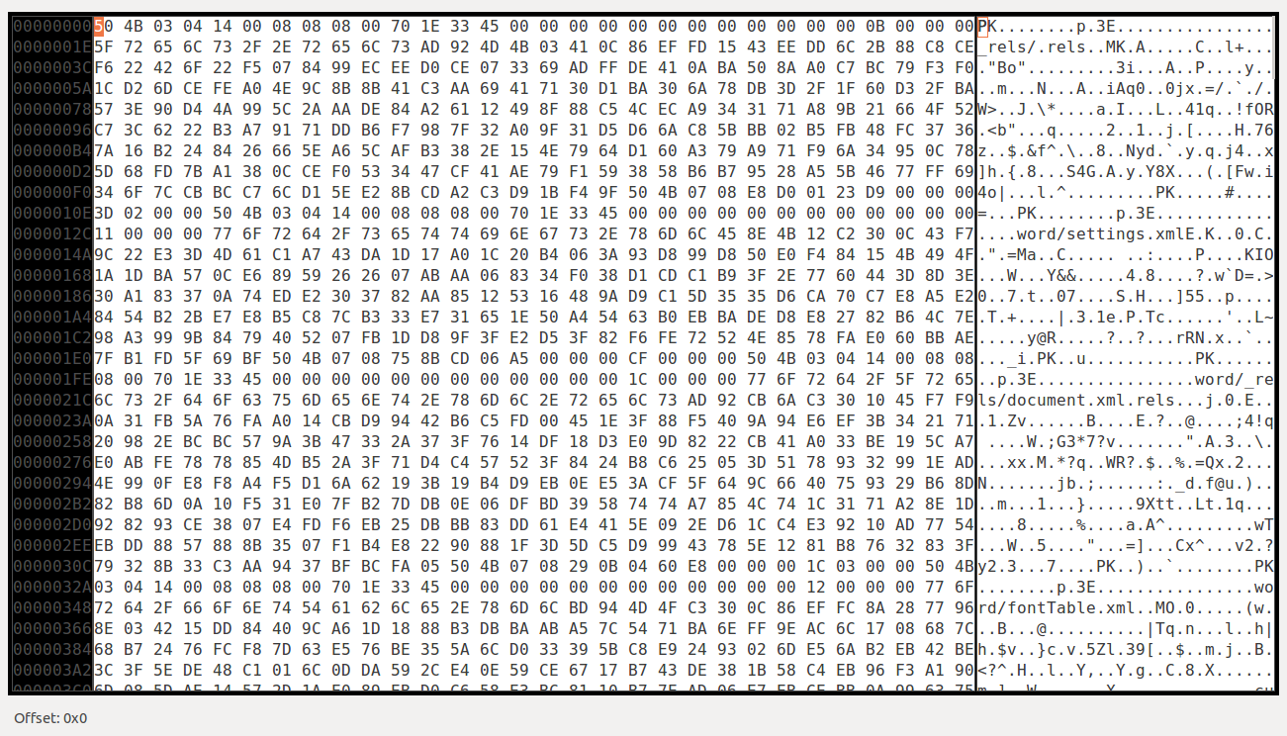
Hex Editor Overview
50 = 1 byte
50 = 8 bits
50 = 1010000
ASCII Code
Address pane

Slide 4
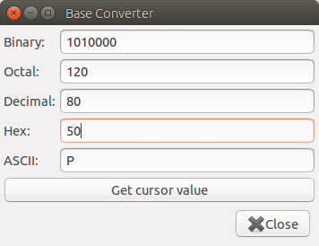
Base Converter

Slide 5
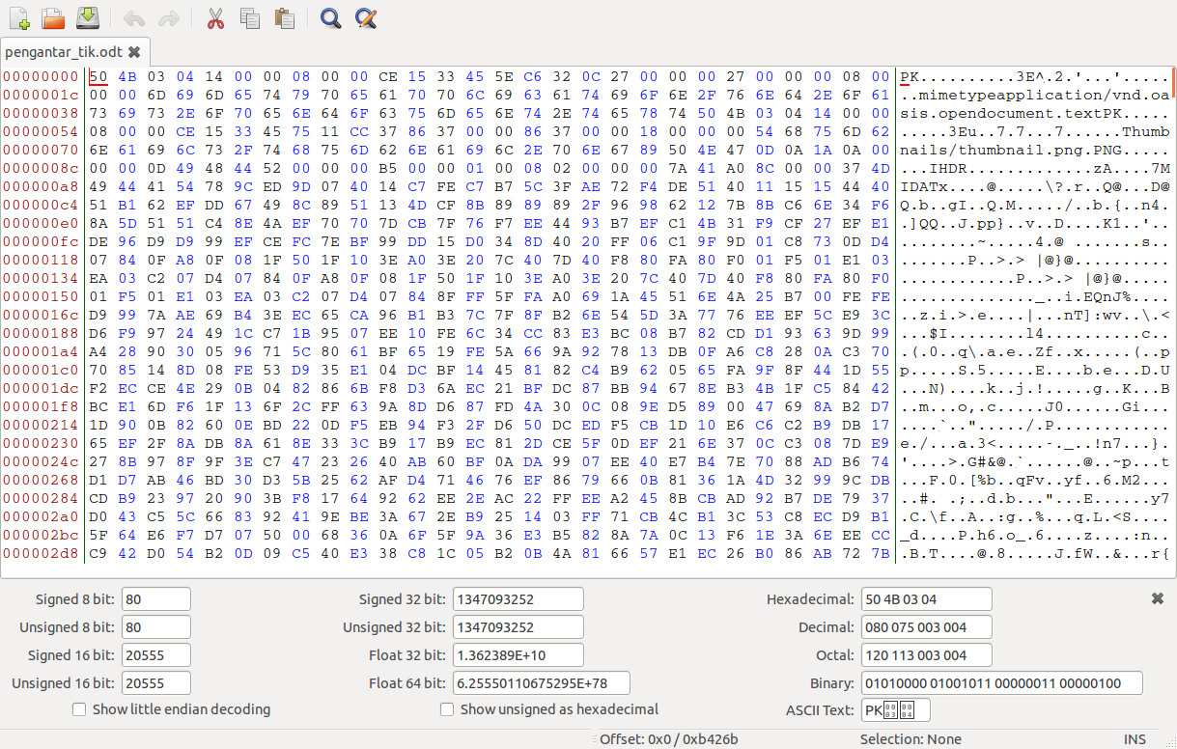
Bless hex editor

Slide 6
ASCII code
ASCII is a code for representing English characters as numbers, (0 -127, M is 77).
Most computers use ASCII codes to represent text
The DOS operating system uses a superset of ASCII called extended ASCII
A more universal standard is the ISO Latin 1
IBM computers used set of code EBCDIC.

Slide 7
UTF-8
UTF-8 (Universal Character Set + Transformation Format—8-bit[1]) is a character encoding capable of encoding all possible characters (called code points) in Unicode.
It was designed for backward compatibility with ASCII and to avoid the complications of endianness and byte order marks in UTF-16 and UTF-32.
Demo → Gedit Save As

Slide 8
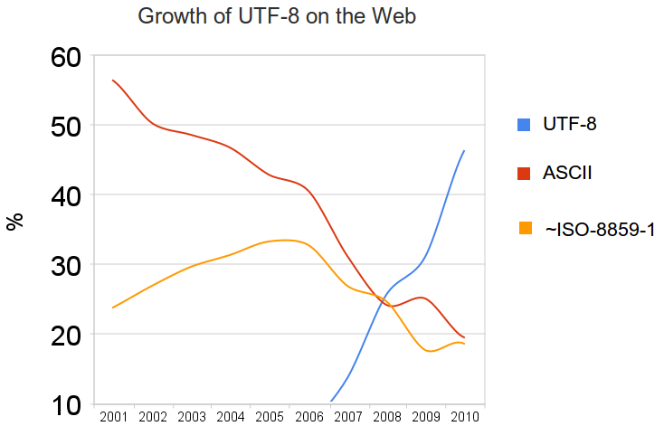
UTF-8, ASCII, ISO-8859-1

Slide 9
How Keyboard Works [1]
As you type, the microprocessor in the keyboard analyzes the key matrix and determines what characters to send to the computer. It maintains these characters in its memory buffer and then sends the data.
The signal from the keyboard is monitored by the computer's keyboard controller (an integrated circuit) that processes all of the data that comes from the keyboard and forwards it to the operating system.
When the operating system (OS) is notified that there is data from the keyboard, it checks to see if the keyboard data is a system level command (e.g: Ctrl+alt+del).

Slide 10
How Keyboard Works [2]
The application determines whether the keyboard data is a command, like Alt-f (Open File menu)
If the data is not a command, the application accepts it as content (Url, typing, etc)
If the current application does not accept keyboard data, it simply ignores the information.
The process from pressing the key to entering content into an application is instantaneously

Slide 11
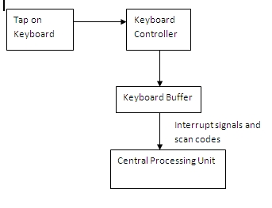
How Keyboard Works [2]

Slide 12
How Keyboard Works [4]
How to disable/change A character:
  Xev
  Press A (shift +a), obseverve “keycode”
  sudo xmodmap -e "keycode 38 = """
  38 is keycode for A
  To view all keycode >> cat .xmodmap

Slide 13
CPU-INFO [*Nix]
/proc/cpuinfo
lscpu
nproc
cpuid
lshw --> lshw-gtk
hardinfo
sudo dmidecode

Slide 14
Other commands
lsusb
tlp-stat
cpupower

