Slide 1
TIK-2:
Komputer: Hardware Addressing
OS, Programming Lang, Apps
@btatmaja

Slide 2
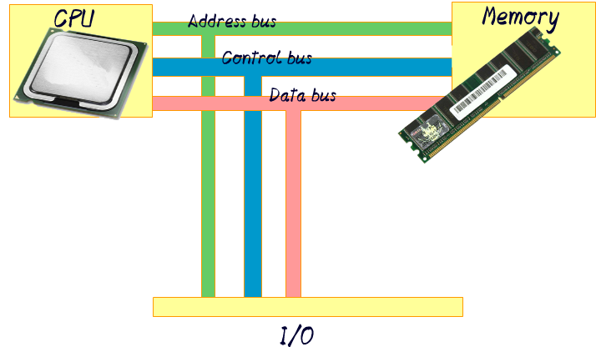
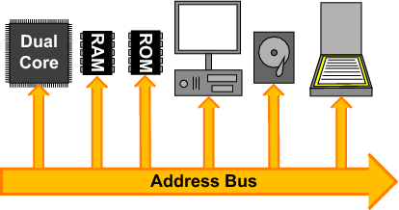
Address Bus

Slide 3
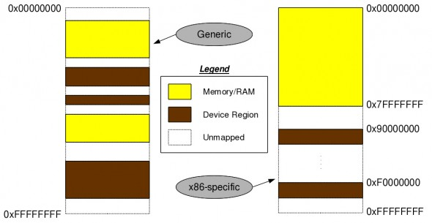
Mac Address
eth0 Link encap:Ethernet HWaddr 3c:97:0e:0d:99:c7
wlan0 Link encap:Ethernet HWaddr 74:e5:43:6f:26:8a
Address Bus
48 bit hexadecimal, unique

Slide 4
I/O Port
0000-0cf7 PCI Bus 0000:00
0060-0060 keyboard
0062-0062 EC data
0064-0064 keyboard
0066-0066 EC cmd
0070-0077 rtc0
0080-008f dma page reg
00a0-00a1 pic2
00c0-00df dma2
00f0-00ff fpu
03c0-03df vesafb
0400-0403 ACPI PM1a_EVT_BLK
0404-0405 pnp 00:06

Slide 5
I/O Port [2]
2000-2fff PCI Bus 0000:03
2000-207f Qualcomm Atheros AR8162 Fast Ethernet (rev 10)
3000-303f Intel Corporation 3rd Gen Core processor Graphics Controller (rev 09)
3060-307f Intel Corporation 7 Series Chipset Family 6-port SATA Controller [AHCI mode]
3060-307f AHCI SATA low-level driver
3080-3087 Intel Corporation 7 Series Chipset Family 6-port SATA Controller [AHCI mode]
3080-3087 AHCI SATA low-level driver
3088-308f Intel Corporation 7 Series Chipset Family 6-port SATA Controller [AHCI mode]
3088-308f AHCI SATA low-level driver
3090-3093 Intel Corporation 7 Series Chipset Family 6-port SATA Controller [AHCI mode]
3090-3093 AHCI SATA low-level driver
3094-3097 Intel Corporation 7 Series Chipset Family 6-port SATA Controller [AHCI mode]
3094-3097 AHCI SATA low-level driver
efa0-efbf Intel Corporation 7 Series/C210 Series Chipset Family SMBus Controller (rev 04)

Slide 6
Memory Address
e0000000-efffffff Intel Corporation 3rd Gen Core processor Graphics Controller (rev 09) (prog-if 00 [VGA controller])
f0000000-f03fffff Intel Corporation 3rd Gen Core processor Graphics Controller (rev 09) (prog-if 00 [VGA controller])
f0400000-f04fffff PCI Bus 0000:03
f0400000-f043ffff Qualcomm Atheros AR8162 Fast Ethernet (rev 10)
f0400000-f043ffff Qualcomm Atheros(R) AR816x/AR817x PCI-E Ethernet Network Driver
f0500000-f05fffff PCI Bus 0000:02
f0500000-f050ffff Qualcomm Atheros AR9285 Wireless Network Adapter (PCI-Express) (rev 01)
f0500000-f050ffff Support for Atheros 802.11n wireless LAN cards.
f0600000-f060ffff Intel Corporation 7 Series/C210 Series Chipset Family USB xHCI Host Controller (rev 04) (prog-if 30 [XHCI])

Slide 7
Memory Address [2]
f0600000-f060ffff xhci_hcd
f0610000-f0613fff Intel Corporation 7 Series/C210 Series Chipset Family High Definition Audio Controller (rev 04)
f0610000-f0613fff ICH HD audio
f0614000-f06140ff Intel Corporation 7 Series/C210 Series Chipset Family SMBus Controller (rev 04)
f0615000-f061500f Intel Corporation 7 Series/C210 Series Chipset Family MEI Controller #1 (rev 04)
f0615000-f061500f Intel(R) Management Engine Interface
f0617000-f06177ff Intel Corporation 7 Series Chipset Family 6-port SATA Controller [AHCI mode] (rev 04) (prog-if 01 [AHCI 1.0])
f0617000-f06177ff AHCI SATA low-level driver
f0618000-f06183ff Intel Corporation 7 Series/C210 Series Chipset Family USB Enhanced Host Controller #1 (rev 04) (prog-if 20 [EHCI])
f0618000-f06183ff ehci_hcd
f0619000-f06193ff Intel Corporation 7 Series/C210 Series Chipset Family USB Enhanced Host Controller #2 (rev 04) (prog-if 20 [EHCI])

Slide 8
Computer Port
Serial ports send and receive one bit at a time via a single wire pair (Ground and +/-)
E.g: USB, DB-15, etc
Parallel ports send multiple bits at the same time over several sets of wires.
E.g: DB-25

Slide 9
Software
Operating System
Programming language
Utility

Slide 10
Operating System
At the simplest level, an operating system does two things:
Manage hardware and software resources (include such things as the processor, memory, disk space)
It provides a stable & consistent way for applications to deal with the hardware without having to know all the details of the hardware.

Slide 11
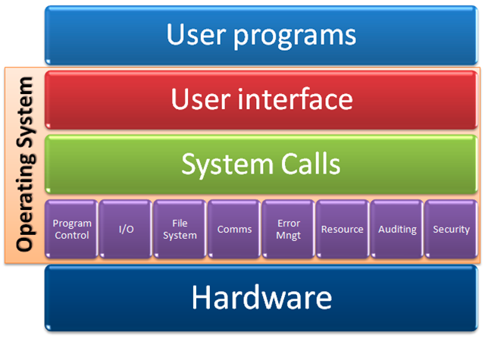
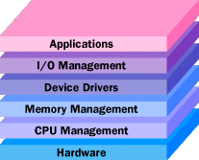
Operating System

Slide 12
OS
Unix
  Mac OS X
  BSD
  Solaris
Windows
Linux
Minix

Slide 13

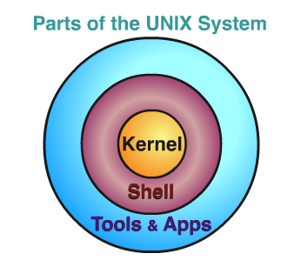

Unix and the like
Unix
Mac OS X
BSD
FreeBSD
OpenBSD
Solaris (by Sun/Oracle)
AIX (by IBM)

Slide 14
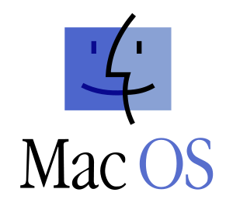
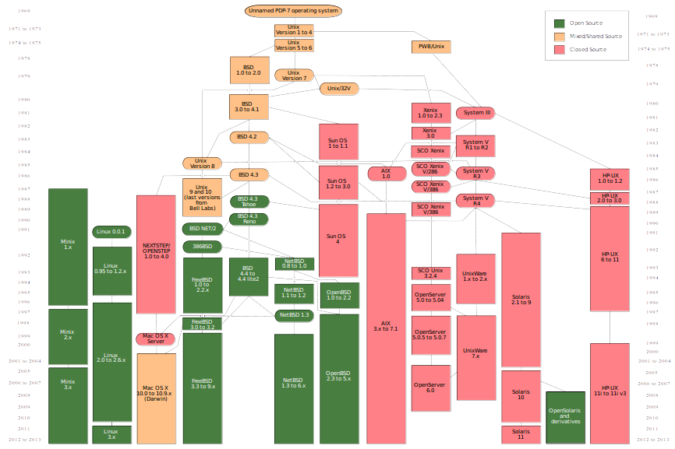

Slide 15
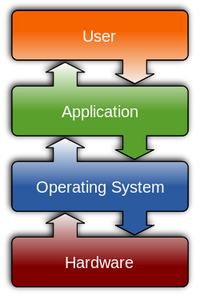
Windows
Windows
  Windows 1.0
  Windows NT
  Windows ME
  Windows XP
  Windows 7
  Windows 8
  Window 10

Slide 16
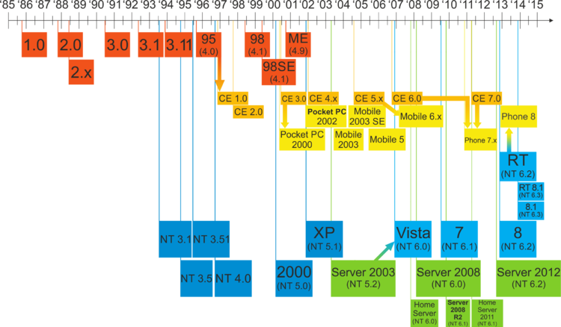
Windows Timeline

Slide 17
Linux-Based OS
Slackware
Redhat
  Fedora
  Centos
  SUSE
Debian
  Ubuntu
  Linux Mint
  Arch Linux

Slide 18
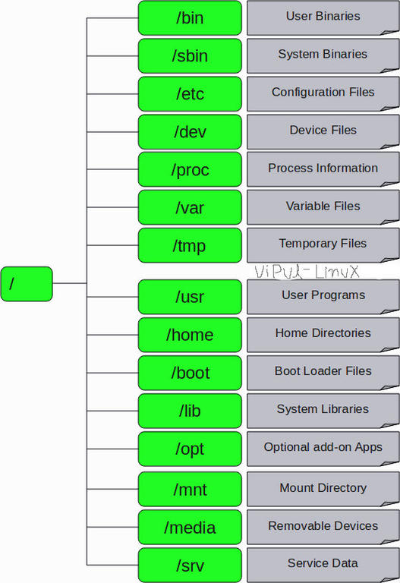
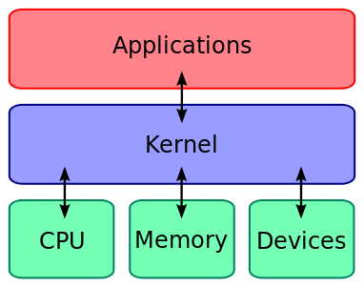
Unix/Linux
Hierarchy

Slide 19
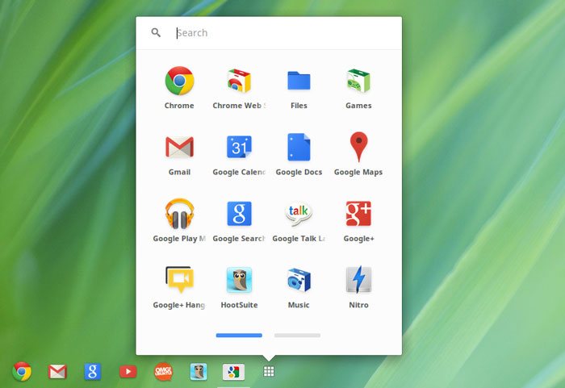
Others
Chrome OS
Android
QNX/Blackberry
Z/OS
Minix
iOS
Palm OS
Symbian

Slide 20
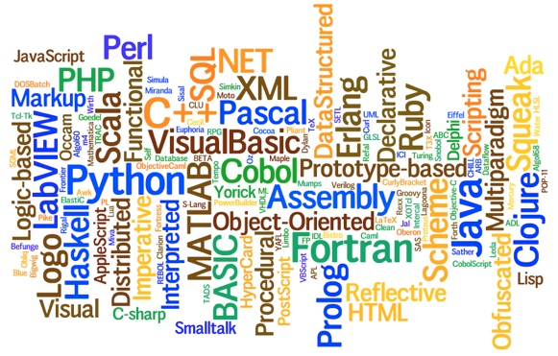
Programming Language

Slide 21
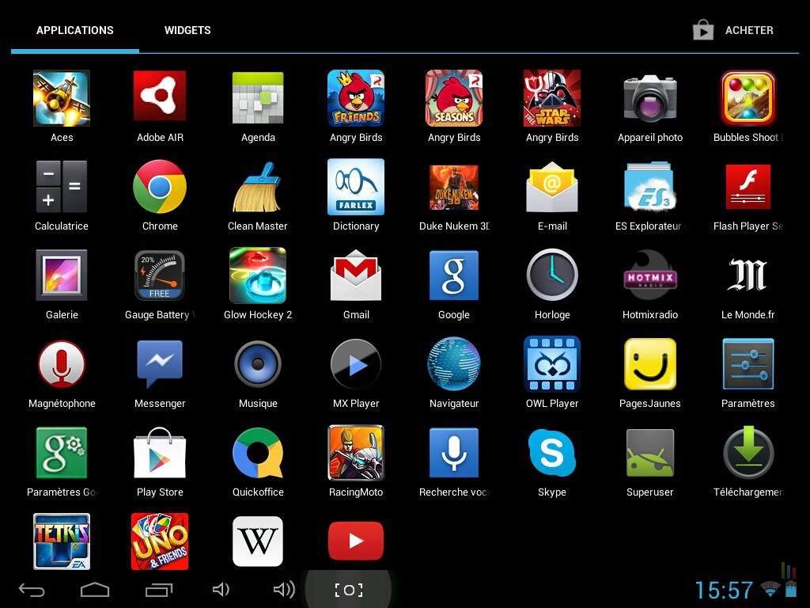
Application

Slide 22


