Slide 1
TIK-4
Komunikasi Data : Mode Transmisi, Modulasi, Hardware
@btatmaja

Slide 2
Transmisi Digital
Data ditransmisikan dalam bentuk sinyal
Untuk mengirim data secara digital, sinyal harus dikonversi dalam bentuk digital
  Digital to Digital Conversion
  Analog to Digital Conversion
Mode Transmisi
  Synchronus Transmission
  Asynchronus Transmission

Slide 3
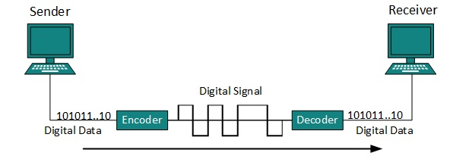
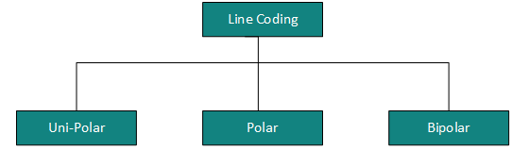
Digital to Digital Conversion
Proses konversi digital to digital → Line Coding

Slide 4
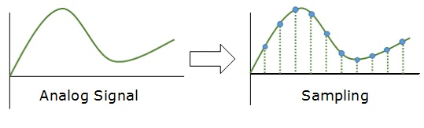
ADC: Sampling

Slide 5
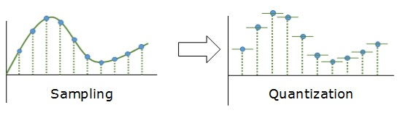
ADC: Quantization

Slide 6
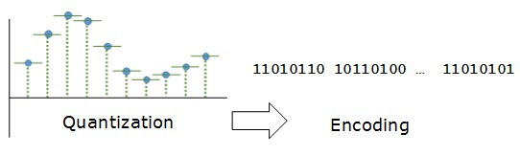
ADC: Encoding

Slide 7
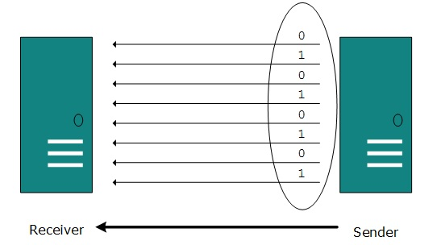
Mode Transmisi: Parallel

Slide 8
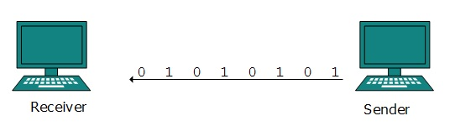
Mode Transmisi: Serial
Mode transmisi serial bisa berupa salah satu asynchronus atau synchronus

Slide 9
Asynchronus Vs Synchronus
Asynchronus | Synchronus
No impportance of Timing | Timing is controlled
During idle condition Signal ‘1’ is transmitted | No idle, clock is used to sync
“Start bit” before the byte and “Stop bit” at the end of the byte for Start/Stop synchronisation → more bit | No Start/Stop bits → less bit
Satu kesalahan → merusak satu karakter | Satu kesalahan merusak satu blok

Slide 10
Modulasi
Dalam komunikasi, hanya range frekuensi tertentu saja yang bisa ditransmisikan
Untuk mengirim data yang tidak dalam cakupan range frekuensi tersebut, maka data perlu “ditumpangkan” pada range frekuensi yang dijinkan
Teknik penumpangan suatu frekuesi (fs) pada frekuensi pembawa (fc) tersebut dinamakan modulasi

Slide 11
Modulasi: Analog
Modulasi:
  Analog
  Digital
Modulasi Analog
  Amplitude Modulation (AM)
  Frequency Modulation (FM)
  Phase Modulatio (PM)

Slide 12
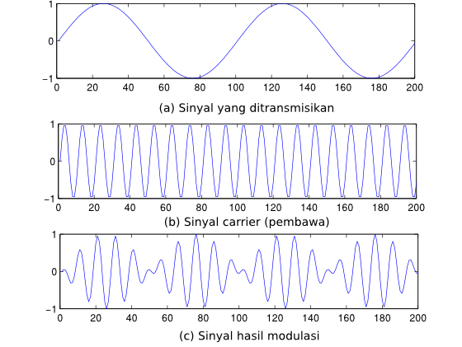
Amplitude Modulation

Slide 13
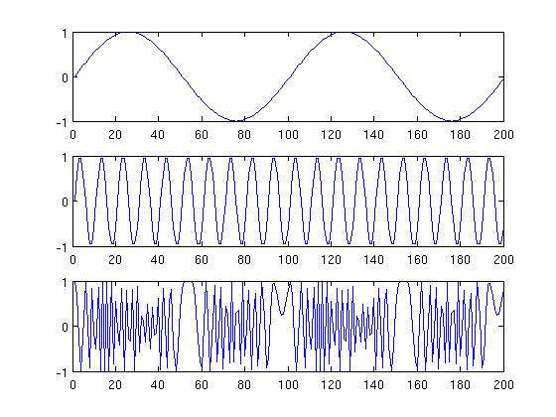
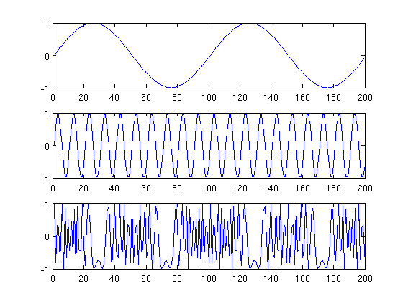
FM dan PM

Slide 14

Digital Modulation

Slide 15
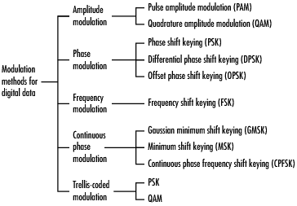
Digital Modulation

Slide 16
Analog Transmission
  Digital to analog conversion : data is converted into bandpass analog signals
  When data is sent via analog carrier, it is converted into analog signal
  Analog signal is modified to reflect binary data
  Analog signal is characterized by its amplitude, frequency, phase.
  Analog-to-analog conversion: ASK, FSK dan PSK

Slide 17
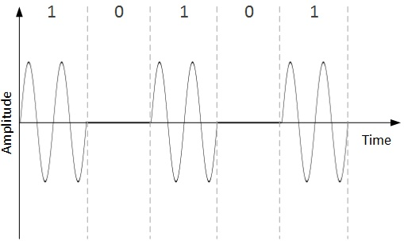
Amplitude Shift Keying
amplitude of analog carrier signal is modified to reflect binary data.

Slide 18
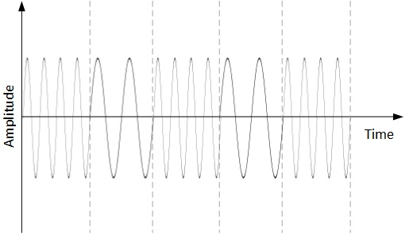
FSK
the frequency of the analog carrier signal is modified to reflect binary data.

Slide 19
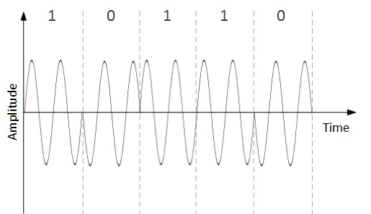
Phase Shift Keying
the frequency of the analog carrier signal is modified to reflect binary data.

Slide 20
Modem
MoDem = Modulator – Demodulator
Internal modem, plugin/on board komputer dapat dihubungkan langsung dengan telefon
Eksternal, berada di luar komputer dan dihubungkan dengan komputer melalui port serial (USB).

