Slide 1
TIK-5 :
Komunikasi Data – Jaringan: Protokol, OSI,
TCP / IP
@btatmaja

Slide 2
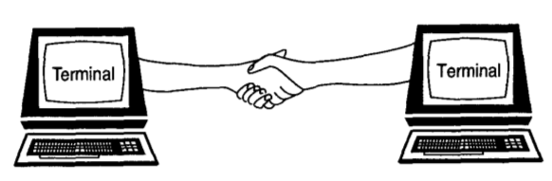
Protocol
A protocol is an agreement between the communicating parties on how communication is to proceed

Slide 3
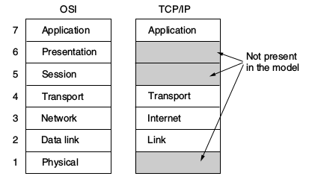
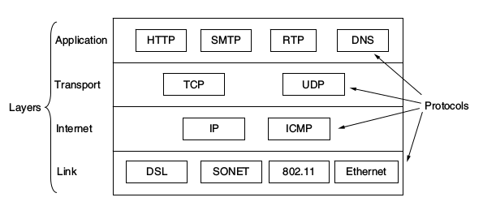
TCP/IP Reference Model

Slide 4
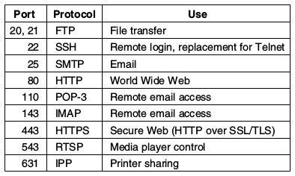
Port, Protocol and the Use

Slide 5
Demo
80 HTTPS/HTTP (WWW)
22 SSH
20 FTP/SFTP
445 SAMBA/SMB

