Slide 1
TIK-6
Komunikasi Data: Modulasi, Mux, CDMA, PSTN, ADSL
@btatmaja

Slide 2
Overview
Modulasi
Multiplexing
CDMA
PSTN
ADSL

Slide 3
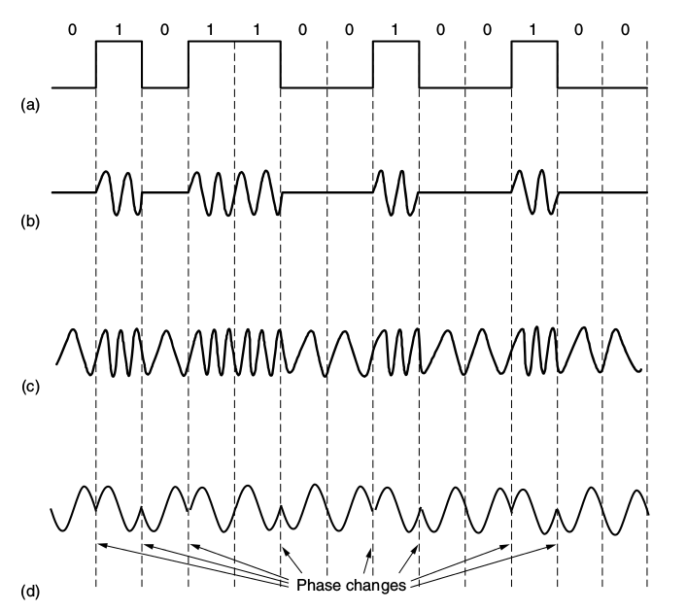
Modulasi

Slide 4
Frequency Division Multiplexing (FDM)
FDM (Frequency Division Multiplexing) takes advantage of passband transmission to share a channel. It divides the spectrum into frequency bands, with each user having exclusive possession of some band in which to send their signal.
AM radio broadcasting illustrates FDM. The allocated spectrum is about 1 Mhz, roughly 500 to 1500 kHz. Different frequencies are allocated to different logical channels (stations), each operating in a portion of the spectrum

Slide 5
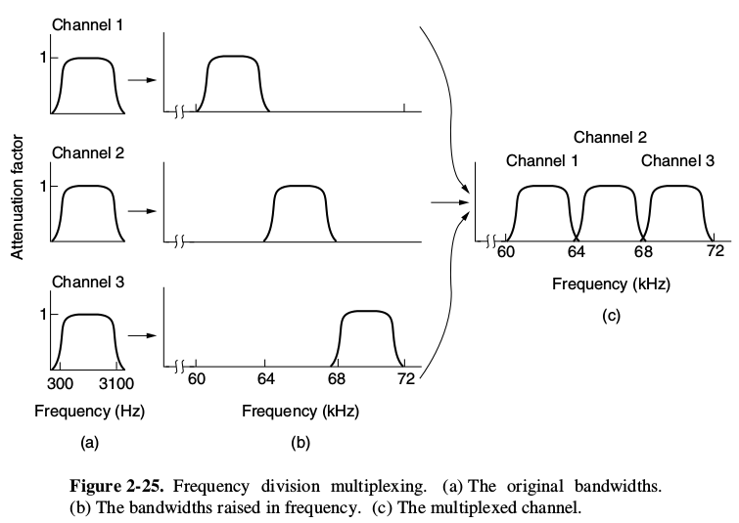
FDM

Slide 6
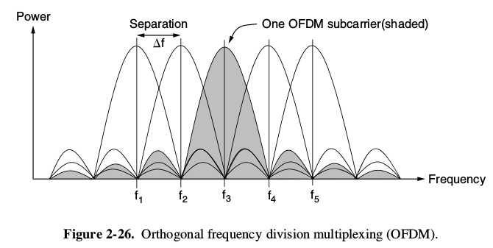
Orthogonal FDM (FDM)

Slide 7
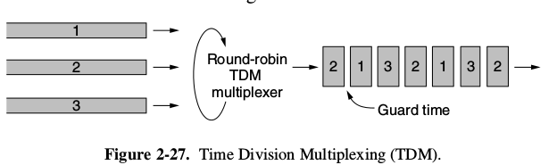
Time Domain Multiplexing
each one periodically getting the entire bandwidth for a little burst of time
Bits from each input stream are taken in a fixed time slot and output to the aggregate stream

Slide 8
Code Division Multiple Access (CDMA)
Spread spectrum communication in which a narrowband signal is spread out over a wider frequency band
CDMA allows each station to transmit over the entire frequency spectrum all the time
the key to CDMA is to be able to extract the desired signal while rejecting everything else as random noise

Slide 9
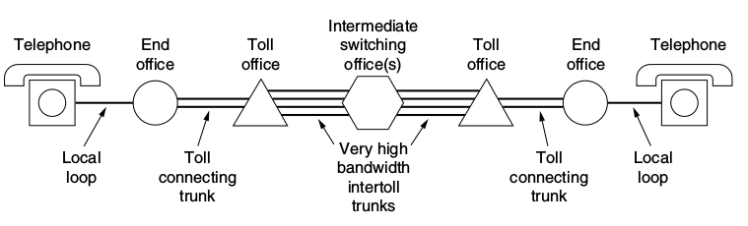
PSTN
PSTN --> Public Switched Telephone Network
Transmitting the human voice in a more-or-less recognizable form

Slide 10
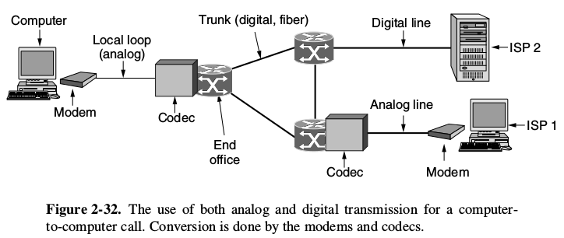
ADSL
DSL --> Digital Subscriber Line, type of Modem with high speed

Slide 11
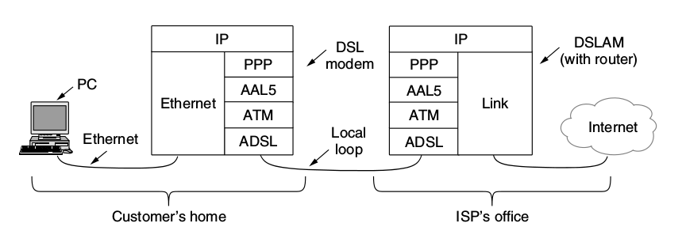
ADSL
ADSL adalah pentransferan date berkecapatan tinggi dengan menggunakan saluran telepon (DSL)
Layanan ASL misal VOD (Video on Demand): TV, Movie, dsb
Kecepatan ADSL: 1.5 Mbps s/d 13 Mbps

Slide 12
ADSL

Slide 13
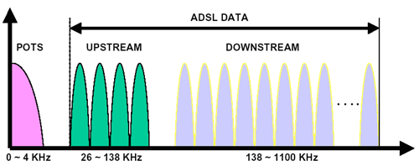
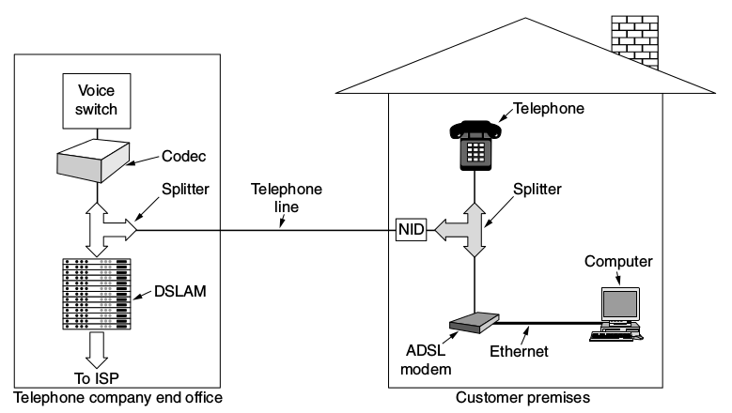
ADSL Conf

