Slide 1
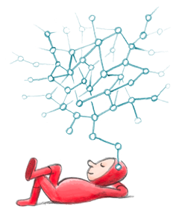
TIK-7 :
INTERNET

Slide 2
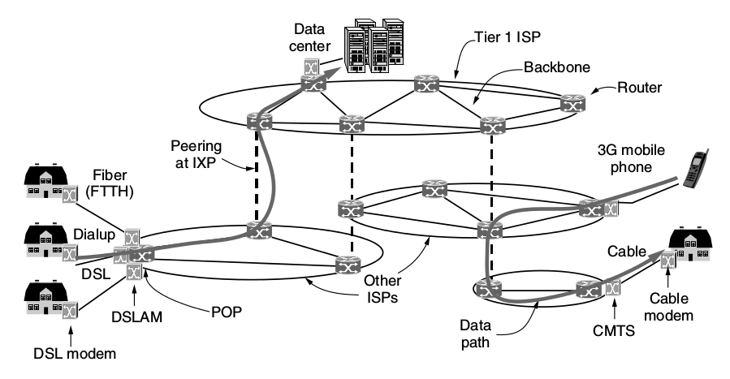
Arsitektur Internet (Andrew Tanenbaum, Computer Network)

Slide 3
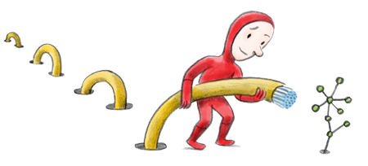
Internet
1974 : TCP/IP, a set of rules that allowed computers to “talk” to each other and send information back and forth.
Data and information could be sent more efficiently when broken into smaller chunks, sent separately, and reassembled --> packets!
The Internet’s bandwidth is equivalent to the amount of water that flows through the stream per second

Slide 4
Html, Javascript, Css
HTML --> language to write web page
Javascript --> web pages could incorporate more meaningful real-time interactions
Css --> Cascading styling sheet, easy & efficient way to define a web page’s layout and beautify the page with design elements
Other: XHR, AJAX, and many more

Slide 5

Browser & Cookies, etc
Browser : IE, Safari, Mozilla Firefox, Chrome/Chromium, Opera, dll
Cookies, a small piece of text sent to your browser by a website you visit. It contains information about your visit that you may want the site to remember
History
Bookmark

Slide 6

URL, uniform resource locator
Top level domain
http://www.tiktf.ga/tugas-1
scheme
hostname
path
https://ep.its.ac.id
Second Level Domain

Slide 7
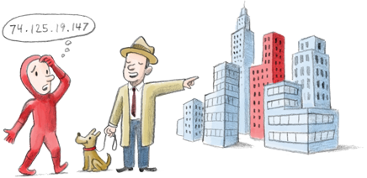
IP Adresses and DNS
74.125.19.147 --> IP address, like phone number
www.google.com --> URL, like phone book name
DNS translates a URL or web address into IP Adress

Slide 8
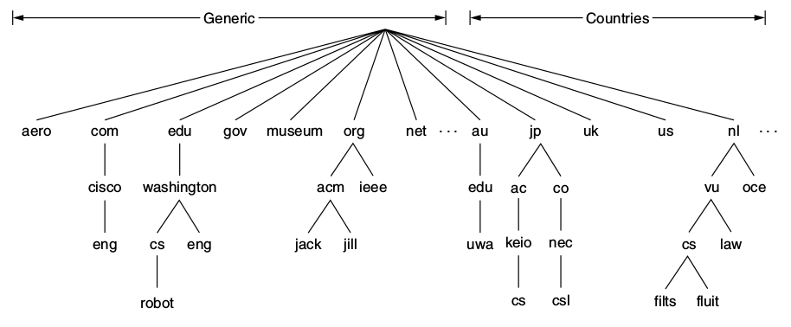
DNS
Cara membacanya dari bawah ke atas, misal:
http://cs.keio.ac.jp

Slide 9

Top Level Domain
.com --> commercial
.gov --> US government, go.id --> indonesia
.ac.id --> Indonesia academic
.ga --> gabon
.edu --> US university, .sch
.info --> generic TLD
.biz --> generic TLD

Slide 10
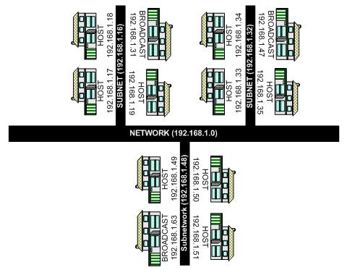
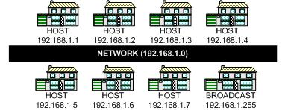
Netmask, Subnet Mask
Analogi, sebuah jalan memiliki beberapa rumah, ketika rumah semakin banyak apa yang harus dilakukan ? --> dibuat gang – gang.
Subnet mask!
Broadcast address/
Ketua RT

Slide 11
Netmask, Subnet Mask [2]
10.10.0.0/16 --> netmask: 255.255.0.0
  10.10.0.0/18 --> subnet mask: 255.255.192.0
  10.10.64.0/18 --> subnet mask: 255.255.192.0
  10.10.128.0/18 --> subnet mask: 255.255.192.0
  10.10.192.0/18 --> subnet mask: 255.255.192.0
CIDR =
Classless
Inter-Domain
Routing
Subnet Mask | CIDR
255.255.0.0 | /16
255.255.192.0 | /18
255.255.255.0 | /24

Slide 12
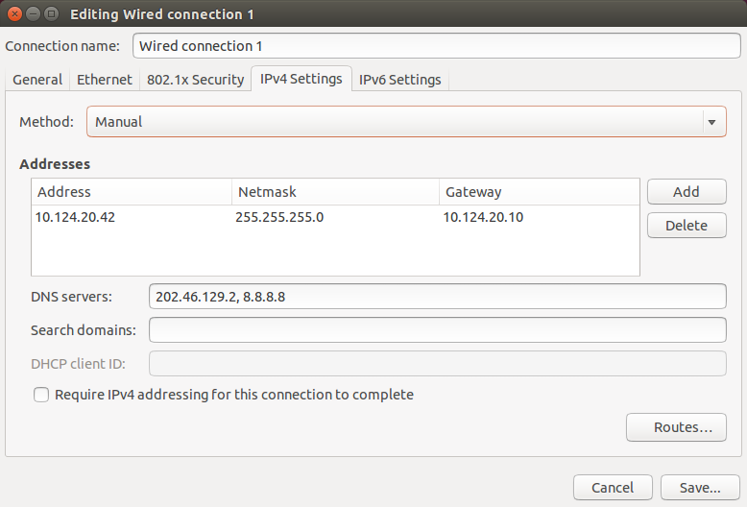
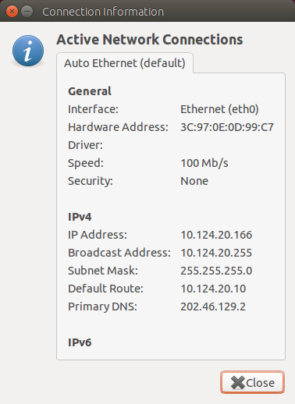
DHCP Vs Manual

Slide 13
Resources:
http://www.20thingsilearned.com/

