Slide 1
TIK-7b :
WWW, HTML, Email,Proxy
@btatmaja

Slide 2
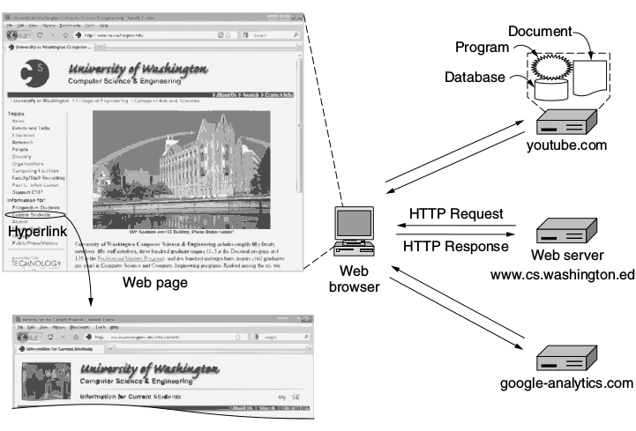
WWW

Slide 3
HTML
<html>
<head>
<title>
Hello world
</title>
</head>
<body>
<b>Hello, </b> World!
</body>
</html>

Slide 4
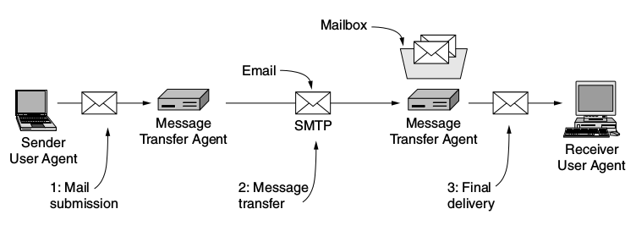
Email

Slide 5
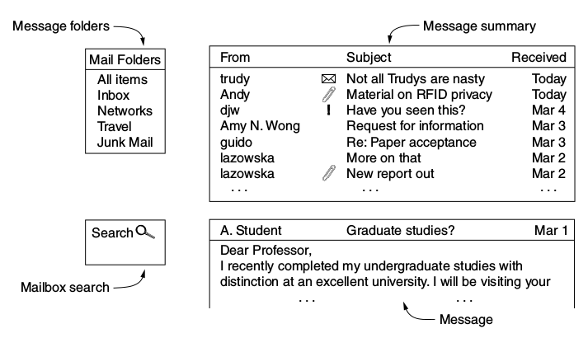
Email element

Slide 6
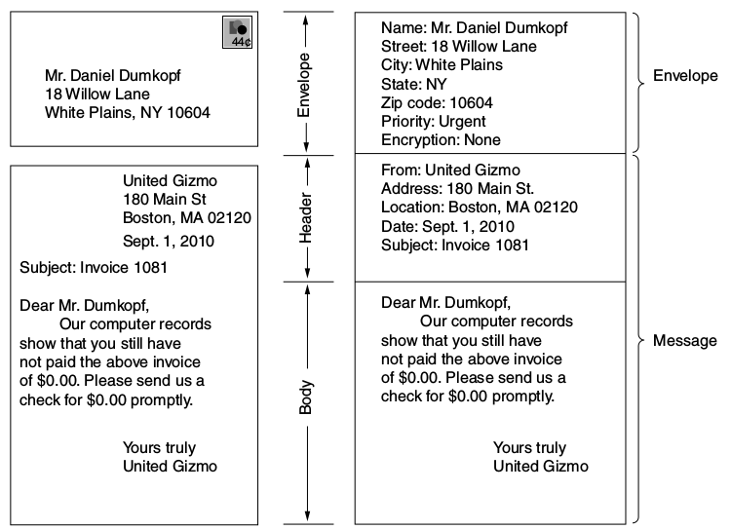
Mail Vs Email

Slide 7
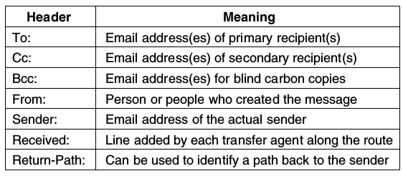
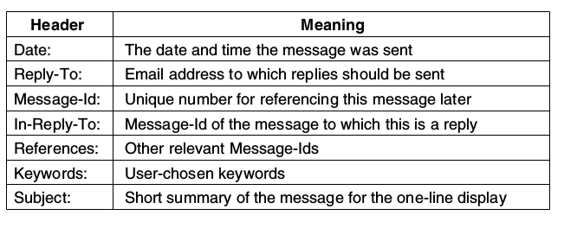
Email : RFC5322
RFC= Request For Comments

Slide 8
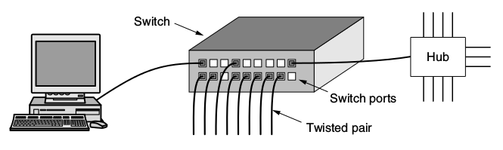
Hardware Jaringan
Modem
Mux (multiplexer) –> hub
Concentrator
Router
Switch
Wiring

Slide 9
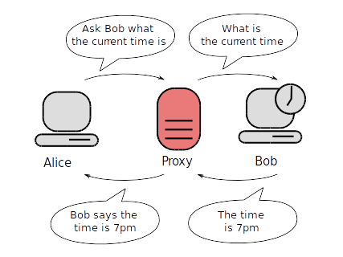
Proxy Server

Slide 10
Kegunaan Proxy (Squid)
Internet cache
Access Control List (ACL)
Manajemen Bandwidth
Port 80 → Port 3128
internet
Server
DHCP
Firewall
SQUID
Client1
Client1
Client1

Slide 11
How Proxy works
Proxy bekerja menggunakan RAM
4-8 GB RAM → 30 client
      satu paket data
RAM
70 %
Data sering diakses
Data jarang diakses
HDD
Trasnsparant cache:
Proxy server bekerja dengan menggunakan jalur transparan ke browser
800MB

Slide 12
Did U understand it?
ADS, AJAX,, CDMA, CDN, CIDR, CRL, CSMA, CSS, DCT, DES, DHCP, DHT, DIFS, DMCA, DMT, DMZ, DNS, DOCSIS, DOM, DSLAM, DTN, FCFS, FDD, FDDI, FDM, FEC, FIFO, FSK, FTP, GPRS, GSM, HDTV, HFC, HTTP, ICANN, ICMP, IDEA, IETF, IMAP, IMP, IP, IPTV, IRTF, ISO, ISP, ITU, JPEG, JSP, JVM, LAN, LATA, LSR, LTE, MAN, MFJ, MIME, MPEG, MPLS, MSC, MTSO, MTU, NAP, NAT, NRZ, NSAP, OFDM, OSI, OSPF, PAWS, PCM, PGP, PIM, PKI, POP, POTS, PPP, PSTN, QAM, QPSK, RED, RFC, RFID, RPC, RSA,RTSP, SHA, SIP, SMTP, SNR, SOAP, SONET, SPE, SSL, TCP, TDD, TDM, TSAP, UDP, UMTS, URL, VLAN, VSAT, WAN, WDM, WWW and XML, SCSI, RAID

Slide 13
Advanced materials
Port Forwarding / tunneling
VPN (Virtual Private Network)
BitTorrent
CSS, PHP, Ajax
MySQL

