Slide 1

Teknik Optik
@btatmaja

Slide 2
Pokok Bahasan
Sumber cahaya: jenis-jenis cahaya (laser, led dll), pembangkitan cahaya, dan karakteristik cahaya
Kuantifikasi sumber cahaya: radiometri dan fotometri
Modifikasi karakteristik cahaya: modulasi, demodulasi, pemanduan cahaya (slab wave guide dan fiber optik), ekspansi, kolimasi, atenuasi dan modifikasi parameter gelombang cahaya (amplitudo, frekuensi, fasa dan polarisasi)
Pendeteksian informasi optis: tranduktansi sinyal optis → Metrology
Material optik: medium isotrop, anisotrop, aktifitas optik, elektro optik dan magneto optic + Acousto optik
Pendekatan sistem linier dalam optik
Berbagai metoda dalam teknik optik: fotografi, holografi, spektroskopi, interferometri, difraktometri, polarimetri, moire, komunikasi optik, optical remote sensing, optical image processing

Slide 3
Resources
Yu FTS, Khoo, IC, Principles of Optical Engineering, John Wiley and Sons, 1990.
Daniel Malacara and Brian J. Thompson, Handbook of Optical Engineering, Marcel Dekker, Inc, 2001.
Ting-Chung Poon & Taegeun Kim, Engineering Optic with MATLAB, World Scientific Publishing, 2006.

Slide 4
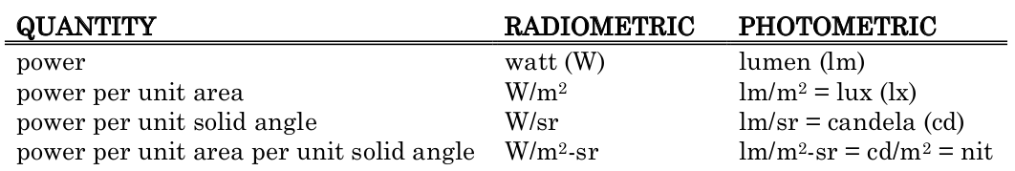
Radiometry & Photometry
Radiometry is the measurement of optical radiation, which is electromagnetic radiation within the frequency range between 3×10 ¹¹ and 3×10¹⁶ Hz.
Photometry is the measurement of light, which is defined as electromagnetic radiation that is detectable by the human eye (360 to 830 nm).

Slide 5
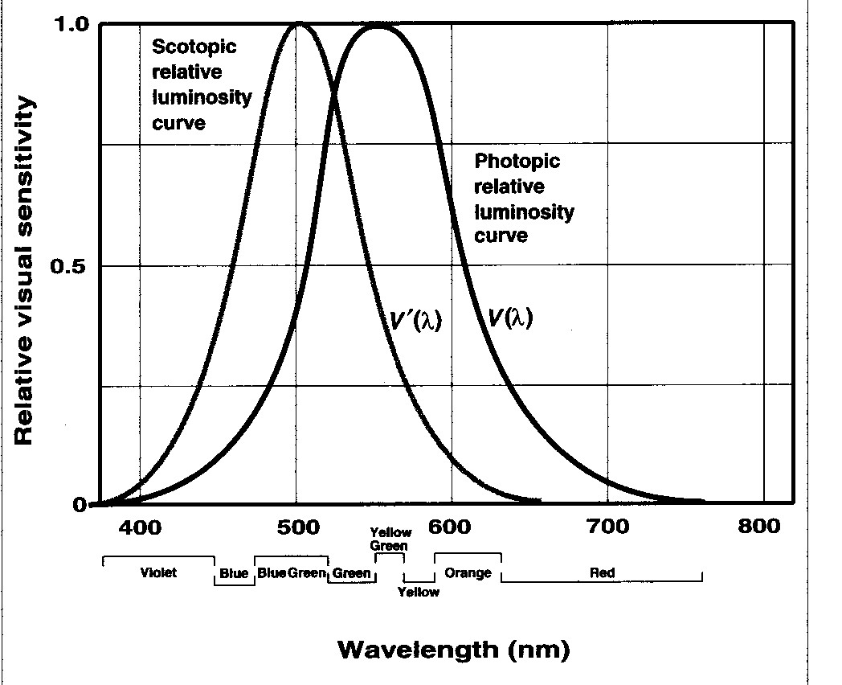
Photometry
Photometry=photo+metry=visible light + measurement
Visual Sensitivity:
The eye is not equally sensitive to the different colors of light in the visible spectrum.
Luminosity Curve:
For the average light adapted eye at moderate intensities (photopic vision) the maximum visual effect is obtained with light of wavelength 55 5nm (yellow-green).
For average dark adapted eye, the maximum is around 500 nm.
daylight
night

Slide 6
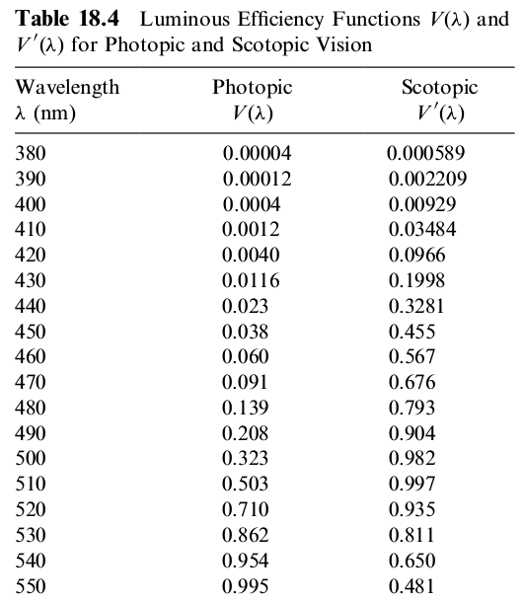

Slide 7
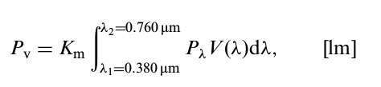
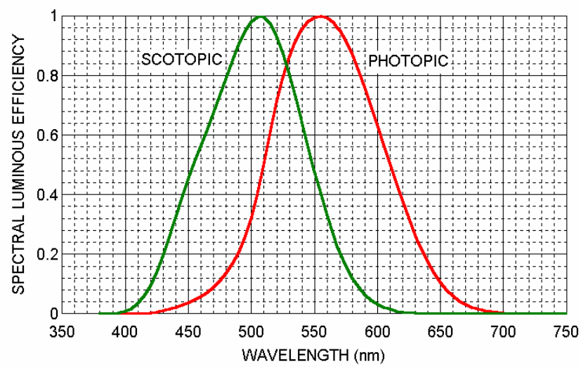


Another approach:

Slide 8
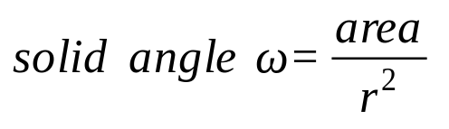
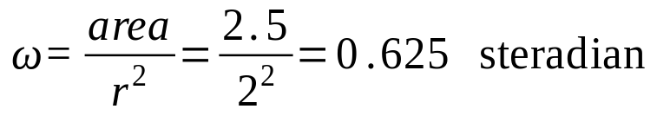
Photometry
Solid Angle:
The total solid angle around a point is 4π (steradians).
Example:
Calculate the solid angle subtended at the center of a sphere, radius 2 m, by an area of 2.5 m² on the surface of the sphere.
r
ω

Slide 9
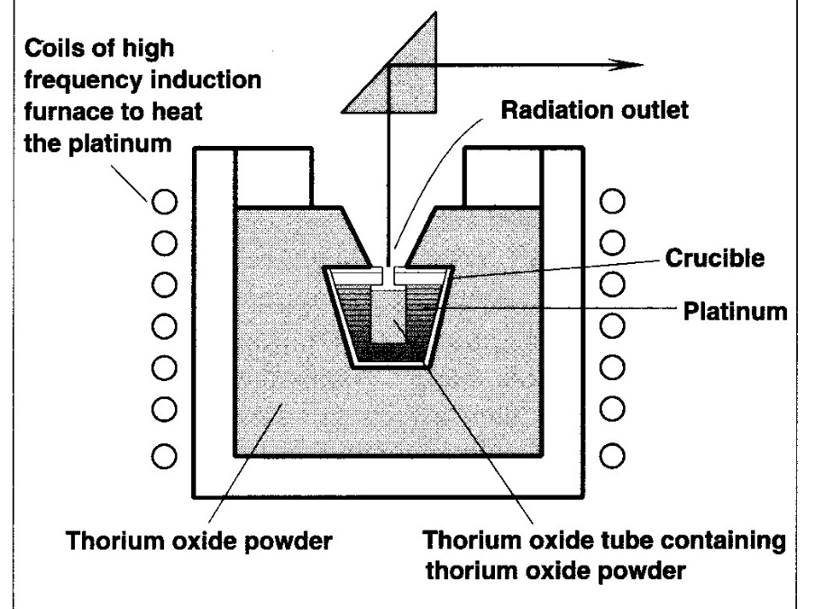
Photometry
Standard Source and Candela:
A standard requires a constant luminous output for all the time.
The present primary standard source of light is based on the concept of a black body radiator. The radiation solely depends on its temperature and does change with time.
baffle
International black body standard
One candela is equal to one sixtieth (1/60) of the luminous intensity per square centimeter of a black body at the temperature of solidification of platinum (1773°C).
Electric lamps are used as everyday working standards for luminous intensity, and are sometimes called sub-standards. They are calibrated periodically with the primary standard in case there is any deterioration in their light output.

Slide 10

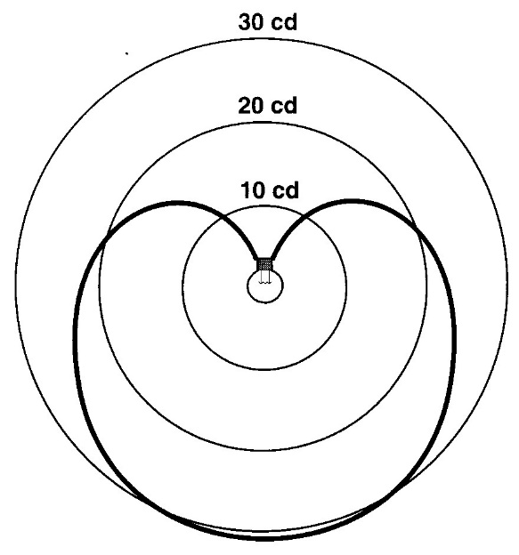
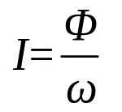
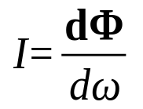
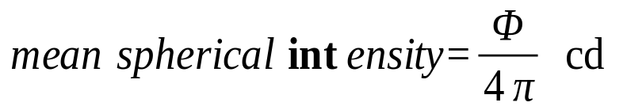


Photometry
Luminous Flux and Intensity:
Luminous flux Φ: the rate at which light energy flows. Unit: lumen
One lumen is the luminous flux emitted into a unit solid angle (1 steradian) from a point source of intensity 1 candela.
Luminous intensity of a source:
For a specified direction:
Example:
A source of light has a mean spherical intensity of 20 cd. How much total flux does it emit?
Example:
A source has an intensity of 250 cd in a particular direction. How much flux is emitted per unit solid angle in that direction?

Slide 11
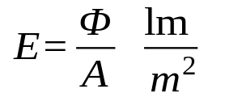
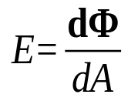
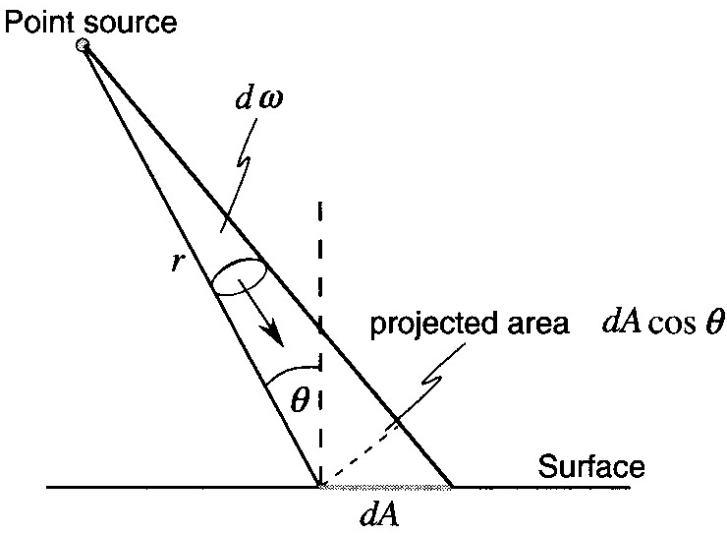
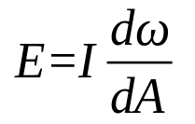

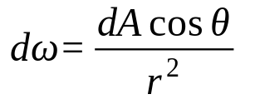
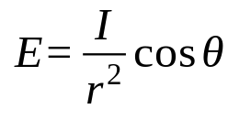
Photometry
Illuminance:
The illuminance at a point on a surface does not depend on the nature of the surface since it is only concerned with incident light.
Two laws:
The illuminance at a point on a surface is inversely proportional to the square of the distance between the point and the source. This law applies strictly only in the case of point sources.
The second is that if the normal to an illuminated surface is at an angle θ to the direction of the incident light, the illuminance is proportional to the cosine of θ.

Slide 12

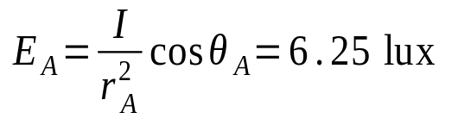
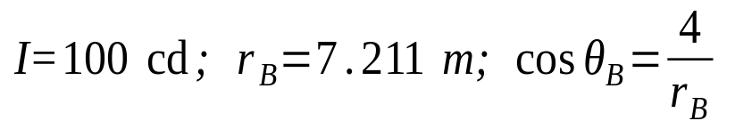
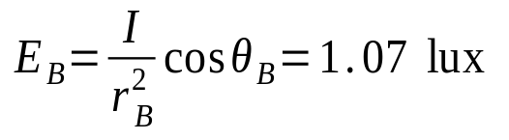
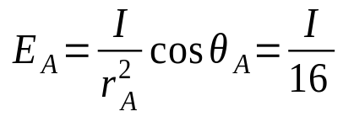
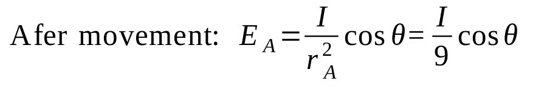

Photometry
Example:
A point source of light S, of intensity 100 cd, is suspended 4 m above a horizontal surface. What is the illuminance on the surface (i) at the point vertically below the source, (ii) at 6 m from this point?
Example:
Light falls normally on a surface at 4 m from a point source of light. If the surface is moved to a distance 3 m from the source, at what angle must the surface be inclined in order that the illuminance is the same value?
For θ=0°,
S (I=100 cd)
4 m
A
6 m
B

Slide 13
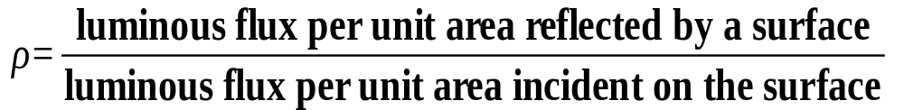
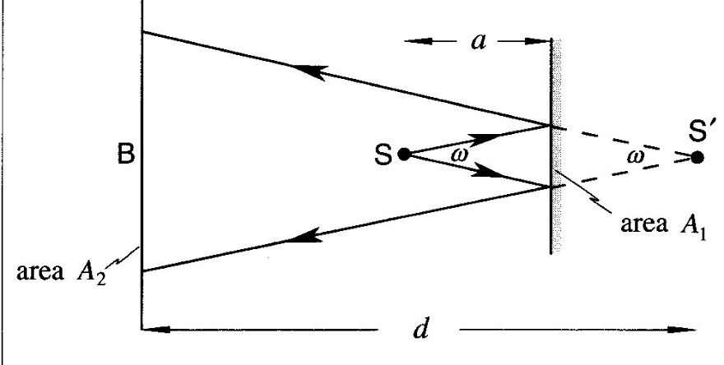
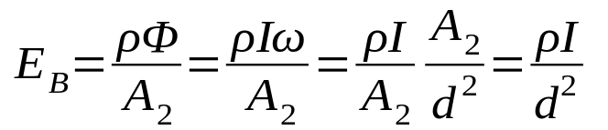
Photometry
Reflectance:
Reflecting Mirror:
The illuminance on the surface at B due to the
reflected light is,
The illuminance at B, due to the reflected light, is as if from a source of intensity ρI situated at the position of the image in the mirror.

Slide 14
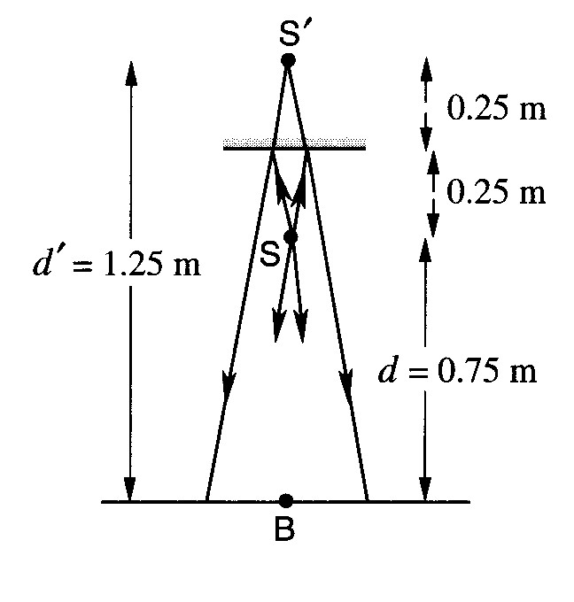
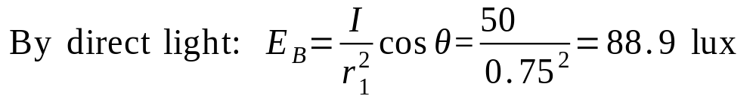
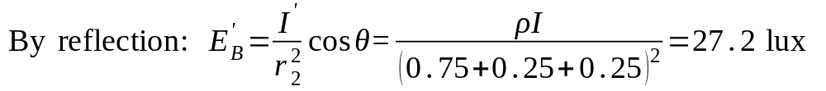
Photometry
Example:
A small 50 cd source which may be assumed to radiate uniformly in all directions, is placed 75 cm above a horizontal table, and a plane mirror is fixed horizontally 25 cm above the source. If the mirror reflects 85% of the incident light, calculate the illuminance on the table at the point vertically below the source.

Slide 15
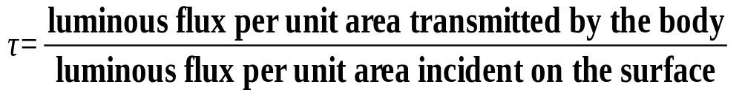
Photometry
Transmittance:
It depends on the nature and thickness of the substance. It may also depend on the wavelength of the light used.
Neutral substances: materials that display an almost constant transmittance across the whole visible spectrum.

Slide 16
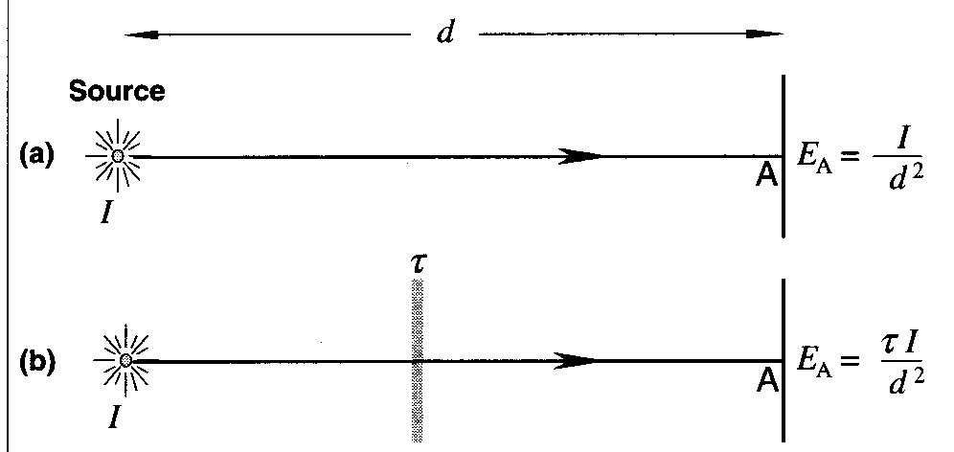
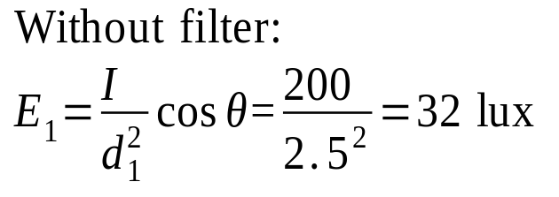
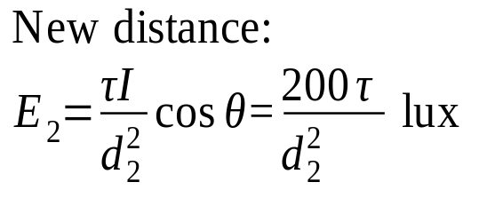

Photometry
Example:
A point light source of intensity 200 cd is 2.5 m from a screen. Calculate the illuminance on the screen for normal incidence. If a neutral filter of transmittance 45% is placed between the source and the screen, what is the new value of the illuminance? Where must the screen and filter be placed such that, with the above mentioned filter in place, and with normal incidence, the illuminance on the screen is restored to its original value?
With filter
E2 = 0.45 x 32 = 14.4

Slide 17

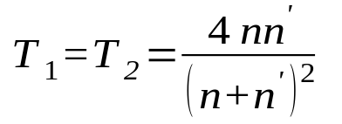
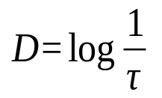
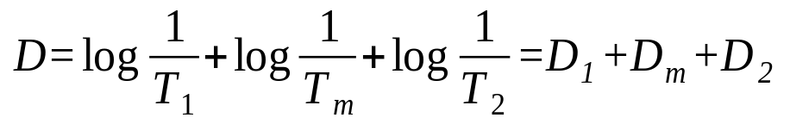
Photometry
Optical Density:
For a transparent plate:
If the material’s thickness has increased by a factor of N,
then the transmittance of the material is changed to (T_{m})^{N}.
Transmittance at two surfaces:
Optical density D of a substance is defined as,
The optical density of the sample is simply the sum of the optical densities of the surfaces and the stated material.
To find new optical density we can simply multiply the optical density D_{m} of the material by whatever factor that gives the new thickness.
N slices

Slide 18
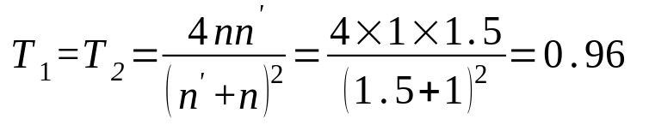
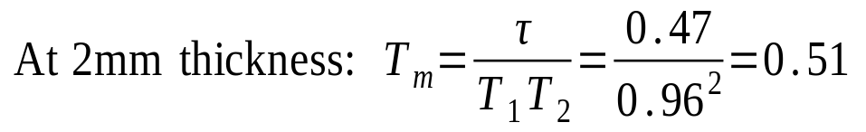
Photometry
Example:
At 2 mm thickness, a certain tinted glass has a transmittance for a specified wavelength of 0.47. Determine the transmittance at 4 mm and 5 mm thickness. n_{g}=1.5.

Slide 19
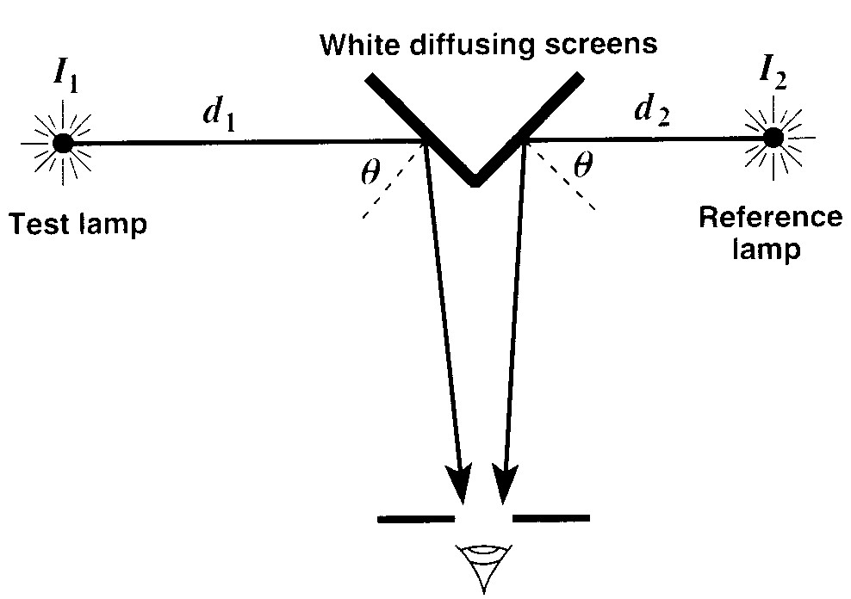


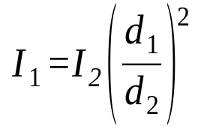
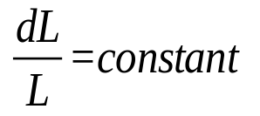
Photometry
Photometer (visual):
Principle: If two adjacent identical white reflecting surfaces appear to be equally bright when illuminated with two sources, then the surfaces will be receiving the same illuminance and the boundary between the surfaces will be difficult to see.
Illuminance on the left hand screen
Illuminance on the right hand screen
Weber-Fechner Law for human eye to judge the equality of brightness of two surfaces: If L is a value for the prevailing luminance of a surface and dL is the minimum noticeable increment, then

Slide 20
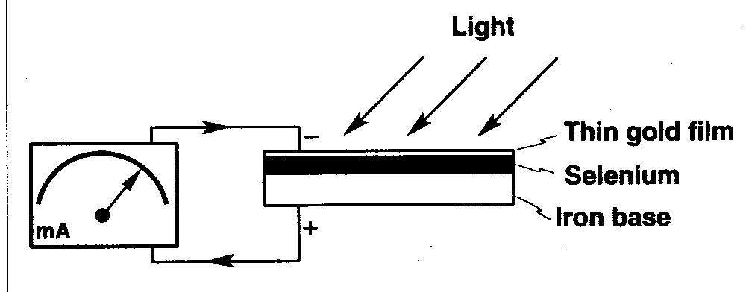
Photometry
Photometer (non-visual):
The non-visual (physical) photometers directly measure the illuminance falling on them. The most commonly used non-visual photometers are photovoltaic cells.
Due to the photoelectric effect, electrons are emitted from the selenium layer when light is incident on the cell. A thin transparent gold film is deposited on the top of Se-layer.

Slide 21
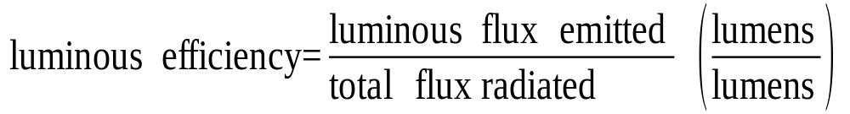
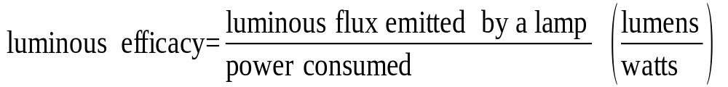
Photometry
Luminous Efficacy:
To describe the effectiveness of a source, two concepts are used:
Luminous efficiency indicates the fraction of total flux radiated that is actually visible.
Luminous efficacy is the fraction of the total consumed power that is used to emit the visible light. A large amount of energy can be wasted in the form of heat or infrared radiation.

Slide 22
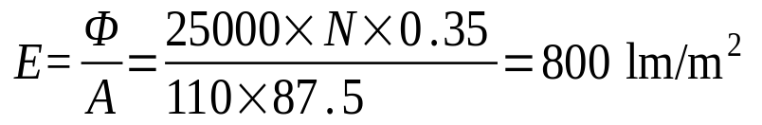

Photometry
Example:
A football pitch 110 m by 87.5 m is illuminated for evening matches by equal banks of 1000 W lamps supported on 16 towers, which are located around the ground to provide approximately uniform illuminance of the pitch. Assuming 35% of the total light emitted reaches the playing area and that an illuminance of 800 lm/m² is necessary for TV purposes, calculate the number of lamps. The luminous efficacy of each lamp may be taken as 25 lm/W.

Slide 23
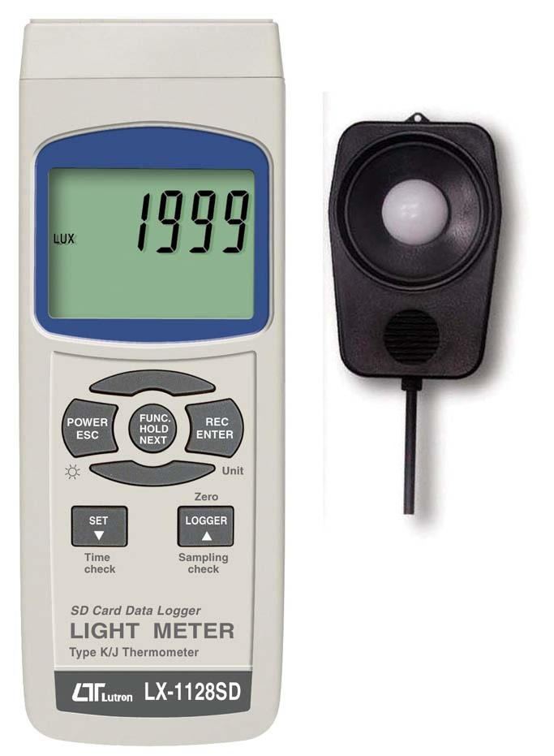
Lux meter
The lux is the SI unit of illuminance and luminous emittance, measuring luminous flux per unit area.
It is equal to one lumen per square metre.
In photometry, this is used as a measure of the intensity
As perceived by the human eye, of light that hits or passes through a surface. It is analogous to the radiometric unit watts per square metre, but with the power at each wavelength weighted according to the luminosity function, a standardized model of human visual brightness perception.

Slide 24
Tugas
Photometry & Radiometry
Kerjakan di buku Catatan anda
Jelaskan perbedaan fotometri dan radiometri beserta kuantitas dan unit satuannya.
Bandingkan laser pointer 5 mW dengan 670 dan 635 nm (diameter beam sama). Berapa lumen output keduanya dan apa kesimpulan saudara ( λ vs brightness).
Hint: Gunakan table 18.4 HOE atau pendekatan untuk mencari V(λ).

