Slide 1
INTERFERENCE

Slide 2

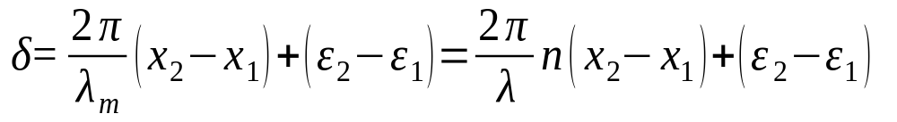

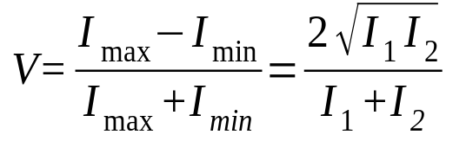
Interference
Conditions for Interference:
(i) (ε₂−ε₁) must remain constant with time. (ii) (x₂-x₁) should not exceed the wave-train length.
Visibility:
Interferometer:
An instrument designed to exploit the interference of light and the fringe patterns that result from optical path differences. An interferometer divides an initial beam into two or more parts that travel diverse optical paths and then reunite to produce an interference pattern. According to the manner in which the initial beam is separated, interferometers can be broadly classified as wavefront division interferometers (divide the same wavefront of a coherent beam of light) and amplitude division interferometers (divide the initial beam into two parts).

Slide 3
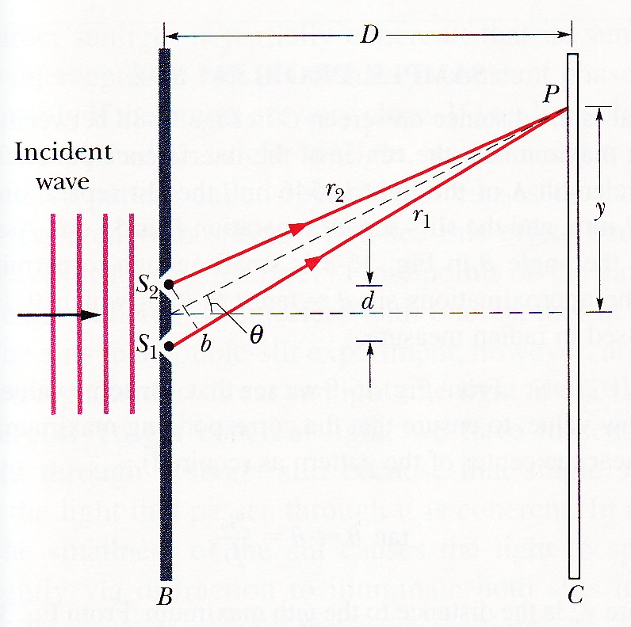
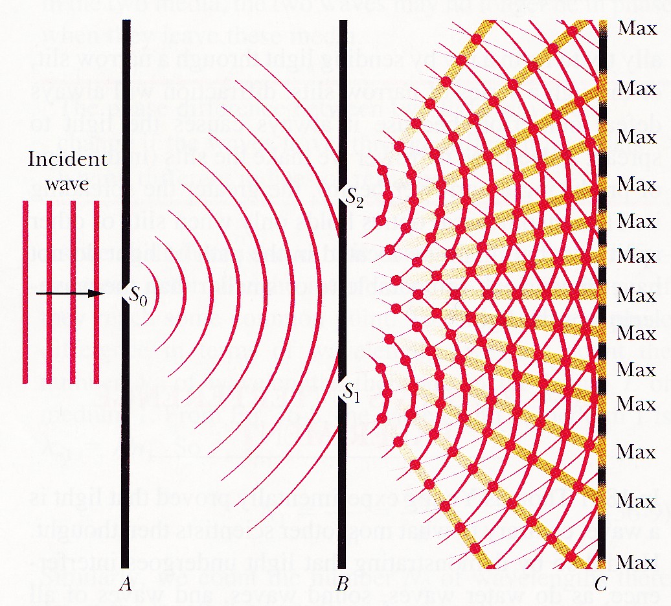
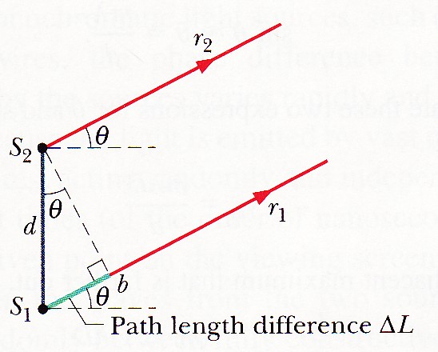

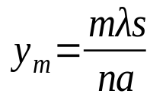
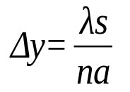
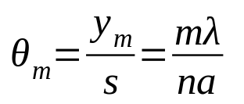
Interference
Young’s Double Slits:
s
a
The waves from S₀ illuminate the slits S₁ and S₂ which act as coherent secondary sources. Each wavefront is split and since the phase difference is constant for waves arising from S₁ and S₂.
a

Slide 4
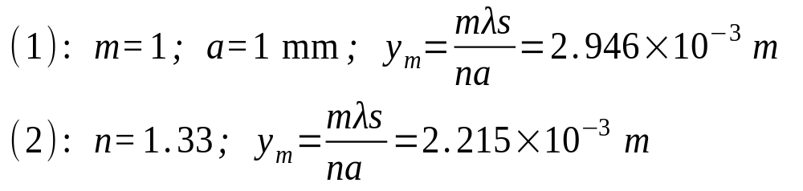
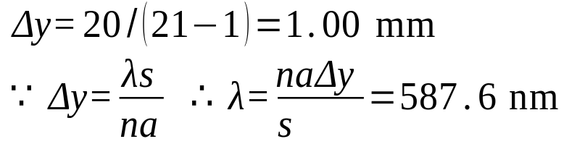
Interference
Example:
The slits S₁ and S₂ in Young’s experiment are 1 mm apart (center to center) and the screen placed such that s = 5 m. If the incident light has a wavelength λ = 589.3 nm and the system is in air, n = 1.00029, find the distance of the first bright fringe form the central bright fringe. If the system is immersed in water, n = 1.33, what will be the result?
Example:
Helium yellow light illuminates two slits, separated by 2.644 mm, in a Young’s experimental set-up. If 21 bright fringes occupy 20 mm on a screen 4.5 m away, calculate the wavelength. Assume the refractive index of air is 1.

Slide 5
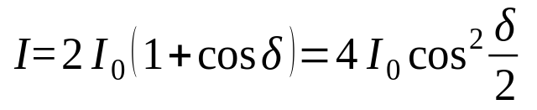
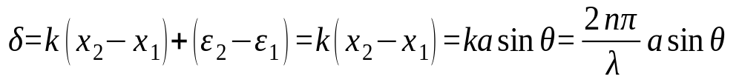
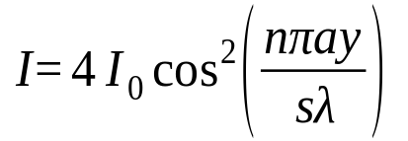
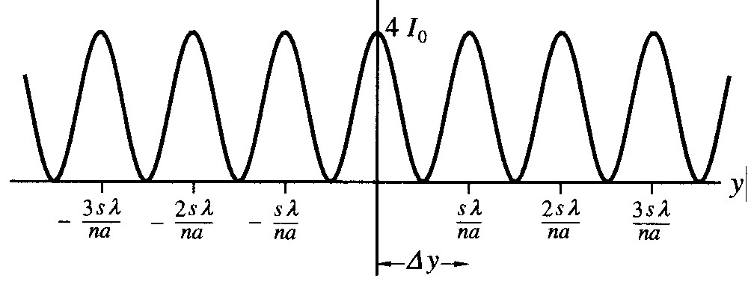
Interference
Intensity Distribution:
In Young’s experiment, the intensities of the two rays arriving at point P can be regarded as the same. I₁=I₂=I₀,

Slide 6
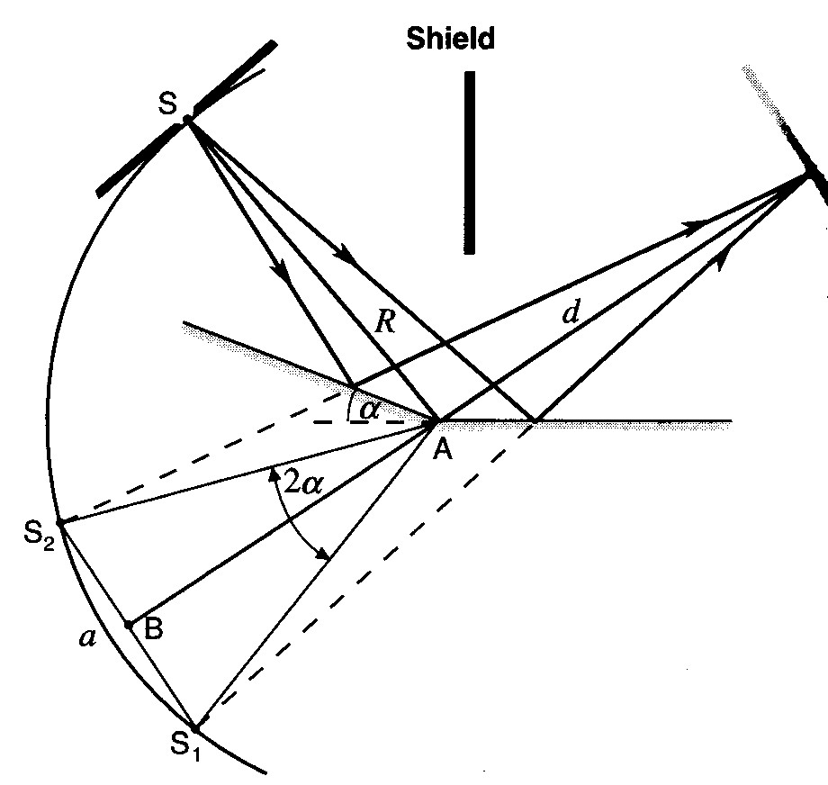
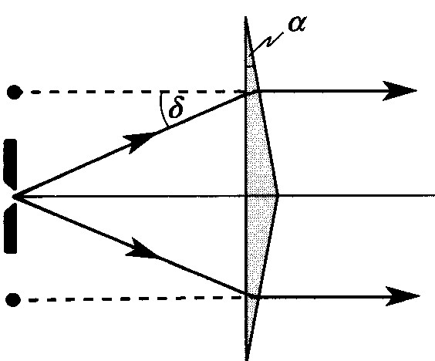
Interference
Fresnel Double mirror interferometer:
The two coherent secondary sources, S₁ and S₂, are formed by reflections in the mirror. The arrangement is then identical to the Young’s double-slit geometry with s=R+d, a=2Rα.
Fresnel’s biprism:
The apical angle α is about 0.5°. Light reaching the screen appears to come from the two coherent secondary sources S₁ and S₂, formed by the biprism. The arrangement is then identical to the Young’s double-slit geometry with s=R+d, a=2Rδ=2R(n_{g}/n-1)α.
s
R
d

Slide 7
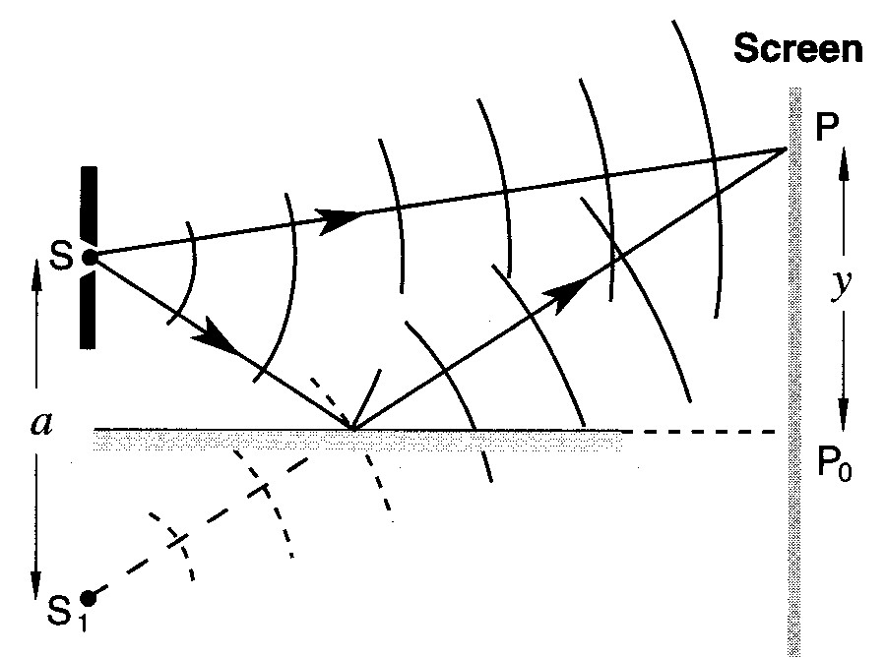
Interference
Lloyd’s Mirror:
Lloyd’s mirror provides a coherent secondary source S₁ (formed by reflection from the mirror) from which light reaches the screen to interfere with light reaching the screen directly from S. A hidden phase change of π occurs upon reflection, and this corresponds to a λ/2 path length change which must be included in calculations.
d
Determination of the Central Bright Fringe:
When a white light is the source for the Young’s double-slit experiment, the fringe width will be different for different wavelength, except for the central fringe which will appear white. All the other positions will exhibit a mixture of color. The central white fringe can be helpful to locate the position of the central fringe.

Slide 8
Interference
Example:
A Fresnel double mirror is used with the source slit at 1 m from the mirror intersection A. When the screen is 4 m distant and λ=500 nm, the fringe width (separation) is 2 mm. Find the angle between the mirrors.

Slide 9
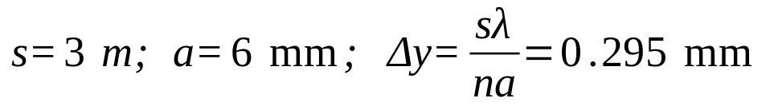
Interference
Example:
Lloyd’s mirror is used with sodium light (λ=589.3 nm) and the slit placed 3 mm above the reflecting surface and 3 m from the screen. Find the position of the first bright fringe above the level of the reflecting surface.
A dark fringe occurs at the level of the reflecting surface.
The first dark fringe is 0.295 mm above the level of the reflecting surface.

Slide 10
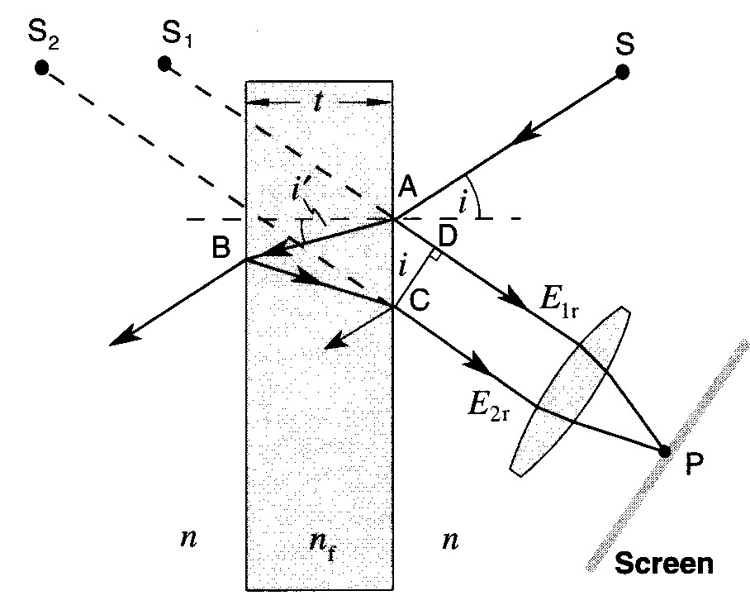
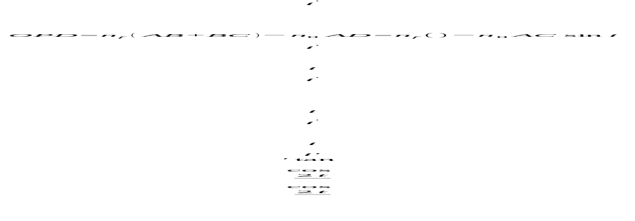



Interference
Dielectric Thin Films:
The optical path difference for the first two emergent beams is,
The conditions for constructive interference is
The condition for destructive interference is

Slide 11
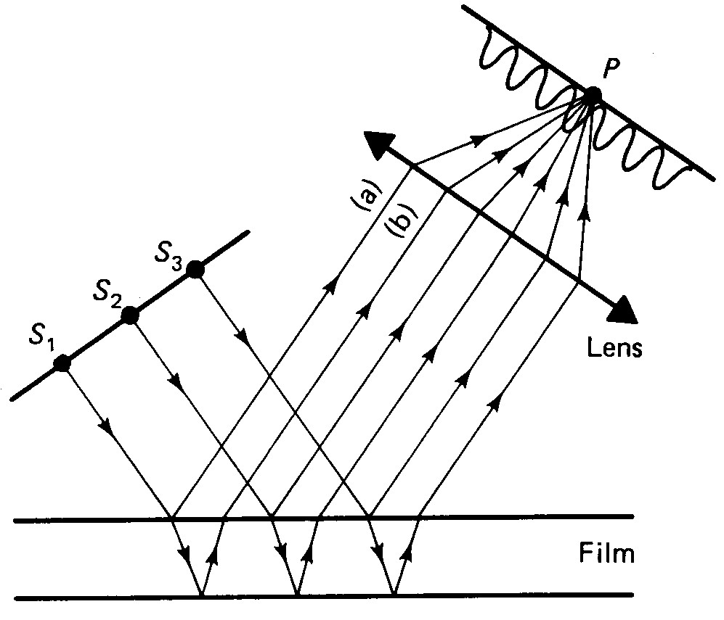

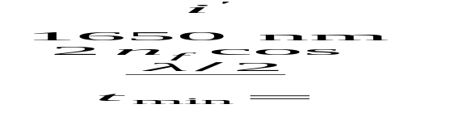
Interference
Fringes of Equal Inclination:
They are formed by parallel incident beams from an extended source. Fringes of equal inclination are focused by a lens.
Example:
Red light from a hydrogen discharge lamp, λ=656.28 nm, is incident at 30° on a thin film of refractive index 1.5. What is the minimum thickness of film if an intensity maximum is to be observed?

Slide 12
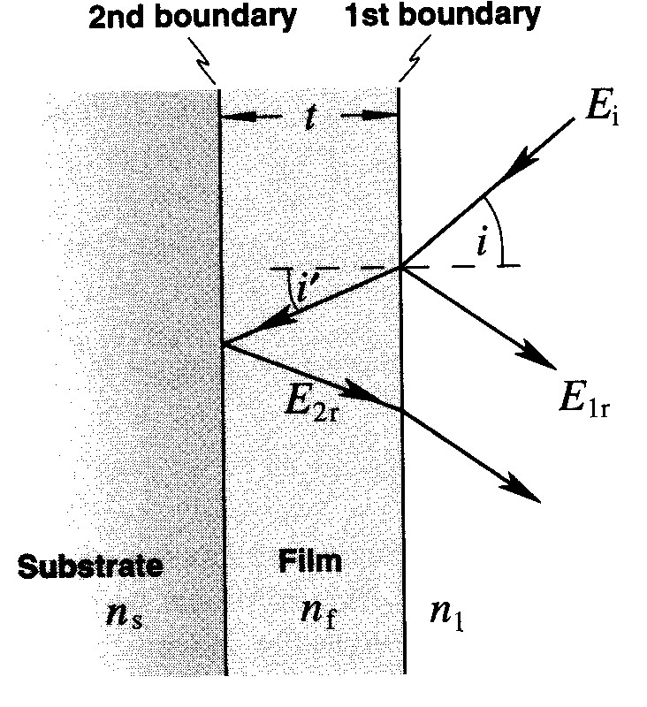

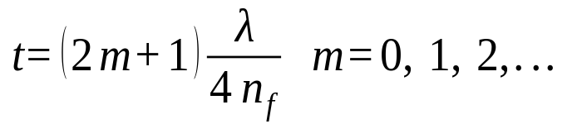

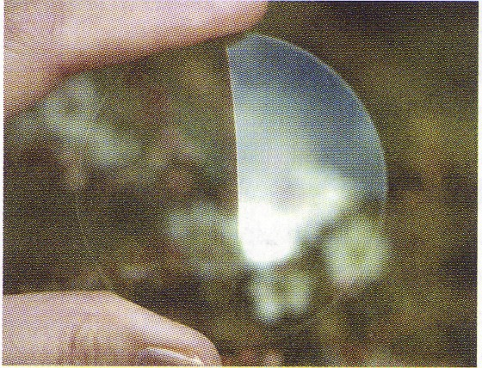
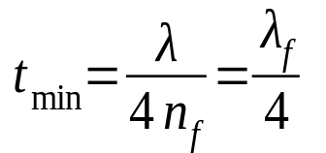
Interference
Antireflection Coating:
Suppose now the film is on a substrate, if n_{s}>n_{f}>n₁, then both E_{1r} and E_{2r} will have a phase shift π at the interface due to the external reflection. For normal incidence, the condition (path condition) for destructive interference will be,
amplitude condition:
The minimum thickness single layer antireflection films are often referred to as quarter-wavelength films.

Slide 13
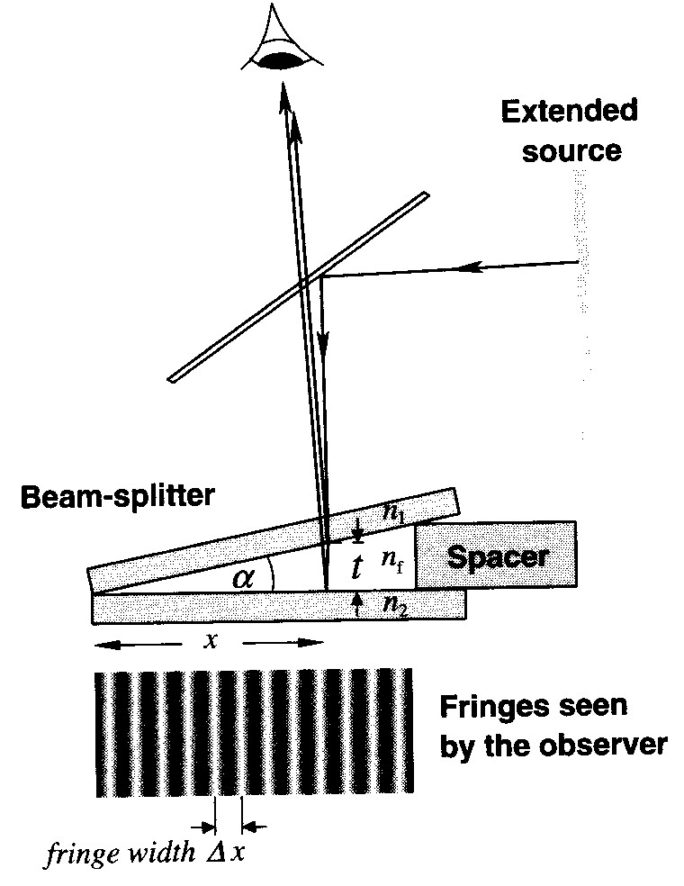
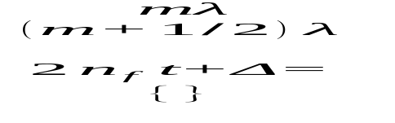
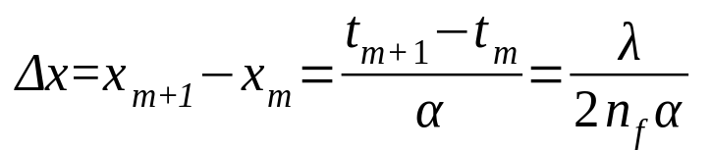
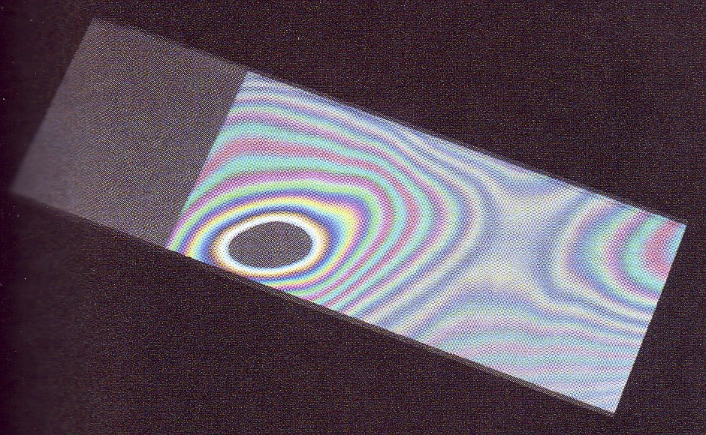
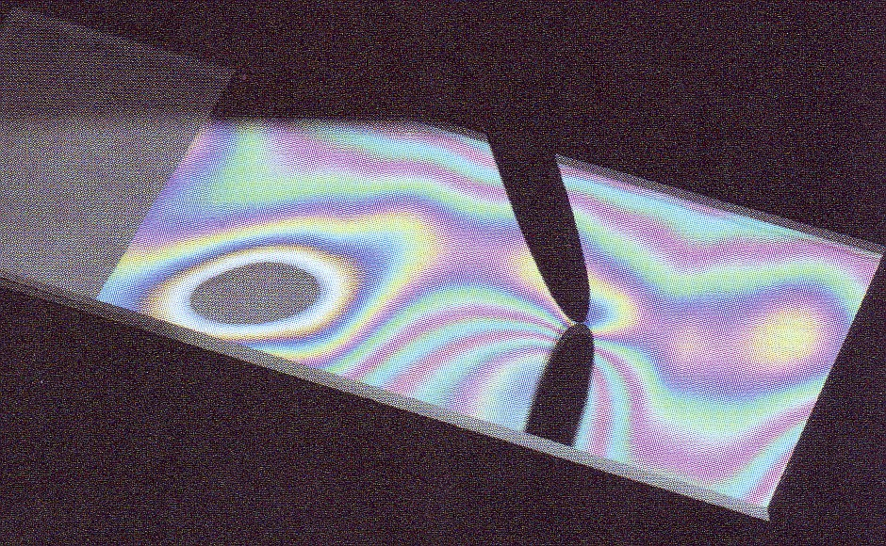
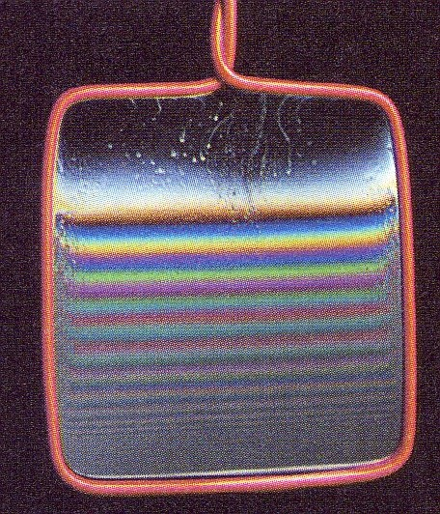
Interference
Fringe of Equal Thickness:
Interference from a wedge-shaped dielectric film, producing localized fringes of equal thickness.
bright fringes
dark fringes
For small wedge angle α, the fringe width is,

Slide 14
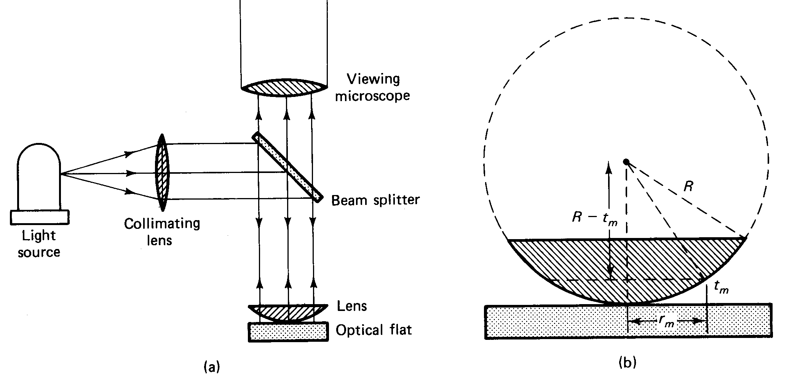
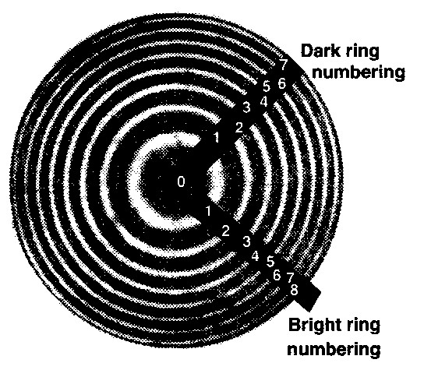
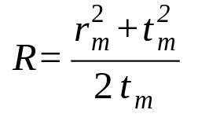


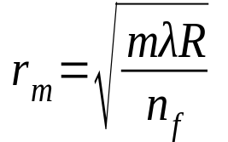
Interference
Newton’s Ring:
The Newton’s ring is formed by an air wedge between the spherical surface and an optically flat surface. Equal-thickness contours are concentric circles around the point of contact with the optical flat
For r_{m}>>t_{m}, The radius of the mth order of the dark fringe is

Slide 15
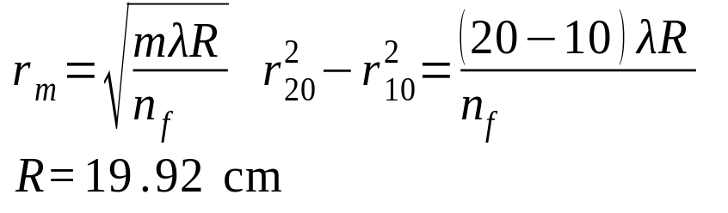
Interference
Example:
In an experiment the Newton’s rings apparatus is illuminated with the green light from a mercury lamp, λ=546.1 m. If the diameters of the 10th and 20th dark rings are 2.10 mm and 2.96 mm, respectively, calculate the radius of curvature of the convex surface. Assuem n_{f}=1.

Slide 16
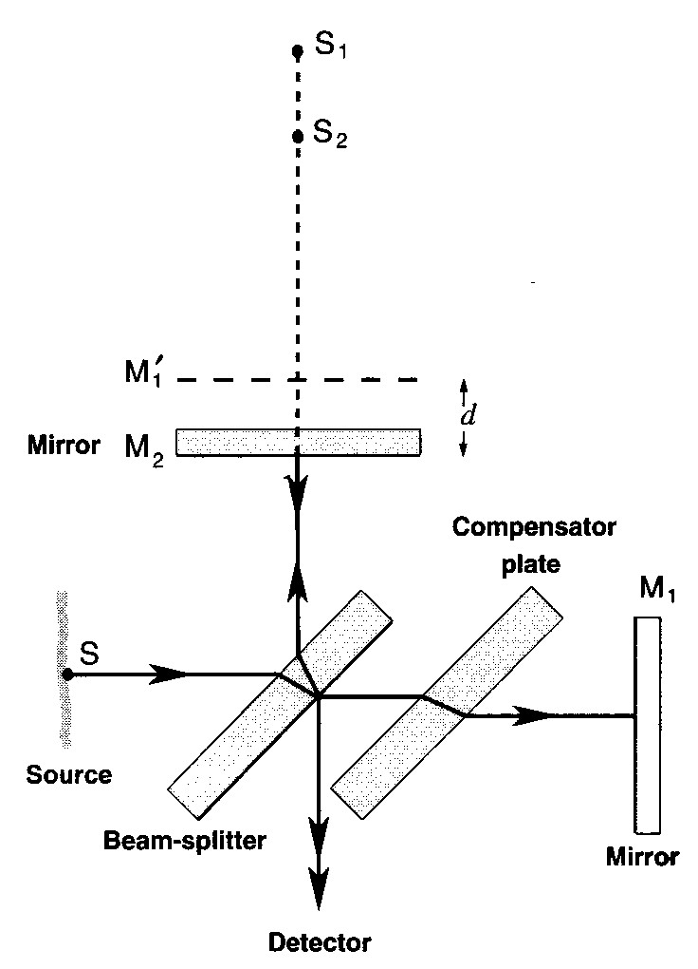
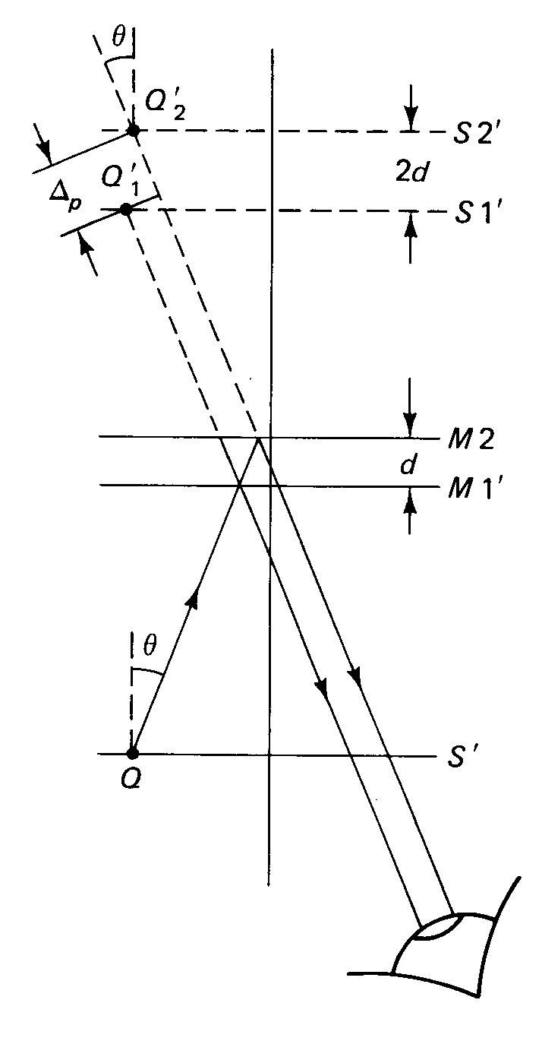
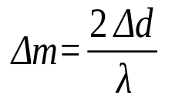

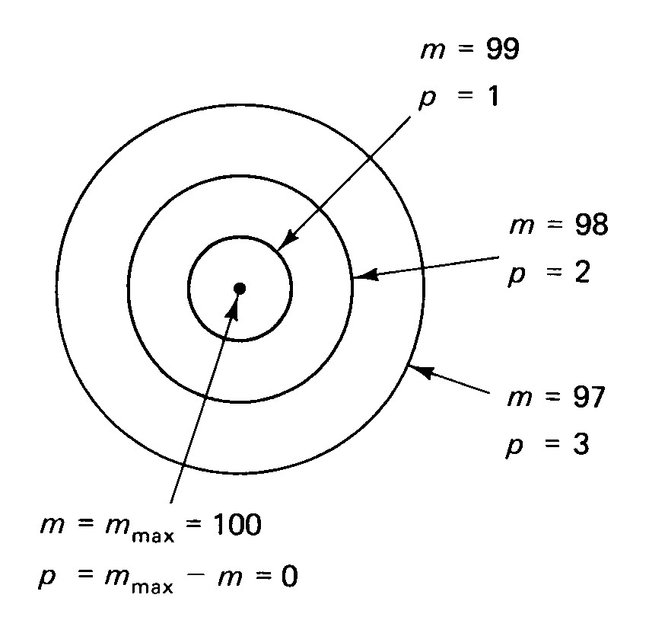
Interference
Michelson Interferometer:
With increasing d, the fringe pattern appears to expand outward from the center, where they seem to originate. With decreasing d, the fringe pattern appears to shrink toward the center, where they seem to disappear.

Slide 17
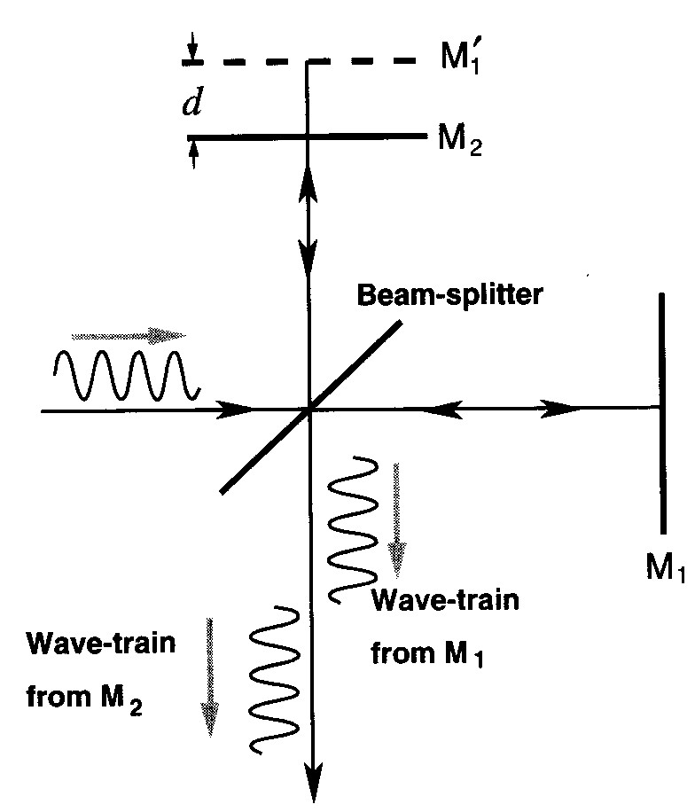
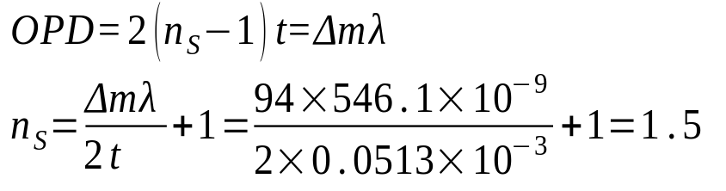
Interference
Coherence:
The OPD must not exceed the coherence length (the wave-train length) if interference is to occur. The Michelson interferometer can thus be used to determine the length of wave-train.
Example:
Suppose a thin sheet of glass of refractive index n_{s} is inserted in one arm of a Michelson interferometer which is illuminated by mercury light, λ=546.1 nm. If 94 fringes are displaced when the sheet is inserted, find its refractive index if the thickness is 0.0513 mm.

Slide 18

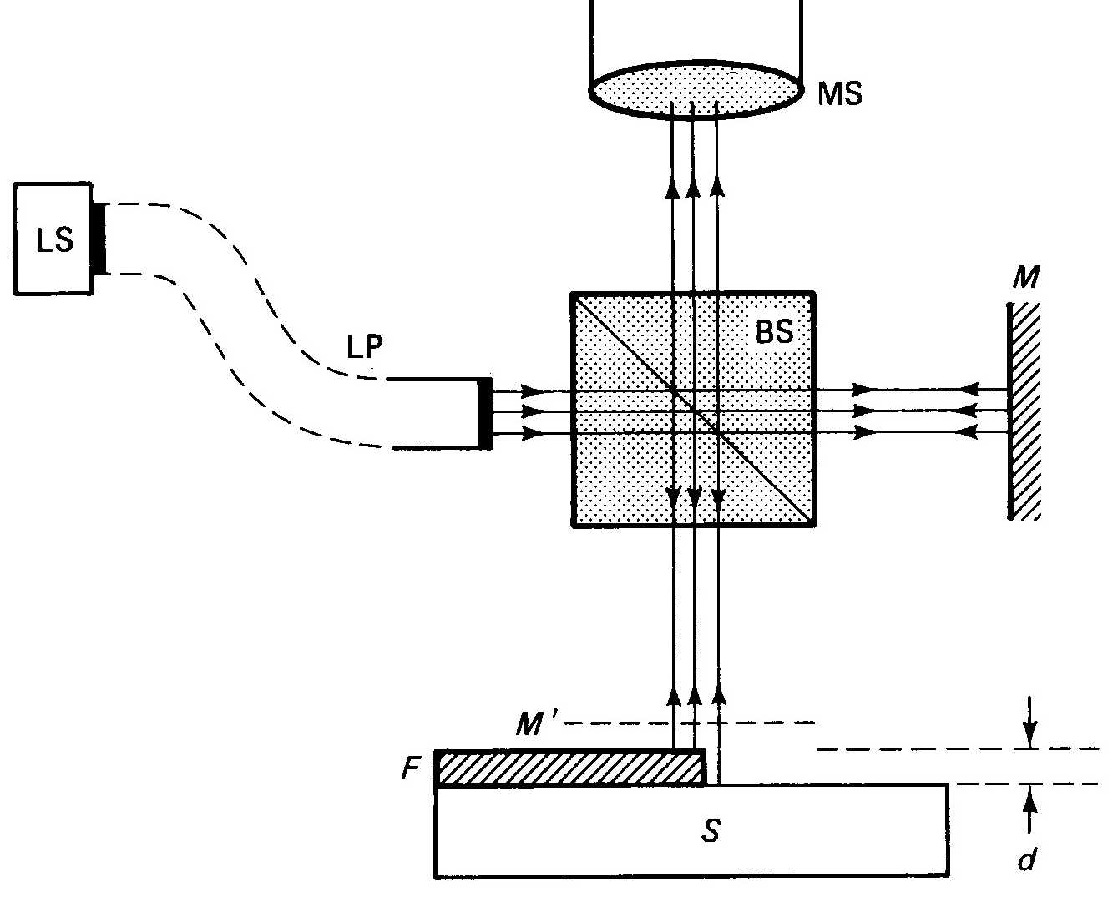


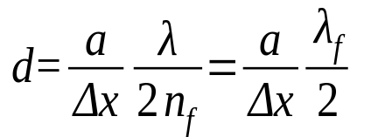
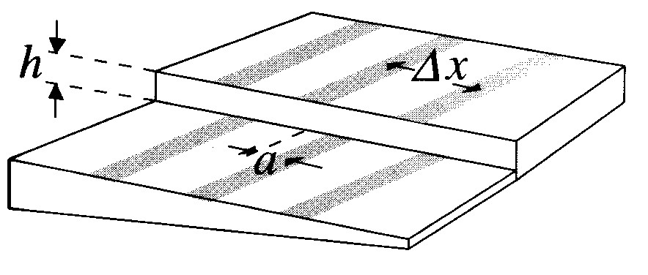
Interference
Film Thickness Measurement:
For normal incidence,
If the air-film thickness changes by Δt=d, the order of interference m changes accordingly,
For a shift of fringes of magnitude a, the change in m is given by
d

Slide 19
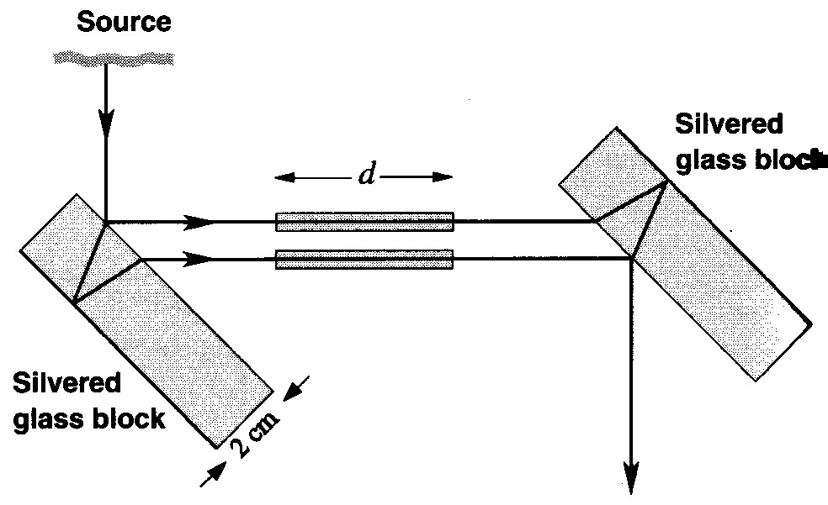
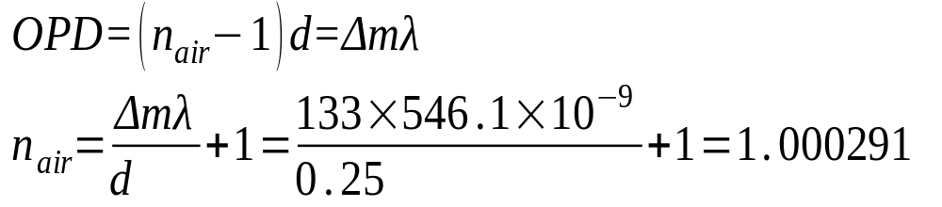
Interference
Example:
The figure shows the Jamin interferometer with two identical chambers placed in the paths of the interfering beams. The inner lengths of the chambers are 25 cm and a mercury source, λ=546.1 nm, illuminates the system. If both chambers are evacuated and air is allowed to slowly fill one of them, the observer sees 133 fringes sweep by a cross-line hair in the focal plane of the telescope objective. Find the refractive index of the air in the chamber.

Slide 20
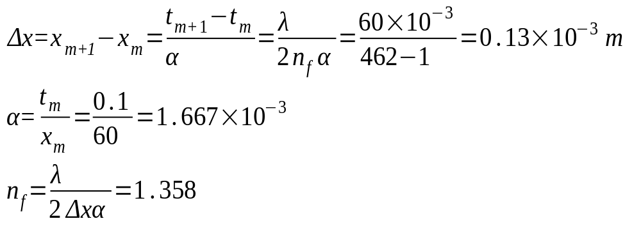
Interference
Example:
A thin wedge of transparent liquid is formed between two flat glass plates. The spacers is a hair 0.1 mm in diameter placed 60 mm from the apex of the wedge and lying at the center of a dark fringe. If there are 462 dark fringes from the apex to the spacer, calculate the refractive index of the film when sodium light, λ=589.3 nm, is used for the illumination.

