Slide 1

Study case of (Audio) AI research for Healthcare and Well-being
Bagus Tris Atmaja
Email: bagus.tris@naist.ac.jp
version 2026/6/5

Slide 2
Overview
AI, Deep Learning, Machine Learning
Healthcare and Well-being
My research on voice technology for healthcare and well-being:
  Pathological Detection
  Cough segmentation
  TB classification
  Dementia prediction
Demo (Scikit-learn, Pandas, SHAP)

Slide 3
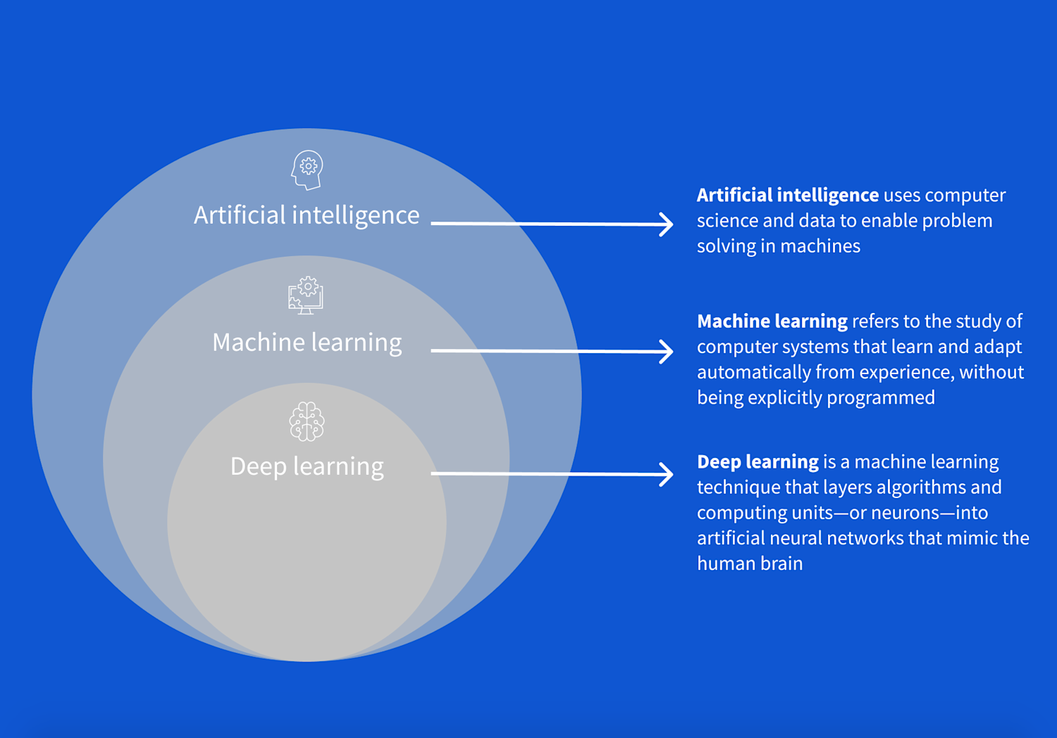
AI, ML, DL
https://www.coursera.org/articles/ai-vs-deep-learning-vs-machine-learning-beginners-guide

Slide 4
Healthcare and well-being
Healthcare → improvement or maintenance of health via the prevention, diagnosis, treatment, rehabilitation, and palliative care (easing suffering)
Physical
Healthcare
Mental → Well-being
Well-being: a complex state of feeling good about life, encompassing physical,
mental, emotional, and social health factors
Healthcare
Well-being

Slide 5
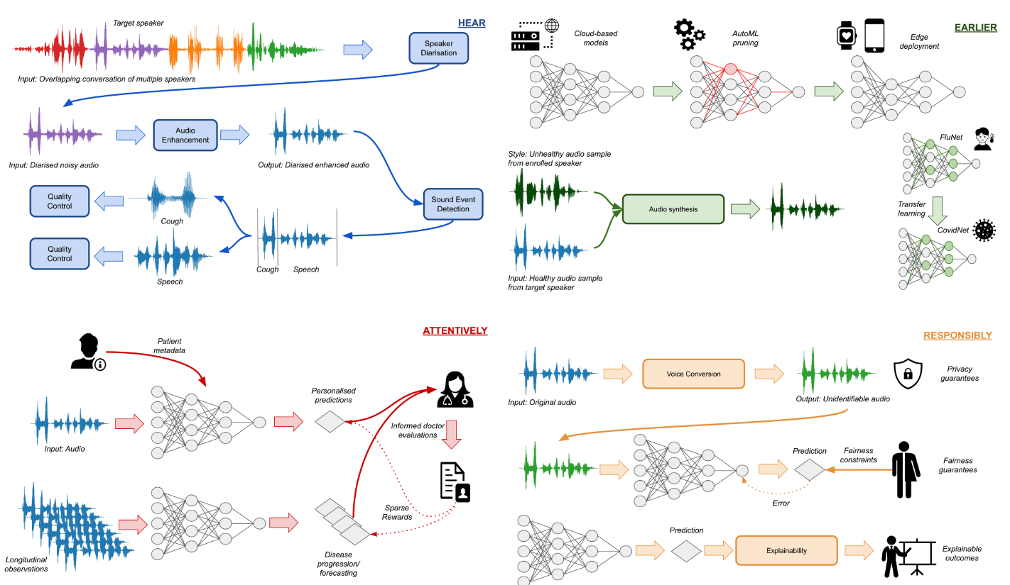
Four Pillars of Healthcare Audio AI (Andreas et al., 2023)
Physical

Slide 6
Research on audio-based healthcare and well-being
Speech Emotion Recognition
COVID-19 Detection
Cough Segmentation
Depression Detection
Laughter classification (happy vs. evil laughter)
Pathological speech detection
Dementia prediction
TB detection

Slide 7
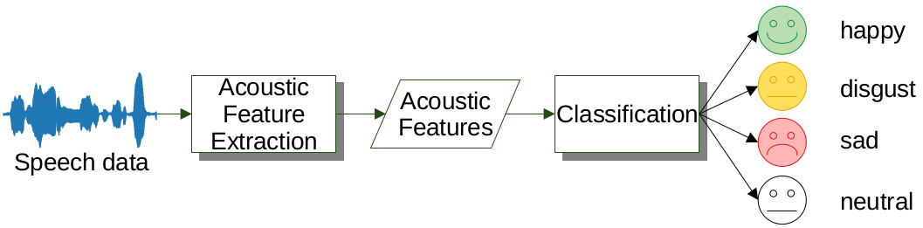
Typical Workflow
Acoustic embedding
correlate to disease?
Model suited for disease?
Dataset
Positive
Negative
+Visual,
Linguistic
Features?
Pre-processing/
post processing?
Feature
Selection?
Loss function,
regression
Can be multiclass

Slide 8
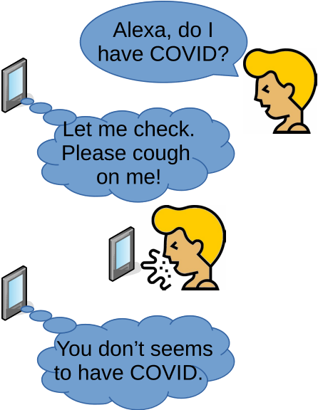
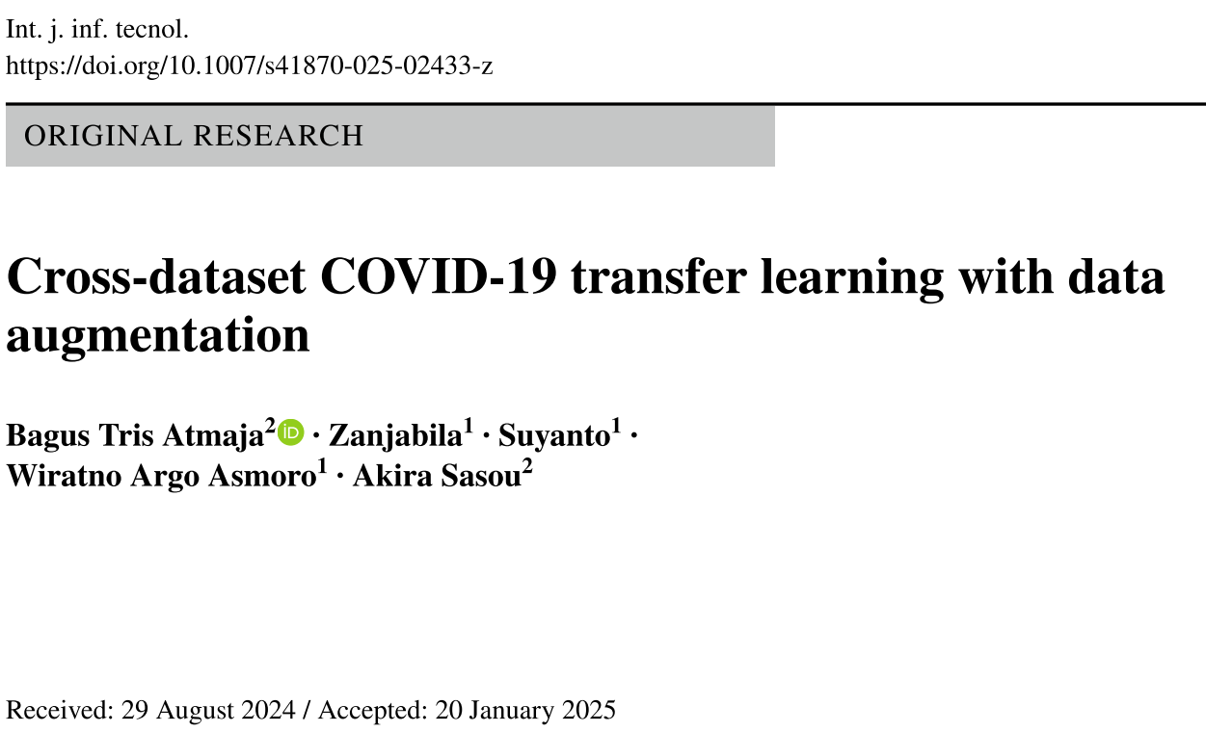
COVID-19 Detection
Atmaja, B. T., Zanjabila, Suyanto, Asmoro, W. A., & Sasou, A. (2025). Cross-dataset COVID-19 transfer learning with data augmentation. International Journal of Information Technology. https://doi.org/10.1007/s41870-025-02433-z

Slide 9
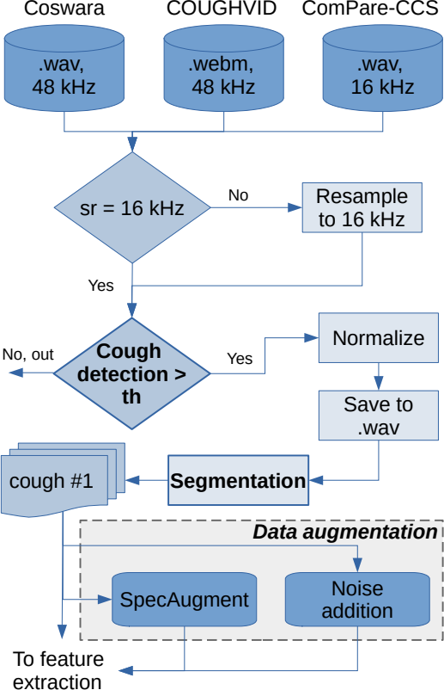
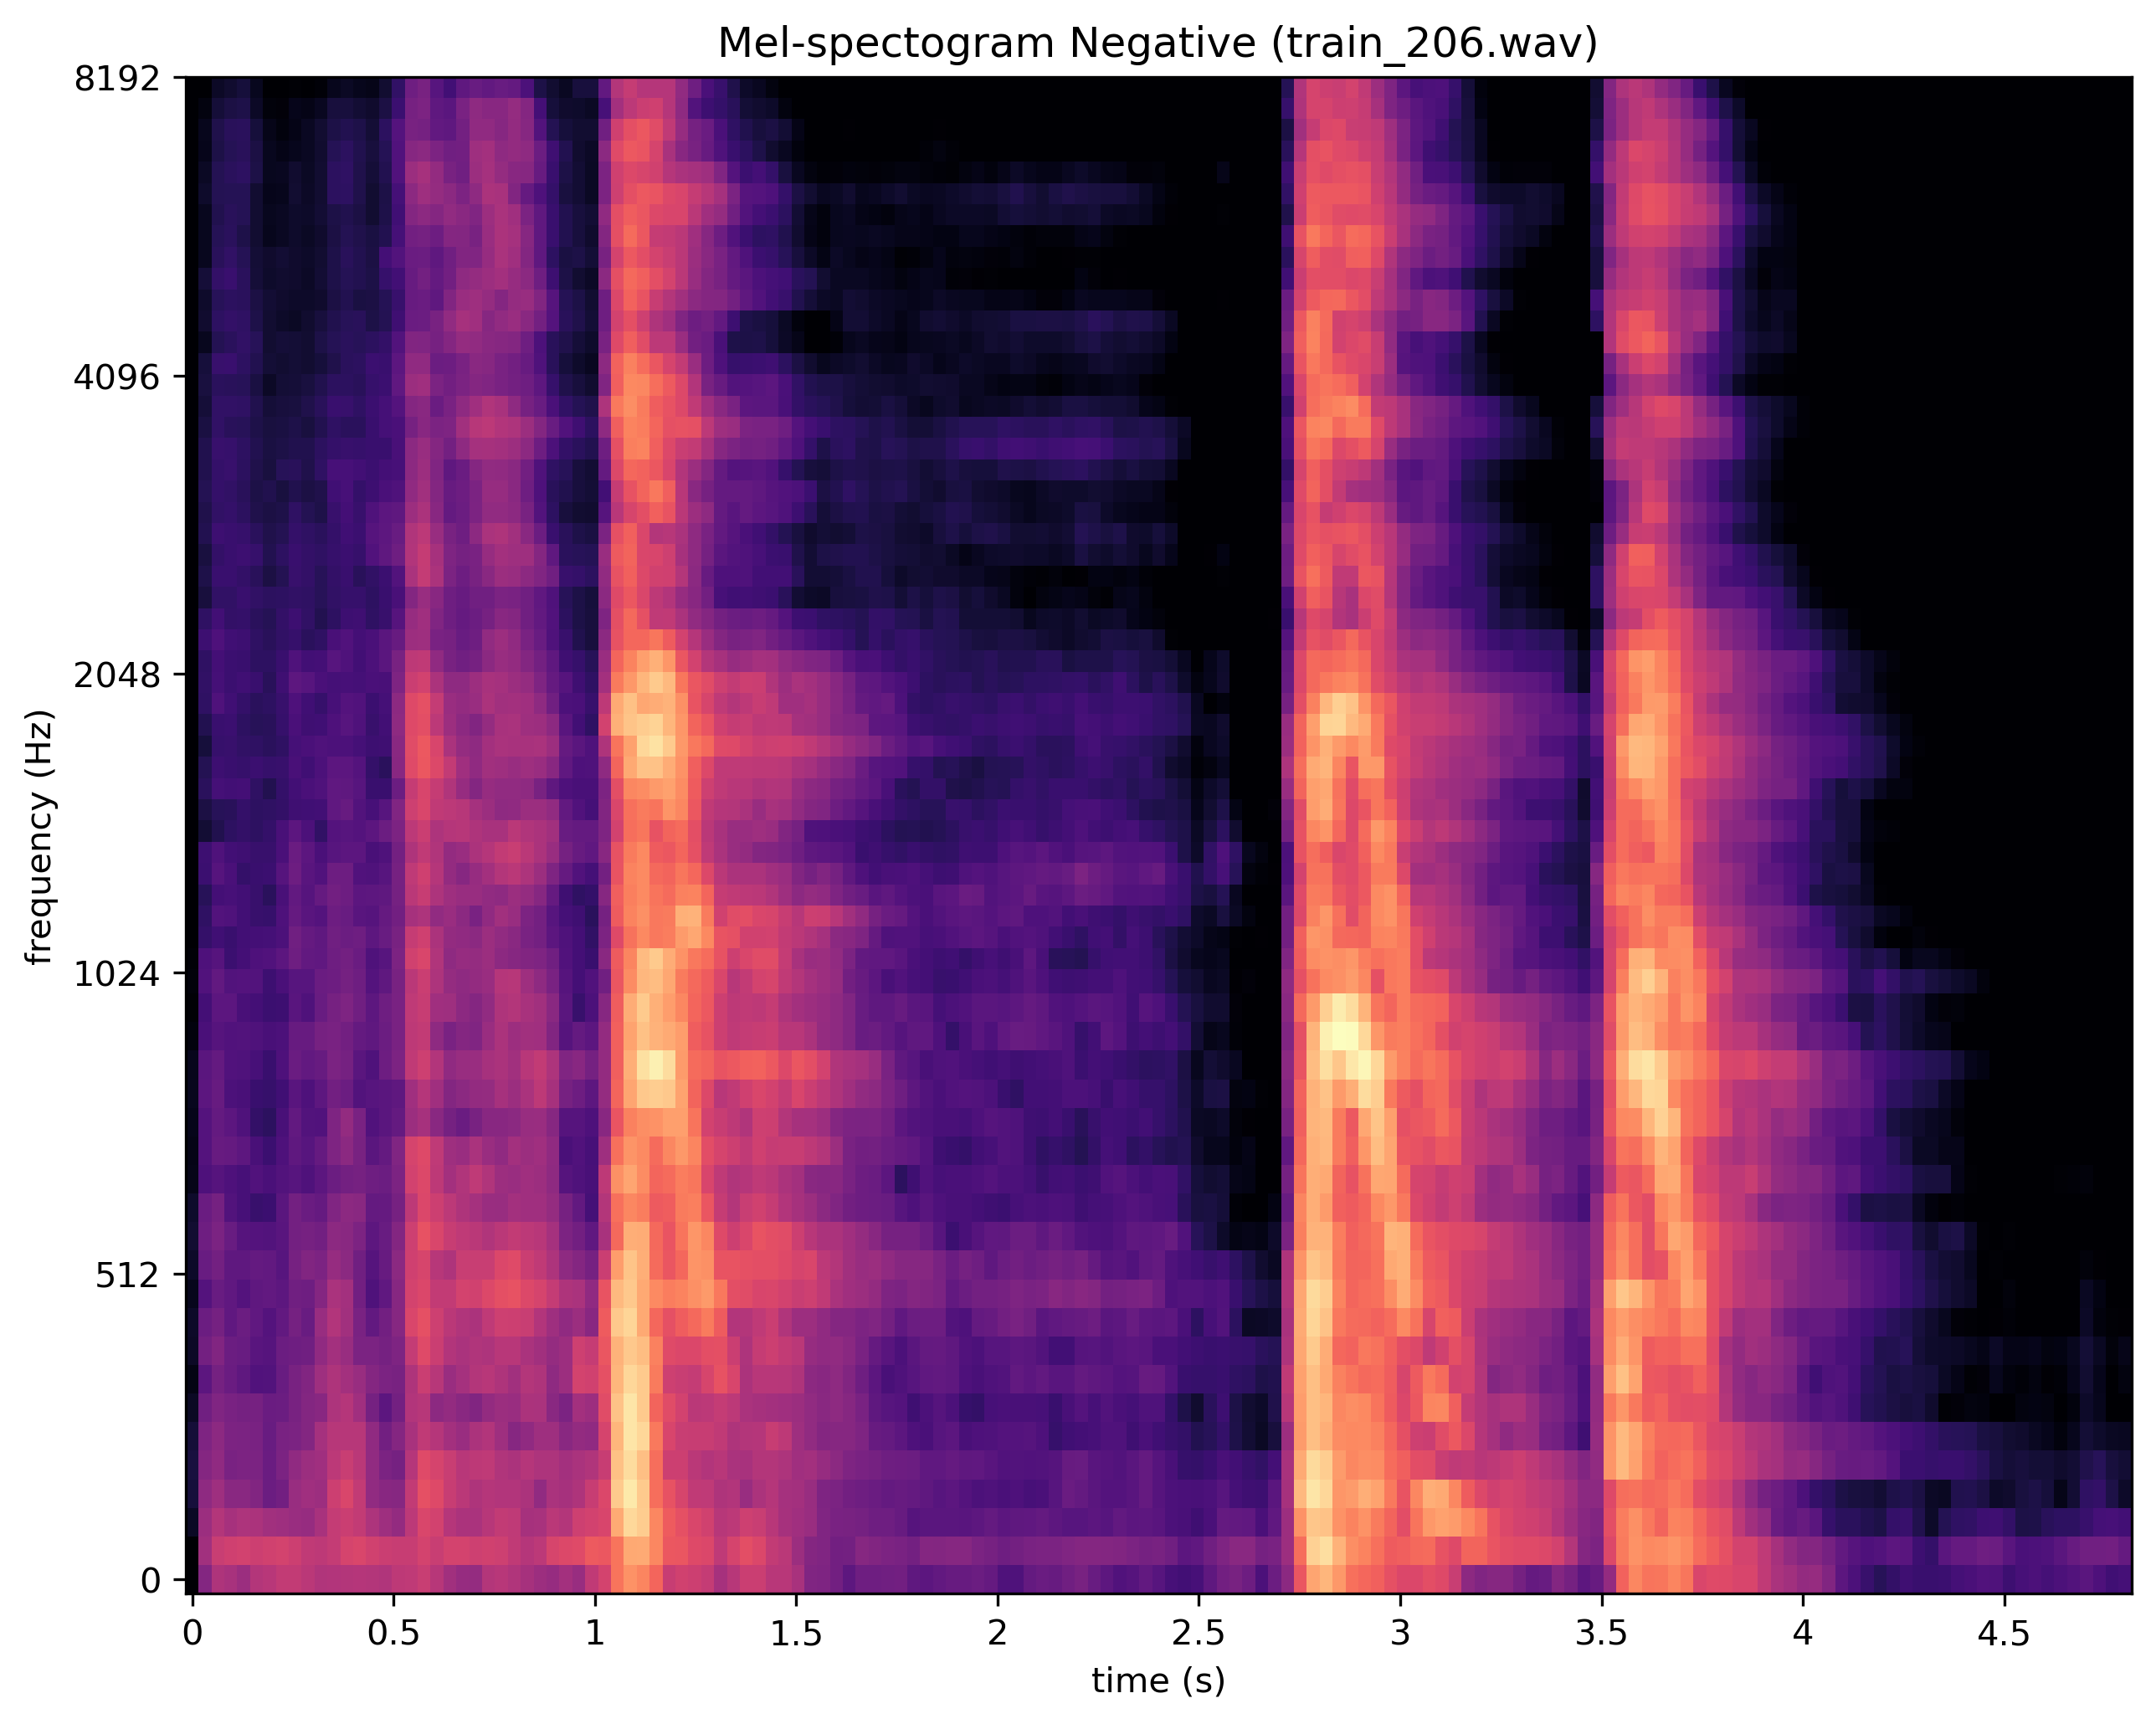
Acoustic Feature Extraction

Slide 10
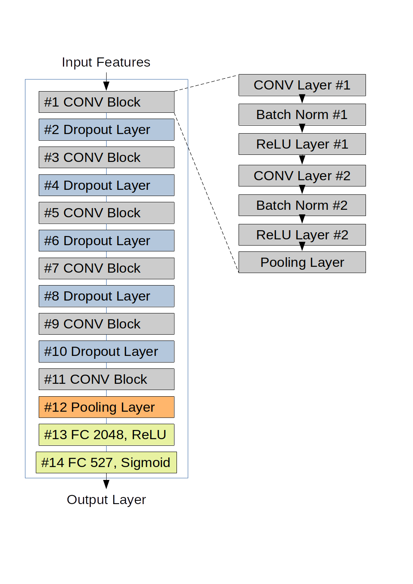
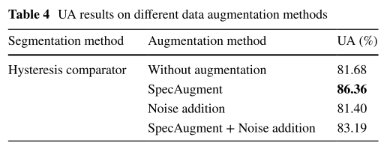
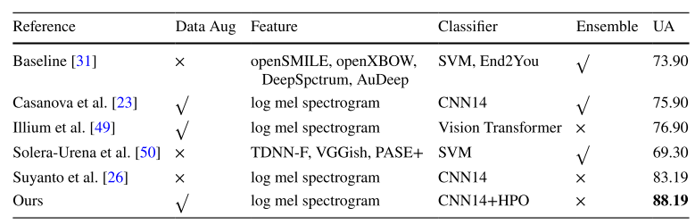
COVID-19 detection result

Slide 11
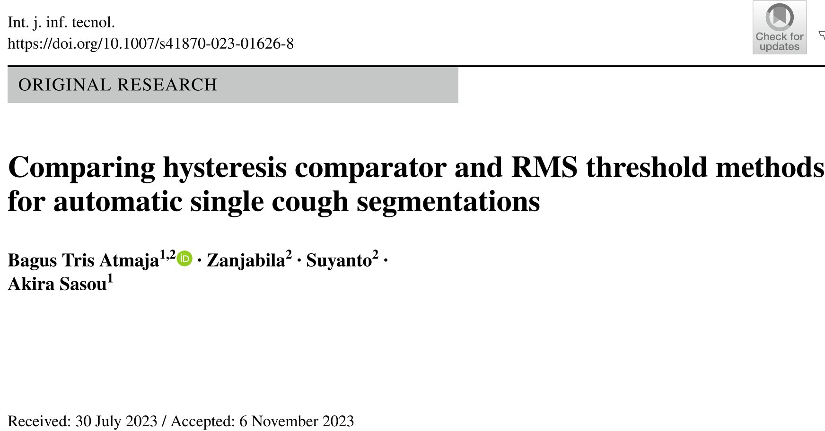
Cough Segmentation
Atmaja, B. T., Zanjabila, Suyanto, & Sasou, A. (2023). Comparing hysteresis comparator and RMS threshold methods for automatic single cough segmentations. International Journal of Information Technology, 0123456789.

Slide 12
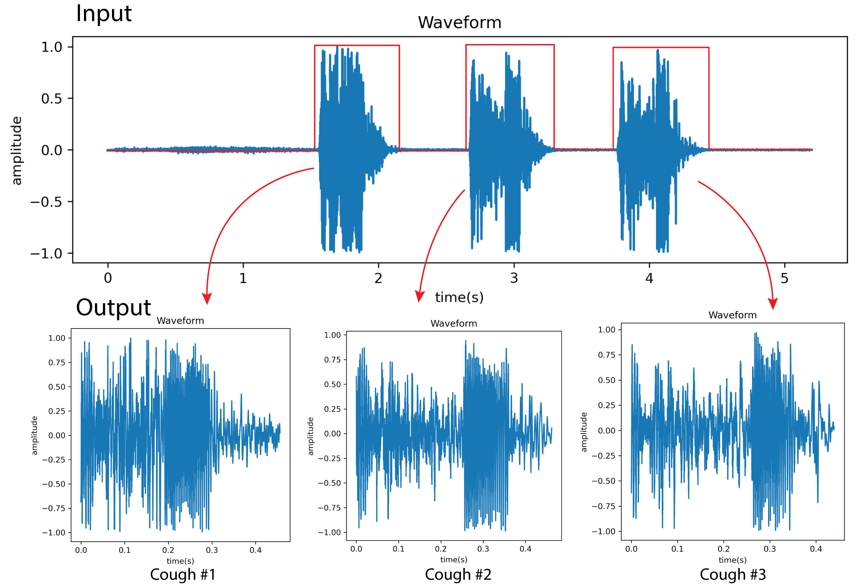
Cough Segmentation
Segmenting multiple cough into individual cough
Application: cough counter (e.g., per hour)

Slide 13
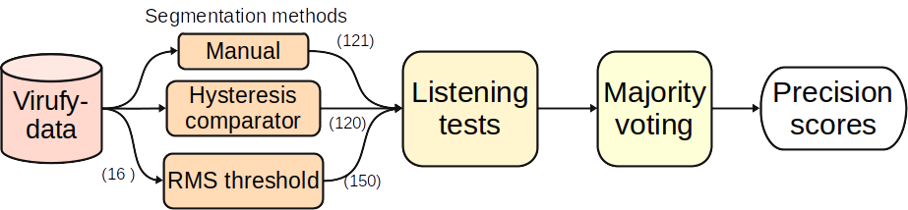


Cough Segmentation result

Slide 14
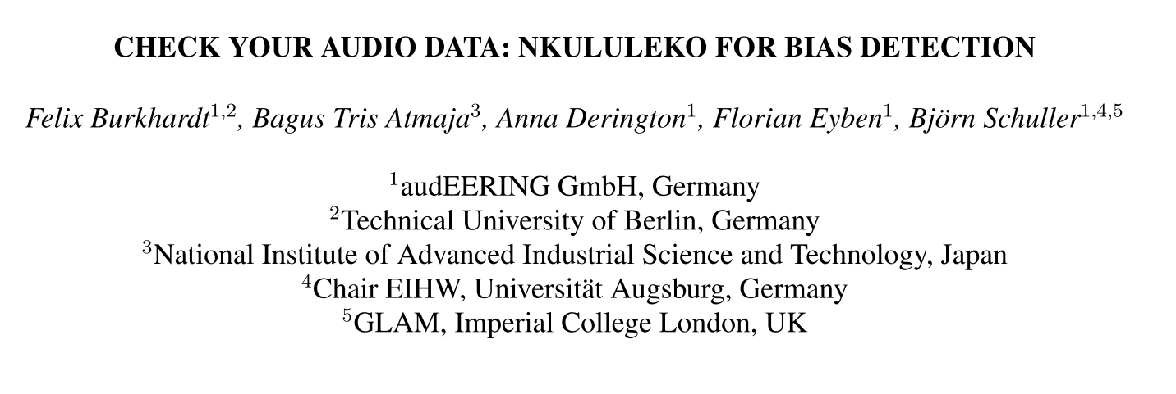
Depression Detection
Burkhardt, F., Atmaja, B. T., Derington, A., & Eyben, F. (2024). Check Your Audio Data : Nkululeko for Bias Detection. Oriental COCOSDA, 1–6. https://doi.org/10.1109/O-COCOSDA64382.2024.10800580

Slide 15
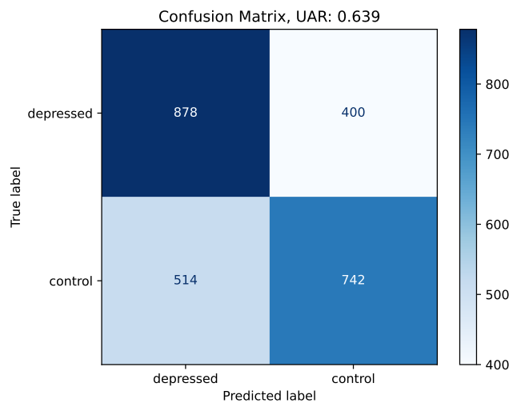
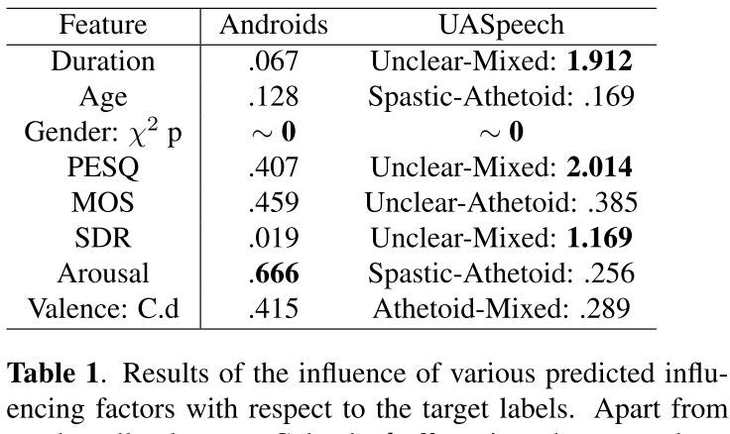
Depression Detection

Slide 16
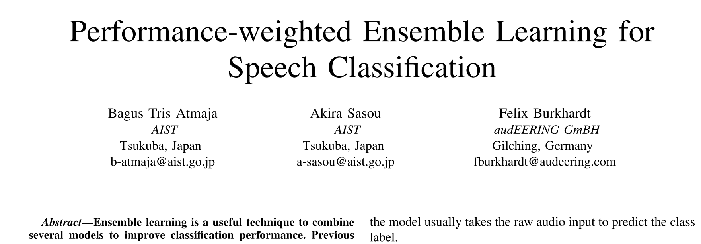
Laughter Classification
Atmaja, B. T., Sasou, A., & Burkhardt, F. (2025). Performance-Weighted Ensemble Learning for Speech Classification. 2025 International Conference on Artificial Intelligence in Information and Communication (ICAIIC), 0044–0048. https://doi.org/10.1109/ICAIIC64266.2025.10920862

Slide 17
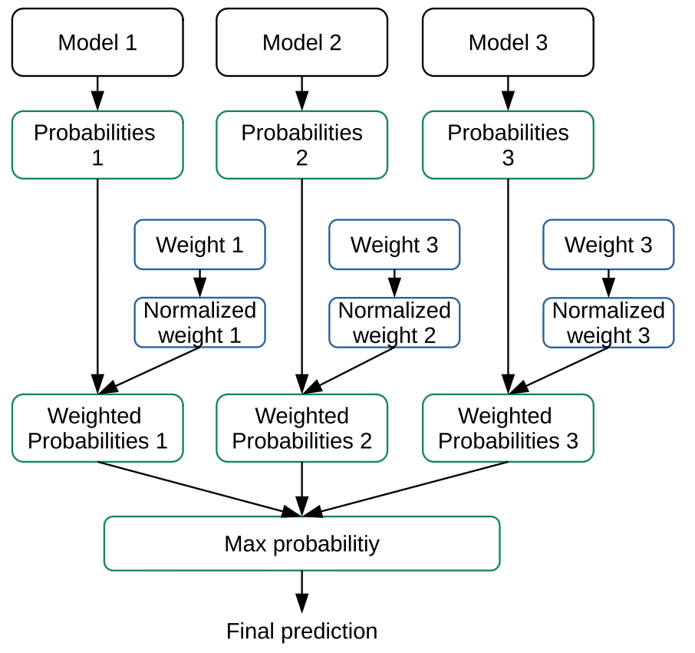
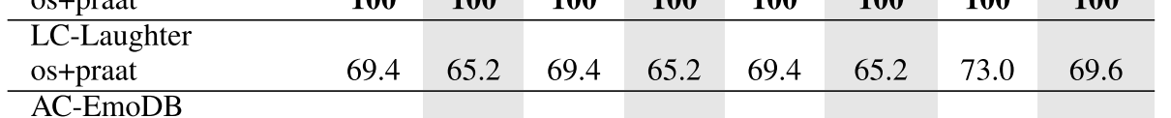
Laughter classification results

Slide 18
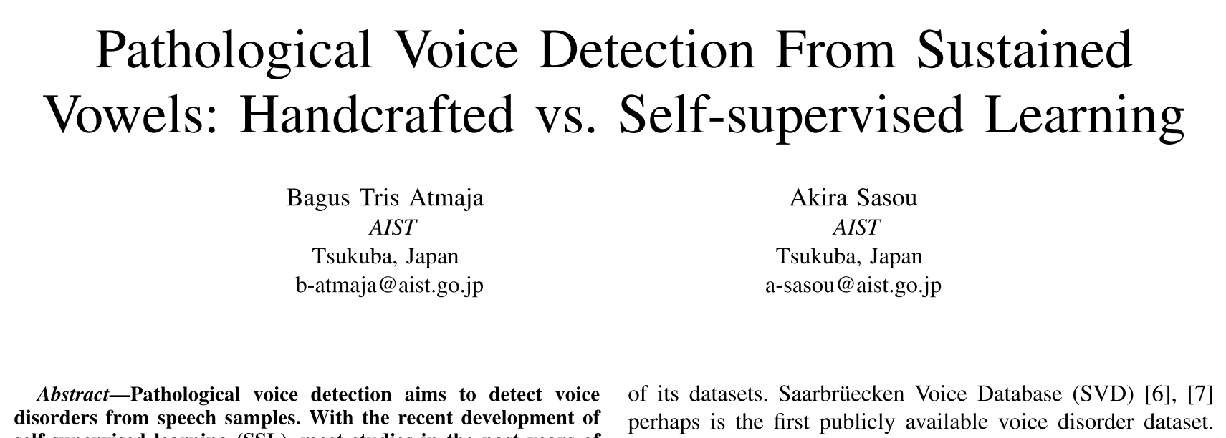
Pathological Voice Detection
Atmaja, B. T., & Sasou, A. (2025). Pathological Voice Detection From Sustained Vowels : Handcrafted vs. Self-supervised Learning. 2025 IEEE
International Conference on Acoustics, Speech, and Signal Processing Workshops (ICASSPW), 1–5. https://doi.org/10.1109/ICASSPW65056.2025.11011272

Slide 19
Pathological Speech Detection
Voice disorder detection determines whether a voice sample contains pathology or not.
The task is binary classification with F1-score and area under curve (AUC) were the most cited metrics
Identification further classifies the type of voice disorder if detected as pathological, e.g., if a voice falls into one type of structural, neurogenic, functional, and psychogenic.

Slide 20
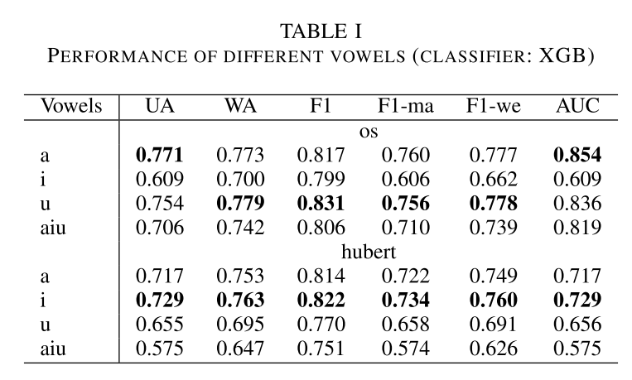
Performance of different vowel

Slide 21
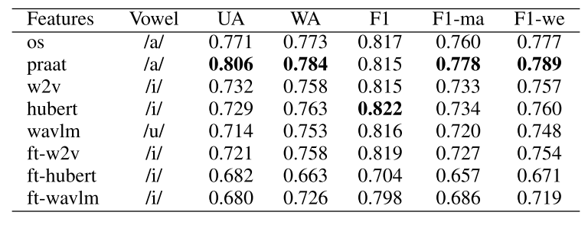
Performance of different features

Slide 22
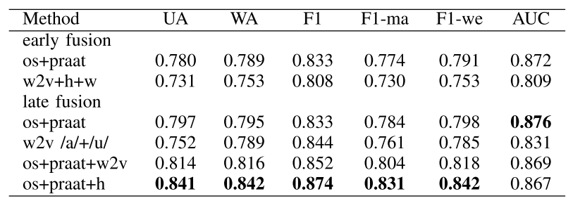
Performance of ensemble learning

Slide 23
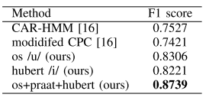
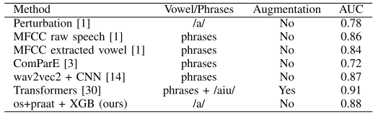
Benchmark
F1-score AUC

Slide 24


Dementia Prediction From Speech Signal Using
Optimized Prosodic Features
Bagus Tris Atmaja, Sakriani Sakti
Presented at APSIPA-ASC 2025, Singapore
Why we need to detect dementia as early as possible:
Early detection of dementia, cognitive decline, is vital for enhancing patient care and management
Conventional clinical assessments and cognitive tests require expert clinicians and are time-consuming
Developing rapid and reliable in-house detection methods is highly desirable
We proposed optimized prosodic features (15 features), with a focus on pause-related features, for dementia classification
version 2025/2/17

Slide 25
Proposed Acoustic Features
pause_lognorm_mu: Location parameter (μ) of the log-normal distribution fitted to pause duration¹
pause_lognorm_sigma: Shape parameter (σ) of the log-normal distribution fitted to pause duration¹
pause_lognorm_ks_pvalue: P-value from Kolmogorov-Smirnov test for goodness of fit of the log-normal distribution¹
pause_mean_duration: Mean duration of pauses between speech segments ²
pause_std_duration: Standard deviation of pause duration²
pause_cv: Coefficient of variation (CV) of pause duration (std/mean)
Proportion of pause duration: Proportion of total pause duration relative to speaking time²
¹ P. Pastoriza-Domınguez, I. G. Torre, F. Di´eguez-Vide, et al., Speech pause distribution as an early marker for Alzheimer’s disease, Jan. 2021
² R. Haulcy and J. Glass, “CLAC: A speech corpus of healthy english speakers,” in Proc. Annu. Conf. Int. Speech Commun. Assoc. INTERSPEECH, vol. 1, 2021, pp. 201–205,

Slide 26
Datasets
DementiaNet¹ contains public figures samples (WAV) with a confirmed dementia diagnosis and other public figures with no cognitive decline (control) over the age of eighty.
DementiaBank² is a shared database of multi-media interactions for the study of communication in dementia. We analyzed subset of DementiaBank namely Pitt Corpus in MP3 format.
Mixed of both datasets above
Model → XGB Feature importance → SHAP, XGB
¹ https://github.com/shreyasgite/dementianet
² https://talkbank.org/dementia/
² https://www.tensorflow.org/datasets/catalog/dementiabank

Slide 27
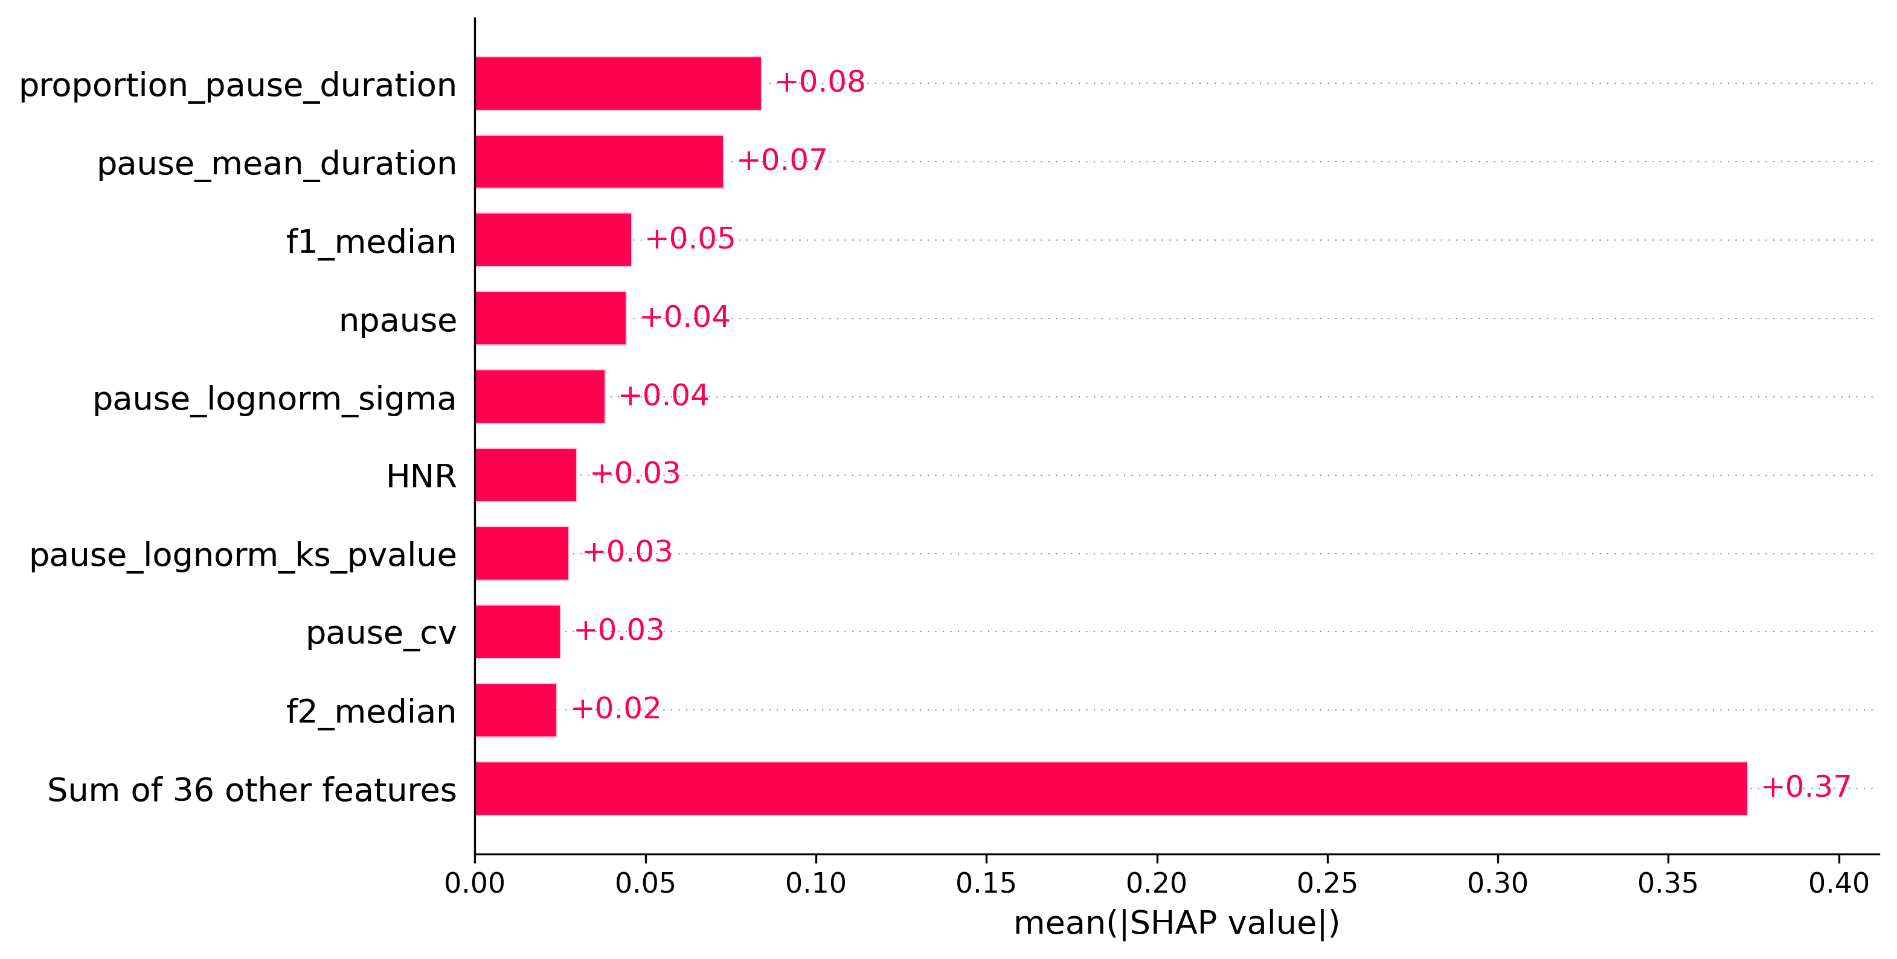
Results: DementiaNet

Slide 28
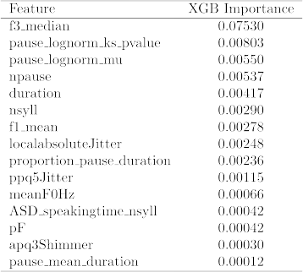
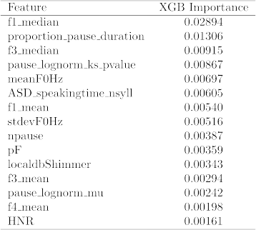
Results: DementiaBank & Mixed
DementiaBank
Mixed Dataset

Slide 29
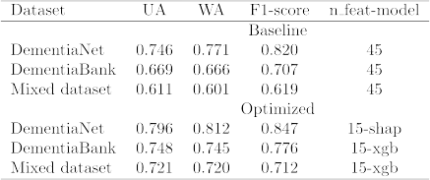
Results: 45 vs. 15 features
Benchmark:

Slide 30
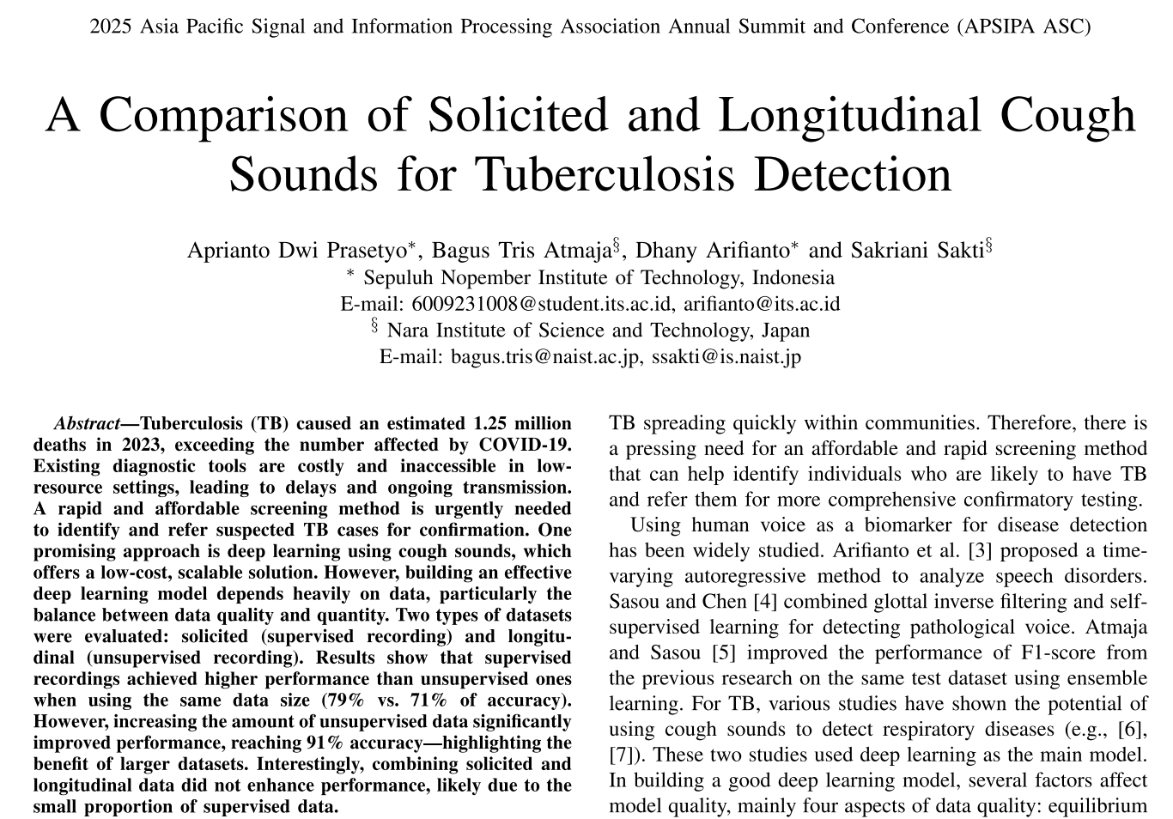

Slide 31
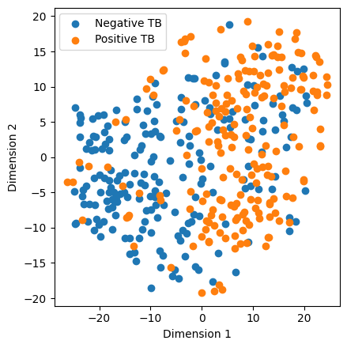
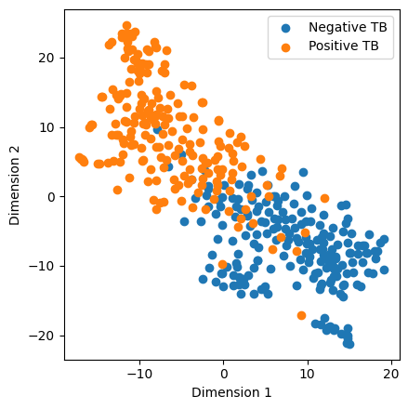
Combining Solicited and Longitudinal Cough
Data | Accuracy | F1 | Sensitivity | Specificity | ROC-AUC
Solicited | 0.79 | 0.80 | 0.70 | 0.82 | 0.78
Longitudinal | 0.91 | 0.91 | 0.93 | 0.91 | 0.92
Combined | 0.91 | 0.91 | 0.93 | 0.92 | 0.91
Combining solicited and longitudinal data gave only marginal gains over longitudinal-only training.
Minimal impact likely due to solicited data forming only ~1.5% of the total dataset.
Solicited model: High class overlap; scattered points → weak separability and noisy feature learning.
Longitudinal model: Clear, compact clusters → stronger class-specific embeddings and better discrimination.
Improved clustering in the longitudinal model shows enhanced feature learning and better class representation overall.
(a) Solicited Model
(b) Longitudinal Model
Figure 7: TSNE visualization of embeddings for two different models.

Slide 32
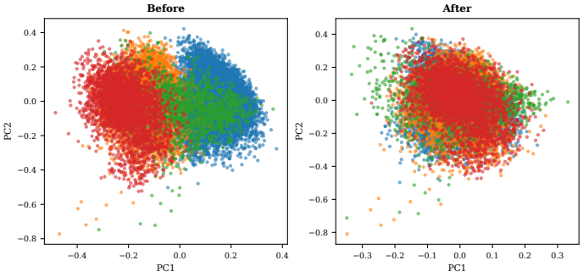
Newer work, removing confounding factors
PCA projections of voice embeddings before (left) and after (right) PCA-
256 and regression confounder removal. Before deconfounding, datasets form
distinct clusters driven by recording conditions; after regression residualiza-
tion, dataset-specific clustering is substantially reduced while disease-relevant
variance is preserved. (submitted to APSIPA 2026)

Slide 33
Takeway messages
Applying AI to healthcare and well-being is hard, but there is potential use of it
Some models work, others didn’t
Only certain cases (of diseases and well-being) could be predicted from voice, NOT all cases
Robustness and generalization is main goal instead of performances only
Large data matters (Effective!!)
Next: Demo

Slide 34
Demo
Linear Regression with Diabetes Dataset
Breast Cancer Classification
Depression Detection
Dementia Prediction

