Slide 1

Study case of (Audio) AI research for Healthcare and Well-being
Bagus Tris Atmaja
Email: bagus.tris@naist.ac.jp
version 2025/2/17

Slide 2
Overview
AI, Deep Learning, Machine Learning
Healthcare and Well-being
My research on voice technology for healthcare and well-being:
  Pathological Detection
  Cough segmentation
  TB classification
  Dementia prediction
Demo (Scikit-learn, Pandas, SHAP)

Slide 3
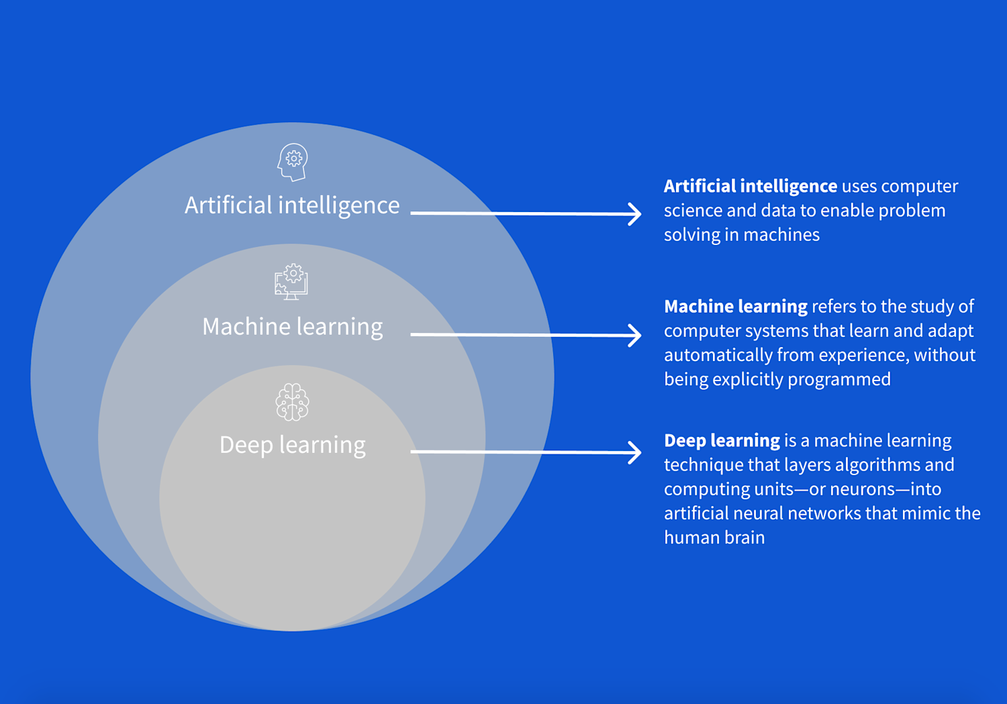
AI, ML, DL
https://www.coursera.org/articles/ai-vs-deep-learning-vs-machine-learning-beginners-guide

Slide 4
Healthcare and well-being
Healthcare → improvement or maintenance of health via the prevention, diagnosis, treatment, rehabilitation, and palliative care (easing suffering)
Physical
Healthcare
Mental → Well-being
Well-being: a complex state of feeling good about life, encompassing physical,
mental, emotional, and social health factors
Healthcare
Well-being

Slide 5
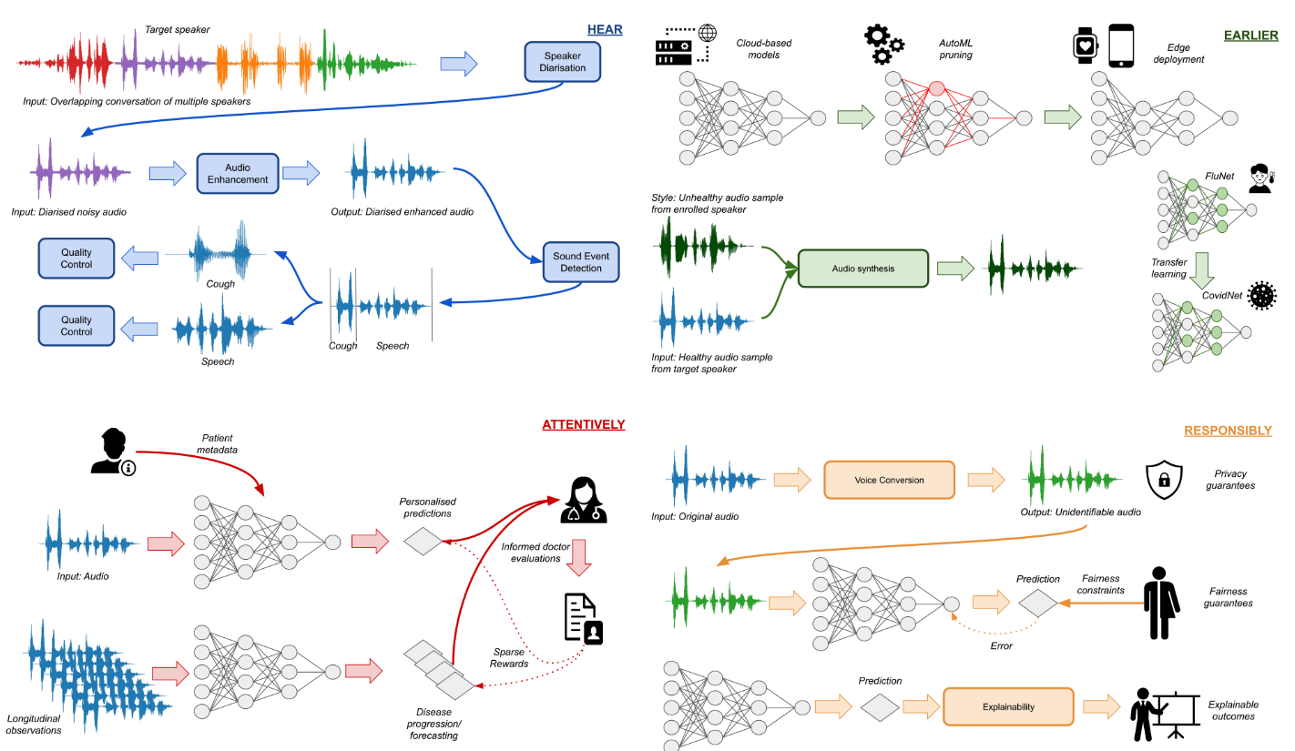
Four Pillars of Healthcare Audio AI (Andreas et al., 2023)
Physical

Slide 6
Research on audio-based healthcare and well-being
Speech Emotion Recognition
COVID-19 Detection
Cough Segmentation
Depression Detection
Laughter classification (happy vs. evil laughter)
Pathological speech detection
Dementia prediction
TB detection

Slide 7
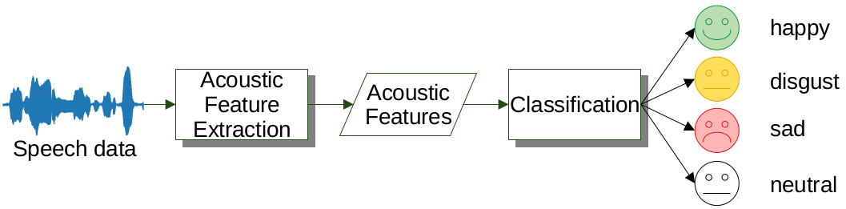
Typical Workflow
Acoustic embedding
correlate to disease?
Model suited for disease?
Dataset
Positive
Negative
+Visual,
Linguistic
Features?
Pre-processing/
post processing?
Feature
Selection?
Loss function,
regression
Can be multiclass

Slide 8
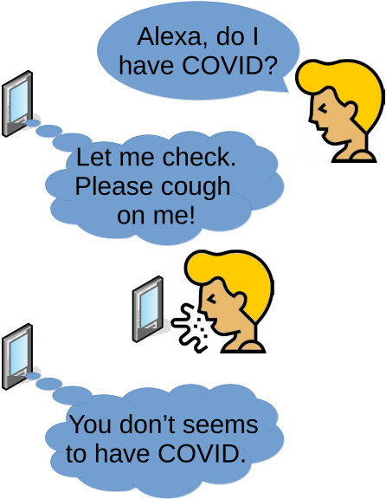
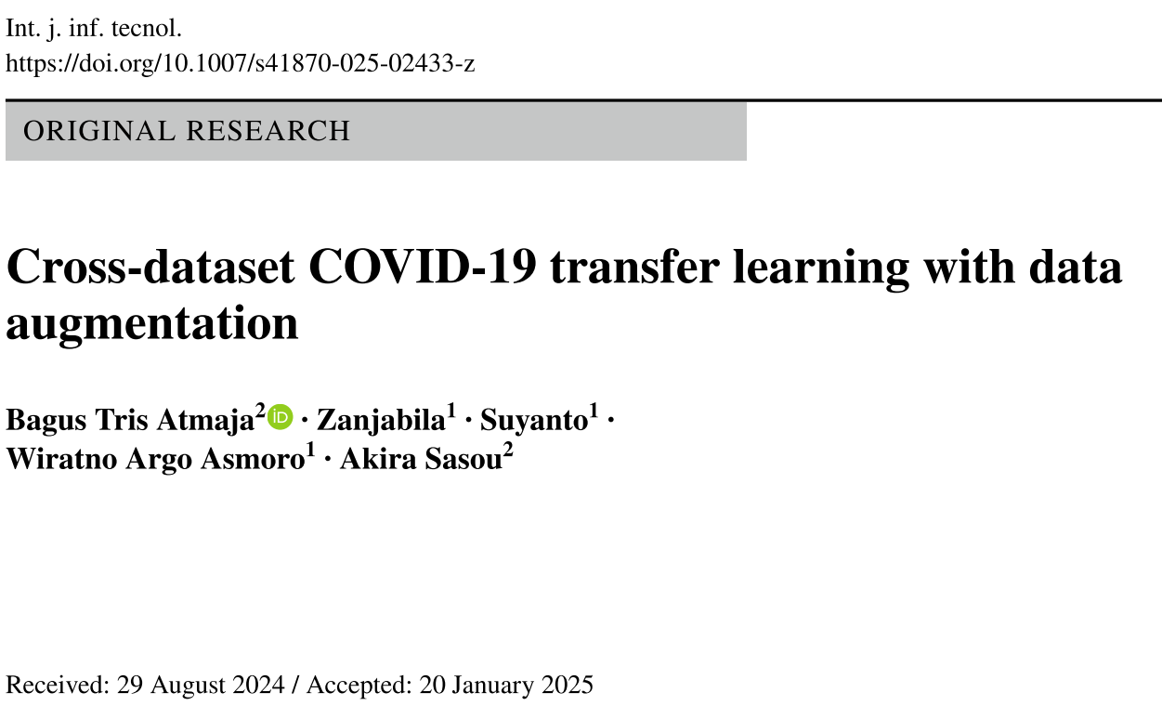
COVID-19 Detection
Atmaja, B. T., Zanjabila, Suyanto, Asmoro, W. A., & Sasou, A. (2025). Cross-dataset COVID-19 transfer learning with data augmentation. International Journal of Information Technology. https://doi.org/10.1007/s41870-025-02433-z

Slide 9
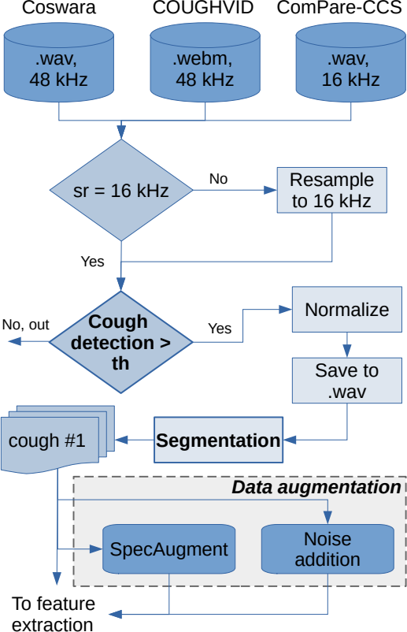
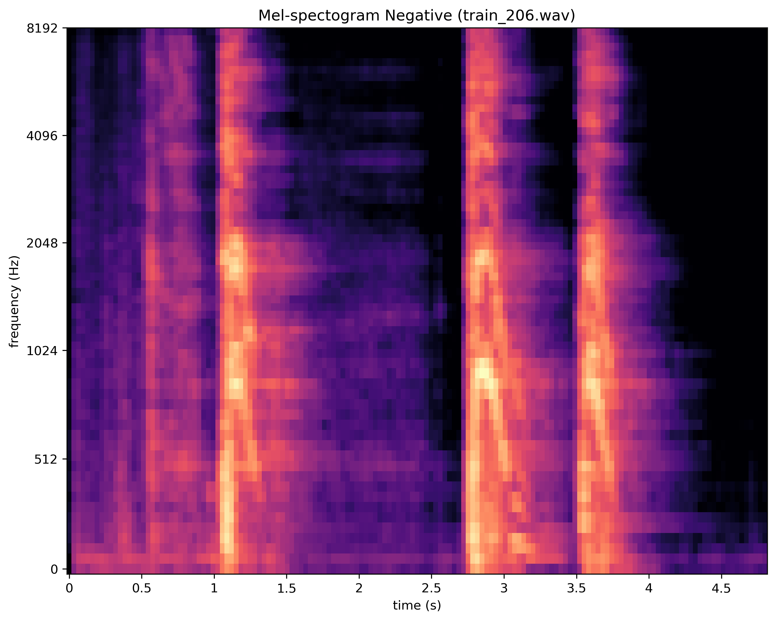
Acoustic Feature Extraction

Slide 10
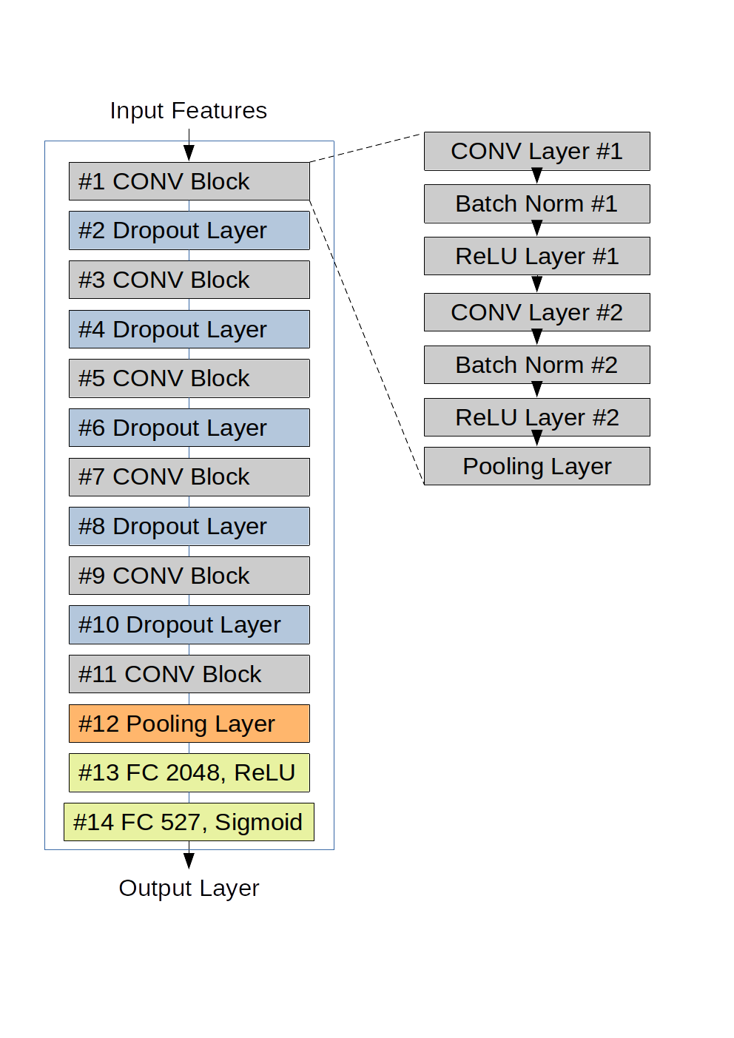
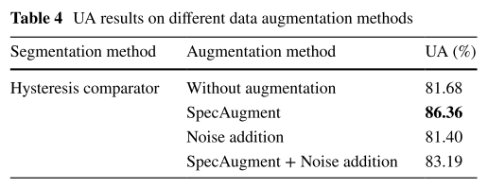
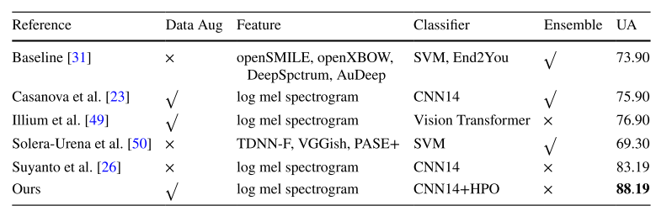
COVID-19 detection result

Slide 11
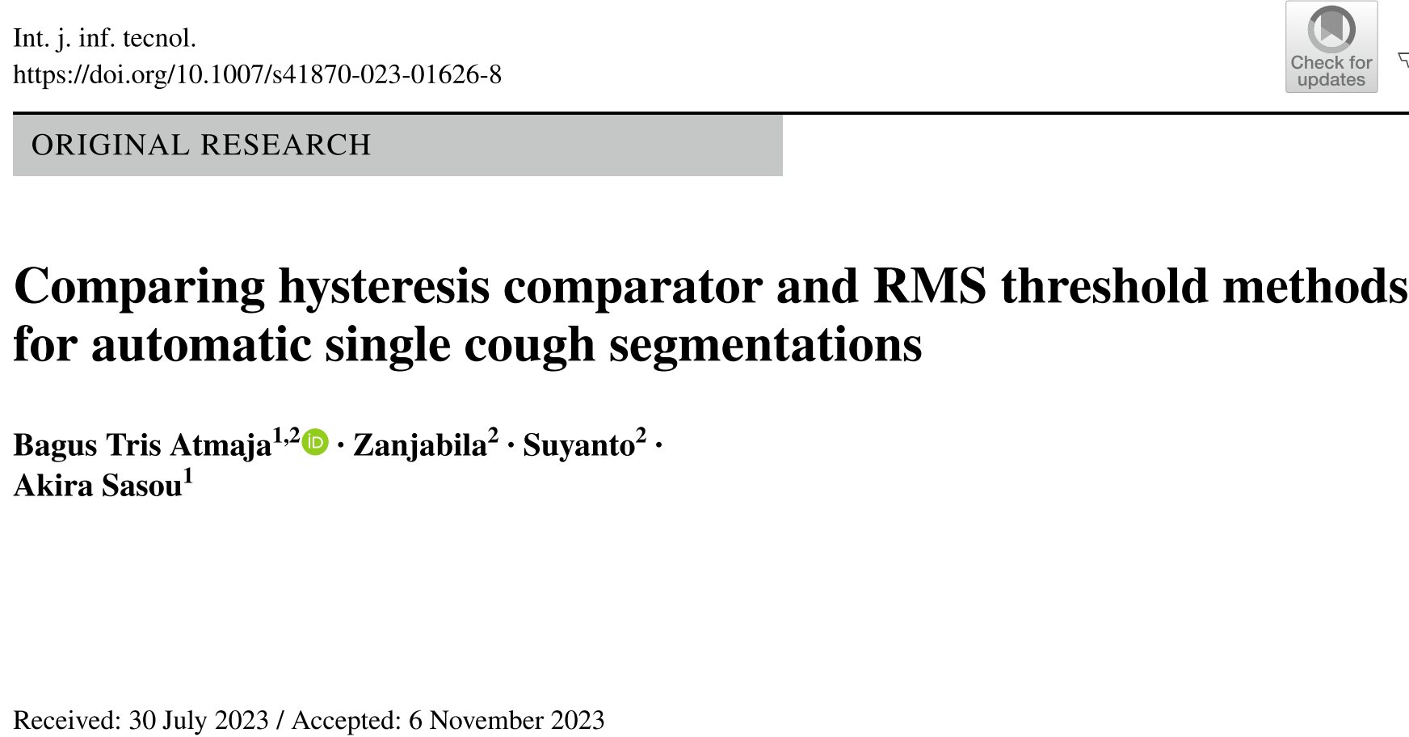
Cough Segmentation
Atmaja, B. T., Zanjabila, Suyanto, & Sasou, A. (2023). Comparing hysteresis comparator and RMS threshold methods for automatic single cough segmentations. International Journal of Information Technology, 0123456789.

Slide 12
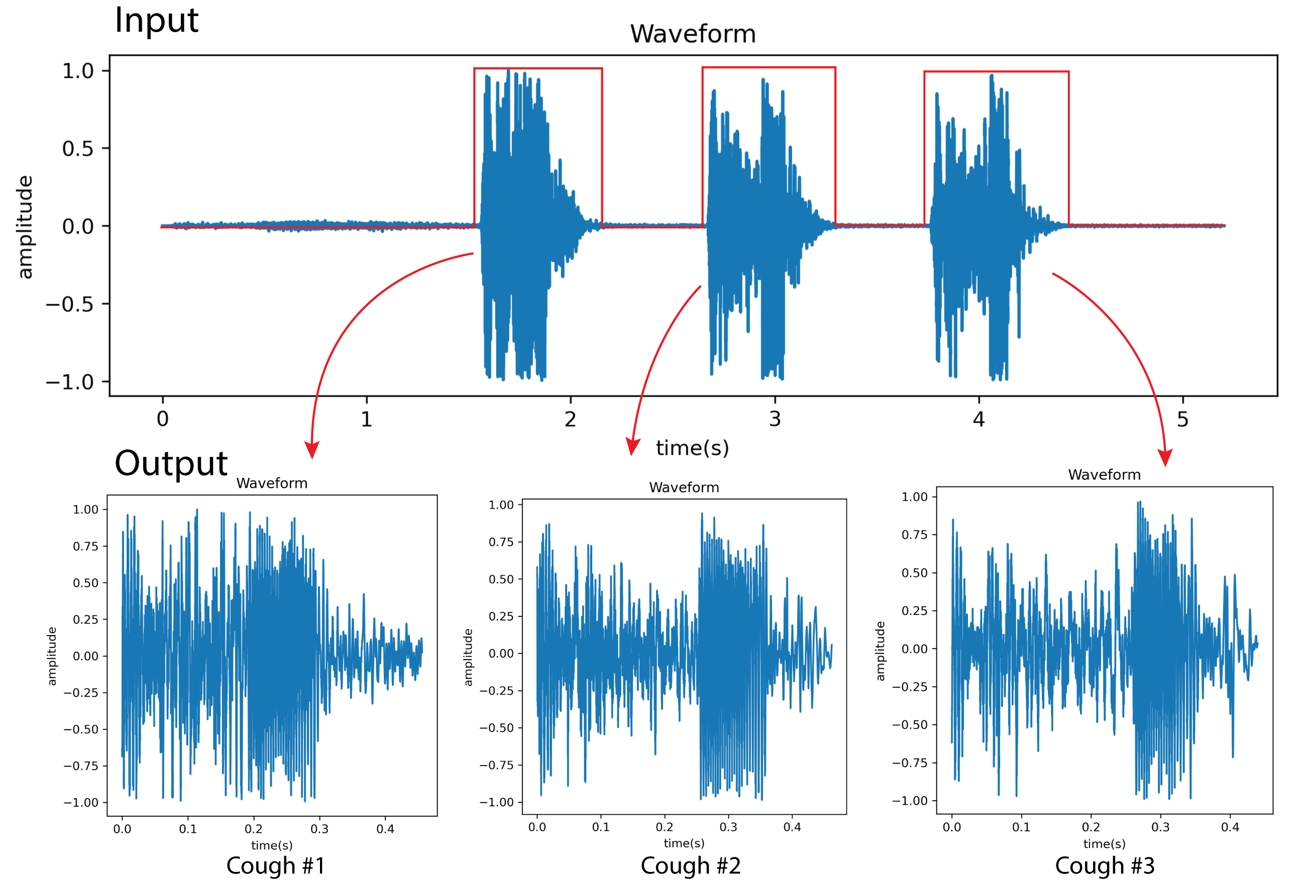
Cough Segmentation
Segmenting multiple cough into individual cough
Application: cough counter (e.g., per hour)

Slide 13
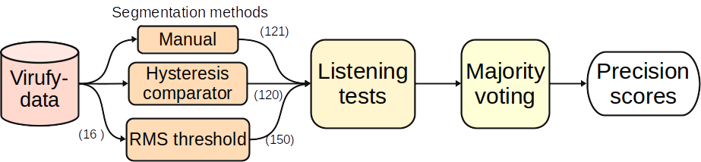


Cough Segmentation result

Slide 14
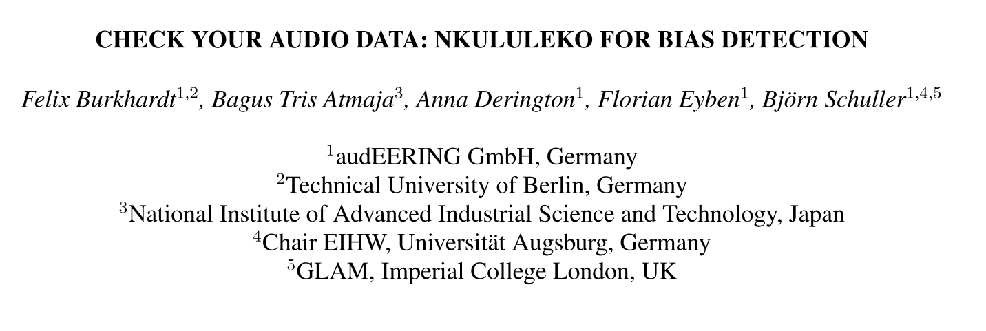
Depression Detection
Burkhardt, F., Atmaja, B. T., Derington, A., & Eyben, F. (2024). Check Your Audio Data : Nkululeko for Bias Detection. Oriental COCOSDA, 1–6. https://doi.org/10.1109/O-COCOSDA64382.2024.10800580

Slide 15
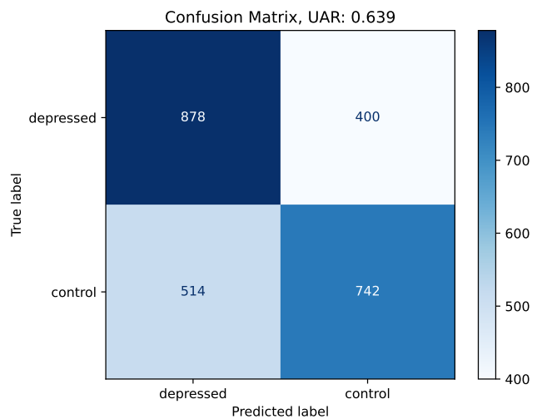
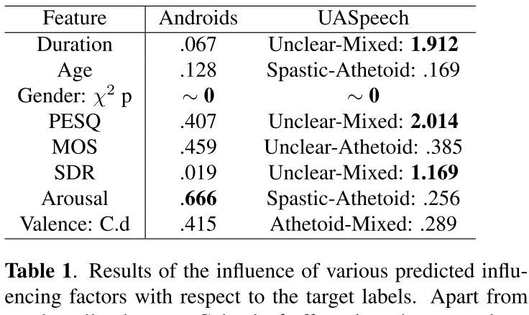
Depression Detection

Slide 16
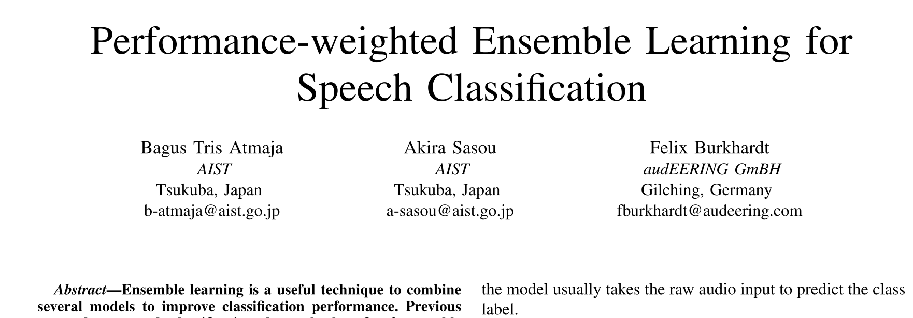
Laughter Classification
Atmaja, B. T., Sasou, A., & Burkhardt, F. (2025). Performance-Weighted Ensemble Learning for Speech Classification. 2025 International Conference on Artificial Intelligence in Information and Communication (ICAIIC), 0044–0048. https://doi.org/10.1109/ICAIIC64266.2025.10920862

Slide 17
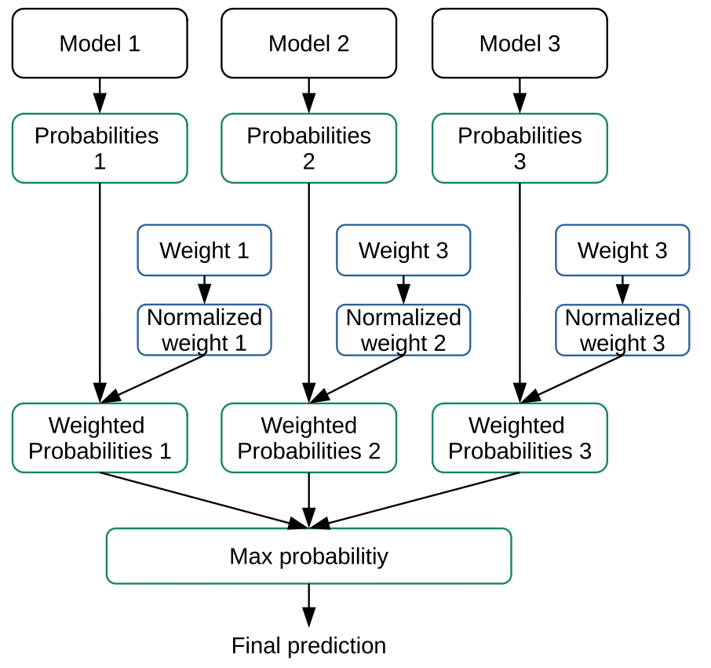
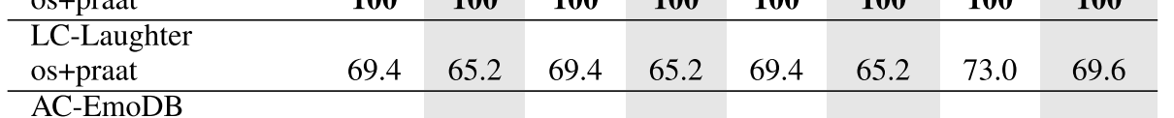
Laughter classification results

Slide 18
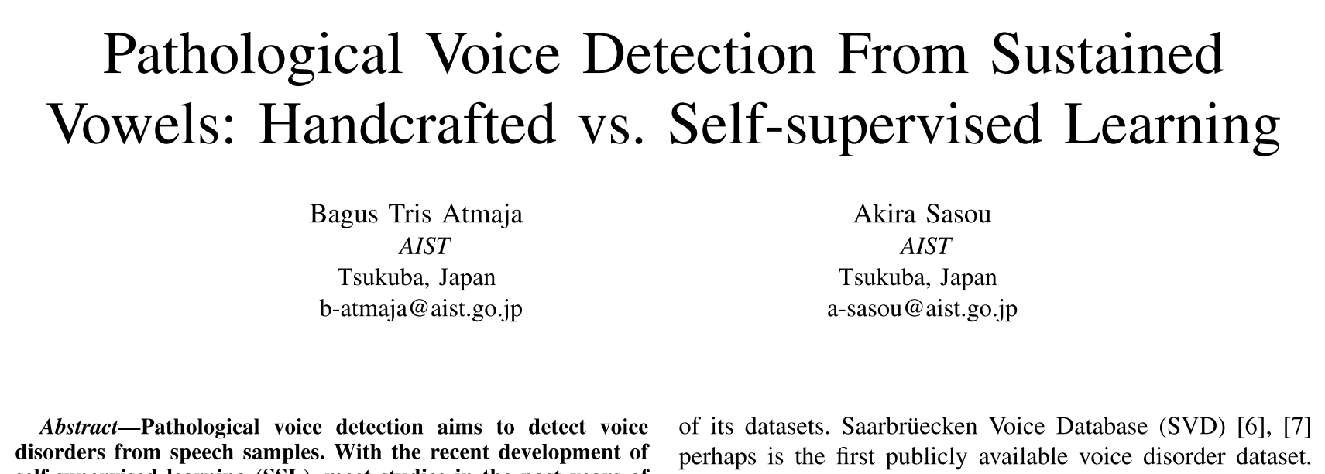
Pathological Voice Detection
Atmaja, B. T., & Sasou, A. (2025). Pathological Voice Detection From Sustained Vowels : Handcrafted vs. Self-supervised Learning. 2025 IEEE
International Conference on Acoustics, Speech, and Signal Processing Workshops (ICASSPW), 1–5. https://doi.org/10.1109/ICASSPW65056.2025.11011272

Slide 19
Pathological Speech Detection
Voice disorder detection determines whether a voice sample contains pathology or not.
The task is binary classification with F1-score and area under curve (AUC) were the most cited metrics
Identification further classifies the type of voice disorder if detected as pathological, e.g., if a voice falls into one type of structural, neurogenic, functional, and psychogenic.

Slide 20
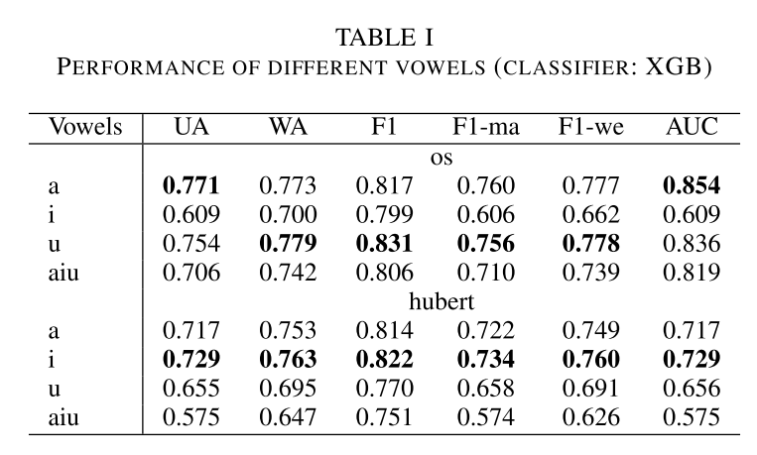
Performance of different vowel

Slide 21
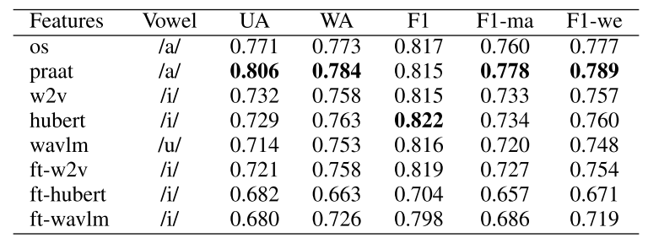
Performance of different features

Slide 22
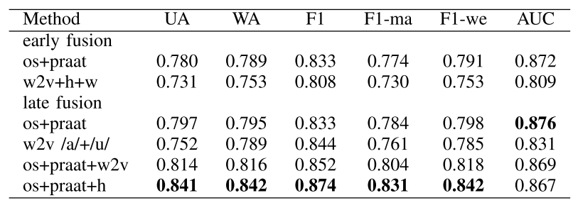
Performance of ensemble learning

Slide 23
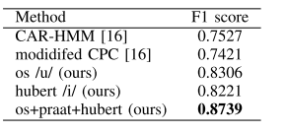
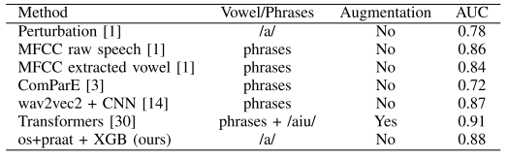
Benchmark
F1-score AUC

Slide 24


Dementia Prediction From Speech Signal Using
Optimized Prosodic Features
Bagus Tris Atmaja, Sakriani Sakti
Presented at APSIPA-ASC 2025, Singapore
Why we need to detect dementia as early as possible:
Early detection of dementia, cognitive decline, is vital for enhancing patient care and management
Conventional clinical assessments and cognitive tests require expert clinicians and are time-consuming
Developing rapid and reliable in-house detection methods is highly desirable
We proposed optimized prosodic features (15 features), with a focus on pause-related features, for dementia classification
version 2025/2/17

Slide 25
Proposed Acoustic Features
pause_lognorm_mu: Location parameter (μ) of the log-normal distribution fitted to pause duration¹
pause_lognorm_sigma: Shape parameter (σ) of the log-normal distribution fitted to pause duration¹
pause_lognorm_ks_pvalue: P-value from Kolmogorov-Smirnov test for goodness of fit of the log-normal distribution¹
pause_mean_duration: Mean duration of pauses between speech segments ²
pause_std_duration: Standard deviation of pause duration²
pause_cv: Coefficient of variation (CV) of pause duration (std/mean)
Proportion of pause duration: Proportion of total pause duration relative to speaking time²
¹ P. Pastoriza-Domınguez, I. G. Torre, F. Di´eguez-Vide, et al., Speech pause distribution as an early marker for Alzheimer’s disease, Jan. 2021
² R. Haulcy and J. Glass, “CLAC: A speech corpus of healthy english speakers,” in Proc. Annu. Conf. Int. Speech Commun. Assoc. INTERSPEECH, vol. 1, 2021, pp. 201–205,

Slide 26
Datasets
DementiaNet¹ contains public figures samples (WAV) with a confirmed dementia diagnosis and other public figures with no cognitive decline (control) over the age of eighty.
DementiaBank² is a shared database of multi-media interactions for the study of communication in dementia. We analyzed subset of DementiaBank namely Pitt Corpus in MP3 format.
Mixed of both datasets above
Model → XGB Feature importance → SHAP, XGB
¹ https://github.com/shreyasgite/dementianet
² https://talkbank.org/dementia/
² https://www.tensorflow.org/datasets/catalog/dementiabank

Slide 27
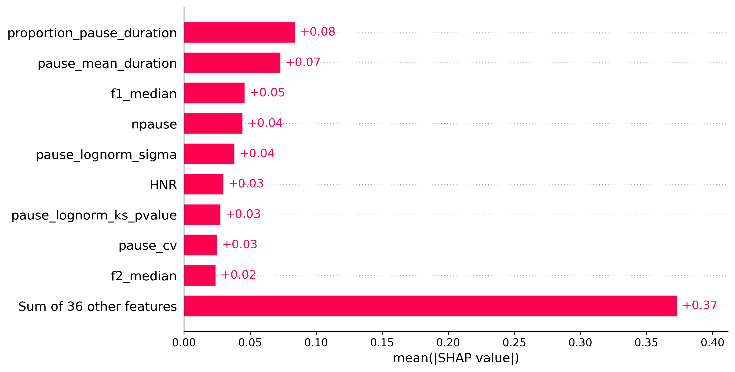
Results: DementiaNet

Slide 28
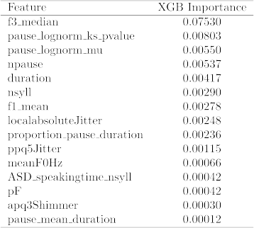
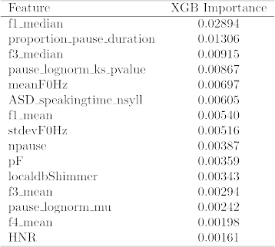
Results: DementiaBank & Mixed
DementiaBank
Mixed Dataset

Slide 29
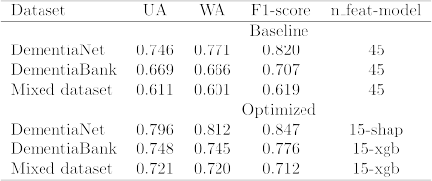
Results: 45 vs. 15 features
Benchmark:

Slide 30
A Comparison of Solicited and Longitudinal Cough Sounds for Tuberculosis Detection
Aprianto Dwi Prasetyo∗, Bagus Tris Atmaja § , Dhany Arifianto ∗ and Sakriani Sakti §
Presented at APSIPA-ASC 2025, Singapore

Slide 31

Introduction
Tuberculosis (TB) remains one of the world’s deadliest infectious diseases, causing ~1.25M deaths in 2023, surpassing COVID-19.
Early and objective detection is essential to reduce global TB mortality
Research Gap
Previous studies emphasize model performance but overlook how data quality impacts outcomes.
Factors such as dataset balance, size, label reliability, and recording contamination remain underexplored.
Objective
Investigate how data characteristics and recording conditions affect deep learning performance in TB detection.
Dataset
CODA TB DREAM Challenge dataset: 700K+ cough samples, 2,143 participants.
Two distinct data types:
  Solicited coughs: Collected under controlled, standardized conditions.
  Longitudinal coughs: Collected passively in real-world settings..
This research systematically analyzes and compares solicited and longitudinal cough data, examining how each and their combination influence deep learning model robustness for real-world TB screening.

Slide 32



Solicited vs Longitudinal Coughs
Solicited Cough
Longitudinal Cough
A subset of participants (n = 565) were also asked to carry a study phone for two weeks and collect longitudinal coughs sounds in an outpatient setting
Contrarily to the solicited cough, longitudinal cough recording was unsupervised by study personnel and was performed in community setting
Coughs are automatically detected and recorded by the system.
Total 647,060 Coughs Data
60 – 90 cm
Smartphones were positioned on tripods in rooms within the clinic in a dedicated room without background noise.
Patient Asked to Cough
Total 9,232 Coughs Data

Slide 33
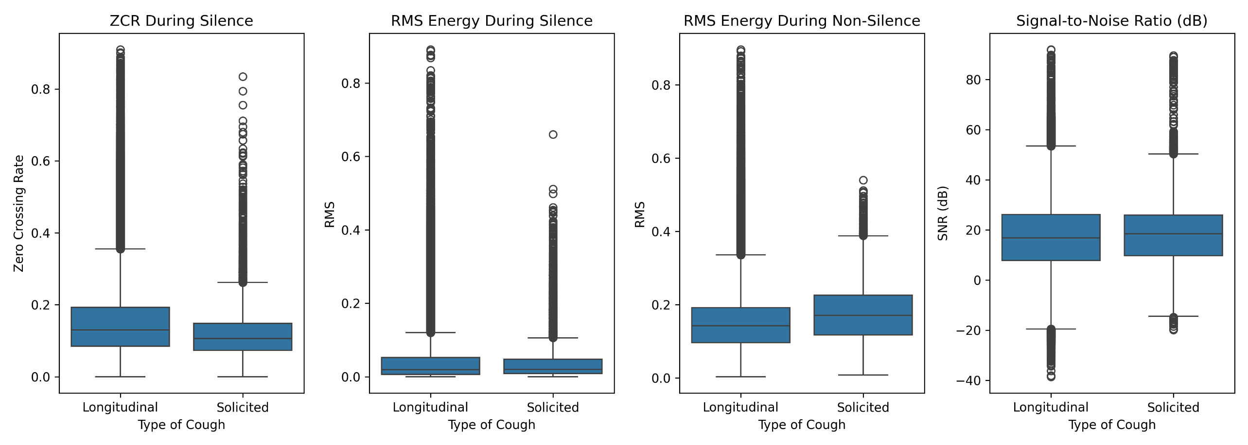
Solicited vs Longitudinal Coughs
ZCR & RMS: Longitudinal coughs show higher and more variable values, indicating persistent background noise and unstable environments. Solicited data remains lower and consistent, reflecting cleaner recordings.
SNR: Slightly lower and more variable in longitudinal data; higher and stable in solicited.
Insight: Longitudinal data is noisier but richer in diversity, while solicited data offers cleaner, more uniform signals.
Notes:
Segment Focus: Analysis targeted silent (0.0–0.1 s) and active (0.2–0.5 s) portions of each 0.5 s cough clip to isolate background noise and signal behavior during actual cough events.
Zero-Crossing Rate (ZCR) and RMS Energy: Longitudinal coughs show higher median values and wider distributions during silence. This indicates persistent background activity and unstable acoustic conditions, such as room noise or nearby sounds. Solicited data, in contrast, maintains tighter ranges with lower median noise levels, reflecting cleaner, more uniform recordings.
Signal-to-Noise Ratio (SNR): Longitudinal data has slightly lower and more variable SNR values, confirming inconsistent environmental control. Solicited recordings retain higher SNR and reduced variance, consistent with supervised data capture.
Interpretation: These results verify that longitudinal data carries richer but noisier acoustic profiles, while solicited data provides stable, high-fidelity signals. The variability in longitudinal samples introduces environmental diversity that can both challenge and enhance model generalization, depending on network robustness.

Slide 34
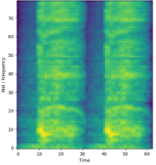
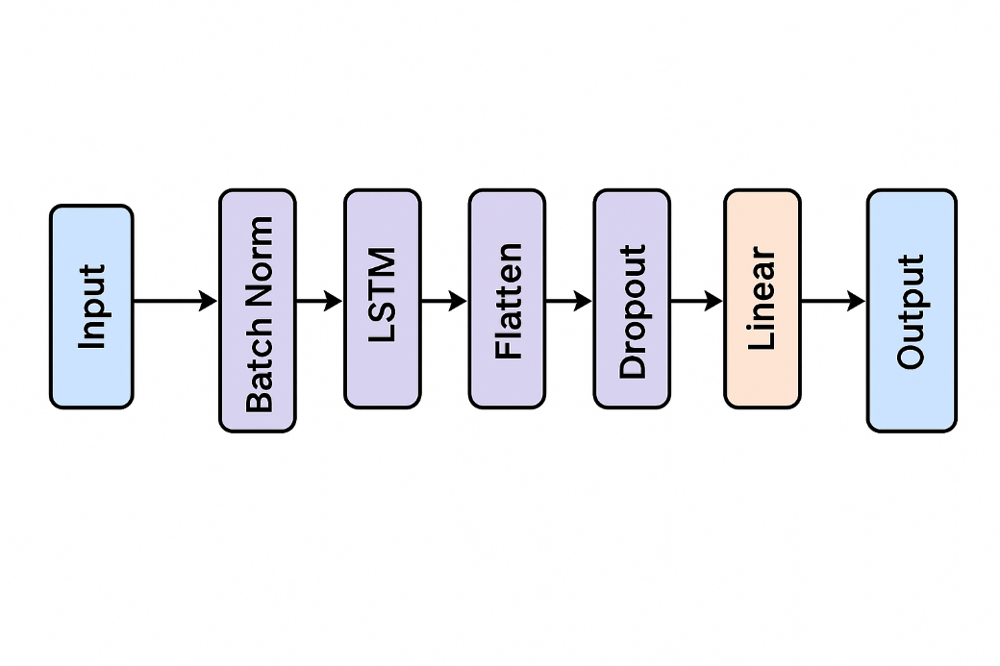
Audio resampled from 44.1 kHz to 16 kHz.
Normalization: Signal normalized to –1 to 1 using Min–Max normalization (dividing by max absolute value).
Length Standardization: Each clip fixed to 1 second duration. Shorter clips extended using repeat padding.
Feature Type: Mel spectrogram. Frame size: 64 ms, Hop length: 16 ms, Window: Hann function, 80 mel channels
Preprocessing and Feature Extraction
2x
Figure 3: Architecture of LSTM Network used.
Training Configuration
Dataset split: 90 % : 10 % (for solicited, longitudinal, and mixed data)
Optimizer: AdamW
Loss Function: Weighted Cross-Entropy
Evaluation Metrics
  Accuracy: Overall correct predictions (TP + TN / Total).
  F1 Score: Harmonic mean of precision and recall
  Sensitivity: Measures correct identification of positive TB cases. High sensitivity → fewer false negatives.
  Specificity: Measures correct identification of non-TB cases. High specificity → fewer false positives.
  ROC-AUC: Summarizes trade-off between sensitivity and specificity. AUC ≈ 1 = strong classifier; AUC ≈ 0.5 = random guessing.

Slide 35
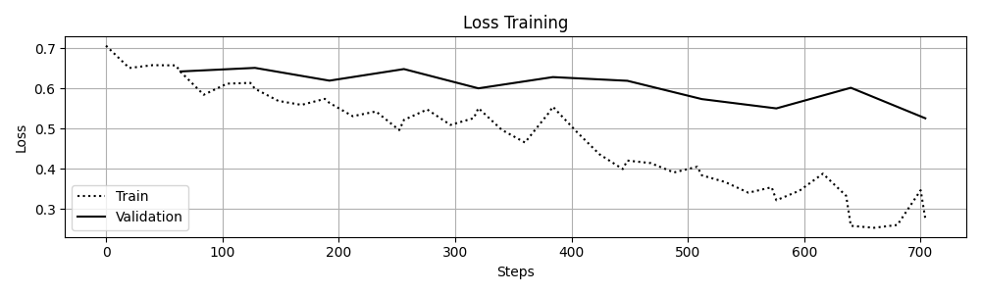
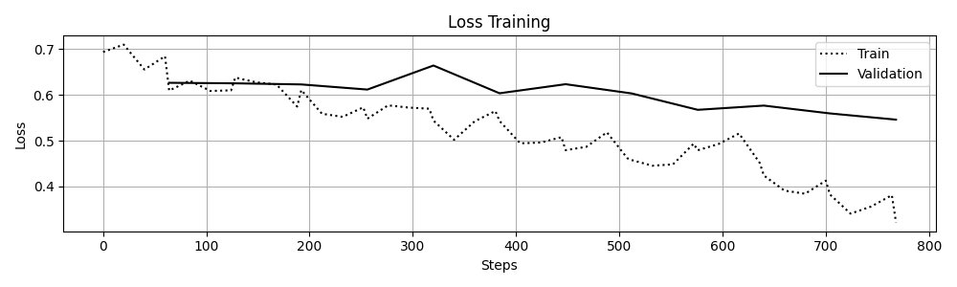
Solicited vs. Longitudinal Cough on the Same Number of Samples
Data | Accuracy | F1 | Sensitivity | Specificity | ROC-AUC
Solicited | 0.79 | 0.7 | 0.82 | 0.78 | 0.80
Longitudinal | 0.71 | 0.62 | 0.73 | 0.71 | 0.72
Each longitudinal model was trained 5× with different random subsets; results are averaged for fairness.
Solicited data performs better due to controlled clinical recordings with consistent equipment, positioning, and low noise → cleaner, high-fidelity signals.
Longitudinal data because higher acoustic variability from noise, device differences, and inconsistent recording conditions → lower model performance.
Fig. 4 and Fig. 5 show that while training loss keeps decreasing, validation loss declines more slowly and eventually diverges, indicating overfitting of the model to the training data in these cases.
Figure 4: Training and validation losses for longitudinal model
Figure 5: Training and validation losses for solicited model

Slide 36
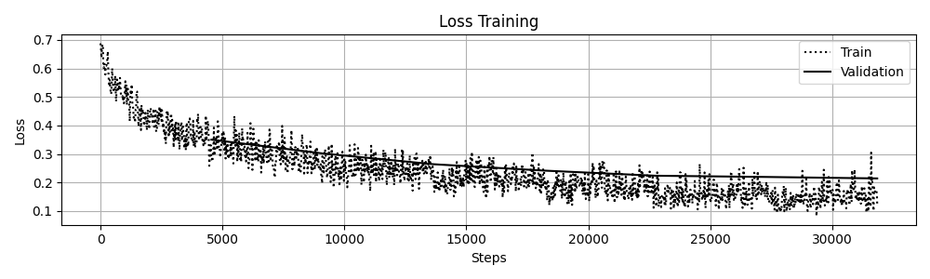
Solicited vs. Longitudinal Cough on Different Number of Samples
Data | Accuracy | F1 | Sensitivity | Specificity | ROC-AUC
Solicited | 0.79 | 0.7 | 0.82 | 0.78 | 0.80
Longitudinal | 0.91 | 0.93 | 0.91 | 0.92 | 0.91
Training on the full longitudinal dataset (647,060 samples) improved performance by ~10% over solicited data → scale advantage.
Despite higher noise and recording variability, this diversity enhances generalization and reduces overfitting.
Solicited data is cleaner but lacks real-world variation.
Figure 6: Training and validation losses decrease together until early stopping → strong generalization.
Figure 6: Training and validation losses for longitudinal model
Figure 5: Training and validation losses for solicited model

Slide 37
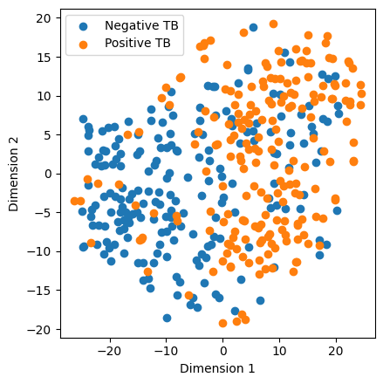
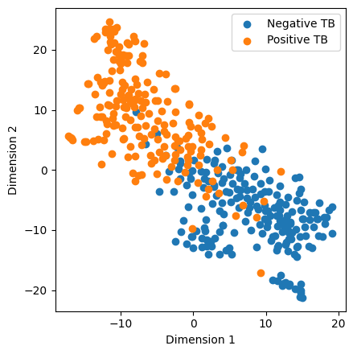
Combining Solicited and Longitudinal Cough
Data | Accuracy | F1 | Sensitivity | Specificity | ROC-AUC
Solicited | 0.79 | 0.80 | 0.70 | 0.82 | 0.78
Longitudinal | 0.91 | 0.91 | 0.93 | 0.91 | 0.92
Combined | 0.91 | 0.91 | 0.93 | 0.92 | 0.91
Combining solicited and longitudinal data gave only marginal gains over longitudinal-only training.
Minimal impact likely due to solicited data forming only ~1.5% of the total dataset.
Solicited model: High class overlap; scattered points → weak separability and noisy feature learning.
Longitudinal model: Clear, compact clusters → stronger class-specific embeddings and better discrimination.
Improved clustering in the longitudinal model shows enhanced feature learning and better class representation overall.
(a) Solicited Model
(b) Longitudinal Model
Figure 7: TSNE visualization of embeddings for two different models.

Slide 38
TB Conclusion
Supervised (solicited) data achieved higher accuracy with equal sample size, but large-scale longitudinal data (~647k samples) improved performance to 91%, demonstrating the value of dataset scale.
Merging both types offered no meaningful gain since solicited data accounted for only ~1.5% of total samples.
Representation analysis (t-SNE)
  Solicited model = High overlap among classes, weak separability, and noisier learned features.
  Longitudinal model = Clear, compact clusters showing strong class-specific embeddings and superior discriminative learning.
Large, diverse unsupervised data enhances both model generalization and feature representation.
For Future work, Focus on standardized supervised data collection and exploration of advanced acoustic features and model architectures.

Slide 39
Takeway messages
Applying AI to healthcare and well-being is hard, but there is potential use of it
Some models work, others didn’t
Only certain cases (of diseases and well-being) could be predicted from voice, NOT all cases
Robustness and generalization is main goal instead of performances only
Large data matters (Effective!!)
Next: Demo

Slide 40
Demo
Linear Regression with Diabetes Dataset
Breast Cancer Classification
Speech Emotion Recognition (Polish Dataset)
Laughter Classification
Dementia Prediction

