Slide 1
Weekly Meeting Report
@btatmaja
April 22, 2019

Slide 2
Overview
Result on start-end silence removal
Result on using additional features (pitches and harmonics)
JAIST Research Grant

Slide 3
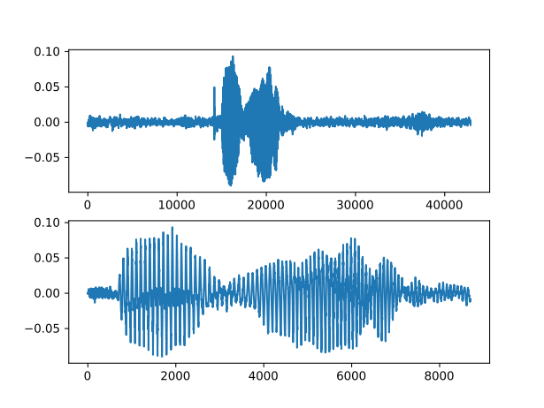
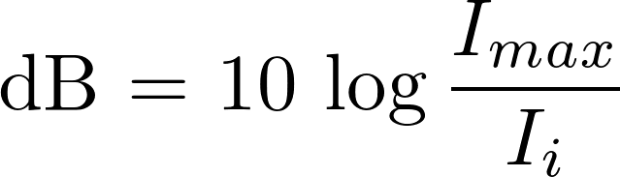
Start-End Silence Removal
Removing silence and beginning and end of speech signal to remove unnecesarry information.
Threshold:
.
Fig. 1: Speech signal after silence removal with dB=15

Slide 4
Evaluation Start-end silence removal
Start-End
Silence
Removal
Predicted
Emotion
Speech
BLSTMA
Accuracy
Dataset: IEMOCAP
Utterances = 5531 (4 cat, happy merged with excitement, ang, neu, sad) --> previous our paper: 4396 utterances, happy is not merged.
Used Threshold : 10, 15, 20, 25, 30, 35, 40, 45, 50, 55, 60 dB

Slide 5
Baseline papers
(same 5331 utterances, IEMOCAP)
There are two groups on speech emotion recognition papers using IEMOCAP dataset to make the dataset balance:
  4936: angry, neutral, sad, happy
  5331: angry, neutral, sad, happy + excitement <--
SPEECH EMOTION RECOGNITION WITH ACOUSTIC AND LEXICAL FEATURES (Qin jin et. al.), using acoustic feature only they achieve: 52.5 % (ACO) and 53.5 % (MFCC) accuracy.
MULTIMODAL SPEECH EMOTION RECOGNITION USING AUDIO AND TEXT (Seunghyun Yoon, et. al.), using Audio Recurrent Encoder they achieve: 54.6% accuracy

Slide 6
Result: Accuracy on system without dropout
No trim : max: 0.5619, min:0.3604, avg:0.4925, std:0.03973
10 dB : max: 0.5095, min:0.3496, avg:0.4586, std:0.04154
20 dB : max: 0.5303, min:0.3369, avg:0.4737, std:0.04909
30 dB : max: 0.5248, min:0.3713, avg:0.4790, std:0.03841
35 dB : max: 0.5384, min:0.3487, avg:0.4907, std:0.04369
40 dB : max: 0.5402, min:0.3640, avg:0.4832, std:0.03944
45 dB : max: 0.5276, min:0.3342, avg:0.4756, std:0.04122
50 dB : max: 0.5574, min:0.3803, avg:0.4898, std:0.0475
55 dB : max: 0.5528, min:0.3785, avg:0.4905, std:0.04615
60 dB : max: 0.5402, min:0.3640, avg:0.4832, std:0.03944

Slide 7
Result: Accuracy on system with dropout = 0.2
No Trim : max: 0.5673, min:0.3469, avg:0.4945, std:0.044
10 dB : max: 0.5095, min:0.3144, avg:0.4503, std:0.04568
20 dB : max: 0.5339, min:0.3379, avg:0.4728, std:0.04696
30 dB : max: 0.5257, min:0.3162, avg:0.4786, std:0.04486
40 dB : max: 0.5483, min:0.3098, avg:0.4861, std:0.04571
50 dB : max: 0.5492, min:0.2945, avg:0.4803, std:0.05698
60 dB : max: 0.5465, min:0.3568, avg:0.4872, std:0.04554

Slide 8
Result: Accuracy on system with dropout = 0.5
NO TRIM : max: 0.5393, min:0.3487, avg:0.4779, std:0.049
10 dB : max: 0.4950, min:0.3288, avg:0.4432, std:0.04334
20 dB : max: 0.5357, min:0.3677, avg:0.4696, std:0.04445
30 dB : max: 0.5438, min:0.3153, avg:0.4687, std:0.04554
40 dB : max: 0.5402, min:0.2855, avg:0.4731, std:0.05679
50 dB : max: 0.5565, min:0.2873, avg:0.4812, std:0.05699
60 dB : max: 0.5384, min:0.3261, avg:0.4852, std:0.05142
CONCLUSION on Silence-start removal:
Can’t be used to improve accuray, maybe due to difficulty to choose the right threshold.

Slide 9
Adding more features...
Current features (our interspeech and icsigsys draft) --> 34 features:
  Zero Crossing Rate, Energy, Entropy of Energy, Spectral Centroid, Spectral Spread, Spectral Entropy, Spectral Flux, Spectral Rolloff (8)
  MFCCs (13), Chroma vector (12), Chroma deviation (1)
Additional features, motivated by evidence that pitch and formants in important cue in emotion perception:
  Pitches (Old=0, Current = 1, 5 Pithces for each frame)
  Harmonics/formants (Current = 5 harmonics)
  Total features = 39, 40, 44

Slide 10
Result
Number of features:
34 : max: 0.5294, min:0.3198, avg:0.4638
max: 0.5492, min:0.3911, avg:0.4903,
39 : max: 0.5799, min:0.3559, avg:0.4832,
40 : max: 0.5736, min:0.3225, avg:0.5020,
44 : max: 0.5474, min:0.3523, avg:0.4960,
49 : ... (10 pitches on each frame)
BLSTMA System for comparison:
Number of layers: 2, Nodes on first layer: 128
Nodes on 2nd layer: (64x64), Dense before output: 128

Slide 11
Current problems/Future works
Try to remove chroma, becasue it is not related to speech emotion.. But, when I make the number of chroma = 0, the program still got error.
Considering gender information as input feature to the system because male/female voice has different pitches, harmonics and other carachteristics.
Move to other databases
Focus on speech and text integration

Slide 12
JAIST Grant
Title: Does semantic contribute to speech emotion perception?"
Purpose: To know whether semantics contribute (or not) to speech emotion perception
Task: Provide listening test on speech emotion perception with and without speech transcription.
Compare the result this human emotion recognition with computer speech emotion recognition.

