Slide 1
The Effect of Silence Feature in Dimensional Speech Emotion Recognition
... and other progress
Bagus Tris Atmaja, December 2019

Slide 2
Overview
Motivation
Purpose
Related Works
Methods
Result
Conclusion
Others

Slide 3
Motivation
Silences/pauses in speech is useful, in publlic speaking pauses helps speaker to engage the audience
In human emotion perception, changinge length of silent pauses influences listeners in attributing emotional states to the speaker
In human categorical human emotion recognition by computer, disfluencies features improve recognition rate
How about silence feature on dimensional speech emotion recognition?

Slide 4
Research Purpose
To investigate the effect of using feature silence on dimensional speech emotion recognition (valence, arousal, dominance); Does it influence/improve the performence?

Slide 5
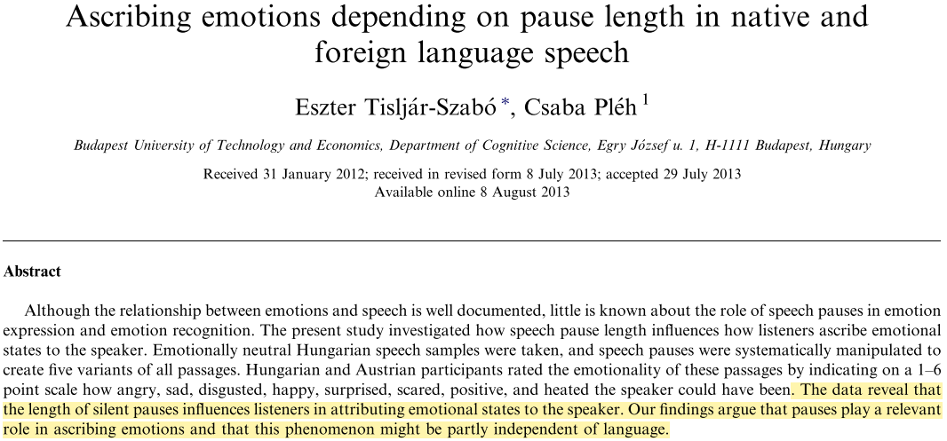
Related Works [1]

Slide 6
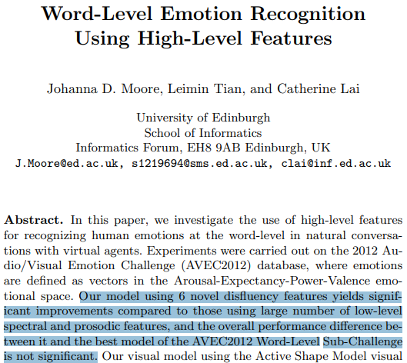
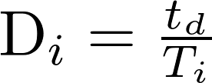
Related Works [2]
Disfluencey feature:
t_{d} = duration
of difluency
T_{i} = total
utterance
length

Slide 7
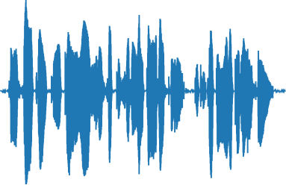
Method : Acoustic Feature Extraction
(GeMAPs, Functionals, and Silence)
23 acoustic features from 3409
moving window are extracted
per utterance
Frame | Loudness | α-ration | hammerberg index | Spectral slop 0-500 Hz | Spectral slope 500-1000 Hz | ... | |F3|
1
2
3
...
3409
Mean
std
1. LLDs
2. HFSs
3. mean+std+silence
23 mean & 23 std are
extracted per utteranc

Slide 8
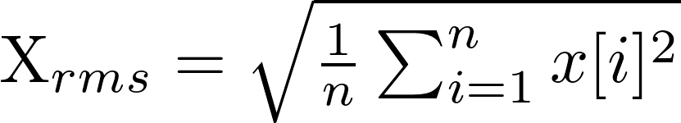







Method: Silence Feature Extraction
...

Slide 9
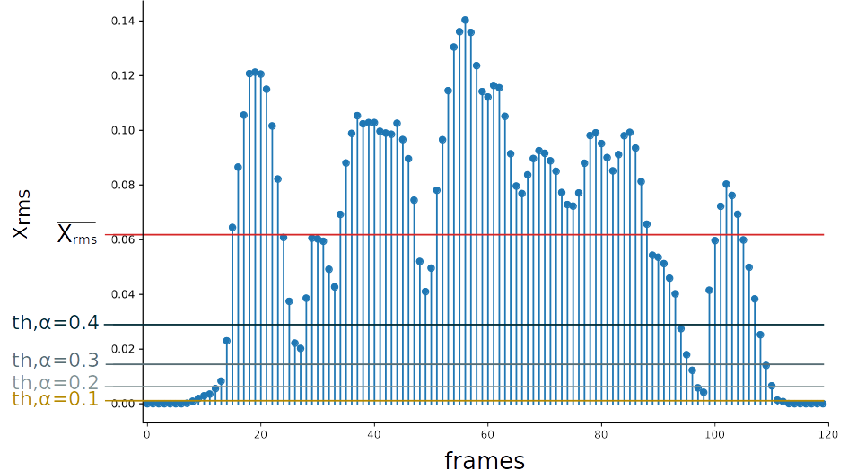
Results: Effect of changing threshold factor

Slide 10
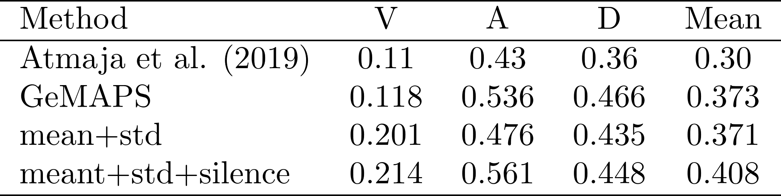
Results: dimensional SER
Note:
Atmaja et al. (2019): 64 nodes on each LSTM with α=0.7, β=0.3, γ=0.6 (3 parameters)
GeMAPS : 512 nodes on each LSTM with α=0.1, β=0.5, γ=0.4 (2 parameters)

Slide 11
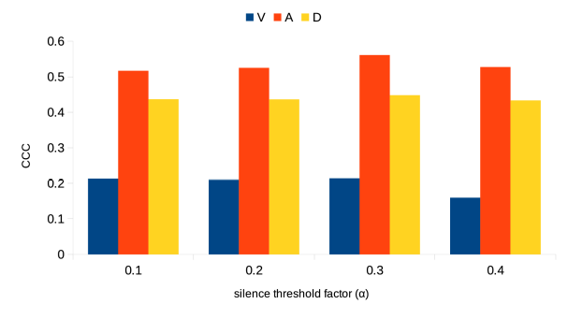
Results: Effect of changing threshold factor
mean= 0.392
mean= 0.408
mean= 0.373
mean= 0.389

Slide 12
Conclusion
Does the use of silence feature influences dimensional speech emotion recognition performance?
Yes, it is. Using it influences arousal dimension. Using the proper threshold could improve the performance of dimensional speech emotion recognition.

Slide 13
Others
APSIPA Transaction Express White Paper
Databases request to NII

Slide 14
APSIPA Transaction EWP
Based on (APSIPA) conference paper
Feedback will be provided within 2 weeks
A white paper (up to 2 pages) is required consist:
  A conference paper
  Confence name, when, and where
  Motivation, improvements, and Novelty from paper

Slide 15
ANSIT White paper plan
Titles: Dimensional Speech Emotion Recognition From Speech Feature and Word Embedding Using Multitask Learning
Motivation:
  Dimensionan SER is more chalanging
  It enables us to analyze more deeply (how angry,...)
Improvements
  The use dimensional label instead of category
  Using GeMAPS as acoustic feature (state-of-the-art)
  The use of Pre-trained word embedding for text
  The use of multitask learning (also as novelty)

Slide 16
Request databases from NII

