Slide 1
Weekly Meeting Report
@btatmaja
June 3, 2019

Slide 2
Overview
Categorical text emotion recognition
  Investigation of data size, number of categories and word embedding weighting
Dimensional text emotion recognition
  investigation of data size
Candidate papers for APSIPA, OCOCOSDA and ASJ Autumn 2019

Slide 3
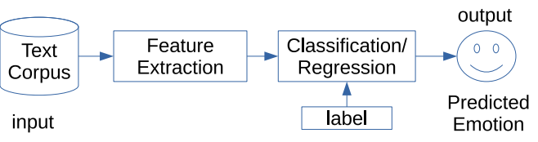
Text emotion recognition (TER)
TER is the process of identifying human emotion from text automatically by machine:
  Categorical: Recognize whether the human emotion is surprise, happiness, anger, fear, disgust, and sadness.
  Dimensional: Recognize the score of emotion dimensions (valence, arousal, dominance)
Basic system:

Slide 4
Text corpora
SemEval Affective Text (2007): Text corpus from news headlines, Categorical + Valence, 1500 sentences
ISEAR (1998): ext corpus of expression for given emotion categories, + Arousal, 7666 sentences.
IEMOCAP (2008): Multimodal emotion dataset, categorical + VAD, 10039 utterances.
EmoBank (2017): Text corpus from multi sources (news, blog, essay, fiction, etc) with VAD labels, 10062 sentences.

Slide 5
Text feature: Word Embedding
Word embedding is representation of document vocabulary.
It is capable to capture context, semantic, syntactic, and relation of words.
Example:
text = “That’s out of control “ Angry ([2.5, 3.5, 3.5])
tokenized = [“That’s”, “out”, “of”, “control”]
That’s = [1 0 0 0], out = [0 1 0 0], of=[0 0 1 0]
control = [0 0 0 1] --> size_of_vocab = 4

Slide 6
Word Embedding
If vocab_size is expanded to number of words in document, e.g. 2182 words, then word vector is
text_vector = [42, 44, 11, 471]
Those vector then is converted to floating point value, this is the text features.
Other word embedding: Word2Vec, GloVe, FastText
Other text features (word representation): Sent2Vec, Doc2vec, ELMo
This time, I only tried word vector with word2vex, Glove and FastText.

Slide 7
Text emotion recognition sytem
Text corpus --> Tokenization --> Text Vector (input)
Max sequence length = 537
Number of dimension (row) = 300
Deep learning architecture:
Layer # | Name | Input | Ouput
1 | Embedding | Text Vector, integer (537, 300) | Text Vector, Float (w/o weight), (537, 300)
2 | GRU 1 | (537, 300) | (537, 512)
3 | GRU 2 | (537, 512) | (256)
4 | Dense 1 | (256) | (512)
5 | Dense 2 | (512) | (6)

Slide 8
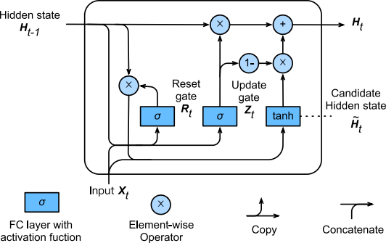
GRU Classifier
Very similar to LSTM but less parameters and faster

Slide 9
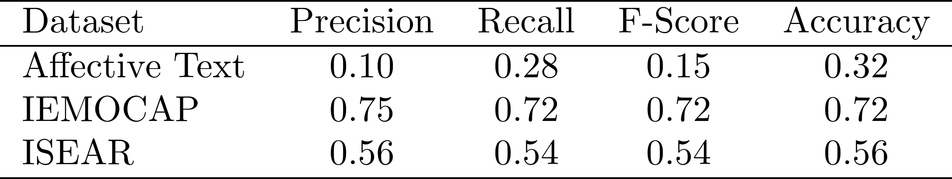
Result on Categorical task
Feed the text corpus into same architecture.
Use six/seven emotion catogiries.
Analyze the performance (prec., recall, f-score, acc.)

Slide 10
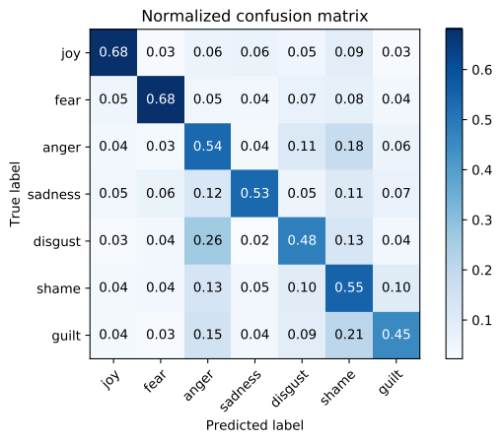
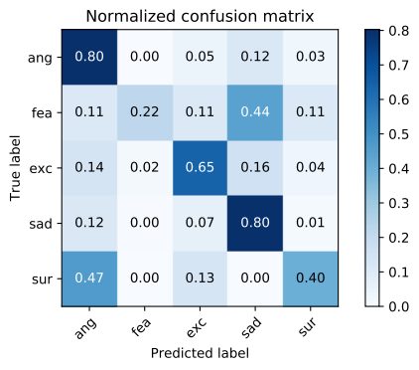
Confusion matrix
Fig. 2. Confusion matrix of IEMOCAP dataset (lef) and ISEAR (right) categorical text emotion recognition

Slide 11
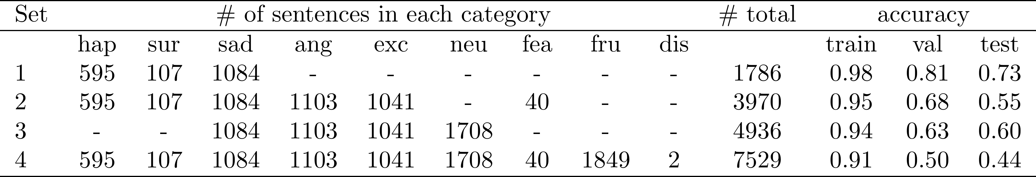
Impact of data size & number of categories
Evalaute the system from small number of categories to the bigger number of categories
Monitor the accuracy of train, val., and test data

Slide 12
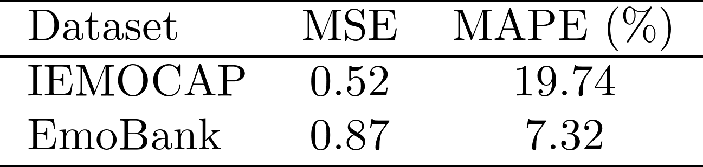
Result on dimensional task
Feed the same input text feature to the system
The difference of the system for dimensional task is the last layer: Number of output and activaction function (linear instead of softmax)
Use MSE as loss and MAPE as performance metric
Train/test split = 80:20 (20% of train used as val.)

Slide 13
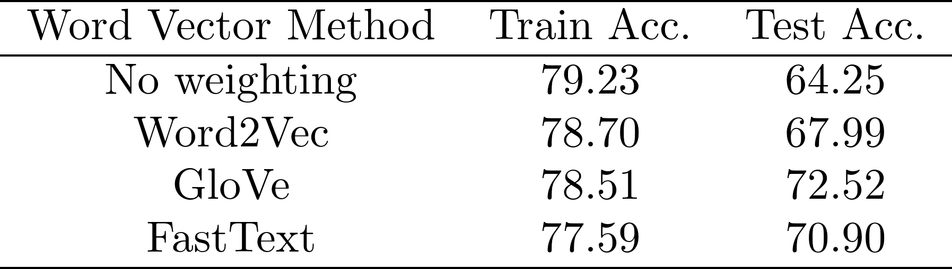
Pretrained Word Embedding
Use pre-trained word embedding from web crawl to weigh word vector

Slide 14
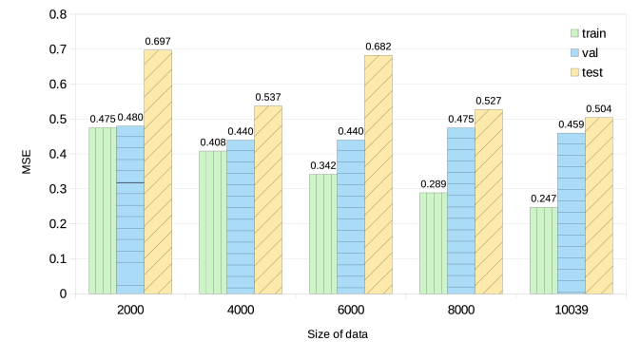
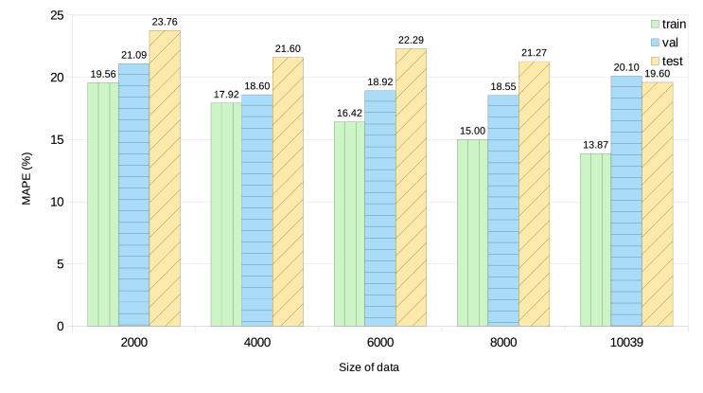
Dimensional data:
Initial result on impact of data size, IEMOCAP
Split data to 2000, 4000, 6000, 8000, 10000
80% for training, 20% for test (20% of training for val.)

Slide 15
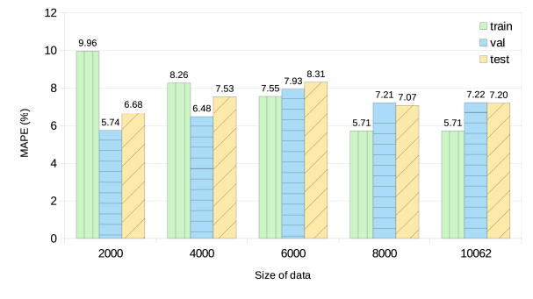
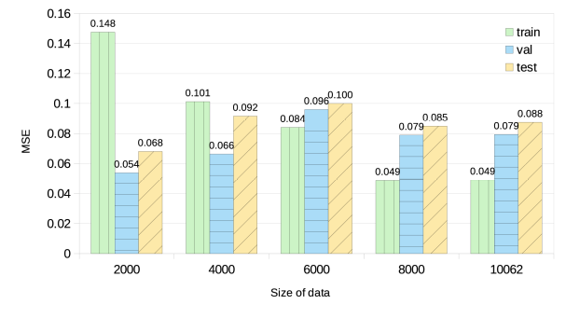
Dimensional data:
Initial result on impact of data size, EmoBank

Slide 16
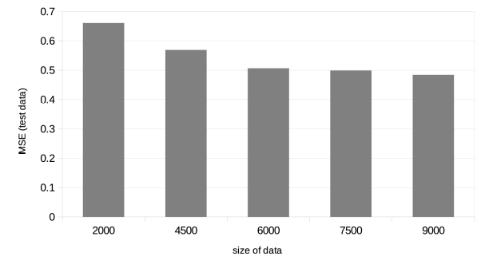
Dimensional task revised: Impact of data size
Keep 1000 data for test, varying train/val set.

Slide 17
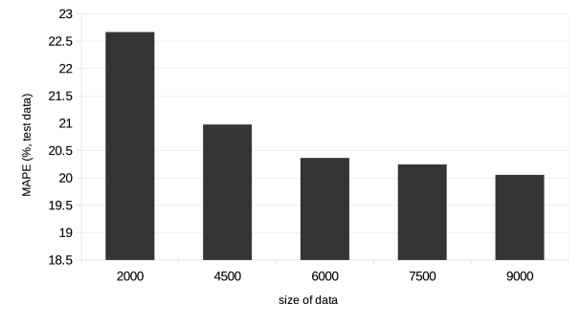
Dimensional task revised: impact of data size
MAPE performance of test data on IEMOCAP dimensional text emotion recognition

Slide 18
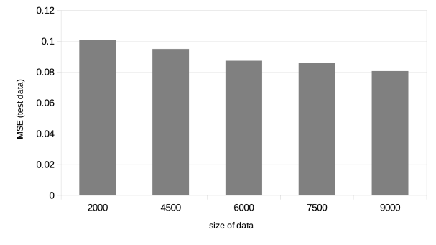
Dimensional task revised: impact of data size
MSE loss of test data on EmoBank dataset

Slide 19
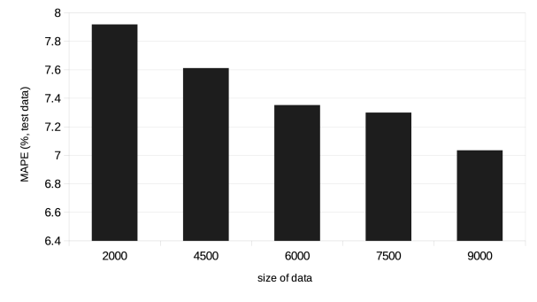
Dimensional task revised: impact of data size
MAPE performance of test data on EmoBank dimensional text emotion recognition

Slide 20
Conclusion on text emotion recognition
Same system works on categorical and dimensional dataset
For categorical: the smaller data with smaller number of categories yield better performance than big data with more categories (similar to how our brain works?)
For dimensional: the more data the better performance
Pre-trained word embedding improves performance

Slide 21
Future works on text emotion recognition
Use different word representation: Sent2vec, ELMo
Use affective dictionary and the similar (Sentiwordnet, VADER (Valence Aware Dictionary for sEntiment Reasoning)) to weigh word vector

Slide 22
Current submitted paper
EUSIPCO
  Continuous Audio/Video Emotion Recognition Using Feature Selection and LSTM
  Review result date: June 4, 2019
Interspeech
  Speech Emotion Recognition Using Voiced Speech and Word Embedding
  Reiview result date: June 17, 2019

Slide 23
Candidate papers: APSIPA/oCOCOSDA/ASJ
If a paper from EUSIPCO and Interspeech is rejected, then I will resubmit it to APSIPA
If both papers are rejected I will resubmit it to APSIPA and/or oCOCOSDA
If one or both is accepted, I have the following results for APSIPA/oCOCOSDA/ASJ:
  Dimensional emotion recognition from acoustic and text features --> APSIPA/oCOCOSDA ..?
  Dimensional speech emotion recognition --> oCOCOSDA/MSEASJ ..?

