Slide 1
Weekly Meeting Progress
July 9th, @btatmaja

Slide 2
Overview
Resume AVEC 2019
Preparation Material for Paper for ASJ Autumn 2019

Slide 3
AVEC 2019
Challenge: Cross-cultural emotion recognition
Given German+Hungarian Corpus, participants are asked to predict Chinese culture ( investigate how emotion knowledge of Western European cultures (German, Hungarian) can be transferred to the Chinese culture)
Dataset: SEWA corpus
Metric: averaged Concordance Correlation Coefficient (CCC)

Slide 4
Feature Sets (Baseline, provided)
Audio: functionals of low-level descriptors (eGeMaps, MFCC), bag-of-audio-words (BoAW-e, BoAW-M), unsupervised deep representations (DeepSpectrum, VGG16); functinal low-level descriptors are additionally provided using openSMILE (eGeMaps Func., MFCC Func.)
Video: functionals of low-level descriptors (FAUs), bag-of-visual-words (BoVW); unsupervised deep representations (ResNet-50, VGG16); low-level descriptors are additionally provided using openFACE (FAUs Func.)

Slide 5
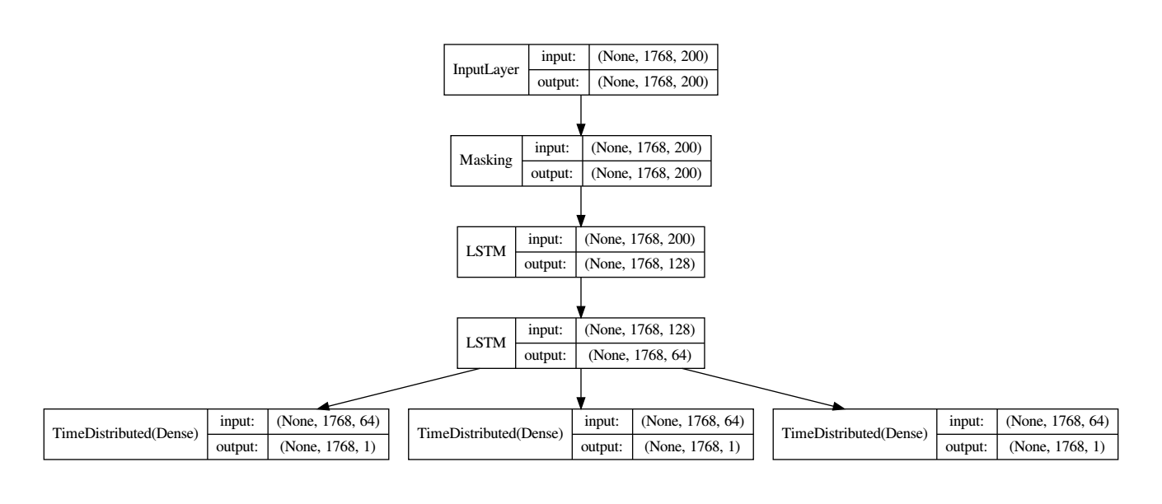
Baseline method

Slide 6
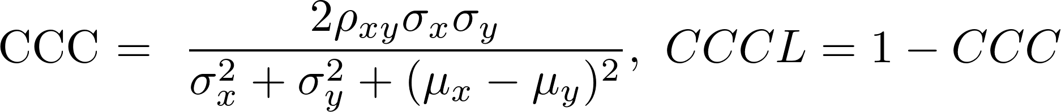
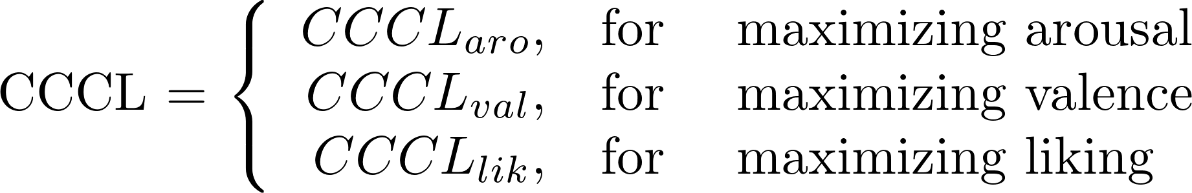
Strategy #1: Multi-task Learning
Multi-task learning = joint learning = learning together
  >> Learning to minimizer loss function of multiple variables at the same time (arousal, valence, liking)
Compared to singlte-task learning (STL): only minimizes single variable in a learning process

Slide 7
Multi-task Learning
Parthasarathy & Busso (2017) formulation,
α and β in range 0-1 (floats).
My proposed multi-task learning,
α, β, and γ are any number (floats or integer).

Slide 8
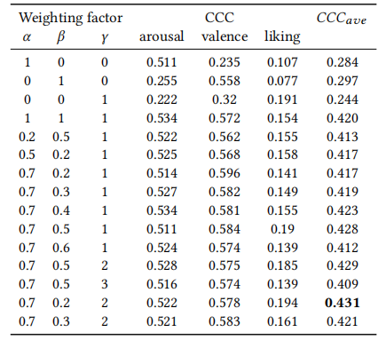
Multi-task learning: find parameter factor

Slide 9
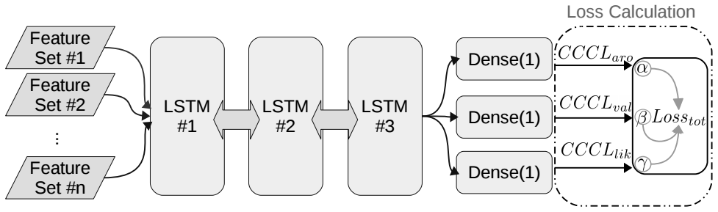
Resume: System with Multi-task learning

Slide 10
Strategy #2: Multistage Fusion
The previous multi-task learning is proposed for unimodal or multimodal with early fusion. How about late fusion?
In late fusion, results are combined at decision level. Some result of prediction (of arousal, valence, and liking) are combined to improve recognition of emotion degree.
Strategies:
  User SVR for late fusion
  Combine result from any unimodal and/or multimodal
  Combine result from early fusion and latefusion with multistage fusion.

Slide 11
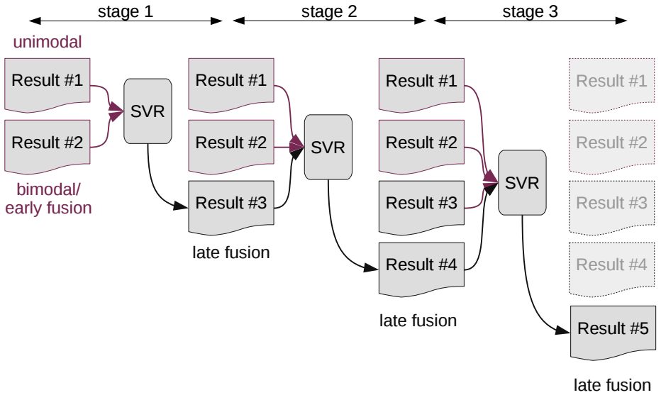
Multistage SVR Fusion

Slide 12
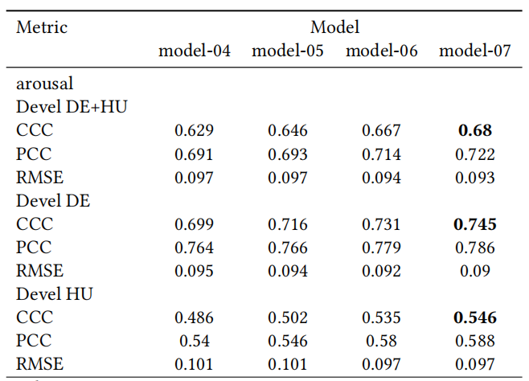
Result

Slide 13
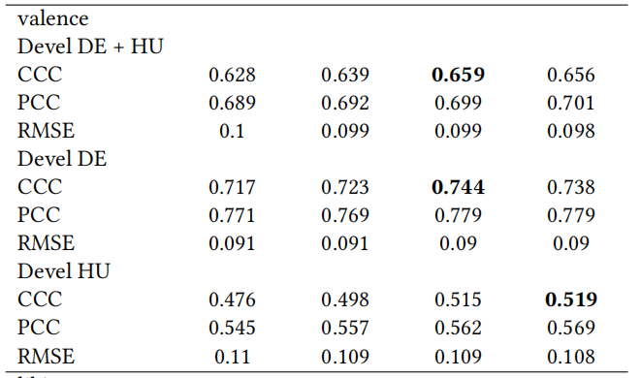
Result on Development Set: Valence

Slide 14
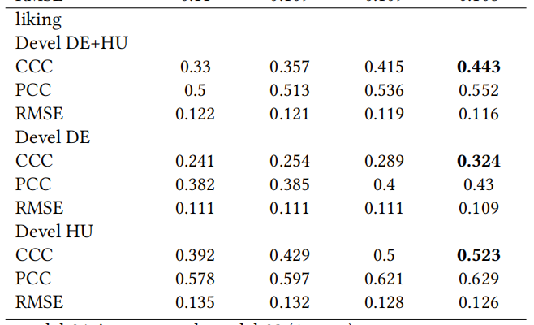
Result on Development Set: Liking

Slide 15
Conclusion on AVEC 2019
Multi-task learning works for recognition rate improvement on emotion degree, but not so much improved.
Multistage fusion improve CCC score significantly, but only for development. It get lower score on cross-language emotion recognition (Chinase language, in this case).

Slide 16
ASJ Autumn 2019
Theme: RNN-based dimensional emotion recognition
Dataset: IEMOCAP
Feature set:
  31 Features
  eGeMaps LLDs
  eGeMaps Functionals
Main contribution:
  Multi-task learning
  RNN-based (GRU/LSTM) for regression task (dimensional emotion) to accommodate multi-task learning.

Slide 17
Method
Dataset: IEMOCAP
Feature Set:
  31 Features
  eGeMaps
Classifier:
  3 layers GRU/LSTMs
  Multi-task Learning

Slide 18
Outline
Introduction
Acoustic Feature Set
  31 Features
  eGeMaps
RNN-based dimensional emotion regressor:
  3 layers LSTM/GRUs
  Multi-task learning
  Analysis of other hyperparameters
Result
Conclusion
Total 2 pages paper.

Slide 19
Result (Using MSE as loss function)
Method | MSE | MAPE | MAE | CCC
31 Features
Baseline DNN (Dense) | 0.77 | 24.3 | 0.70 | 0.145
GRU | 0.78 | 25.4 | 0.70 | 0.147
LSTM | 0.74 | 23.83 | 0.68 | 0.14
eGeMAPS
Baseline DNN (Dense) | 0.839 | 25.306 | 0.72 | 0.153
GRU | 0.665 | 22.99 | 0.653 | 0.069
LSTM | 0.654 | 23.259 | 0.653 | 0.072

Slide 20
Conclusion on ASJ Draft
Works done:
  Multi-task learning for maximizing arousal, valence, dominance.
  RNN-based classifier architecture
Remaining problems:
  Functional feature extraction
  CCC implementation for IEMOCAP
Potential implementation
  Independent layer instead of shared layer for Multi task learning
Layer2
Layer2
Layer2
Layer2
Layer1
Layer1

