Slide 1
Weekly Meeting
@btatmaja
August 1st, 2019

Slide 2
Overview
Feedback froms ICSigSys and ISST
Preparation for ASJ Autumn 2019
Current papers waiting for decisision
To-do (in August): Finishing Minor Research

Slide 3
Feedback from ICSigSys and ISST
ICSigSys (Acceptance rate: 54%):
  Why the performance still low? Compared to others with the similar data, it is comparable. This is the challange, two most crucial techniques: feature extraction and classification.
  What is future application? Call center to recognize caller emotion, sentiment/polarity view of debate, etc.
ISST:
  The use of GPU? Yes.
  Future research? Combining text and speech.

Slide 4
Result for ASJ Autumn 2019
eGeMaps feature set outperforms traditional (31) features (need proper processing to make it works: N frames, etc.)
Multi-task learning works well to predict dimension of valence, arousal, and dominance simultaneously.
RNN with LSTM works better than GRU and DNN.
Successfully implement CCC score as evaluation matrices (now we can compare and benchmark to other researcher results)

Slide 5
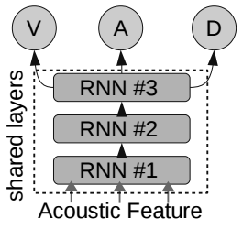
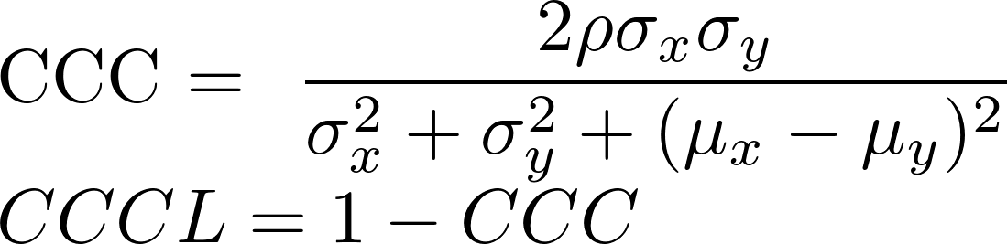
RNN-based SER
Loss function:
Multi-task learning:

Slide 6
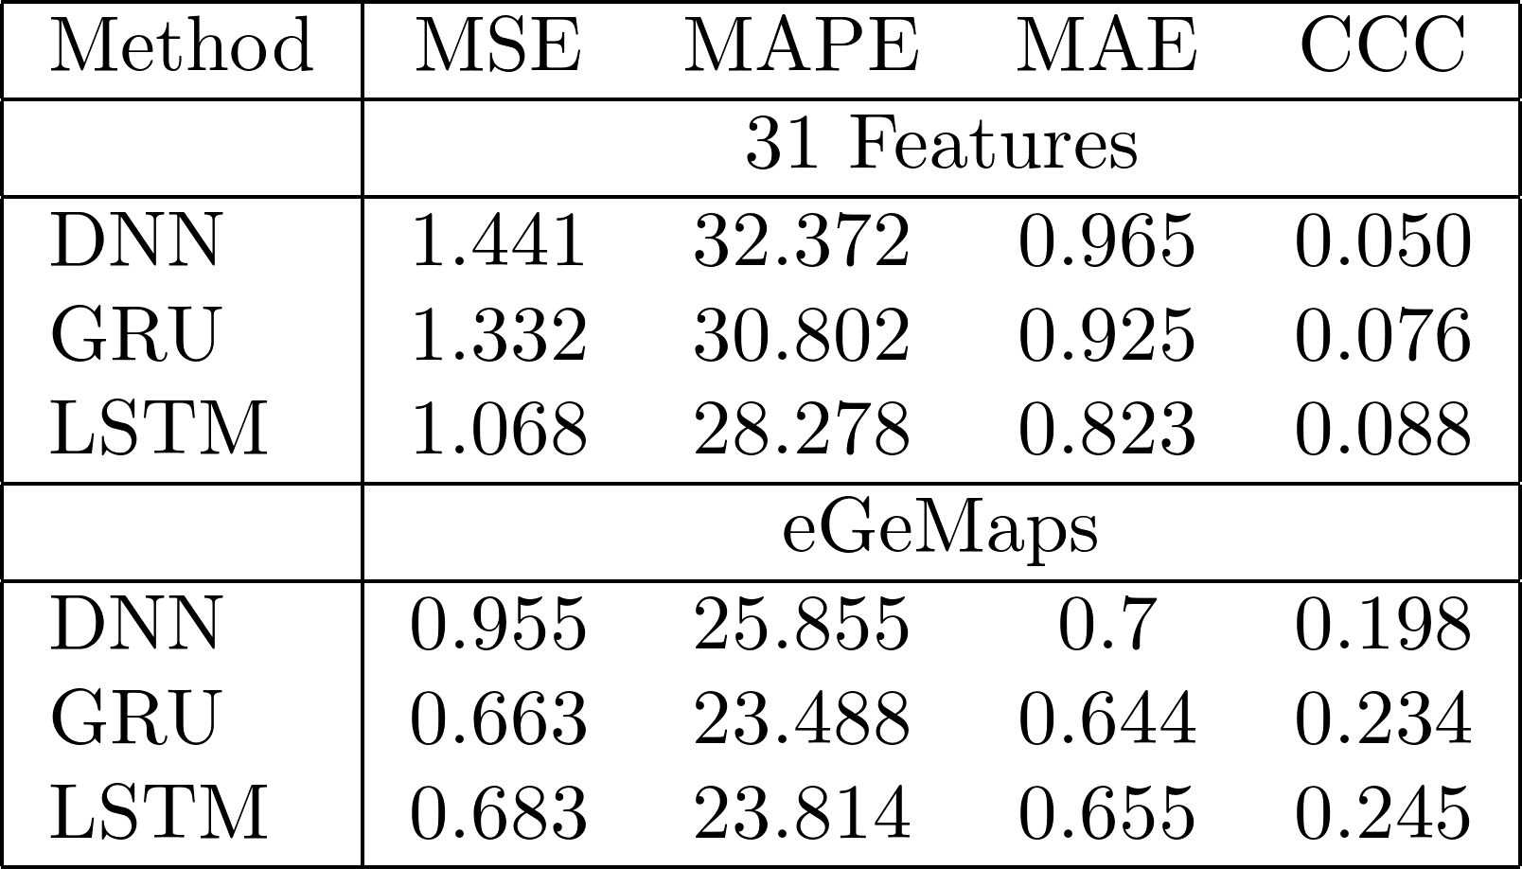
Result ASJ Autumn 2019

Slide 7
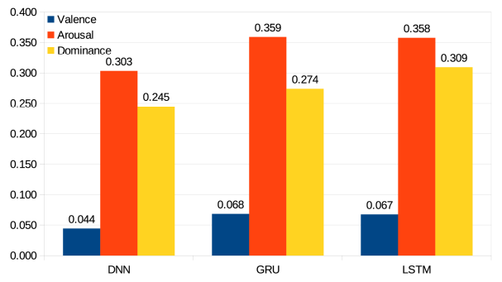
Result AJS Autumn 2019
Best CCC score (LSTM): [0.11, 0.43, 0.36]

Slide 8
Review/Future works from ASJ Autumn Draft
Use three different model instead of single model (as used in AVEC), i.e. each model predict one dimension (valence, arousal, OR dominance)
Use independent layers instead of shared layer.
Try? : BoAW and functional (statistics) feature from eGeMaps.

Slide 9
Current papers waiting for decision
AVEC 2019 (August 5th):
  Multi-task learning and Multistage Fusion Audio/Visual Emotion Recognition
APSIPA 2019 (July 31):
  Continuous Audio/Video Emotion Recognition Using Feature Selection and LSTM
  Speech Emotion Recognition Using Speech Feature and Word Embedding
O-COCOSDA 2019 (August 7th):
  Dimensional Speech Emotion Recognition from Acoustic and Text Features

Slide 10
Todo: Finishing Minor Research
Tasks done in minor research: categorical and dimensional text emotion recognition using word embedding.
Remain task in minor research: text emotion recogntion using affective dictionary/lexicons.
Todo:
  Evaluating text emotion recognition using the following methods:
    Sentiwordnet (sentiment/valence only)
    VADER (sentiment/valence only)
    ANEW (valence, arousal, and dominance)

