Slide 1
Weekly Meeting
November 2019
@btatmaja
Notes:
Introduce yourself. (Change your name in the slide and the name of the event).
Explain what the workshop is about:
Introduction to the Ubuntu Touch platform
Get participants set up.
Explain how to flash your device with Ubuntu Touch.
Introduce the Ubuntu SDK.
Introduce the technologies used for Ubuntu Apps.
Walk the audience through a QML and a HTML5 apps.

Slide 2
Outline
Current works
Rejected Papers & Plan
Proposal for ASJ Spring 2020
Proposal for Journal Manuscript

Slide 3
Current works
Comparing MTL with 2 and 3 parameters
Last LM, feedback from Unoki Sensei:
  The previous paper use 2 params because the sum to be bounded, 0-1.
But, I think It (2 parameters) may give better result if the relation between valence, arousal, and dominance close to correct/optimal

Slide 4
MTL with 2 parameters [1]
MSE
Best parameters, α = 0.7, β = 0.3, γ = 0
Use CCC as metric and MSE as loss function.
Use two dense layer as shared layer in MTL1 and shared + independent layer in MTL2.
No explanation why the sum is limited in bound 0-1, because it is loss function with no statistical meaning, it may lies in unbounded range.
[1] S. Parthasarathy and C. Busso, “Jointly Predicting Arousal, Valence and
Dominance with Multi-Task Learning,” in interspeech, 2017, pp. 1103–1107.

Slide 5
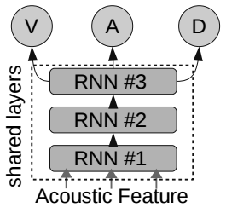
Proposed MTL with 2 and 3 parameters
MTL with 2 parameters
MTL with 3 parameters
CCCL = 1 - CCC

Slide 6
MTL with 2 params
Number of k-combinations: 121
Best parameter:
  IEMOCAP: α = 0.1, β = 0.5, γ = 0.4
  IMPROV: α = 0.3, β = 0.6, γ = 0.1
Best result:
  IEMOCAP: [0.13, 0.56, 0.47], μ=0.39
  IMPROV: [0.36, 0.56, 0.45], μ=0.45

Slide 7
MTL with 3 parameters
Number of k-combinations: 1331
Parameter (not highest):
  IEMOCAP: α = 0.7, β = 0.3, γ = 0.6
  IMPROV: α = 1, β = 1, γ = 1
Result (not highest)
  IEMOCAP: [0.15, 0.47, 0.46], avg=0.36
  IMPROV: [0.34, 0.53, 0.41], avg=0.43
Can’t perform linear search to find best parameter due to limitation of wall time in JAIST MPC (3days)
Current own PC is used to find best parameters on AVEC dataset (already 1 month running)

Slide 8
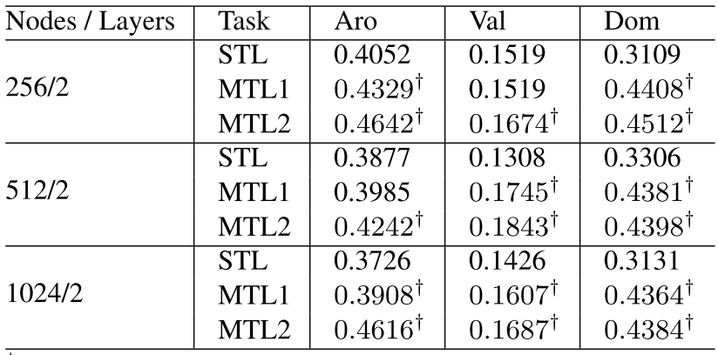
Srinivas’ Result [1]
Dataset: IEMOCAP+IMPROV
μ=0.34
*the similar dataset (iemocap+improv) is not performed yet

Slide 9
On going works
Find best parameters in MTL with 3 parameters
Surface plot parameters as function of average CCC

Slide 10
Rejected Papers and Plan
APSIPA 2019
  Title: Continuous Audio/Video Emotion Recognition Using Feature Selection and LSTM
  Plan: to be submitted to Journal of Signal Processing (RISP)
OCOCOSDA 2019
  Title: Dimensional Speech Emotion Recognition from Acoustic and Text Features
  Plan: to be submitted to Telkomnika Journal

Slide 11
Proposal for ASJ Spring 2020
Continue what is done in ASJ Autumn 2019: RNN-based Dimensional Speech Emotion Recognition
Add text feature to previous work above
Proposed title:
  Dimensional Emotion Recognition with Speech and Text Feature using Multitask Learning
  Alternate: Predicting Valence, Arousal, and Dominance in Speeh from Acoustic and Text Feature

Slide 12
Proposal for Journal Manuscript
Journal + Theme: Computer Speech and Language,
‘’Recursive SVM feature fusion for combining acoustic and text features in speech emotion recognition’’
Highlights:
  Acoustic and text feature are combined to improve performance of speech emotion recognition from single modality.
  Multitask learning are used to balance performance among among valence, arousal, and dominance emotional dimensions.
  Proposed recursive SVM by combining result from speech and text emotion recognitions improve recognition performance

Slide 13
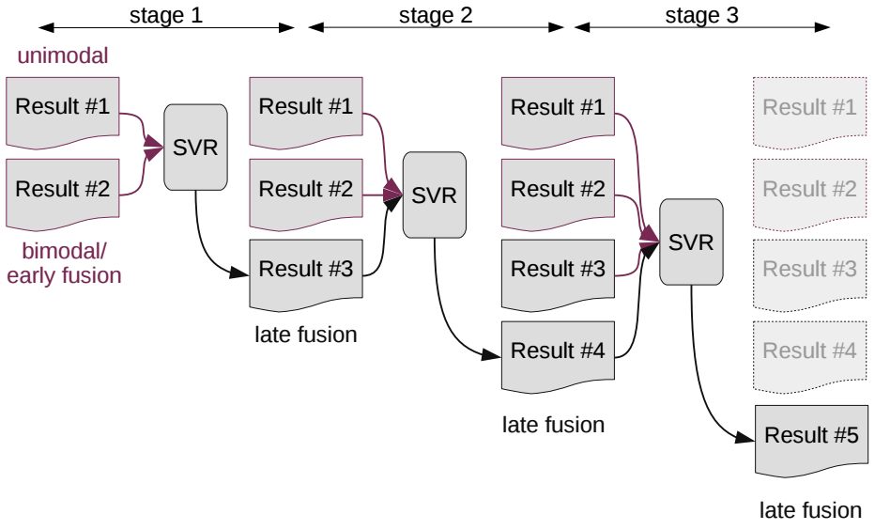
Recursive SVR
Improvement from method submitted to ICASSP
In previous method, the number of
stages is determined explicitely and
performed stage by state. In proposed
the process id done automatically.
Number of stages,
N = 3

