Slide 1

Prokom-0:
Computer, Computation, Algorithm, Numeral System, Flowchart, Pseudocode, IDE, C language
@btatmaja

Slide 2
Course Information
Pre-requisite: Basic Understanding on how Computer Works
  Visit and Learn: TIK course D3 Instrumentasi
  http://share.its.ac.id/course/view.php?id=802
Course home page: Pemrograman Komputer C
http://share.its.ac.id/course/view.php?id=1017
Laboratory experiment (praktikum) will be organized by Labkom E-205.

Slide 3
Overview
Programming, Algorithm
Flowchart, Pseudocode
ASCII, Binary
Compiler, IDE
C and C++ language
Hello World!

Slide 4
Programming
Every computer is a machine >> It does not think >> It cannot understand >> It does not know what you want it to do.
Everything you want it to do must be told to it, explicitly in its language >> comp programming
Belajar memprogram != belajar membuat program

Slide 5
Binary
Binary: 0, 1
Octal: 0,1, 2, 3, 4, 5, 6, 7
Decimal: 0, 1, 2, 3, 4, 5, 6, 7, 8, 9
1 2 3₁₀= ..₂
100 10 1
100 x 1 + 10 x 2 + 1 x 3

Slide 6
Hexadecimal
0, 1, 2, 3, 4, 5, 6,7, 8, 9, a, b, c, d, e, f
Decimal: 255 256
Binary: 1111 1111 1101 1000
Hexa: f f d 8
            0xff 0xd8

Slide 7
ASCII
A B C D E F G H I
65 66 67 68 69 70 71 72 73
J K L M N O P Q R
74 75 76 77 78 79 80 81 82
S T U V W X Y Z
83 84 85 86 87 88 89 90
H I !
72 73 33

Slide 8
Algorithm
Algoritma adalah langkah-langkah logis penyelesaian suatu masalah
Input >> ALGORITMA >> output
Algoritma bisa berupa:
  Flowchart
  Pseudo code

Slide 9
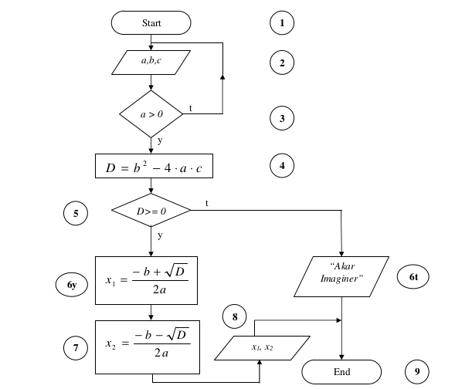
Flowchart

Slide 10
Name
Symbol
Use in Flowchart
Oval
Denotes the beginning or end of the program
Parallelogram
Denotes an input operation
Denotes a process to be carried out e.g. addition, subtraction, division etc.
Rectangle
Denotes a decision (or branch) to be made. The program should continue along one of two routes. (e.g. IF/THEN/ELSE)
Diamond
Hybrid
Denotes an output operation
Denotes the direction of logic flow in the program
Flow line

Slide 11
Pseudocode
Ambil buku telfon
Buka tengah-tengah buku
Cari nama “Sanusi”
If “Sanusi” ada di halaman tersebut
Telfon Sanusi
Else if “Sanusi” berada di halaman depan
Buka tengah buku kiri
Ke baris-3
Else if “Sanusi” berada di halaman belakang
Buka tengah buku bagian kanan
Ke baris-3
Selesai

Slide 12
Hello C!
#include <stdio.h>
int main (void)
{
printf(“hello world”);
}

Slide 13
Hello World!
#include <stdio.h>
Int main (void)
{
printf(“hello world\n”);
}

Slide 14
Hello, Bagus!
#include <stdio.h>
Int main (void)
{
char nama[10] = "Bagus";
printf("hello, %s\n", nama);
}

Slide 15
Hello, Nama!
#include <stdio.h>
int main(void)
{
char nama[10];
printf("Masukkan nama anda: ");
scanf("%s", nama);
printf("hello, %s\n", nama);
}

Slide 16
How it works
Source Code
Compiler >> Compile/build
Object Code >> Run
fdsafa

Slide 17
The Compiler
Turbo C
Visual C
GCC
Borland C
Clang
...

Slide 18
Command (line)
gcc -o hello hello.c >> ./hello
gcc hello.c >> ./a.out
clang -o hello hello.c -lcs50 >> ./hello
clang hello.c -lm >> ./a.out
Code::blocks >> build > run
Visual C >> build > run

Slide 19





Editor and IDE
Gedit and Terminal plugin
Geany
Code::Blocks
Dev-C++
VisualStudio Express
www.cs50.io

Slide 20
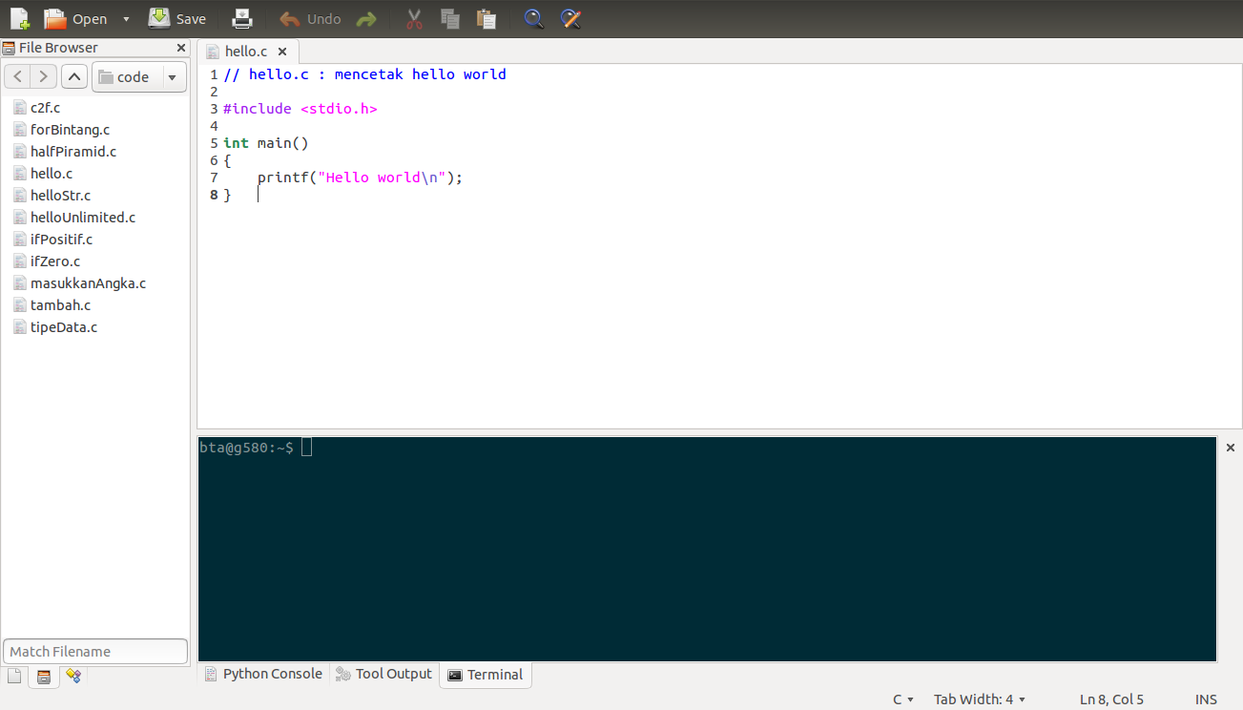
Editor >> Gedit

Slide 21
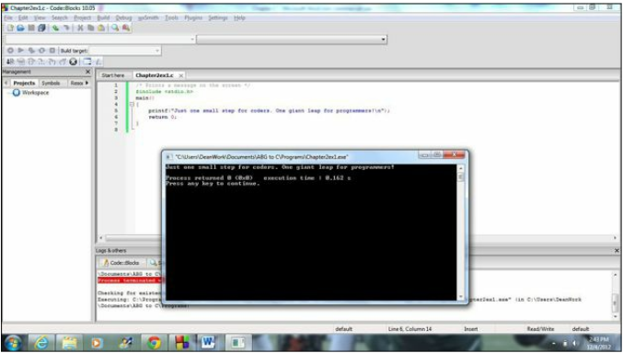
IDE >> Code::Blocks
Integrated development Editor
Buid >> Run

Slide 22
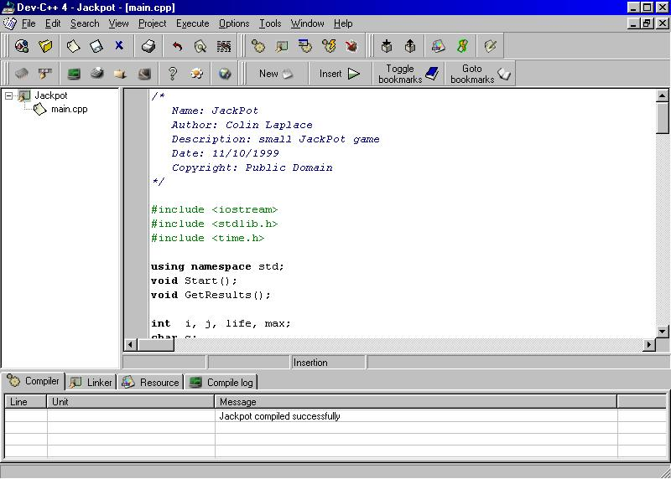
Dev-C++

Slide 23
Operator
Operator Assignment
Operator Unary / Arithmetic
Operator Binary / Boole
Operator Ternary / Coditional / Relational

Slide 24
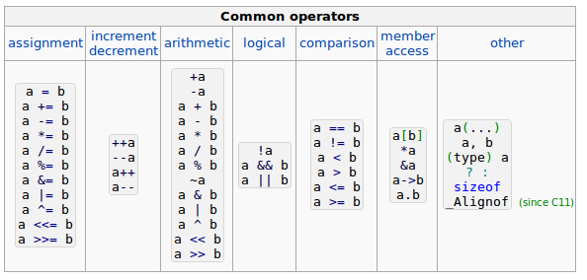
Operator

Slide 25
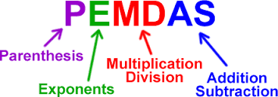
Operators
Add + 4 + 4 = 6
Substract - 4 - 4 = 0
Multiply * 4 * 4 = 16
Divide / 4 / 4 = 1
Modulo % 4 % 4 = 0
Order of operator >>

Slide 26
Assignment
= Assignment operator
+= Increment and assign
-= Decrement and assign
*= Multiply and assign
/= Divide and assign
%= Modulo and assign
&= Bitwise AND and assign
^= Bitwise exclusive OR and assign
|= Bitwise inclusive (normal) OR and assign
<<= Bitwise shift left and assign
>>= Bitwise shift right and assign

Slide 27
Relational
> greater than 5 > 4 is TRUE
< less than 4 < 5 is TRUE
>= greater than or equal 4 >= 4 is TRUE
<= less than or equal 3 <= 4 is TRUE
== equal to 5 == 5 is TRUE
!= not equal to 5 != 4 is TRUE

Slide 28
Decision Tree: IF .. ELSE
Jika nila kurang dari 60
cetak “anda lolos”
Sebaliknya
anda “tidak lolos”
if (x > 60)
  printf(“Anda Lolos”);
else
  printf(“Anda tidak lolos”);
START
Input
M1,M2,M3,M4
GRADE←(M1+M2+M3+M4)/4
Y
IS
GRADE>
60
N
PRINT
“PASS”
PRINT
“FAIL”
STOP

Slide 29
IF ... ELSE IF ... ELSE
if (n > 0)
printf("Anda memasukkan bilangan positif!");
else if (n == 0)
printf("Anda memasukkan bilangan 0");
else
printf("Anda memasukkan bilangan negatif!");

Slide 30
Selamat Belajar
Work Hard
Work Smart
Learning by Doing
One day, One Code
Keep coding!
Referensi:
share.its.ac.id
github.com/bagustris
cplusplus.com
cppshell.com
cs50.net
@btatmaja

