Slide 1
Prokom-1:
Algorithm, Programming, Flowchart, Pseudocode,
Decisision Tree, Loop

Slide 2
Overview
C Vs C++
Syntax
Decision Tree
Variable
Statements
Loop

Slide 3
Algorithm
Algoritma adalah langkah-langkah logis penyelesaian suatu masalah
Input >> ALGORITMA >> output
Algoritma bisa berupa:
  Flowchart
  Pseudo code

Slide 4
C Vs C++
C | C++
Structural/Procedural | Object Oriented
Standard Library (stdio) | iostream
Simplicity | Complexity
User defined, struct | Template, Class, etc

Slide 5
Syntax
#include <stdio.h>
Int main (void)
{
printf(“hello world”);
}

Slide 6
Hello C!
#include <stdio.h>
Int main (void)
{
printf(“hello world\n”);
}

Slide 7
Hello, Bagus!
#include <stdio.h>
Int main (void)
{
char nama[10] = "Bagus";
printf("hello, %s\n", nama);
}

Slide 8
Hello, Bagus!
#include <stdio.h>
int main(void)
{
char nama[10];
printf("Masukkan nama anda: ");
scanf("%s", nama);
printf("hello, %s\n", nama);
}

Slide 9
How it works
Source Code
Compiler >> Compile/build
Objec Code >> Run
fdsafa

Slide 10
Decision Tree: IF .. ELSE
Jika nila kurang dari 60
cetak “anda lolos”
Sebaliknya
anda “tidak lolos”
if (x > 60)
  printf(“Anda Lolos”);
else
  printf(“Anda tidak lolos”);
START
Input
M1,M2,M3,M4
GRADE←(M1+M2+M3+M4)/4
Y
IS
GRADE>
60
N
PRINT
“PASS”
PRINT
“FAIL”
STOP

Slide 11
IF ... ELSE IF ... ELSE
if (n > 0)
printf("Anda memasukkan bilangan positif!");
else if (n == 0)
printf("Anda memasukkan bilangan 0");
else
printf("Anda memasukkan bilangan negatif!");

Slide 12
Format Code & Escape Sequence
%f
%i
%d
%c
%lld
%s
\n
\r
\t
\'
\”
\\

Slide 13
Comments – Single Line
Do's
// convert Fahrenheit to Celsius
float c = 5.0 / 9.0 * (f – 32.0);
Don'ts
//convert Fahrenheit to Celsius
// convert Fahrenheit to Celsius.

Slide 14
Comments - Mutline
/**
* hello.c
*
* Bagus Tris Atmaja
* bagus@ep.its.ac.id
*
* Says hello to the world.
*/

Slide 15
Statement
int x = 12;
int x;
if ( x > y )
printf("hello, %s\n", s);
function

Slide 16
Variable
// declaring a variable
int counter = 0;
int counter2;
// resetting a variable
counter = 4;
counter2 = 5;

Slide 17
Variable
int counter = 0;
while (true)
{
printf("%d\n", counter);
counter++;
}

Slide 18
Loop
Digunakan untuk kejadian berulang
Untuk i=0, i kurang dari 10, i++
  cetak *
I++ >> i = i+1
Output :
**********

Slide 19
For Loops
Inisialisasi
Update
Cek Kondisi
Keluar
Eksekusi
for ( i = 1; i<=10; i++)
// eksekusi

Slide 20
For
#include <stdio.h>
int main(void) {
int i;
for (i = 0; i < 10; i++)
printf("*");
}

Slide 21
For [1]
#include <stdio.h>
int main(void) {
int i;
for (i = 0; i <= 10; i++)
printf("*");
printf("\n");
}

Slide 22
For [2]
#include <stdio.h>
int main(void) {
Int i:
for (int i = 0; i <= 10; i++)
printf("*\n");
}

Slide 23
For [3]
#include <stdio.h>
int main(void) {
int i, j;
for (i=1; i<=10; i++) {
for (j=1;j<=i; j++)
printf("*");
printf("\n");
}
}

Slide 24
Output
*
**
***
****
*****
******
*******
********
*********
**********
FLOWCHART??

Slide 25
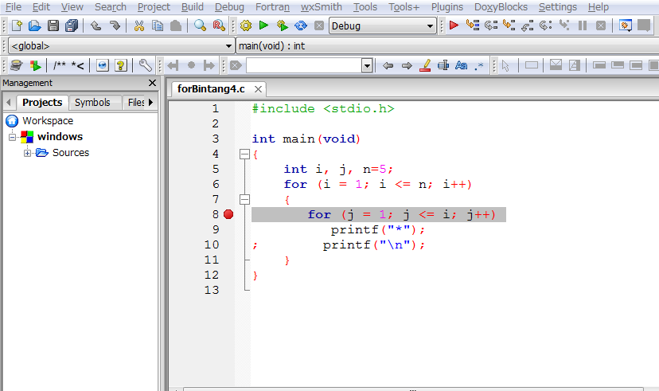
Debug
Toggle break point (F5)
Start (F8)
Next line (F7)
Inside a project

Slide 26
Buatlah
Flowchart untuk membentuk pola berikut.
Input = N bilangan bulat
Output
N =1 * | N = 3 * ** ***
N = 5 * ** *** **** ***** | N = 7 * ** *** **** ***** ****** *******

Slide 27

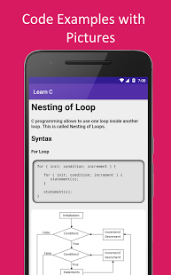
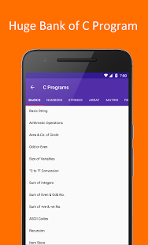
Install Android Apps >> Learn C
Selamat Belajar
Work Hard
Work Smart
Learning by Doing
One day, One Code
Keep coding!

