Slide 1
Prokom-4:
Argumen, Array, String, Pointer, Fungsi
@btatmaja

Slide 2
Slide Contents
Argument
Keywords
Array dan String
Array bukan String
Pointer
Memory Allocation

Slide 3
Argumen
>> ping its.ac.id
[y, fs, n] = wavread('fena.wav');
int main(int argc, char* argv[])
input
Argument
actual
parameter
Command/
Perintah
Command/
Perintah
Command/
Perintah
output argumen
Command line argument / formal parameter

Slide 4
Keywords (C/C++)
asm, auto, bool, break, case, catch, char, class, const, const_cast, continue, default, delete, do, double, dynamic_cast, else, enum, explicit, export, extern, false, float, for, friend, goto, if, inline, int, long, mutable, namespace, new, operator, private, protected, public, register, reinterpret_cast, return, short, signed, sizeof, static, static_cast, struct, switch, template, this, throw, true, try, typedef, typeid, typename, union, unsigned, using, virtual, void, volatile, wchar_t, while

Slide 5

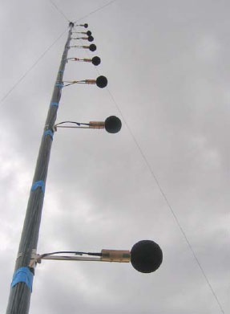
Array, what is that?
SINGLE MIC
MIC ARRAY

Slide 6
Array
char nama[20];
int candy[15];
float hari[375];
An array is a series of item/elements of the same type
Character Array and A String
Character Array but NOT String
An array called nama that has [20] elements of type char
h | e | l | l | o |  | w | o | r | d | ! | \0
h | e | l | l | o |  | w | o | r | d | !
printf/cout

Slide 7
String Terminator
char G[5];
G[0] = 'G';
G[1] = 'O';
G[2] = 'O';
G[3] = 'D';
G[4] = '\0';
G | O | O | D | \0
G[0]
G[1]
G[2]
G[3]
G[4]
MEMORY
G
O
O
D
\0

Slide 8
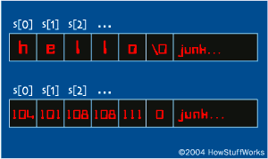
String
#include <stdio.h>
int main ()
{
char greeting[6] = {'H', 'e', 'l', 'l', 'o', '\0'};
printf("Greeting message:\n ");
printf(“%c”, greeting);
return 0;
}

Slide 9
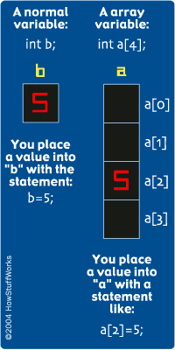
Array
int i, a[5];
a[0]=0;
a[1]=1;
a[2]=5;
a[3]=10;
for(i=0; i<4; i++)
printf(“%d “, a[i]);
printf(“\n”);
return 0;

Slide 10
Array0.c
int sample[10];
int t;
for(t=0; t<10; t++)
sample[t]=t;
for(t=0; t<10; t++)
  printf("this is sample [%d] \n", sample[t] );
  return 0;

Slide 11
Array3.c
float rata2; int nums[10];
printf("Masukkan 10 angka: ");
for(i=0; i<10; i++) {
scanf("%d", &nums[i]);
jml=jml+nums[i]
if (i==0)
min=max=nums[i];
else {
if(nums[i]<min)
min=nums[i];
if(nums[i]>max)
max=nums[i];
}
}
rata2 = jml/10.0;
printf("Rata-rata adalah %d", rata2);
printf("Min: %d", min);
printf("Max: %d", max);

Slide 12
Array 2D --> Multidimensi
int t,i,nums[3][4];
for(t=0; t<3; t++)
{
for(i=0; i<4; i++)
{
nums[t][i]=(t*4)+i+1;
printf("%d ", nums[t][i]);
}
printf(“\n”);
}

Slide 13
Pointer
A pointer is an object that contains a memory address
Operator Description
& Address-of operator
* Dereferencing Operator/Pointer
  int var1=5, float var2=2.5; //define variable
  int * pVar1; // define pointer variables
  int * pVar2;
  int * pVar1 = &var1; //Link up the pointer

Slide 14
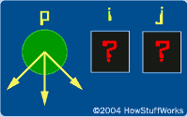
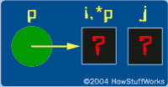
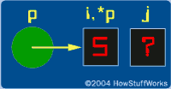
Pointer0.c
int main() {
int i,j;
int *p; // pointer to integer
p = &i; // address-of
*p = 5; // store 5 in pointer p
j = i;
printf(“i = %d, j = %d, p = %d\n“, i, j *p);
return 0;
}

Slide 15
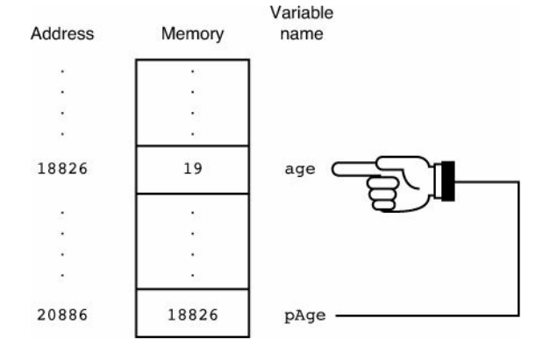
Pointer1.c
int age; // Defines a regular integer
int * pAge; // Defines a pointer to an integer
age = 19; //Stores 19 in age
pAge = &age; // Links up the pointer

Slide 16
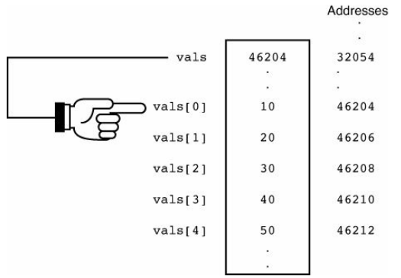
Array and Pointer
vals[5] = {10, 20, 30, 40, 50};
for (i=0; i<5; i++)
printf("Array %d is %d, Saved in %p.\n", i, vals[i], &vals[i]);

Slide 17
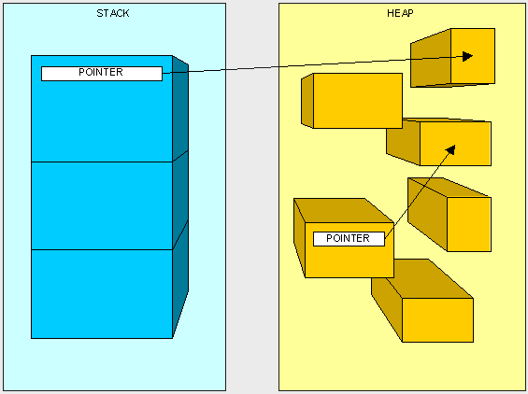
HEAP & STACK
OPERATING SYSTEM
C PROGRAM FILE
VARIABLES
HEAP
HEAP : Unused Memory
STACK: where all memory you have used has been stored

Slide 18

Malloc
int* ptr = malloc(sizeof(int));
free(ptr);
Null Check
if(ptr==NULL) {
  printf(“OUT OF MEMORY.\n”);
  return 1;
}
00
HEAP

Slide 19
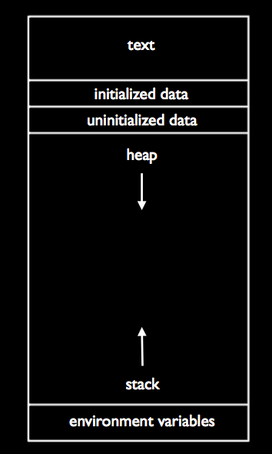
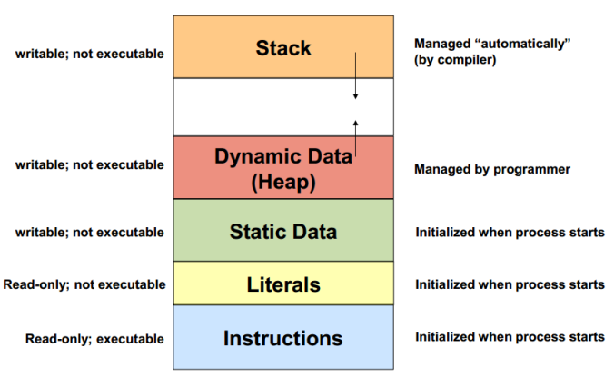
Dynamic Memory Alocation

Slide 20
Fungsi Pointer (1)
Unlike normal pointers, a function pointer points to code, not data. Typically a function pointer stores the start of executable code.
Unlike normal pointers, we do not allocate de-allocate memory using function pointers.
A function’s name can also be used to get functions’ address. For example, in the below program, we have removed address operator ‘&’ in assignment. We have also changed function call by removing *, the program still works.

Slide 21
#include <stdio.h>
// A normal function with an int parameter
// and void return type
void fun(int a) {
printf("Value of a is %d\n", a);
}
int main(){
void (*fun_ptr)(int) = fun; // & removed
fun_ptr(10); // * removed
}
return 0

Slide 22
Fungsi Pointer (2)
Like normal pointers, we can have an array of function pointers. Below example in point 5 shows syntax for array of pointers.
Function pointer can be used in place of switch case. For example, in below program, user is asked for a choice between 0 and 2 to do different tasks.

Slide 23
Fungsi Pointer (3)
Like normal data pointers, a function pointer can be passed as an argument and can also be returned from a function.
For example, consider the C program where wrapper() receives a void fun() as parameter and calls the passed function.
Many object oriented features in C++ are implemented using function pointers in C. For example virtual functions. Class methods are another example implemented using function pointers.

