Slide 1
Prokom6: Class, OOP, Hardware
@btatmaja

Slide 2
We are almost done
Struct
C++
Class
OOP

Slide 3


Programming Trend

Slide 4
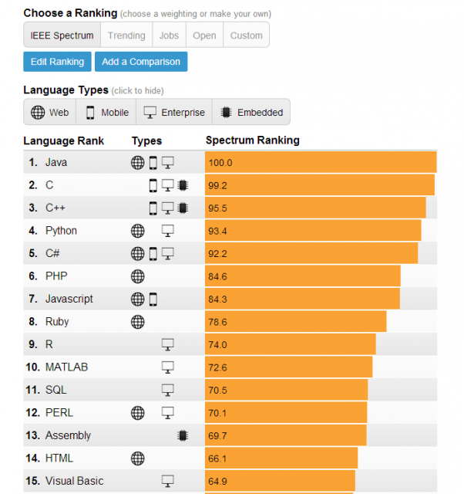
IEEE Rank

Slide 5

TIOBE Index

Slide 6
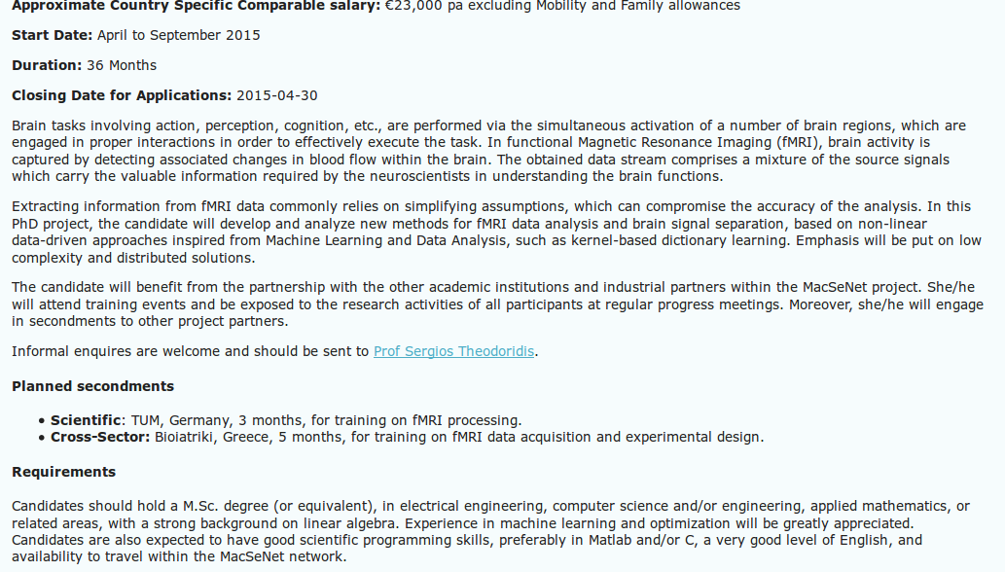
Job Offer with C/Matlab Skill

Slide 7
Struct
struct Point {
double x;
double y;
};
struct is public by default.

Slide 8
C++ Header File
Header File | Function and Description
<iostream> | This file defines the cin, cout, cerr and clog objects, which correspond to the standard input stream, the standard output stream, the un-buffered standard error stream and the buffered standard error stream, respectively.
<iomanip> | This file declares services useful for performing formatted I/O with so-called parameterized stream manipulators, such as setw and setprecision.
<fstream> | This file declares services for user-controlled file processing

Slide 9
Class
Class is for C++, essentially it is the same with struct except it is private by default
class Point {
public:
double x;
double y;
};

Slide 10
Object Oriented Programming (OOP)
The way you structure a program C++ is:
  Split it up into a set of tasks and subtasks .
  Make functions for the each tasks.
  Instruct the computer to perform them in sequence.

Slide 11
OOP
Encapsulation: grouping related data and functions together as objects and defining an interface to those objects.
Inheritance: allowing code to be reused between related types.
Polymorphism: allowing a value to be one of several types, and determining at runtime which functions to call on it based on its type.

Slide 12
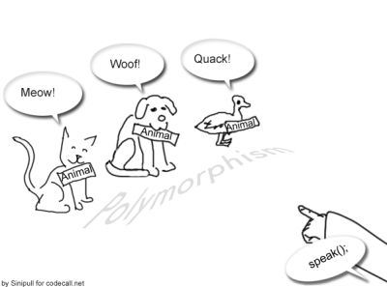
Thanks, that's all!
Encapsulation >> class!
Inheritance >>
  Super Class: Parent Class
  Sub Class: Child Class
  Base Class: Parent Class
  Derived Class: Child Class
Polymorphism >>
Abstraction
Next: Matlab

