Slide 1

Prokom-0:
Programming, Algorithm, Flowchart, Pseudocode, C language
@btatmaja

Slide 2
Overview
Programming, Algorithm
Flowchart, Pseudocode
ASCII, Binary
Compiler, IDE
C and C++ language
Hello World!

Slide 3
Programming
Every computer is a machine >> It does not think >> It cannot understand >> It does not know what you want it to do.
Everything you want it to do must be told to it, explicitly in its language >> comp programming
Belajar memprogram != belajar membuat program

Slide 4
Binary
Binary: 0, 1
Octal: 0,1, 2, 3, 4, 5, 6, 7
Decimal: 0, 1, 2, 3, 4, 5, 6, 7
1 2 3₁₀= ..₂
100 10 1
100 x 1 + 10 x 2 + 1 x 3

Slide 5
Hexadecimal
0, 1, 2, 3, 4, 5, 6,7, 8, 9, a, b, c, d, e, f
Decimal: 255 256
Binary: 1111 1111 1101 1000
Hexa: f f d 8
            0xff 0xff

Slide 6
ASCII
A B C D E F G H I
65 66 67 68 69 70 71 72 73
J K L M N O P Q R
74 75 76 77 78 79 80 81 82
S T U V W X Y Z
83 84 85 86 87 88 89 90
H I !
72 73 33

Slide 7
Algorithm
Algoritma adalah langkah-langkah logis penyelesaian suatu masalah
Input >> ALGORITMA >> output
Algoritma bisa berupa:
  Flowchart
  Pseudo code

Slide 8
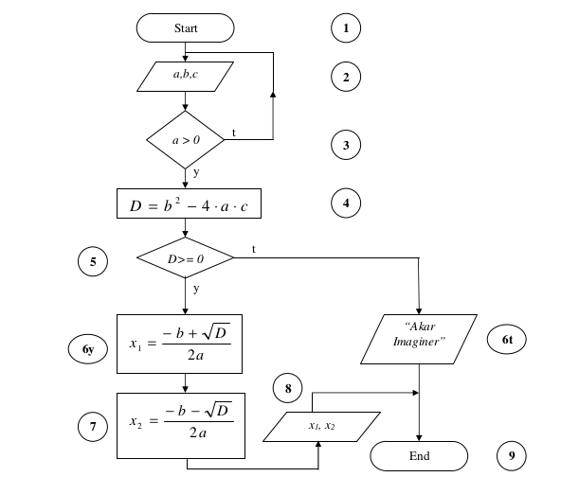
Flowchart

Slide 9
Name
Symbol
Use in Flowchart
Oval
Denotes the beginning or end of the program
Parallelogram
Denotes an input operation
Denotes a process to be carried out e.g. addition, subtraction, division etc.
Rectangle
Denotes a decision (or branch) to be made. The program should continue along one of two routes. (e.g. IF/THEN/ELSE)
Diamond
Hybrid
Denotes an output operation
Denotes the direction of logic flow in the program
Flow line

Slide 10
Pseudocode
Ambil buku telfon
Buka tengah-tengah buku
Cari nama “Sanusi”
If “Sanusi” ada di halaman tersebut
Telfon Sanusi
Else if “Sanusi” berada di halaman depan
Buka tengah buku kiri
Ke baris-3
Else if “Sanusi” berada di halaman belakang
Buka tengah buku bagian kanan
Ke baris-3
Selesai

Slide 11
Hello C!
#include <stdio.h>
Int main (void)
{
printf(“hello world”);
}

Slide 12
Hello World!
#include <stdio.h>
Int main (void)
{
printf(“hello world\n”);
}

Slide 13
Hello, Bagus!
#include <stdio.h>
Int main (void)
{
char nama[10] = "Bagus";
printf("hello, %s\n", nama);
}

Slide 14
Hello, Nama!
#include <stdio.h>
int main(void)
{
char nama[10];
printf("Masukkan nama anda: ");
scanf("%s", nama);
printf("hello, %s\n", nama);
}

Slide 15
How it works
Source Code
Compiler >> Compile/build
Object Code >> Run
fdsafa

Slide 16
The Compiler
Turbo C
Visual C
GCC
Borland C
Clang
...

Slide 17
Command (line)
gcc -o hello hello.c >> ./hello
gcc hello.c >> ./a.out
clang -o hello hello.c -lcs50 >> ./hello
clang hello.c -lm >> ./a.out
Code::blocks >> build > run
Visual C >> build > run

Slide 18





Editor and IDE
Gedit and Terminal plugin
Geany
Code::Blocks
Dev-C++
VisualStudio Express
www.cs50.io

Slide 19
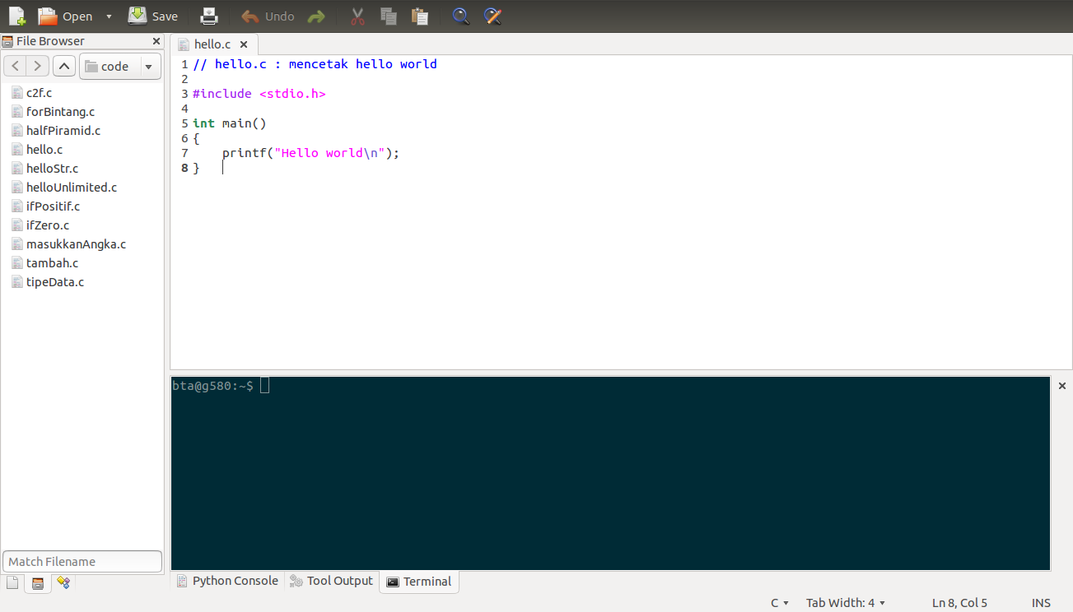
Editor >> Gedit

Slide 20
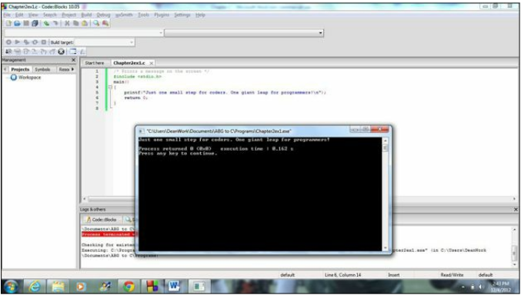
IDE >> Code::Blocks
Integrated development Editor
Buid >> Run

Slide 21
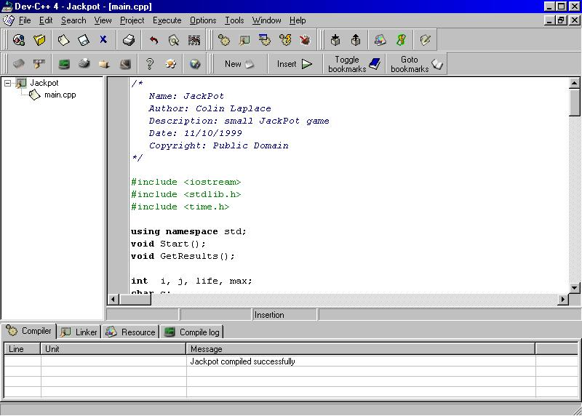
Dev-C++

Slide 22
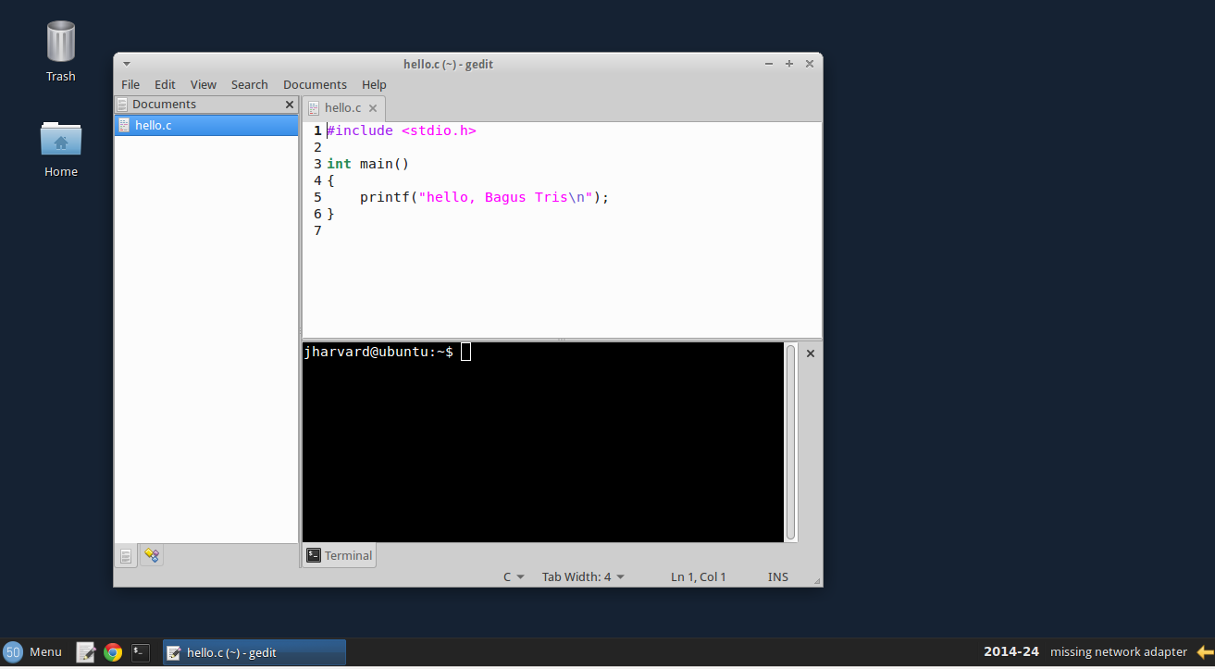
To-do (aka TUGAS)
Install Dev-C++ atau Code::Blocks
Install VMware atau VirtualBox
Install CS50 pada Vmware/VirtualBox
Run hello world.

Slide 23
Decision Tree: IF .. ELSE
Jika nila kurang dari 60
cetak “anda lolos”
Sebaliknya
anda “tidak lolos”
if (x > 60)
  printf(“Anda Lolos”);
else
  printf(“Anda tidak lolos”);
START
Input
M1,M2,M3,M4
GRADE←(M1+M2+M3+M4)/4
Y
IS
GRADE>
60
N
PRINT
“PASS”
PRINT
“FAIL”
STOP

Slide 24
IF ... ELSE IF ... ELSE
if (n > 0)
printf("Anda memasukkan bilangan positif!");
else if (n == 0)
printf("Anda memasukkan bilangan 0");
else
printf("Anda memasukkan bilangan negatif!");

Slide 25
Selamat Belajar
Work Hard
Work Smart
Learning by Doing
One day, One Code
Keep coding!
Referensi:
share.its.ac.id
github.com/bagustris
cplusplus.com
cppshell.com
cs50.net
@btatmaja

