Slide 1
Prokom4:
Parameter, Reference, Library, Struct
@btatmaja

Slide 2
Contents
Pointer Review
Parameter
Refference
Pass-by-Value
Passing-a-Refference
Library
Struct
Union

Slide 3
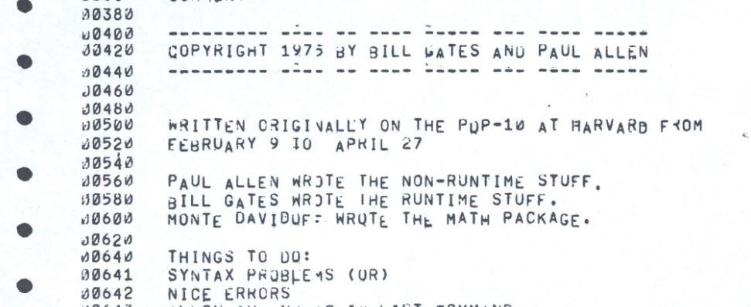
40 years ago Microsoft began, what a journey! Here is the title page from Microsoft’s first product BASIC

Slide 4

Pointer Review -> Pointer Fun
Pointer and Pointees
Dereferencing
Pointer Assignment
Question :
At the end of the above code, y is set to have a pointee and then dereferenced it store the number 13 into its pointee. After this happens, what is the value of x's pointee?
Create the following
Structure of Ponter

Slide 5
Parameter -> Variable
A Parameter is the symbolic name for "data" that goes into a function.
A reference parameter is not a copy of the input data, as is so often the case. A reference parameter is an "alias" for the same bucket in memory as the input data. Thus any change made to a reference parameter is in fact made to the original variable!
There are two ways to pass parameters in C:
  Pass by Value,
  Pass a reference/Pass by Addres (Pass by Reference in C++)

Slide 6
Pass By
Pass By Value, means that a copy of the data is made and stored by way of the name of the parameter. Any changes to the parameter have NO affect on data in the calling function.
Pass By Reference, A reference parameter "refers" to the original data in the calling function. Thus any changes made to the parameter are ALSO MADE TO THE ORIGINAL variable.
  Arrays
  Function ( & parameter_name )

Slide 7
References
A reference variable is a nickname, or alias, for some other variable
References allow you to create a second name for the a variable that you can use to read or modify the original data stored in that variable.
C does not directly support pass by reference because it always uses pass by value, but a we can implement pass by reference by passing a pointer to the variable that the we wants passed by reference.

Slide 8
Pass By Value
void doit(int x) { x = 5; } | int main() { int z = 27; doit(z); printf(“z is now %z”, z) return 0; }
In C, the default is to pass by value, it just copy via parameter, no affect in calling function.

Slide 9
Pass By Reference -> passing a reference
void doit(int *x) { *x = 5; } | int main() { int z = 27; doit(&z); printf(“z is now %d", z); return 0; }
In reference parameter, any changes to the parameter inside the function are reflected "outside" of the function.

Slide 10
Array Parameter
Arrays are always passed by reference in C.
They do not use the '&' notation, but are pass by reference none the less
ex :
void build_array(int array_variable[], int length_of_array)
...
build_array(values, 50);

Slide 11
Constant Reference
To protect from accidentally changing a reference parameter, when we really want it not to be changed (we just want to save time/memory) we can use the C keyword const
example :
void doit(const int &x)
{
x = 5;
}

Slide 12
Library
Preprocessor directives --> #
  #include --> Library
  #define --> Constant
#include <header.h>
#include "libMyLib.h"
#include "libMyLib.txt"
#define CONSTANT constantDefinition
#define pi 3.14

Slide 13
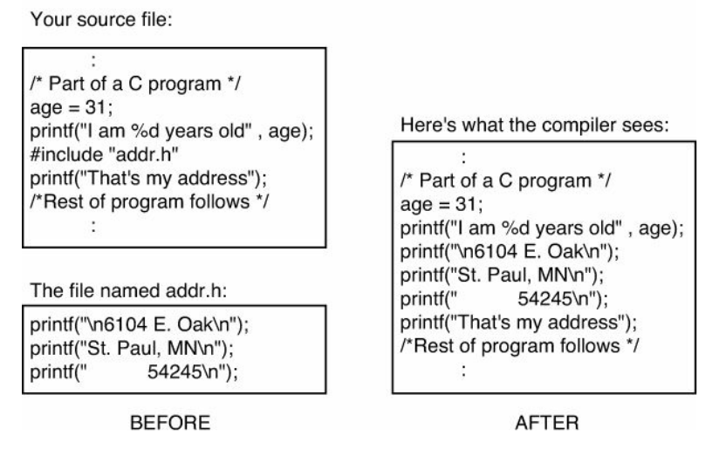
Library

Slide 14
libHeaderDemo.h
void address() {
printf("\nJl. Taman Apsari 10\n");
printf("Royal Square Boulevard, Surabaya\n");
printf("60111\n");
}

Slide 15
headerDemo.c
int main() {
char name[20] = "Thomas";
printf("Hy, My name is %s and I lived on the
address below!\n", name);
address();
return 0;
}

Slide 16
Structure
A structure type is the Name of a "grouping" of related pieces of "named" information about a single entity.
struct name{
  member definition;
  member definition;
  ...
  member definition;
};

Slide 17
Struct
struct Point {
double x;
double y;
};
struct is public by default.

Slide 18
Calling Struct
struct my {
  int age;
  int name[20];
};
int main(void) {
  struct my MyFriend;
  printf(”Masukkan nama”);
  scanf(“%s”, MyFriend.name”);
  printf(”Masukkan umur”):
  scanf(“%s, MyFriend.age)
}

Slide 19
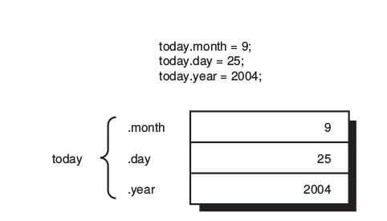
Struct: Assigning Value
struct date {
int month;
int day;
int year;
};
struct date today;
today.month = 9;
today.day = 25;
today.year = 2004;

Slide 20
Union
In a struct, the members occupy different areas of memory, but in a union, the members occupy the same area of memory :
union name{
  int i;
  double d;
} u;
The programmer can access either u.i or u.d, but not both at the same time

Slide 21
Resources
http://github.com/bagustris/c-code
https://en.wikipedia.org/wiki/C_%28programming_language%29
Tutorialpoint.com >> C Tutorial
CS50.net
Cplusplus.com

