Slide 1
Prokom: Intro to Octave/Matlab
@btatmaja
https://github.com/bagustris/m-code

Slide 2
Outline
IF
FOR
SWITCH
WHILE
DO-WHILE
plotsin
mencariMean
biseksi
jumlah
Debug
Repo Untuk Octave Code:
https://github.com/bagustris/prokom-tf/code/octave

Slide 3
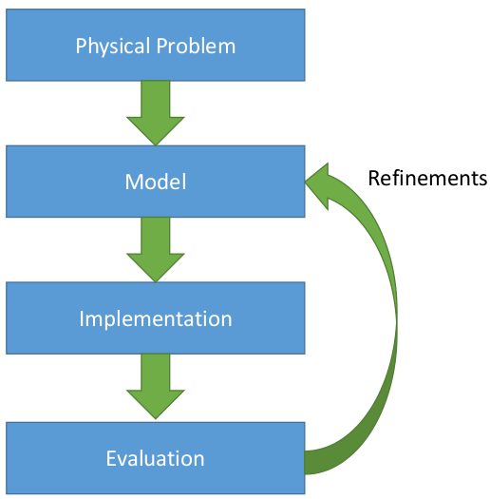
Scientific Programming/Computing
Problem Solving
Algorithm
Coding

Slide 4
C AND MATLAB
C-lang is is a general-purpose, imperative compiled computer programming language
Matlab is scripting language for scientific programming, it is abbrr. of Matrix Laboratory
The similar :
  GNU Octave
  Python Scipy, Numpy and Matplotlib
  FreeMat
  Scilab
  (Labview) Mathscript

Slide 5
ALGORITHMS & FLOWCHARTS
A typical programming task can be divided into two phases:
Problem solving phase
  produce an ordered sequence of steps that describe solution of problem
  this sequence of steps is called an algorithm
Implementation phase
  implement the program in some programming language

Slide 6
Steps in Problem Solving
First produce a general algorithm (one can use pseudo code)
Refine the algorithm successively to get step by step detailed algorithm that is very close to a computer language.
Pseudo code is an artificial and informal language that helps programmers develop algorithms. Pseudo code is very similar to everyday English.

Slide 7
Pseudocode & Algorithm
Example 1: Write an algorithm to determine a student’s final grade and indicate whether it is passing or failing. The final grade is calculated as the average of four marks.

Slide 8
Example 1
START
Step 1: Input M1,M2,M3,M4
Step 2: GRADE ← (M1+M2+M3+M4)/4
Step 3: if (GRADE <50) then
Print “FAIL”
else
Print “PASS”
endif
Input
M1,M2,M3,M4
GRADE←(M1+M2+M3+M4)/4
IS
GRADE<50
N
Y
PRINT
“PASS”
PRINT
“FAIL”
STOP

Slide 9
Code
n1=input('masukkan nilai pertama= ');
n2=input('masukkan nilai kedua= ');
n3=input('masukkan nilai ketiga= ');
n4=input('masukkan nilai keempat= ');
nbar = (n1+n2+n3+n4)/4;
If nbar < 50;
disp('FAIL');
else
  disp('PASS')
end
nilai.m

Slide 10
Example 2
Write an algorithm and draw a flowchart to convert the length in feet to centimeter.
Pseudo code:
Input the length in feet (Lft)
Calculate the length in cm (Lcm) by multiplying LFT with 30
Print length in cm (LCM)

Slide 11
Flowchart
Algorithm
Step 1: Input Lft
Step 2: Lm ← Lft x 30
Step 3: Print Lm
START
Input
Lft
Lcm ← Lft x 30
Print
Lcm
STOP

Slide 12
Code
ft= input('Masukkan panjang dalam feet: ');
cm= ft * 30.48;
disp([num2str(ft) ' adalah sama dengan ' ... num2str(cm)]);

Slide 13
Example 3
Write an algorithm and draw a flowchart that will read the two sides of a rectangle and calculate its area.
Pseudocode
Input the width (W) and Length (L) of a rectangle
Calculate the area (A) by multiplying L with W
Print A

Slide 14
Algorithm
Step 1: Input W,L
Step 2: A ← L x W
Step 3: Print A
START
Input
W, L
A ← L x W
Print
A
STOP

Slide 15
Example 4
Write an algorithm and draw a flowchart that will calculate the roots of a quadratic equation
Hint: d = sqrt ( ), and the roots are: x1 = (–b + d)/2a and x2 = (–b – d)/2a

Slide 16
Pseudo code:
Input the coefficients (a, b, c) of the quadratic equation
Calculate d
Calculate x1
Calculate x2
Print x1 and x2

Slide 17
START
Algorithm:
Step 1: Input a, b, c
Step 2: d ← sqrt ( b x b – 4 x a x c)
Step 3: x1 ← (–b + d) / (2 x a)
Step 4: x2 ← (–b – d) / (2 x a)
Step 5: Print x1, x2
Input
a, b, c
d ← sqrt(b x b – 4 x a x c)
x₁ ←(–b + d) / (2 x a)
X₂ ← (–b – d) / (2 x a)
Print
x₁ ,x₂
STOP

Slide 18
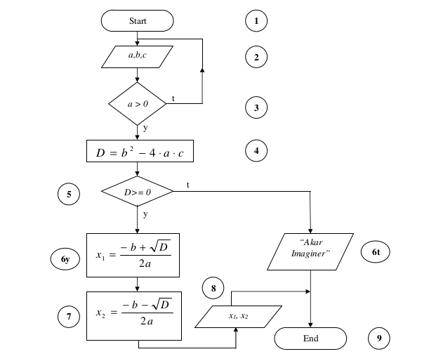
Another Flowchart

Slide 19
Comments
Comment sangat penting agar program kita mudah dibaca oleh orang lain
Comment juga bisa dapat digunakan untuk menelusuri algoritma dari suatu program
Dalam Matlab --> %, Octave --> #
Gunakan double %% untuk sub-bab atau cell.

Slide 20
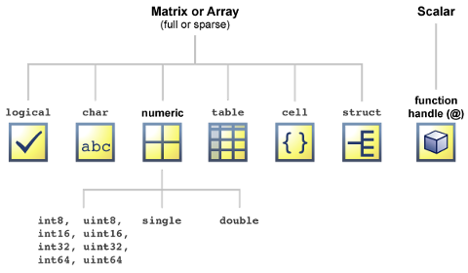
Type Data
Numeric: by default double
Character and string
format short >> format short, pi, single(pi)
format long >> format long, pi, single(pi)
dataTypeDemo.m

Slide 21
IF
if rand<0.5
disp('HEAD');
else
disp('TAILS');
end
CointTosss.m

Slide 22
IF.. ELSE IF... ELSE
if x == 0
disp('Anda memasukkan 0');
elseif x < 0
disp('Anda memasukkan angka negatif');
else
disp('Anda memasukkan angka positif');
end
ifZero.m

Slide 23
FOR
for variable = expr, statement, ..., statement END
for i=1:n
  disp('Hello world');
end
forHello.m

Slide 24
For: bintangSpasi.m
for i = 1:n
for j = 1:i-1 % cetak spasi
fprintf(' ');
end
for j = 1:n % cetak bintang
fprintf('*');
end
fprintf('\n');
n = n - 1;
end
Masukkan jumlah baris: 5
*
**
***
****
*****

Slide 25
SWITCH
switch switch_expr
CASE case_expr,
statement, ..., statement
CASE {case_expr1, case_expr2, case_expr3,...}
statement, ..., statement
...
OTHERWISE,
statement, ..., statement
END

Slide 26
SWITCH
switch n
case num2cell(1:33)
disp ('Anda memasukkan angka kecil')
case num2cell(34:67)
disp ('Anda memasukkan angka medium');
case num2cell(68:100)
disp ('Anda memasukkan angka besar');
otherwise
disp ('And memasukkan angka yang salah');
end
switchDemo.m

Slide 27
WHILE
DO-WHILE ?
whileDemo.m
while expression
statements
end
while (true)
    disp ('Hello world')
end
doDemo.m

Slide 28
KnowledgeAtTheEnd.m
SecPerDay=60*60*1;
tau=5*secPerDay;
t=15*secPerDay;
knowledgeAtEnd=1-exp(-t/tau);
disp(['Di akhir kuliah Prokom, Saya akan menguasai ' ...
num2str(knowledgeAtEnd*100) ' % Pemrograman MATLAB'])

Slide 29
Fungsi: fungsiBintang.m
fungsibintang(5)
*
**
***
****
*****
function [] = fungsibintang(n)
for i = 1:n
for j = 1:i-1 % cetak spasi
fprintf(' ');
end
for j = 1:n % cetak bintang
fprintf('*');
end
fprintf('\n');
n = n - 1;
end

Slide 30
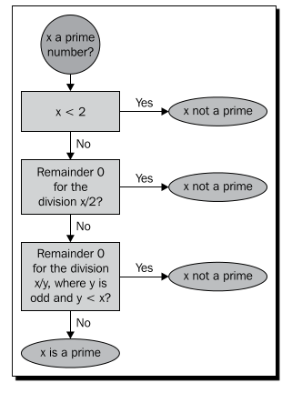
Prime
cekPrima.m

Slide 31
plotSin
% plotsin.m : mem-plot berdasarkan frekuensi
function plotsin(f)
x=linspace(0,2*pi,f*16+1);
%figure
plot(x,sin(f*x))
PlotSin.m, plotDemo.m

Slide 32
mencariMean
function mean = mencariMean(x)
% MyMean Mean
% For a vector x, mymean(x) returns the mean of x;
%
% For a matrix x, mymean(x) acts columnwise.
[m n] = size(x);
if m == 1
m = n;
% handle case of a row vector
end
mean = sum(x)/m;

Slide 33
Debug
Gunakan perintah keyboard;
Untu mendebug >> dbstep
Matlab >> klik “-” di samping line number
n= input ('Masukkan jumlah baris: ');
for i=1:n
disp('Hello world');
keyboard;
end
forHello.m

Slide 34
biseksi.m
x=input('Masukkan angka: ');
error = 0.1; tebakan=0; atas=x; bawah=0;
while abs(akar^2-x) >= error
disp(['bawah = ' num2str(bawah) ' atas =' num2str(atas) ' akar = ' num2str(akar)])
if akar^2 > x
atas = akar;
else
bawah = akar;
end
akar = (atas + bawah) / 2.0;
tebakan = tebakan + 1;
end

Slide 35
Nargin, Varargin
function E = jumlah(varargin)
E = 0;
for i=1:nargin
E = E + varargin{i};
end
end
greet.m, jumlah.m

Slide 36
jumlah
% jumlah.m : demo fungsi dengan nargin dan varargin
function [jml, mean] = jumlah(varargin)
jml = 0;
for i=1:nargin
jml =jml + varargin{i};
mean= jml/nargin;
end
end

Slide 37
Read Data (sound, image)
Read/write sound data
[x, fs]=audioread(‘my_sound.wav’);
y = process_my_sound
audiwrite(y, fs, ‘new_sound.wav’);
Read/write image data
I = imread ("my_input_image.img");
J = process_my_image (I);
imwrite (J, "my_output_image.img");

Slide 38
QUIZ

Slide 39
Academic Honesty
“the essence of all work that you submit must be your own”
“.. you may show your code to others, but you MAY NOT view theirs, so long as you and they respect this's policy's other constraints”

Slide 40
Quiz - Now
Quiz Individu:
  Membuat Fungsi
  Semakin rumit fungsi yang dibuat (jml baris, dll) semakin tinggi nilainya
Quiz Kelompok
  Satu kelompok terdiri dari 4 orang
  Dibagi berdasarkan absen
  Semua anggota kelompok harus mengerjakan
Dikumpulkan minggu depan

