Slide 1
Prokom6:
File I/O. Searching. Sorting.
@btatmaja

Slide 2
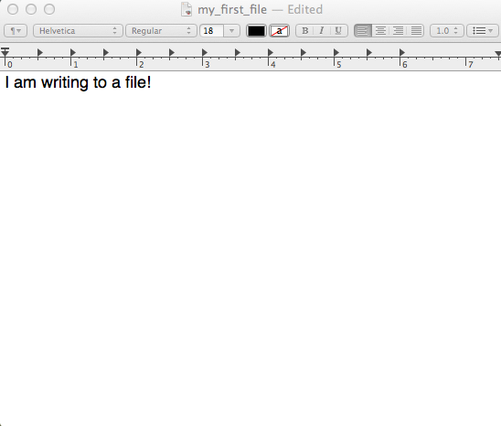
File I/O
We are used to reading from and writing to the terminal:
read from stdin
write to stdout
But we can also read from
and write to files!
Notes:
The ability to read data from and write data to ﬁles is the primary means of storing persistent data, or data which does not disappear when your program ﬁnishes running.

Slide 3
Step 1: Create a reference to the file
FILE* file;
Step 2: Open the file
file = fopen(“file.txt”, “r”);
1st argument -- path to the file
2nd argument – mode
  “r” -- read, “w” -- write, “a” -- append
Notes:
The abstraction of ﬁles provided by the standard I/O library (stdio) is implemented in a structure called FILE. Calling fopen returns a pointer to the file you have just opened. If it returns NULL, then it could not open the requested file.
Almost all of the functions you’ll then use to manipulate your newly opened file take this file pointer as one of one of their arguments.

Slide 4
Step 3a: Read from the file
fgetc -- returns the next character
fgets -- returns a line of text
fread -- reads a certain # of bytes and places them into an array
fseek -- moves to a certain position
Step 3b: Write to the file
fputc -- write a character
fputs -- returns a line of text
fprintf -- print a formatted output to a file
fwrite -- write an array of bytes to a file
Notes:
These functions allow us to read from or write to the file we’ve just opened.

Slide 5
Step 4: Close the file
fclose(file);
Remember!
Always open a file before reading from or writing to it
Always close a file if you open it
Notes:
Be sure to fclose any and all files that you have fopened.
UNIX will close any ﬁles you’ve left open when your program terminates, but it is considered poor coding practice to rely on this behavior.

Slide 6
Example #1: Writing to a file
#include <stdio.h>
#define STUDENTS 3
int main(void) {
int scores[] = { 96, 90, 83 };
FILE* file = fopen(“database”, “w”);
if (file != NULL) {
for (int i = 0; i < STUDENTS; i++) {
fprintf(file, “%i\n”, scores[i]);
}
fclose(file);
}
}
Notes:
In this program, we are storing the values of an array called scores in a file named database.
We open the file using the fopen function. The second argument "w" tells fopen that we want to write to this file. If a file named database does not already exist, fopen will create it.
if (file != NULL) is a sanity check that call to fopen didn’t fail.
fprintf takes a file pointer as its first argument. Instead of printing to the screen, fprintf prints to the file we pass to it.

Slide 7
Example #2: What does this program do?
#include <stdio.h>
int main(int argc, char* argv[]) {
if (argc < 2) {
printf("Usage: cat file [file ...]\n");
return 1;
}
for (int i = 1; i < argc; i++) {
FILE* file = fopen(argv[i], "r");
if (file == NULL) {
printf("cat: %s: No such file.\n", argv[i]);
return 1;
}
for (int c = fgetc(file); c != EOF; c = fgetc(file)) {
putchar(c);
}
fclose(file);
}
return 0;
}
Notes:
This program opens each file whose name is specified in argv, reads into memory its characters, and prints those characters to stdout.

Slide 8
Search Algorithm
Linear search Binary search
Linear: Does the array contain 7?
Is array[0] == 7? if yes → end
If no → move
0
1
2
3
4
5
6
3
1
5
6
10
9
7
Notes:
How do these two approaches compare in terms of their times to solve the problem?
In the graph below, the first steep line (n in red) represents the approach of turning one page at a time. The second steep line (n/2 in yellow) represents a slightly improved approach of turning two pages at a time. The curve (log n in green) represents our “tear and throw away” approach.
As the size of the problem grows, the time to solve that problem doesn’t grow nearly as quickly. In the context of this problem, n is the number of pages in the phonebook. As we go from 500 to 1000 to 2000 pages in the phonebook, we need only tear the phonebook in half at most one or two more times.

Slide 9
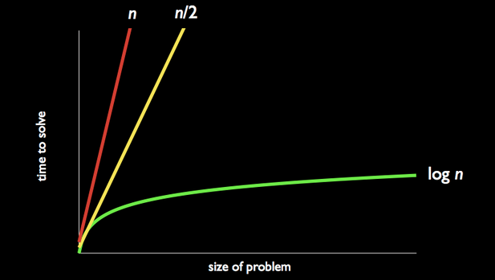
Binary Search
Notes:
How do these two approaches compare in terms of their times to solve the problem?
In the graph below, the first steep line (n in red) represents the approach of turning one page at a time. The second steep line (n/2 in yellow) represents a slightly improved approach of turning two pages at a time. The curve (log n in green) represents our “tear and throw away” approach.
As the size of the problem grows, the time to solve that problem doesn’t grow nearly as quickly. In the context of this problem, n is the number of pages in the phonebook. As we go from 500 to 1000 to 2000 pages in the phonebook, we need only tear the phonebook in half at most one or two more times.

Slide 10
Does the array contain 7?
Lin
0
1
2
3
4
5
6
1
3
5
6
7
9
10
Notes:
We can apply the same logic to searching for a value in an array of sorted numbers.

Slide 11
0
1
2
3
4
5
6
1
3
5
6
7
9
10
Is array[3] == 7?
Is array[3] < 7?
Is array[3] > 7?
Lin
Notes:
First, check the value stored at the middle index of the array.
We see that array[3] is 6, which is < 7. So, just as we tore off half the phone book, we can now disregard the entire left half of this array.

Slide 12
0
1
2
3
4
5
6
1
3
5
6
7
9
10
Is array[5] == 7?
Is array[5] < 7?
Is array[5] > 7?
Lin
Notes:
Next, check the value stored at the middle index of what's left of the array.
We can see that array[5] is 9, which is > 7. This time, we'll discard the right portion of what's left of the array.

Slide 13
0
1
2
3
4
5
6
1
3
5
6
7
9
10
Is array[4] == 7?
Is array[4] < 7?
Is array[4] > 7?
Lin
Notes:
array[4] == 7! We've found the value we were searching for!
This algorithm takes log n steps in the worst case. When there are only 7 array indices to check, n might not seem all that much bigger than log n. But if we have a 4 billion indices, the difference certainly matters. In that case, linear search would take 4 billion steps in the worst case, while binary search would only take 32.
Note however, that these arrays were presorted. We'll next cover sorting algorithms like bubble sort, merge sort, insertion sort, selection sort, and quick sort that can be employed if you're not lucky enough to start out with a sorted dataset!

Slide 14
Sorting Algorithm
How to sort the following number
0
1
2
3
8
6
4
2
to be :
0
1
2
3
2
4
6
8
Notes:
Let's sort the elements of this array in ascending order.

Slide 15
Bubble Sort Algorithm
Step through entire list, swapping adjacent values if not in order
Repeat from step 1 if any swaps have been made
Notes:
While stepping through the data, if two adjacent values are not in sorted order, then swap them. After a full scan of the array, repeat from step 1 if any changes have been made.
The algorithm can be used to sort a list in either ascending or descending order.

Slide 16
First pass: 3 swaps
0
1
2
3
8
6
4
2
0
1
2
3
6
8
4
2
0
1
2
3
6
4
8
2
Notes:
During our first pass through the array, we've swapped (8,6), (8,4), and (8,2). The value 8 has "bubbled" up to its correct position.

Slide 17
Second pass: 2 swaps
0
1
2
3
6
4
2
8
0
1
2
3
4
6
2
8
0
1
2
3
4
2
6
8
Notes:
During our second pass, we've swapped (6,4) and (6,2). The value 6 has "bubbled" up to its correct position.

Slide 18
Third pass: 1 swap
0
1
2
3
4
2
6
8
0
1
2
3
2
4
6
8
0
1
2
3
2
4
6
8
Notes:
During our third pass, we've swapped (4,2). The value 4 has "bubbled" up to its correct position.

Slide 19
Fourth pass: 0 swaps
0
1
2
3
2
4
6
8
0
1
2
3
2
4
6
8
0
1
2
3
2
4
6
8
Notes:
On this final pass through the list no swaps were made, signalling that the array has been completely sorted.

Slide 20
initialize counter
do
{
set counter to 0
iterate through entire array
if array[n] > array[n+1]
swap them
increment counter
}
while (counter > 0)
Notes:
And this is how you can implement bubble sort in C to sort an array in ascending order.
What change would you make to this pseudocode if you wanted to sort a list in descending order instead?

Slide 21
Insertion Sort
Sorted
Unsorted
0
1
2
3
4
3
5
2
6
4
Notes:
Insertion sort is one way to sort an array of numbers. Data is divided into sorted and unsorted portions. One by one, the unsorted values are inserted into their appropriate positions in the sorted subarray.

Slide 22
All values start as Unsorted
Sorted
Unsorted
0
1
2
3
4
3
5
2
6
4
Notes:
Let's use insertion sort to sort the elements of this array in ascending order.
Insertion sort relies on breaking up the array into sorted and unsorted portions.
Before we start sorting, all values are considered unsorted.

Slide 23
Add first value to Sorted
Sorted
Unsorted
0
1
2
3
4
3
5
2
6
4
Notes:
On our first pass, we'll take the first unsorted value (3) and insert it into the sorted subarray. 3 is now the start and end of our sorted subarray.

Slide 24
5 > 3
insert 5 to right of 3
Sorted
Unsorted
0
1
2
3
4
3
5
2
6
4
Notes:
Since 5 > 3, we'll insert it to the right of 3 in our sorted subarray.

Slide 25
2 < 5 and 2 < 3
shift 3 and 5
insert 2 to left of 3
Sorted
Unsorted
0
1
2
3
4
3
5
2
6
4
Notes:
Next we'll work on inserting 2 to our sorted subarray.
We'll compare 2 to the values in the sorted subarray from right to left to find it's correct sorted position. We see that 2 < 5 and 2 < 3. We've reached the beginning of the sorted subarray, so we know that 2 must be inserted to the left of 3. This forces us to shift 3 and 5 rightwards to make room for 2.

Slide 26
6 > 5
insert 6 to right of 5
Sorted
Unsorted
0
1
2
3
4
2
3
5
6
4
Notes:
6 is an easy one. 6 > 5, so it can be inserted to the right of 5.

Slide 27
4 < 6, 4 < 5, and 4 > 3
shift 5 and 6
insert 4 to right of 3
Sorted
Unsorted
0
1
2
3
4
2
3
5
6
4
Notes:
4 < 6 and 4 < 5, but 4 > 3. Therefore, we know that 4 must be inserted to the right of 3.
Again, we are forced to shift 5 and 6 rightwards to make room for 4.

Slide 28
4 < 6, 4 < 5, and 4 > 3
shift 5 and 6
insert 4 to right of 3
Sorted
Unsorted
0
1
2
3
4
2
3
4
5
6
Notes:
4 < 6 and 4 < 5, but 4 > 3. Therefore, we know that 4 must be inserted to the right of 3.
Again, we are forced to shift 5 and 6 rightwards to make room for 4.

Slide 29
For each unsorted element n:
Determine where in sorted portion of the list to insert n
Shift sorted elements rightwards as necessary to make room for n
Insert n into sorted portion of the list
Notes:
In summary, here's the insertion sort algorithm:
Take each unsorted element, n, and compare it to values in the sorted subarray from right to left until you determine the appropriate sorted position for n.
Shift sorted elements rightward as necessary to make space for n, and insert the previously unsorted n into its appropriate position in the sorted subarray.

Slide 30
for i = 0 to n - 1
element = array[i]
j = i
while (j > 0 and array[j - 1] > element)
array[j] = array[j - 1]
j = j - 1
array[j] = element
Notes:
And here's some pseudocode to implement insertion sort in C. Try it yourself!

Slide 31
Selection Sort
Sorted
Unsorted
0
1
2
3
4
2
3
5
6
4
Swap
Notes:
Selection sort is one way to sort an array of numbers. Data is divided into sorted and unsorted portions. One by one, the smallest values remaining in the unsorted portion are selected and swapped over to the sorted portion of the array.

Slide 32
Algorithm
Find the smallest unsorted value
Swap that value with the first unsorted value
Repeat from Step 1 if there are still unsorted items
Notes:
First, scan the unsorted portion of the array to find the smallest value.
Swap that value with the first unsorted value -- it is now part of the sorted subarray.
Repeat until there are no more values in the unsorted portion of the array.

Slide 33
All values start as Unsorted
Sorted
Unsorted
0
1
2
3
4
3
5
2
6
4
Notes:
Let's use selection sort to sort the elements of this array in ascending order.
Selection sort relies on breaking up the array into sorted and unsorted portions.
Before we start sorting, all values are considered unsorted.

Slide 34
First pass:
2 is smallest, swap with 3
Sorted
Unsorted
0
1
2
3
4
3
5
2
6
4
Swap
Notes:
On our first pass through the unsorted subarray (which on our first pass is actually the entire array), we find that 2 is the smallest.
We must now swap 2 with the first unsorted value (3) in order to add it to the sorted subarray.

Slide 35
Second pass:
3 is smallest, swap with 5
Sorted
Unsorted
0
1
2
3
4
2
5
3
6
4
Swap
Notes:
On our second pass through the unsorted subarray, we find that 3 is the smallest.
We must now swap 3 with the first unsorted value (5) in order to add it to the sorted subarray.

Slide 36
Third pass:
4 is smallest, swap with 5
Sorted
Unsorted
0
1
2
3
4
2
3
5
6
4
Swap
Notes:
On our third pass through the unsorted subarray, we find that 4 is the smallest.
We must now swap 4 with the first unsorted value (5) in order to add it to the sorted subarray.

Slide 37
Fourth pass:
5 is smallest, swap with 6
Sorted
Unsorted
0
1
2
3
4
2
3
4
6
5
Swap
Notes:
On our fourth pass through the unsorted subarray, we find that 5 is the smallest.
We must now swap 5 with the first unsorted value (6) in order to add it to the sorted subarray.

Slide 38
Fifth pass:
6 is the only value left, done!
Sorted
Unsorted
0
1
2
3
4
2
3
4
5
6
Notes:
When only one value (the largest value) remains in the unsorted subarray, the array has been completely sorted!

Slide 39
for i = 0 to n - 2
min = i
for j = i + 1 to n - 1
if array[j] < array[min]
min = j;
if min != i
swap array[min] and array[i]
Notes:
And this is a way to implement selection sort in C. Try it yourself!

Slide 40
Merge Sort
3
5
2
6
4
1
3
5
2
6
4
1
3
5
2
6
4
1
3
5
2
4
6
1
3
5
2
4
6
1
2
3
5
1
4
6
1
2
3
4
5
6
Notes:
Merge sort is a recursive algorithm for sorting that decomposes the large problem of sorting an array into subproblems that are each a step closer to being solved.
The basic idea is to handle sorting by dividing an unsorted array in two and then sorting the two halves of that array recursively.

Slide 41
On input of n elements:
If n < 2
Return.
Else
Sort left half of elements.
Sort right half of elements.
Merge sorted halves.
Notes:
This is merge sort in pseudocode.
To sort the array, we must sort the left half, sort the right half, and then merge the two sorted halves. But how would we sort the left and right halves? Easy -- just break those subarrays in half as well, sort their respective left and right halves, and merge!

Slide 42
3
5
2
6
4
1
3
5
2
6
4
1
Notes:
Let's use merge sort to sort the elements of this array in ascending order.

Slide 43
Halve until each subarray is size 1
3
5
2
6
4
1
3
5
2
6
4
1
3
5
2
6
4
1
3
5
2
4
6
1
Notes:
Keep halving the array until each subarray is of size 1 -- a subarray of size 1 is considered sorted.

Slide 44
Merge Sorted Halves
3
5
2
4
6
1
3
5
2
4
6
1
2
3
5
1
4
6
1
2
3
4
5
6
Notes:
Two sorted subarrays can be merged in O(n) time, by a simple algorithm:
Remove the smaller of the numbers at the start of each subarray and append it to the merged array, repeating until all elements of both subarrays are used up.

Slide 45
sort (int array[], int start, int end)
{
if (end > start)
{
int middle = (start + end) / 2;
sort(array, start, middle);
sort(array, middle + 1, end);
merge(array, start, middle, middle + 1, end);
}
}
Notes:
Here is one implementation of merge sort on an array that identiﬁes the subarrays using pairs of integer indices into the array.

Slide 46
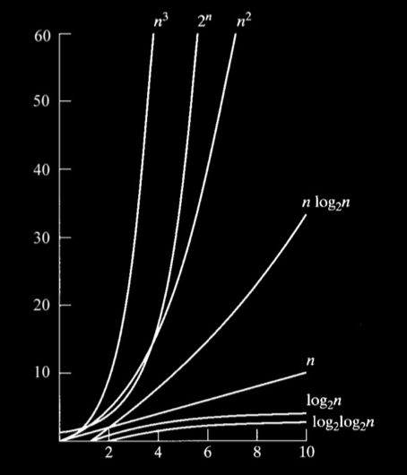
Notes:
As you can see, O(n²) is far from efficient. Maybe we can do better with other sorting algorithms?

Slide 47
Bubble Sort
Selection Sort
Insertion Sort
Merge Sort
O
n²
n²
n²
nlogn
Ω
n
n²
n
nlogn
Θ
n²
nlogn
Notes:
Here's a comparison of the runtimes of selection sort to the runtimes of other sorting algorithms covered in CS50.

Slide 48
References
All material in this slide is taken from study.cs50.net
15 Sorting Algorithms in 6 Minutes >> http://youtu.be/kPRA0W1kECg
http://bigocheatsheet.com/

