Slide 1
Signal & System
Lecture 1:
Intro, Ref, Journey, Signal, System,
Transform, Terms, Symbol
“There is no royal road to mathematics” -Menaechmus
@btatmaja, TF '05
Based on works by @dprananto, TF '05

Slide 2
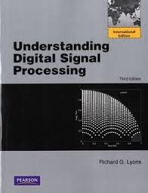
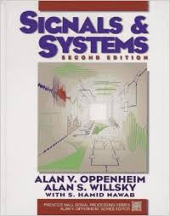
Reference
Lyon, Understanding Digital Signal
Processing.
A. V. Oppenheim, A. S. Willsky, S. H. H.
Nawab, Signal and System Ed.1,
Wikipedia
Octave / MATLAB

Slide 3
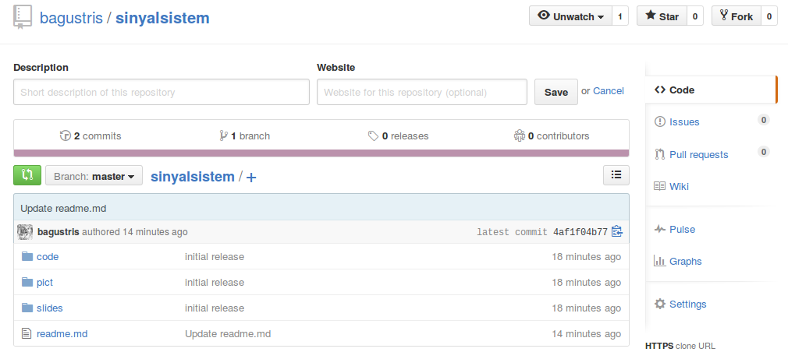
RESOURCES
https://github.com/bagustris/sinyalsistem

Slide 4
THE JOURNEY
Periodic Sampling
How can the spectra of sampled
signal be analyzed?
Window Function
How can the effective sample rate of discrete signal be changed?
How can DFT
measurement be improved?
How can digital filter freq response be improved?
Discrete Fourier
Transform
How can spectra be modified?
Digital Filter
How does
windowing works
Why are discrete spectra periodic and what causes DFT leakage
What cause passband ripple in digital filter
How can spectral noise can be reduced?
Convolution
How can noise reduction effect of averaging be analyzed?
Signal Averaging

Slide 5
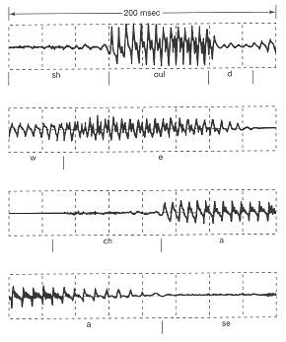
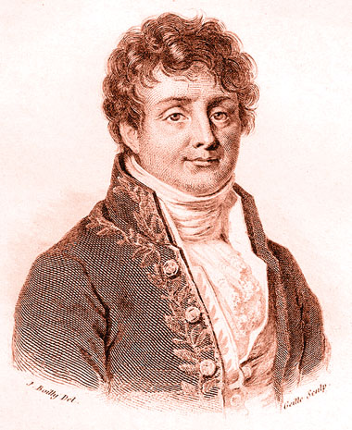
Signal & system
SIGNAL
Something that changinng in one or more independent variables that contains information
Variation of
acoustic pressure
Variation of brightness on (2D) position
y
x
Joseph Fourier (21 March 1768 – 16 May 1830)
(Credit: wikimedia commons)

Slide 6
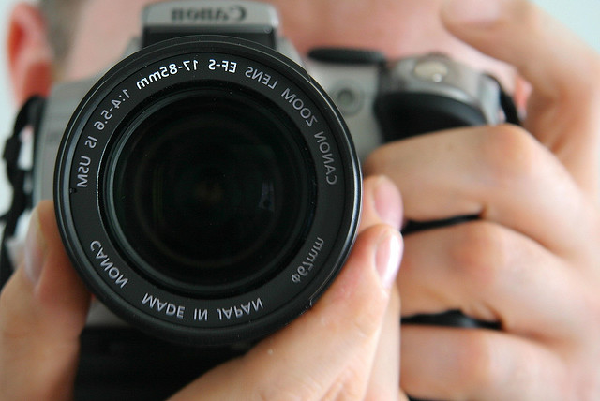
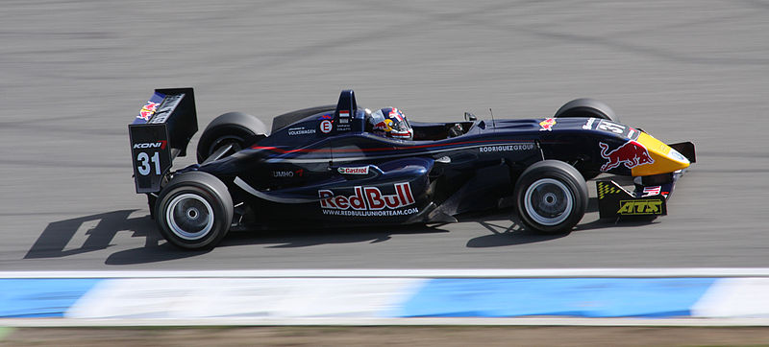
Signal & system
SYSTEM
A set of components with different functionality that combines together to reach a certain purpose
Signal and Systems
are everywhere
around us

Slide 7
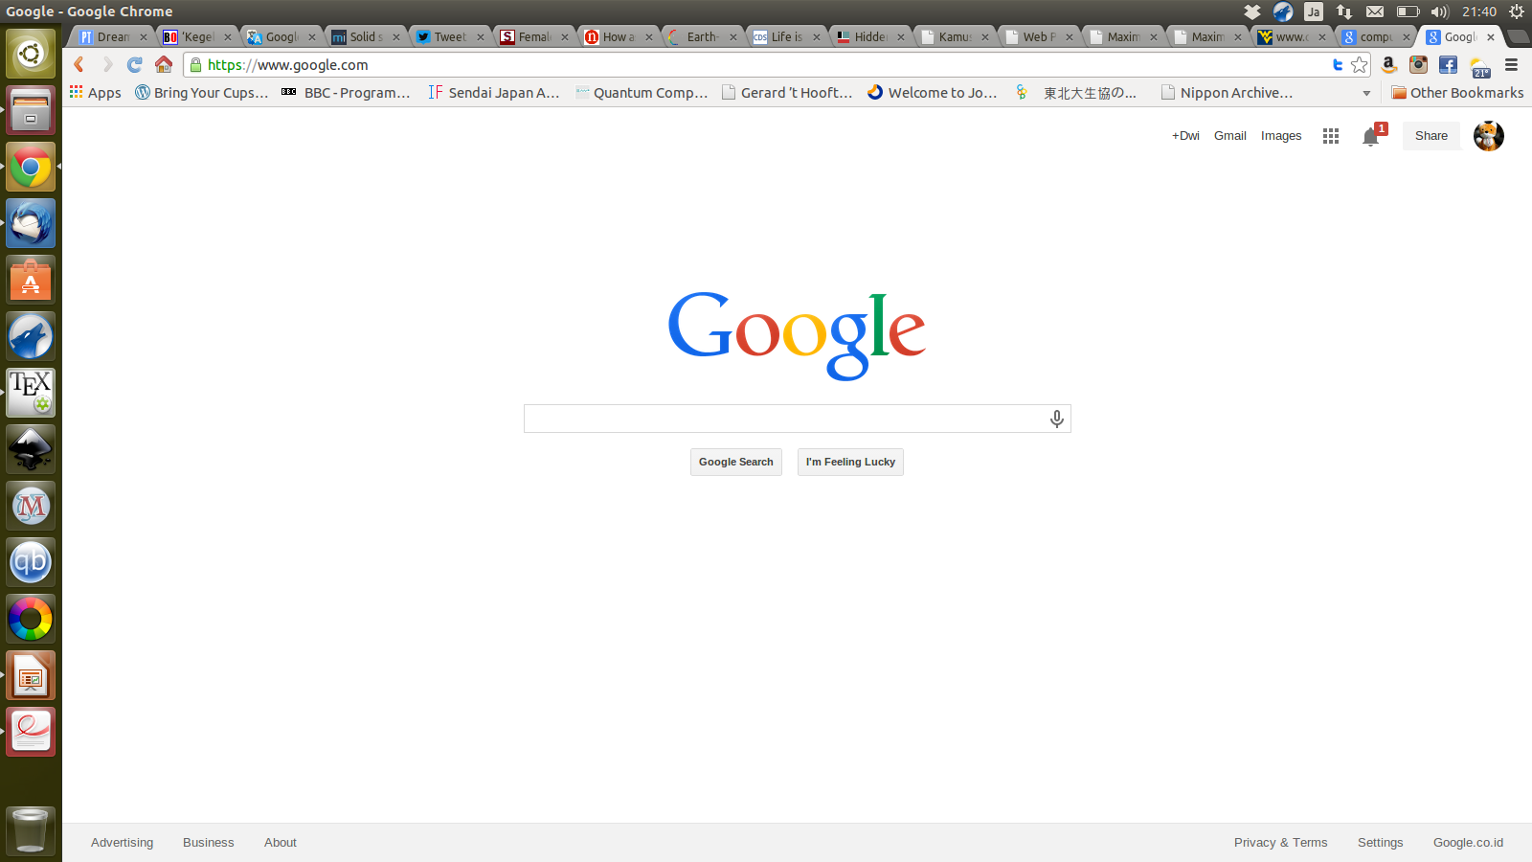
Signal & system
SIGNAL & SYSTEM:
The Interaction
Input
signal
Output
signal
SYSTEM
Google's Speech-to-text
system
Car system
Gas pedal
Input Speech
Speed
Text

Slide 8
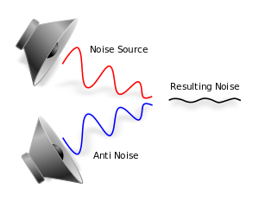
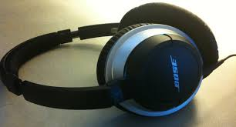
Signal & system
What can we do with the concept
Of Signal and System?
signal processing
Active
Noise
Canceling

Slide 9
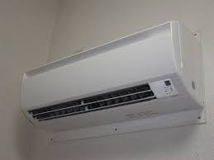
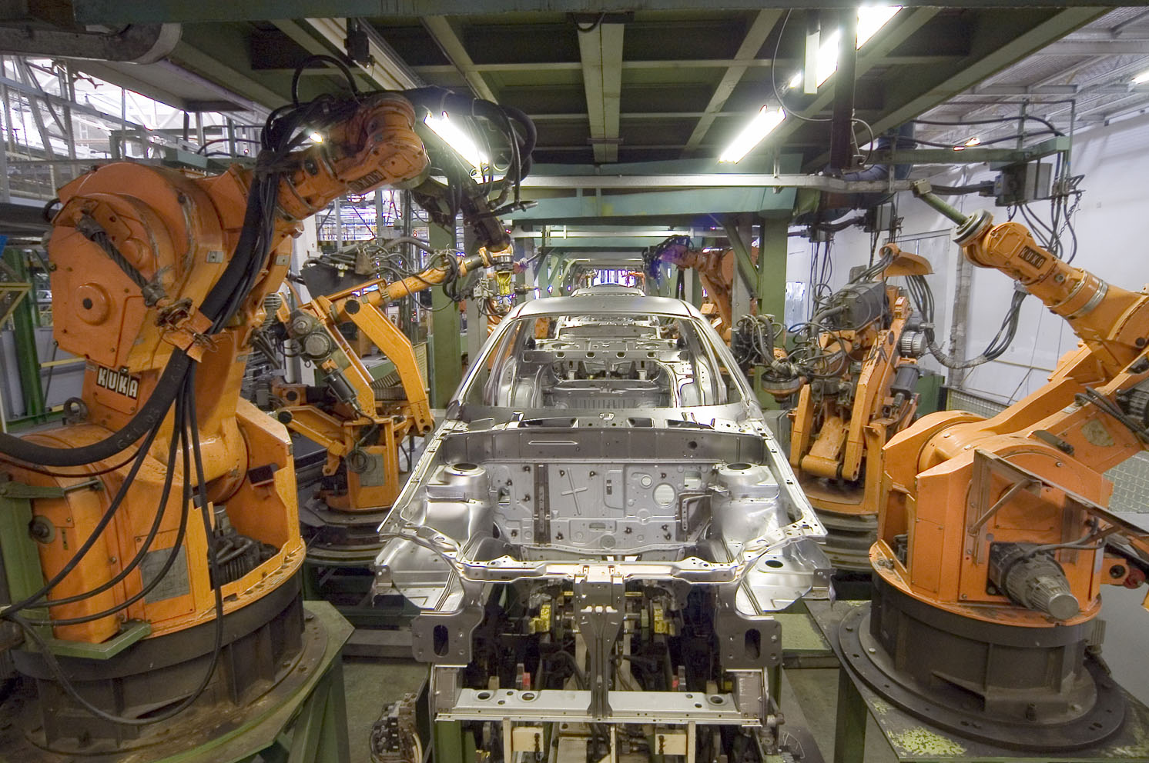
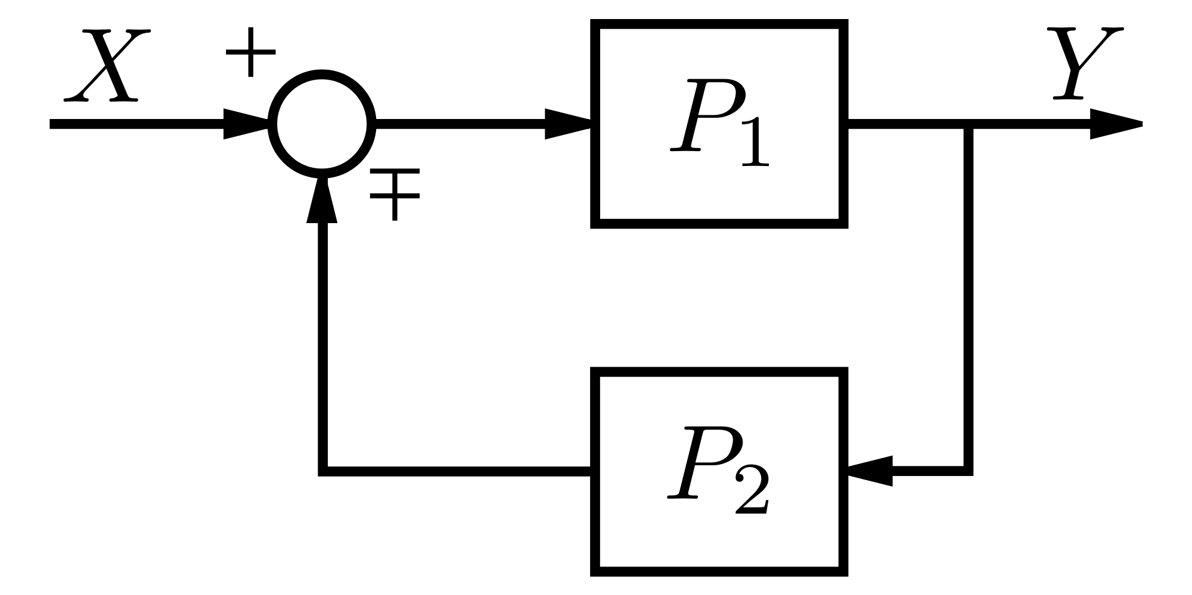
Signal & system
What can we do with the concept
Of Signal and System?
Automatic Control System

Slide 10
Signal & system
What can we do with the concept
Of Signal and System?
System Characterization
Variation of
Input Signal
Black
box
Variation of
Response

Slide 11
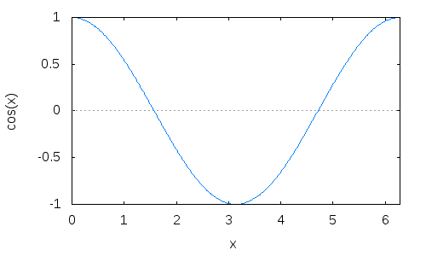
Signal & system
KATEGORI SINYAL
Sinyal waktu-kontinu
Variabel bebas berubah secara kontinu
t merupakan variable bebas waktu-kontinu

Slide 12
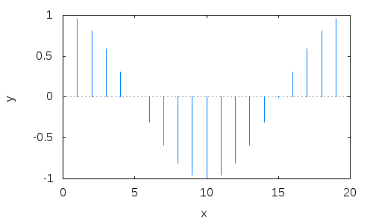
Signal & system
KATEGORI SINYAL
Sinyal waktu-diskrit → Discrete Sequence
Variabel bebas berubah secara diskrit
n merupakan variable bebas waktu-diskrit

Slide 13
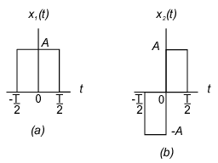
Signal & system
SIGNAL GANJIL & GENAP
Sinyal genap
Untuk semua t
Sinyal ganjil
Signal genap
Simetris
Terhadap
Waktu asal
Signal ganjil
Tak-simetris
Terhadap
Waktu asal
Untuk semua t

Slide 14
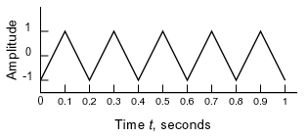
Signal & system
PERIODIC SIGNAL
Sinyal tak berubah dengan pergeseran waktu
kontinu
Untuk semua t
diskrit
Untuk semua n

Slide 15
Periodic Seq.

Slide 16
Signal & system
SINYAL EKSPONENSIAL REAL
Bentuk umum
C dan a bilangan real
Plot:
Eksponensial
meningkat
Eksponensi meluruh
dan

Slide 17
Signal & system
SINYAL EKSPONENSIAL KOMPLEKS PERIODIK
Bukti periodik
Merupakan sinyal periodik
C bilangan real
a bilangan imajiner
Syarat periodik
Periode Dasar

Slide 18
Signal & system
SINYAL EKSPONENSIAL KOMPLEKS UMUM
C dan a bilangan kompleks dengan bentuk berbeda

Slide 19
Signal & system
SINYAL EKSPONENSIAL KOMPLEKS UMUM
Bentuk hubungan Euler
Plot:

Slide 20
Signal & system
KARAKTERISTIK SINYAL EKSPONENSIAL
WAKTU-KONTINU

Slide 21
Signal & system
SINYAL EKSPONENSIAL KOMPLEKS
WAKTU-DISKRIT
Bentuk umum
atau
dimana

Slide 22
Signal & system
Discrete-Time Real Exponential Signal
Karakteristik:
Eksponensial meluruh dengan amplituda bergantian antara +C dan -C
Eksponensial meningkat dengan amplituda bergantian antara +C dan -C

Slide 23
Signal & system
SINYAL EKSPONENSIAL KOMPLEKS
WAKTU-DISKRIT

Slide 24
Exponential Signal
Sinyal Eksponensial Real Diskrit
Sinyal Eksponensial Real Kontinyu

Slide 25
Signal & system
SINYAL SINUSOIDAL
Bentuk umum
Plot:
Amplituda
Frekuensi sudut (rad/s)
Hubungan Euler
Fase (rad)

Slide 26
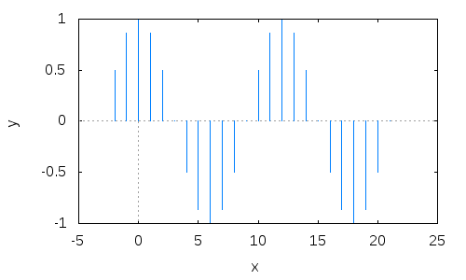
Signal & system
SINYAL SINUSOIDAL WAKTU-DISKRIT
Hubungan Euler

Slide 27
Sinusoidal Seq.

Slide 28
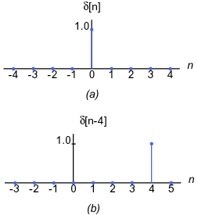
Signal & system
SINYAL IMPULS WAKTU-DISKRIT

Slide 29
Random Seq.

Slide 30
Signal & system
SINYAL STEP WAKTU-DISKRIT
u[n]
n

Slide 31
Signal & system
HUBUNGAN SINYAL IMPULS & STEP WAKTU-DISKRIT
Sinyal impuls adalah perbedaan pertama dari sinyal step
Sinyal step adalah jumlahan sinyal impuls

Slide 32
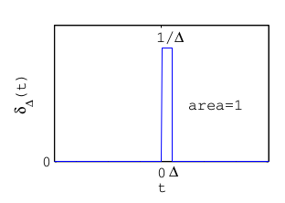
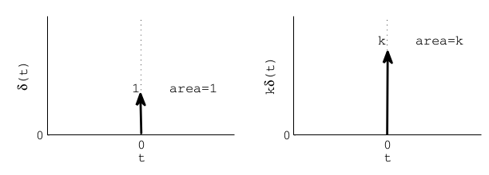
Signal & system
SINYAL IMPULS WAKTU-KONTINU
dimana

Slide 33
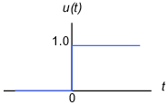
Signal & system
SINYAL STEP WAKTU-KONTINU

Slide 34
Signal & system
HUBUNGAN SINYAL IMPULS & STEP WAKTU-KONTINU
Sinyal step adalah integrasi sinyal pulsa
Sinyal pulsa adalah derivatif sinyal step

Slide 35
Signal & system
TRANSFORMASI SINYAL
Pergeseran waktu (time shift)
Sinyal diskrit
Geser ke kanan
(time delay)
Geser ke kiri

Slide 36
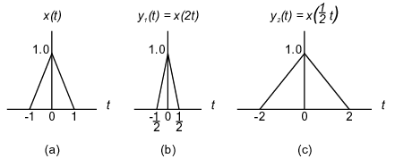
Signal & system
TRANSFORMASI SINYAL
Penskalaan waktu (time scaling)
Sinyal terkompresi
Sinyal melar

Slide 37
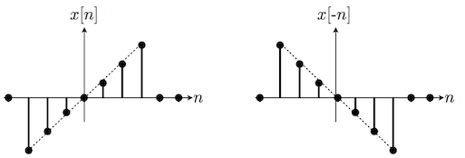
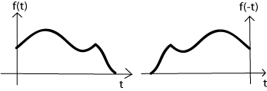
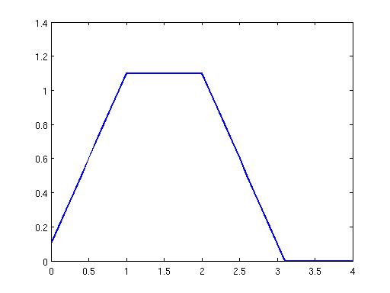
Signal & system
TRANSFORMASI SINYAL time reversal
Sinyal Kontinyu
Sinyal Kontinyu
Dapatkan x(-t) dari sinyal berikut:
x(t)=exp(t)
x(t)=u(t+3)
x(t)=

Slide 38
Amplitude Vs Magnitude
Amplitude → 1
Magnitude :
Absolute Value
of amplitude

Slide 39
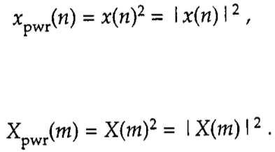

Signal Power
The power of signal is proportional to its amplitude/magnitude squared
Average power:

Slide 40

Signal Energy
>> load laughter;
>> x=y;
>> Ex1 = sum(x .* conj(x)); % one approach
>> Ex2 = sum(abs(x) .^ 2); % another appr

Slide 41
Operational & Symbol
Adder
Substractor
Summation
Multiplication
Unit delay
+
a(n)=b(n)+c(n)
b(n)
c(n)
+
+
b(n)
a(n)=b(n)-c(n)
-
c(n)
b(n)
b(n+1)
+
a(n)=b(n)+b(n+1)+b(n+2)+b(n+3)
a(n)
b(n+2)
b(n+3)
X
b(n)
a(n)=b(n).c(n)
c(n)
Delay
b(n)
a(n)=b(n-1)
Z⁻¹
b(n)
a(n)=b(n-1)

Slide 42
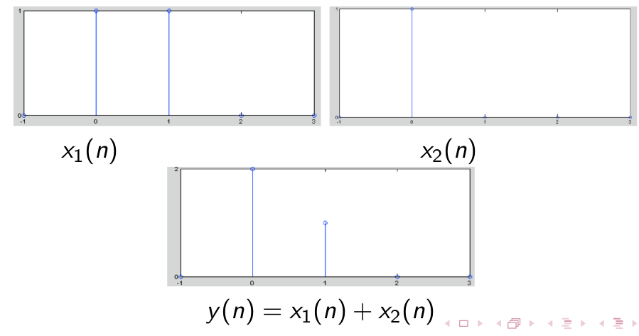
Addition

Slide 43
Subtraction
x₁[n]
x₂[n]
x₃=x₁[n] - x₂[n]

Slide 44
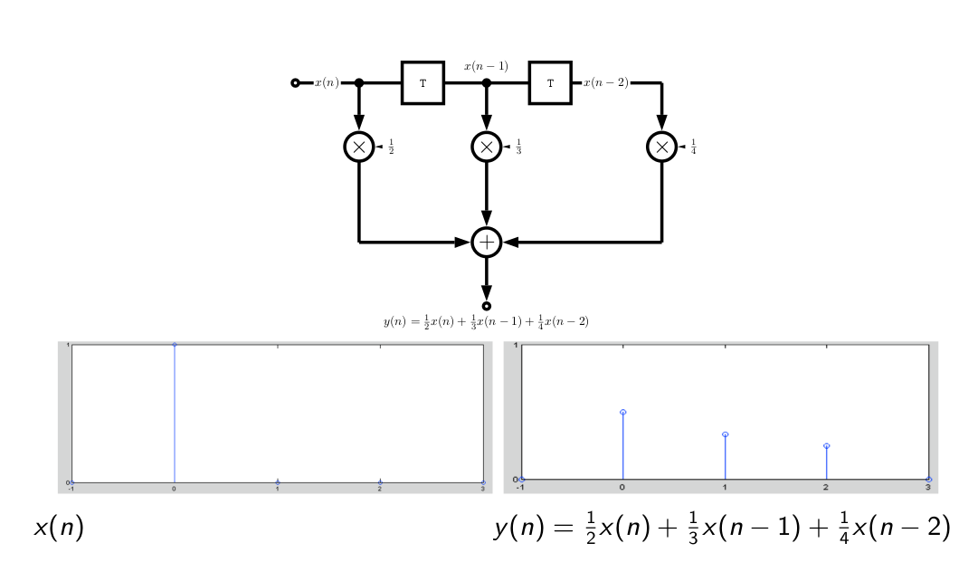
Summation

Slide 45
Multiplication
x₁[n]
x₂[n]
x₃=x₁[n].*x₂[n]

Slide 46
Delay
x[n - 1]

Slide 47
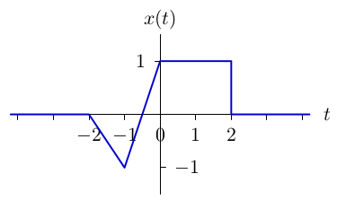
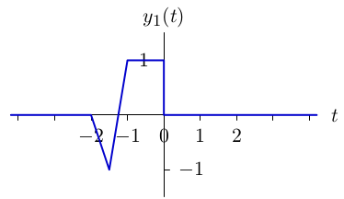
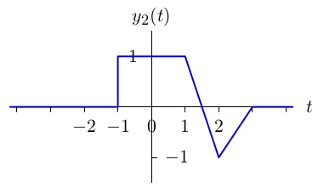
HOMEWORK #1
Jelaskan perbedaan differential equation dan difference equation, berilah contoh masing-masing satu soal beserta solusinya.
Apa fungsi kedua persamaan tersebut dalam sinyal dan sistem ?
Tentukan y₁(t) & y₂(t) dalam fungsi x(t) sbb:

Slide 48
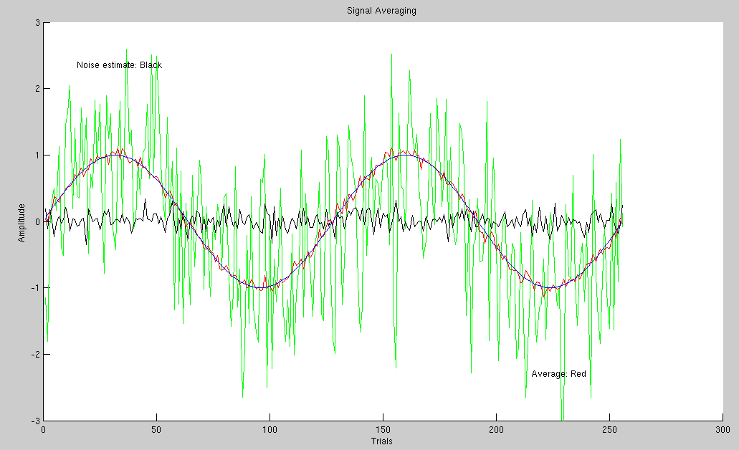
Signal Averaging
Signal averaging is a signal processing technique applied in the time domain, intended to increase the strength of a signal relative to noise that is obscuring it

