Slide 1
Presentation Title
Presenters: Student Name (Student ID)
Instructor: Associate Professor Yuto Lim
School of Information Science, JAIST

Slide 2
1. Research Problem
Discuss the research problem that is trying to solve. Come up with a simple pictorial or graphical example that illustrates the problem.

Slide 3


1. Research Problem
If the node always choose the best path, the energy may not balance in the network, causing a short network lifetime.
Network lifetime : time until the first sensor node or group of sensor nodes in the network runs out of energy.
50%
N1
Finally after : 20 h
0%
After 10 h
100%
Sink
N3
100%
50%
Lifetime is short
75%
N2

Slide 4
2. Proposed Solution
What is the main idea behind the solution? What is the scientific contribution (if any) behind the solution? Use a simple pictorial or graphical example to illustrate the solution.

Slide 5



2. Proposed Solution
Broadcasting method : the node broadcasts a request message to neighbors in order to obtain the link power level.
Automatic notification method: the neighbors send their link power automatically to the node when their link power fall to some level.
Broadcasting method
Automatic notification method
80%
75%
80%
N1
N1
Sink
Sink
70%
65%
After some time
70%
N2
N2

Slide 6
3. Evaluation Method
How do you evaluate the proposed solution on the given topic? Is there any novelty in the evaluation methodology?

Slide 7


3. Evaluation Method
MATLAB Simulation using first-order radio model [1]
The energy consumption to transmit m-bit packet
The energy consumption to receive m-bit packet
is the energy spent by electronic circuit to transmit or receive one data bit.
is the transmission amplifier.
is distance between two nodes.
Is the propagation loss exponent.
Number of sensor | 5
Transmission Range | 20 m
Data gathering cycle | 10 s
Payload size | 104 bytes
Header size | 24 bytes
Broadcast/Response size | 3 bytes / 6 bytes
Propagation loss exp. | 3.5
Radio electronics | 50 nJ/bit
Transmission amp. | 100 pJ/bit/m^{3.5}
Initial battery capacity | 10 J
[1] A. Lim, A. H. Vuong, Z. Chen, and Y. Tan, “2-hop scheme for maximum lifetime in wireless sensor networks,” in Sensors, 2012 IEEE, Oct 2012, pp. 1-4.

Slide 8
4. Scenario and Result
If proof, sketch the proof. If an experimental, discuss the scenario, parameter, setup, and results briefly by including table and graph.

Slide 9
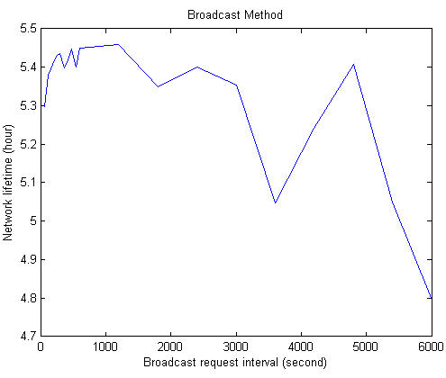
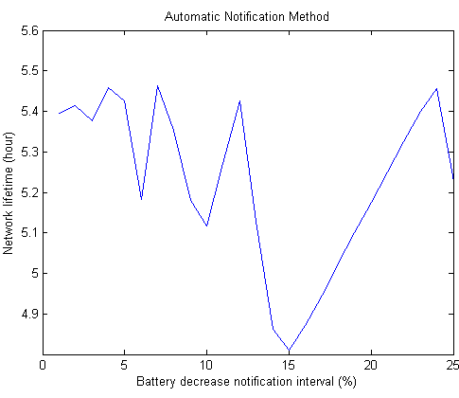
4. Scenario and Result
Common multi-hop network lifetime = 3.5944 hrs
Sink
Source
Prefer interval = 240s – 1200s
Network lifetime average = 5.4295 hrs
Prefer interval = 1% – 5%
Network lifetime average = 5.4139 hrs

Slide 10
5. Discussion and Issue
Discuss how your proposed solution faces the issues of on-site deployment. Can it be implemented into the current project? If no, why? If yes, how? Discuss all the technical difficulties and issues of the proposed solution. How to improve the proposed solution?

Slide 11
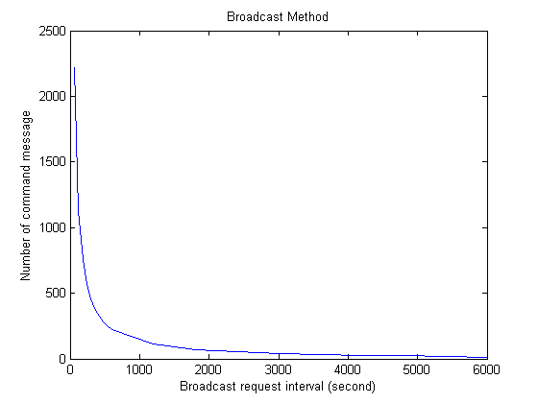
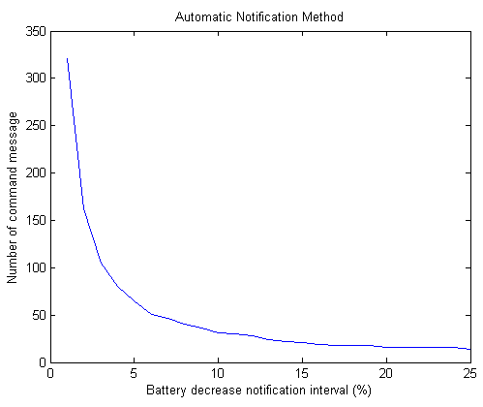
5. Discussion and Issue
The battery of Memsic mote mica does not decrease as we expected.
Broadcast method
A lot of command messages
Automatic notification method
If the node dies , its neighbor will not know

