Slide 1

ZCMD
Open source orchestration tools and more
Frank Font and Chris Desautels August 2019
Meetup Silver Spring MD
Notes:
Copyright Frank Font
frankfont@room4me.com
20190820 Presentation to Docker Group

Slide 2
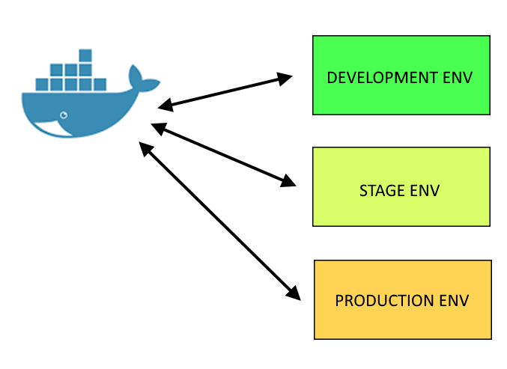
Docker Everywhere
Notes:
Memorize how do do everything, maybe even create custom scripts to manage application specific aspects. Every time a new project create new custom scripts.

Slide 3

Purpose of ZCMD
The ZCMD framework is a curated Open Source collection of bash and python utilities and configuration conventions that facilitate the operation and management of docker containers and collections of containers ("zcmd stacks").
The framework is intended to be appropriate for use in DEV, STAGE, and PROD environments.
https://github.com/bah-insignia/zcmd

Slide 4
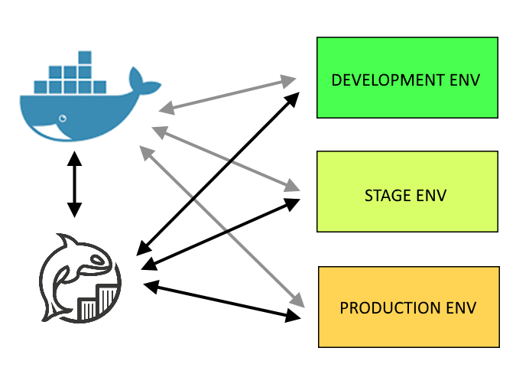
ZCMD Helping with Reuse
Notes:
Can we use Docker here?
So many arguments and missed opportunities for reuse.
What tools are available?
Custom one-off scripts?
Reusable script framework!
Into production we go!
Open source it!

Slide 5
Commands Based on Launch Folder
Machine Context
Configuration and commands for building a container
Stack Context
Configuration and commands for operating collection of containers
Global Context
Configuration and commands that apply everywhere
Notes:
Run some demos after this slide

Slide 6
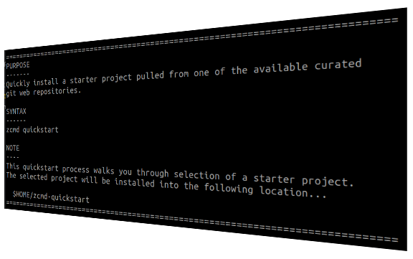
Lots of Help
zcmd
zcmd --help
zcmd --help <command>
E.g., zcmd --help quickstart

Slide 7
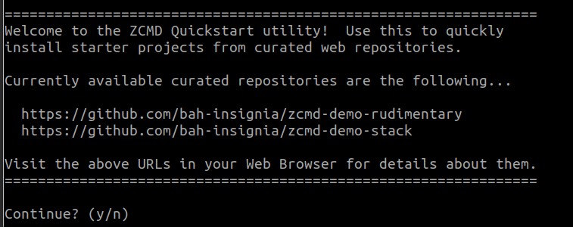
Quickstart
zcmd quickstart
Notes:
Run some demos of quickstart

Slide 8
Other utilities
cdutil
git-*
s3*
Notes:
Anything in devutils is on your path. Some helper scripts are already there.

Slide 9




ZCMD Integration Today
Notes:
Export, import, Drupal stuff; work with private image repo etc

Slide 10
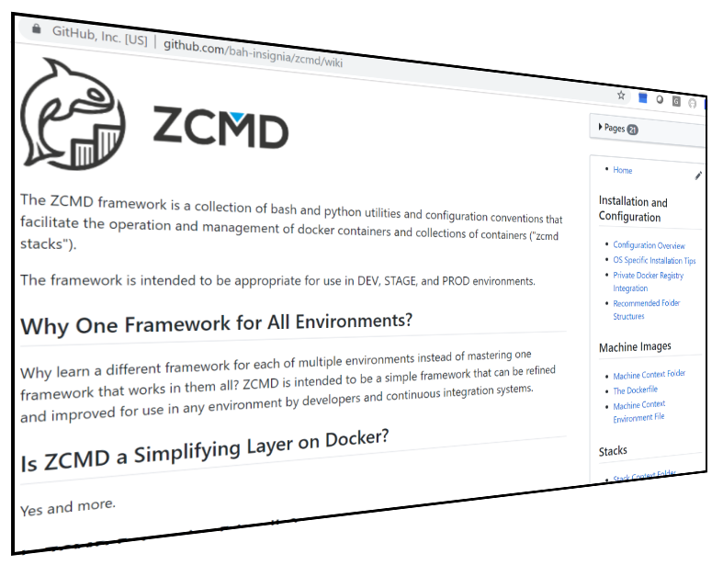
Comprehensive Documentation
https://github.com/bah-insignia/zcmd/wiki

Slide 11
Docker Today Kubernetes Tomorrow?
zmcd up ← fire up a stack of containers.
zcmd down ← shut down stack of containers
Containers are Docker
Future could be Kubernetes
Zcmd usage and commands do not change
https://github.com/bah-insignia/zcmd

Slide 12
Production Scaling Orchestration
Integrate with ZCMD Someday?
Kubernetes
Rancher
AWS ECS

Slide 13

Free for Use -- Private, Educational, Commercial

Slide 14

Wrap-Up / Final Discussions
Try new things! Share your Container expertise by adding to ZCMD; contributors welcome and sought!
https://github.com/bah-insignia/zcmd
Contact for more info ...
Email -- frankfont@room4me.com
Linkedin -- www.linkedin.com/in/frankfont

