Slide 1
Health Sentinel
Carlos Arguello Ortiz, Bri Lynn, Sydney Segear, Csaba Toth
Booz Allen Hamilton
June 4, 2025

Slide 2
Project Goal: AI-driven public health sentinel
Motivation: During the COVID-19 emergency, conflicting messaging and lack of a centralized surveillance mechanism hindered the rapid response to rising cases and hospitalizations through the United States.
Proposed solution: AI-driven public health sentinel - Agentic system that automates data collection, leverages tools for data analysis and provides risk levels/alerts and policy recommendations during public health emergencies.
Dataset: Leveraged historic COVID-19 relevant data (e.g., case counts, hospitalizations). Data obtained from Delphi Group at Carnegie Mellon University https://delphi.cmu.edu/about/

Slide 3
Decision Maker User Story
View status of public health risks, including health alerts and data trends
Use AI to generate strategies to mitigate high risk alerts
Use AI to generate policy document based on AI-generated strategy
Review, edit, and approve public health policy documents

Slide 4
Regular User Story
View status of public health risks, including health alerts and data trends
Filter health alerts by location
View approved policy documents for health alerts

Slide 5
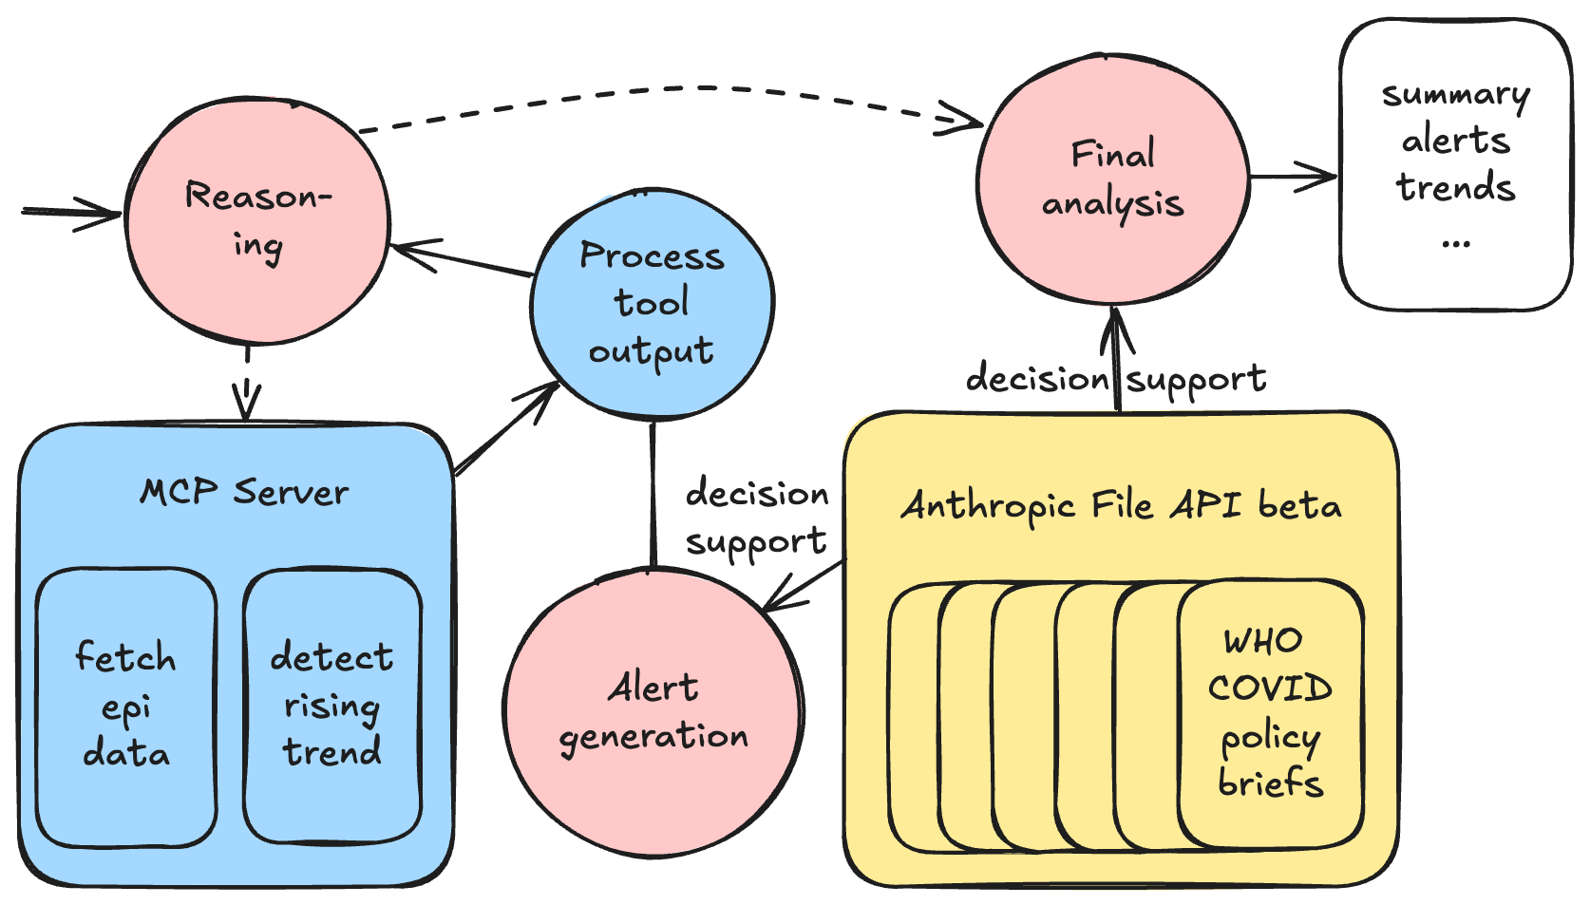
Architecture: Dashboard Agent

Slide 6
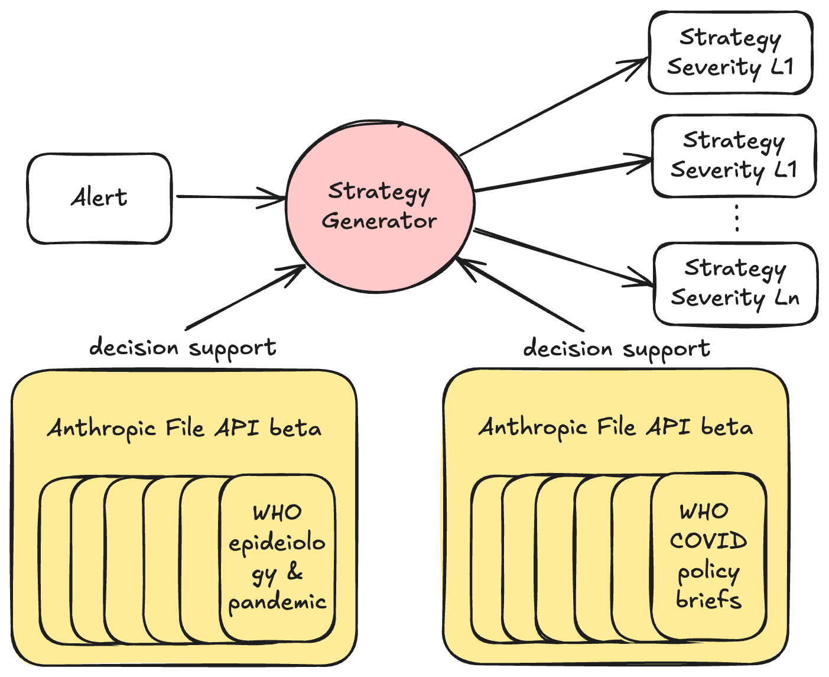
Architecture: Strategy Generator Agent

Slide 7
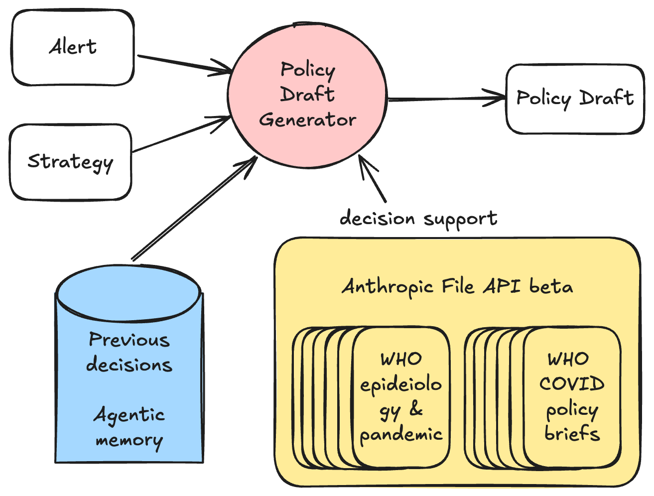
Architecture: Policy Draft Generator Agent

Slide 8
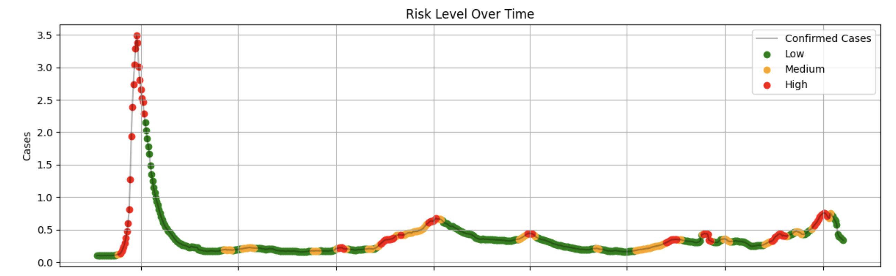
Anomaly/Trend Detection Agentic Tool
Possible to select between statistical methods (parametric) and ML driven methods (e.g., isolation forest)
Settled for light-weight, interpretable methods: regression in log-transformed data (data has only positive values) and z-score deviations.
Considered more sophisticated approaches (Kalman Filters). However, more complex approach required further estimation of model parameters that complicated entire pipeline.

Slide 9
Tech Stack
Backend: Python, FastAPI
Frontend: React, JavaScript
AI: LangGraph Agentic workflows, ReAct agents, FastMCP server tools
Claude 4 extended thinking mode, beta File API use
Observability: LangFuse
Checkpointing and memory: PostgreSQL
Data Source: Delphi Epidata Covidcast – CMU group: https://delphi.cmu.edu/about/
GitHub: https://github.com/bah-scsp-hackathon-2025/public-health-app
Slides: https://github.com/bah-scsp-hackathon-2025/public-health-app/blob/main/BAH-Hackathon.pptx

