Slide 1
Health Sentinel
Carlos Arguello Ortiz, Bri Lynn, Sydney Segear, Csaba Toth
Booz Allen Hamilton
June 4, 2025

Slide 2
Decision Maker User Story
View status of public health risks, including health alerts and data trends
Use AI to generate strategies to mitigate high risk alerts
Use AI to generate policy document based on AI-generated strategy
Review, edit, and approve public health policy documents

Slide 3
Regular User Story
View status of public health risks, including health alerts and data trends
Filter health alerts by location
View approved policy documents for health alerts

Slide 4
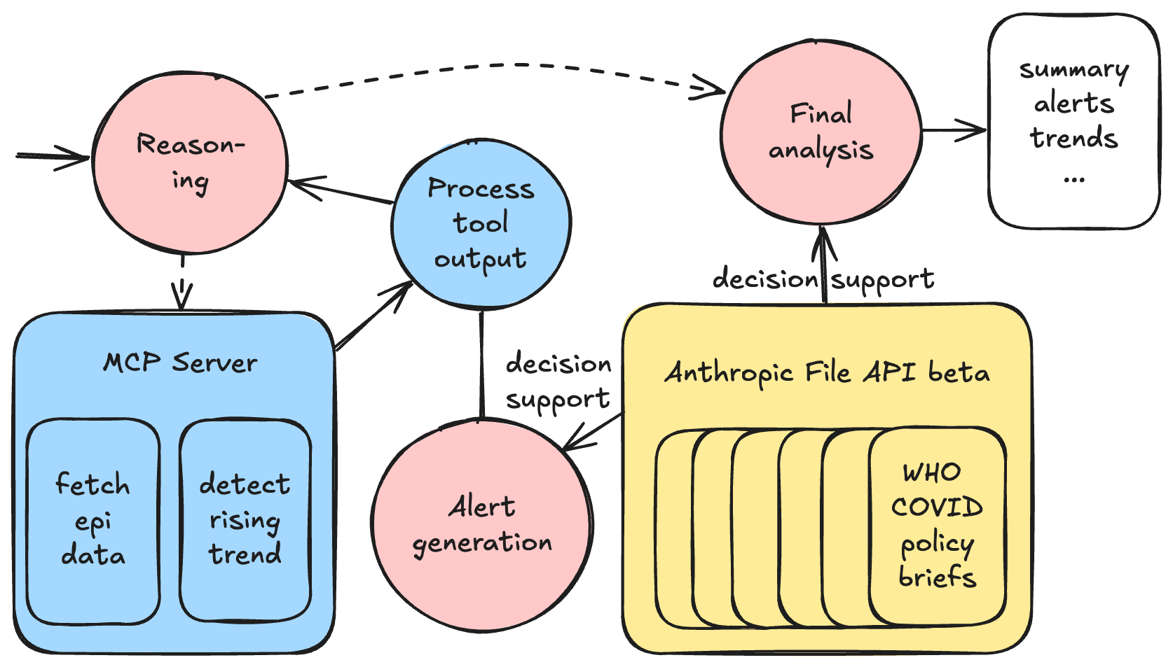
Architecture: Dashboard Agent

Slide 5
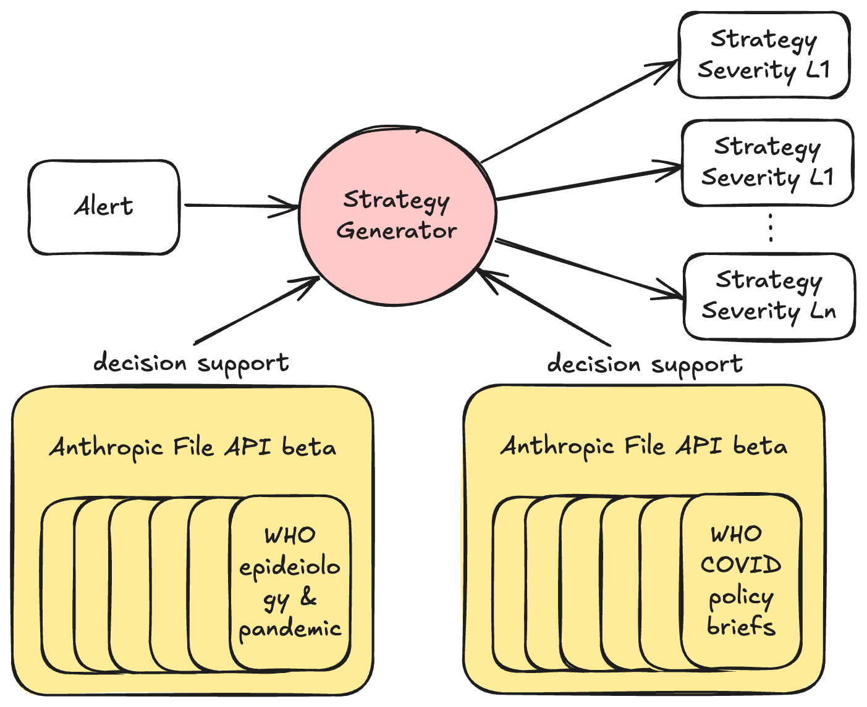
Architecture: Strategy Generator Agent

Slide 6
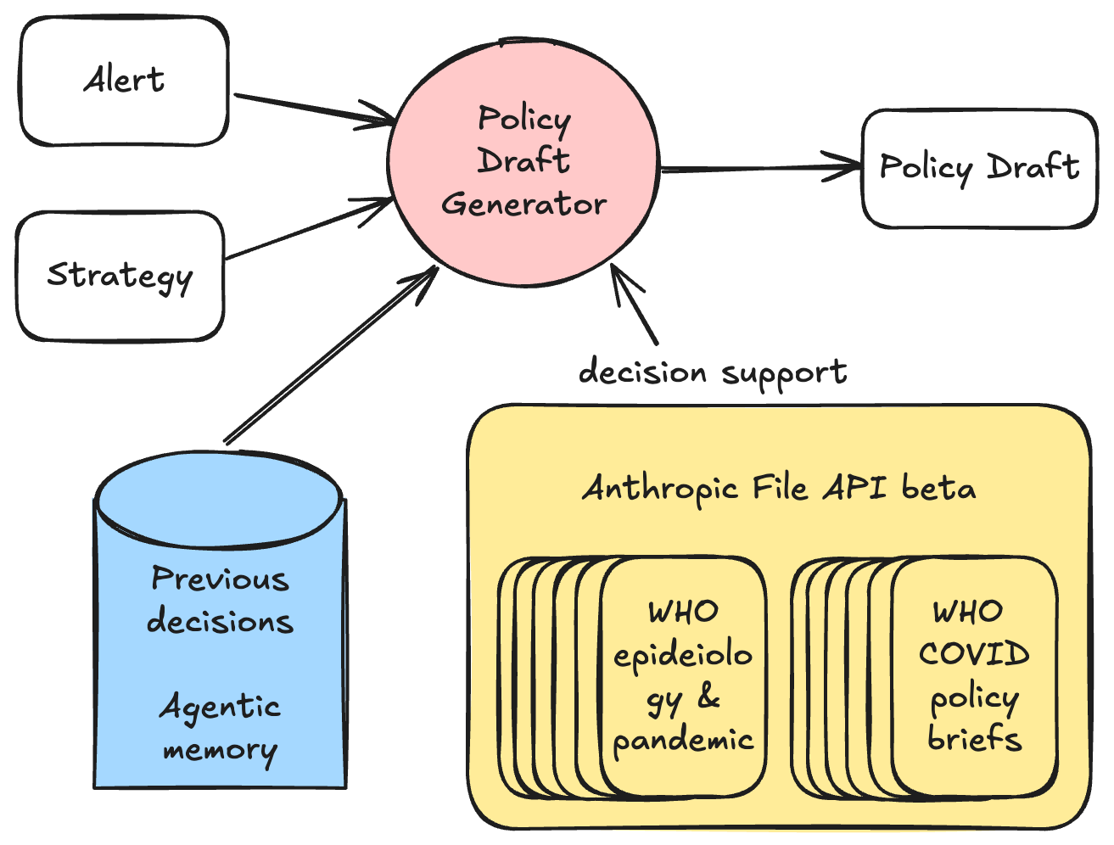
Architecture: Policy Draft Generator Agent

Slide 7
Tech Stack
Backend: Python, FastAPI
Frontend: React, JavaScript
AI: LangGraph Agentic workflows, ReAct agents, FastMCP server tools
Claude 4 extended thinking mode, beta File API use
Observability: LangFuse
Checkpointing and memory: PostgreSQL
GitHub: https://github.com/bah-scsp-hackathon-2025/public-health-app
Slides: https://github.com/bah-scsp-hackathon-2025/public-health-app/blob/main/BAH-Hackathon.pptx

