Slide 1

TinyLFU cache implementation in C++

Slide 2
INTro
We implemented the TinyLFU caching policy as described in the paper by Roy Friedman ,Gil Einziger and Ben Manes in C++ programming language.
The paper assumes and proves that this caching algorithm will have better results than other caching policies like LFU,LRU and more sophisticated policies.

Slide 3
DEPENDENCIES
Our project will be written as a contribution to the open-source caching simulator “WEBCACHESIM” on GitHub.
The project heavily relies on the environment of the simulator and runs simply by command line.
The project also makes a use of some methods of a CM Sketch wrote by “Muthu Muthukrishnan”. The files reside in the subfolder caches/sketch (countmin.c/.h massdal.c/.h prng.c/.h)

Slide 4

Implemented Caching policies
TinyLFU
W_TinyLFU
Adaptive W_TinyLFU

Slide 5

policies
1. TinyLFU inherits LRU to use it for the main cache in eviction policy + using CM_sketch for implementing the admition policy
2. Class W_TinyLFU inherits Class cache , contains two types of caches main cache SLRU and window cache LRU with fixed size (80% main cache 20% window) + using CM_sketch for implementing the admition policy
3. Class W_TinyLFU inherits Class cache contains two types of caches SLRU and LRU with adaptive size + using CM_sketch for implementing the admition policy
4. Same as point three with the addition of Door keeper
5. To switch from the fixed W_TinyLFU to the adaptive one you should turn on the HILL_CLIMBER flag , this flag turns on the adaptive algorithm to change the size of the main cache and window cache in run time

Slide 6
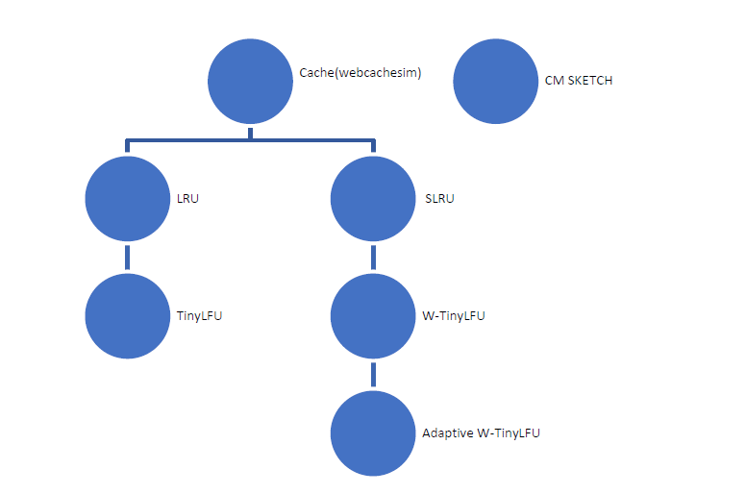
Class diagram

Slide 7
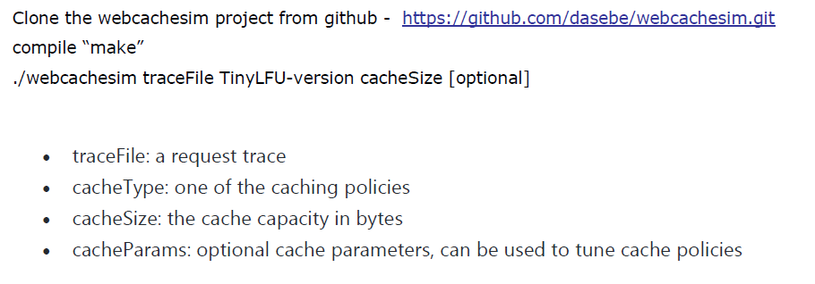
How to run the simulator
https://github.com/baha2303/webcachesim

Slide 8
Example runs
TinyLFU - ./webcachesim multi1.trace TinyLFU 1000
RUNS THE TRACE MULTI1 WITH TINYLFU CACHING POLICY WITH CACHE SIZE OF 1000 ENTRIES.
WTinyLFU - ./webcachesim test.tr W_TinyLFU 1000 5
RUNS THE WEBCAHCESIM SIMULATOR TEST TRACE TEST.TR WITH THE W_TINYLFU POLICY, CACHE SIZE OF 1000 AND WINDOW INITIALIZED AT 5% OFF THE TOTAL CACHE SIZE.

Slide 9
RESULTS
Trace provided by webcachesim

Slide 10
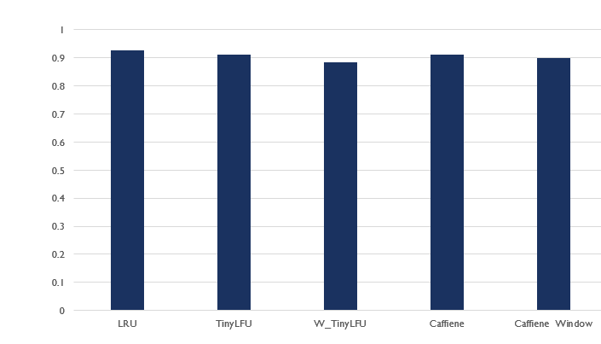
BIG TRACE (~500K)

Slide 11
REFERENCES
CM SKETCH LIBRARY https://www.cs.rutgers.edu/~muthu/countmin.c
WEBCACHESIM SIMULATOR https://github.com/dasebe/webcachesim/blob/master/README.md
CAFFEINE SIMULATOR FOR ALGORITHM IMPLEMENTATION CODE IN JAVA https://github.com/benmanes/
TINYLFU ALGORITHM PAPERS
https://dl.acm.org/doi/10.1145/3274808.3274816
https://arxiv.org/pdf/1512.00727.pdf

Slide 12


Time table
Getting familiar with webcachesim simulator | week 1
Reading the papers about the TinyLFU algorithm and its variations | week 2
TinyLFU algorithm (LRU as main cache with CM sketch for statistics) | week 3
W-tinyLFU (SLRU as main cache,LRU for window cache ) | week 4,5
Adaptive W-tinyLFU algorithm | week 6-8
Writing tests to compare results with other known algorithms | week 9-10
Improving the design & adding more features to the algorithm for example ( The doorkeeper data structure ) | week 11-12
Final code review & submission | week 13

Slide 13
Team
Bahaa Manasra - CS
Aseel Nassar - CE

Slide 14

Thank You

