Slide 2
Gathering information

Slide 3
Interview -interview schedule:-
Meeting | Purpose interview | Position | Name
3/6/2022 | Gathering information about the receiving part | receptionist | Receptionists
4/6/2022 | Gathering information about the employees and rooms and departments part | admin | Admins
5/6/2022 | Gathering information about the workers in the hotel | worker | staff
6/6/2022 | Gathering information about the any thing in the hotel | Manager | Manager

Slide 4
Question for receptionists:-
[1] what are some of problems you face on a daily basis
[2] Do you keep records of guests if yes then for how many years you keep record?
[3]what are the information you stored of guest?
[4] how you take payment from the guest?
[5] Describe me how you deal with a customer ?
[6] What do you want from the new system?

Slide 5
Questions for admins
[1] How many departments in Hotel and what they are named? [2] How many rooms in Hotel and what they are number? [3] what are the services in your hotel you provide ?
[4] how many staff members in each department?
[5] Describe me how you deal with a problems in the hotel?
[6] What do you want from the new system?

Slide 6
Questions for staff
[1] what are some of problems you face on a daily basis?
[2] How many orders do you(chef) make per day?
[3] What food would you(chef) like to have on the list?
[4] how many rooms you(housekeeper) clean per day?
[5] how can order processing be improved?
[6] What do you want from the new system?

Slide 7
Questions for manager
[1] how many employees in the hotel?
[2] what is computer skill level of employees?
[3] what is the economic status of your hotel per year since you manage this hotel?
[4] What are the hotel's weaknesses in the hotel?
[5] What are the hotel’s strengths in the hotel?
[6] What do you want from the new system?

Slide 8
Other method to gathering information
[1] document analysis
is used to understand the as is system . Forms , report ,policy manuals, organization charts describe the formal system that the business organization uses
[2] observation
the act of watching processes being performed.
it is powerful tool to gain insight into the as is system , and to check the validity of information gathering from other sources

Slide 9
Feasibility study
Technical feasibility
Economic feasibility
Organization feasibility

Slide 10
Technical feasibility
Familiarity with technology
We have good experiences in softwere and disktop aplications
And deal with technology
Project Size
Medium project not have risk
Compatibility integrate the system with existing disktop services

Slide 11
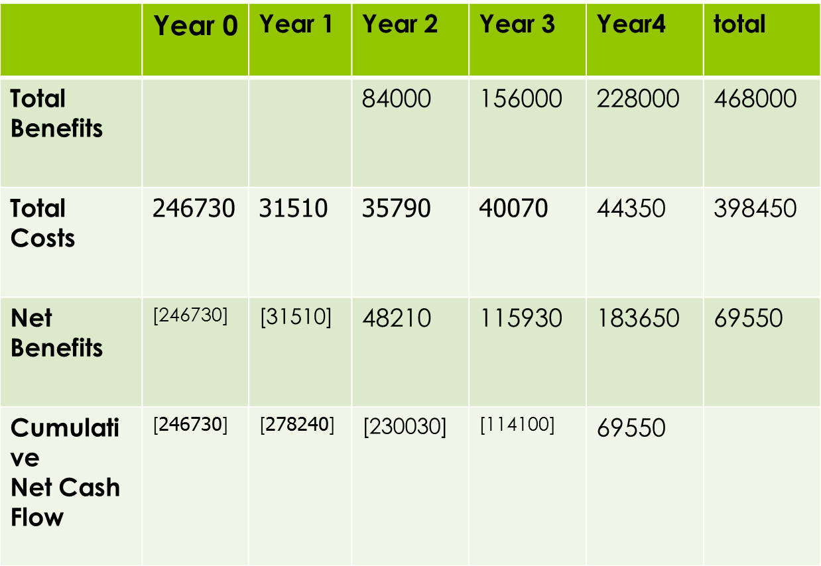
Economical study

Slide 12
B.E.P = YEARS NAGATIVE +(YEAR NET CASH – YEAR COMM)/YEAR COMM B.E.P = 3 +)183650-69550)/183650 B.E.P = 3 .62 ROI = (TOTAL BENEFIT-TOTAL COST )/TOTAL COST ROI = (468000-398450)/398450)=6080 =17.4%
total | Year 4 | Year 3 | Year 2 | Year 1 | Year 0
468000 | 228000 | 156000 | 84000 |  |  | Total benefit
342353.64 | 155727.06 | 117205.10 | 69421.48 |  |  | Pv fot benefit
398450 | 44350 | 40070 | 35790 | 315110 | 246730 | Total cost
335977.18 | 30496.55 | 30105.18 | 29578.51 | 28645.54 | 246730 | Pv for cost

Slide 13
Organizational feasibility
From an organizational perspective, this project has low risk. The objective of the system, which is to increase income, easily reserve the rooms ,easily paid.

Slide 14
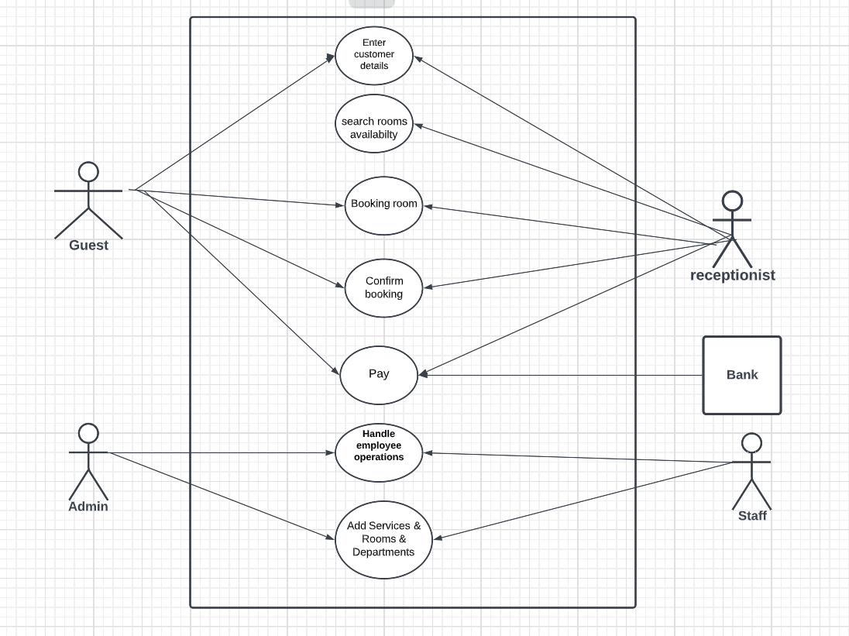
Use case

Slide 15
Use case table

Slide 16
Enter customer details | Use case name
1 | Use case id
High | Priority
Guest | Actor
the use case show that guest enter details to receptionist In order to get a suitable room | Description
The guest needs a room | Trigger
External | type
The guest prepares his data | Precondition
Guest enter your name Guest enter the room state Guest enter credit card Guest contact number | Normal course
the receptionist search room availabilty | Post condition
required data Confirm the required data | input
Guest | source
Guest data | output
Database | destination

Slide 17
Search room availability | Use case name
2 | Use case id
High | Priority
receptionist | Actor
the use case show how find room available to guest | Description
Guest enter details to receptionist | Trigger
External | type
The guest entered his details | Precondition
Chick the room availability Chick the room suitable Prepare the room | Normal course
The room will be booked | Post condition
Guest data | input
receptionist | source
Is there an empty room or not | output
Database | destination

Slide 18
Booking room | Use case name
3 | Use case id
High | Priority
Receptionist & Guest | Actor
the use case show booking the room to guest | Description
When there are rooms with the appropriate specifications for the guest | Trigger
External | type
There is room available | Precondition
Determine the period of stay Define customer services | Normal course
Confirm booking | Post condition
Guest data | input
receptionist | source
the room booked | output
Database | destination

Slide 19
Confirm Booking | Use case name
4 | Use case id
High | Priority
Receptionist and guest | Actor
the use case show confirm booking the room to guest | Description
Room booked | Trigger
External | type
The receptionist booked the room | Precondition
Make sure to specify the period of stay Ensure that customer services are specified | Normal course
Check payment | Post condition
Guest data | input
receptionist | source
the room sure booked | output
Database | destination

Slide 20
Pay | Use case name
5 | Use case id
High | Priority
receptionist & Guest & Bank | Actor
the use case show Pay hotel dues | Description
Stay period is over | Trigger
Eternal | type
The guest finished your time in the hotel | Precondition
Prepare credit card And it has enough money | Normal course
Leave the hotel | Post condition
Credit card | input
Guest | source
Receiving the hotel's dues | output
Database | destination

Slide 21
Check out | Use case name
6 | Use case id
High | Priority
Receptionist | Actor
the use case show check out | Description
Stay period is over | Trigger
Eternal | type
The guest finished your time in the hotel | Precondition
Confirmation of the payment amount | Normal course
Leave the hotel | Post condition
Payment value | input
Receptionist | source
Confirmation of the payment amount | output
Database | destination

Slide 22
Handle employee operations | Use case name
7 | Use case id
High | Priority
Admin | Actor
the use case show Handle employee operations | Description
The system needs workers | Trigger
Eternal | type
The system needs workers | Precondition
Add worker | Normal course
The presence of sufficient workers in the organization | Post condition
Worker data | input
Admin | source
The presence of sufficient workers in the organization | output
Database | destination

Slide 23
Add Services & Rooms & Departments | Use case name
8 | Use case id
High | Priority
Admin | Actor
the use case show Handle rooms and services and department operations | Description
The system needs services and rooms and department | Trigger
Eternal | type
The system needs services and rooms and department | Precondition
Add services and rooms and department | Normal course
The presence of sufficient services and rooms and department in the organization | Post condition
organization data | input
organization | source
The presence of sufficient services and rooms and department in the organization | output
Database | destination

Slide 24
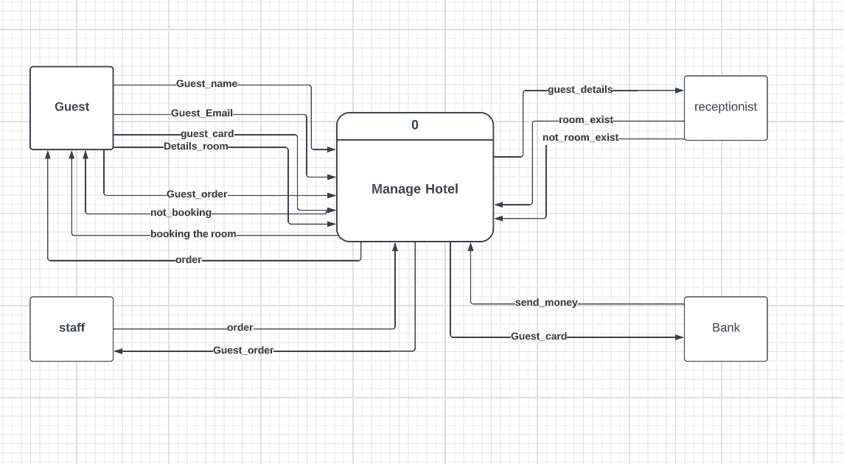
Data flow Context level

Slide 25
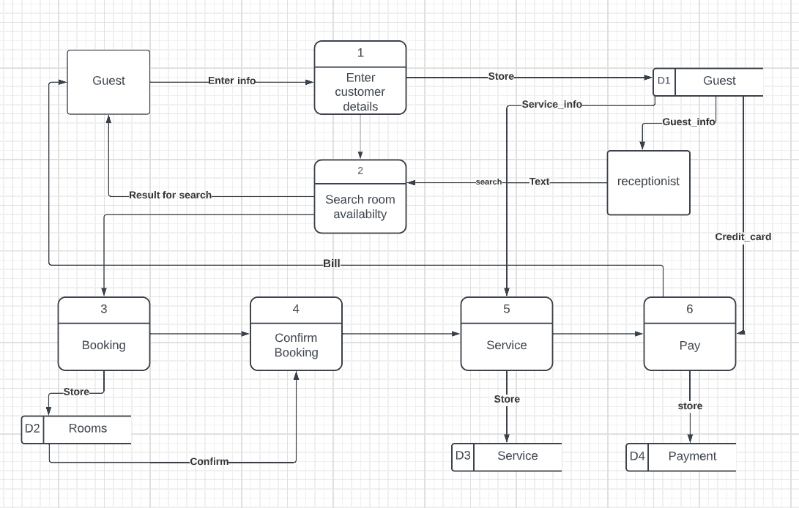
Data flow Zero level

Slide 26
Data dictionary

Slide 27
Table Guest
Required | length | Data type | Description | Name
yes | 20 | integer | Number of guest | Guest_id
yes | 255 | varchar | Name of guest | Guest_name
yes | 20 | integer | Credit of guest | Guest_crid_card
no | 255 | varchar | Email of guest | Guest_email
yes | 255 | varchar | The phone of guest | Guest_contact_num
no | 20 | integer | Number of branch | Hotel_branch_id
yes | 20 | integer | Number of rooms | Booking_id

Slide 28
Table Rooms
Required | length | Data type | Description | Name
yes | 20 | integer | Number of room | Room_id
yes | 20 | integer | Number of room in hotel | Room_number
yes | 255 | varchar | Type of room | Room_type
yes | 255 | varchar | Description room | Room_describtion
no | 255 | varchar | The room with air condition | Air_condition
yes | 255 | varchar | Smoking in the room | Smoke_friendly

Slide 29
Table Services
Required | length | Data type | Description | Name
yes | 20 | integer | Number of service | Service_id
yes | 255 | varchar | Name of service | Service_name
yes | 255 | varchar | Description of service | Service_description
yes | 30 | decimal | Cost of service | Service_cost

Slide 30
Table hotel branch
Required | length | Data type | Description | Name
yes | 20 | integer | Number of branch | Branch_id
yes | 255 | varchar | Name of branch | Branch_name
yes | 255 | varchar | Phone of branch | Branch_contuct_num
no | 255 | varchar | Email of branch | Branch_email
yes | 255 | Varchar | Manager of branch | Branch_manager
no | 20 | integer | Count of rooms | Branch_total_rooms

Slide 31
Table departments
Required | length | Data type | Description | Name
yes | 20 | integer | Number of department | Department_id
yes | 255 | varchar | Name of department | Department_name
yes | 255 | varchar | Description of department | Department_description
yes | 255 | varchar | Manager of department | Dpartment_manager
yes | 20 | integer | Number of branch | Branch_id

Slide 32
Table Employees
Required | length | Data type | Description | Name
yes | 20 | integer | Number of employee | Emp_id
yes | 255 | varchar | Name of employee | Emp_name
yes | 255 | varchar | Role of employee | Emp_role
yes | 30 | decimal | Salary of employee | Emp_salary
yes | 255 | varchar | Phone of employee | Emp_contuct_num
no | 255 | varchar | Email of employee | Emp_email
yes | 20 | integer | Number of department | Department_id

Slide 33
Table booking
Required | length | Data type | Description | Name
yes | 20 | integer | Number of booking | Booking_id
yes | 255 | varchar | Date of booking | Booking_date
yes | 255 | varchar | Duration of stay | Duration_of_stay
yes | 255 | varchar | Check in date | Check_in_date
yes | 255 | varchar | Check out date | Check_out_date
yes | 20 | integer | Number of employee | Emp_id
yes | 20 | integer | Count rooms booked | Total_rooms_booked
yes | 20 | integer | Number of guest | Guest_id
yes | 20 | integer | Number of payment | Payment_id

Slide 34
Table payment
Required | length | Data type | Description | Name
yes | 20 | integer | Number of payment | Payment_id
yes | 255 | varchar | Type of payment | Payment_type
yes | 255 | varchar | Date of payment | Payment_date
yes | 20 | integer | Count of payments | Total_payment
yes | 20 | integer | Number of guest | Guest_id

Slide 35
Table transaction
Required | length | Data type | Description | Name
yes | 20 | integer | Number of transaction | Transaction_id
yes | 255 | varchar | Name of transaction | Transaction_name
yes | 255 | varchar | Date of transaction | Transaction_date
yes | 20 | integer | Number of booking | Booking_id

Slide 36
Table room_booked
Required | length | Data type | Description | Name
yes | 20 | integer | Number of booked room | Booked_id
yes | 20 | integer | Number of room | Room_id

Slide 37
Table booking_has_services
Required | length | Data type | Description | Name
yes | 20 | integer | Number of booking | Booking_id
yes | 20 | integer | Number of service | Service_id

