Slide 1
SALES ESTIMATION
Baha Hakkı Demircioğlu

Slide 2
Sales predıctıon
Target is predict, the sales and dependencies on the given variables.
Make/explain the reasonable dependency/connection with features.

Slide 3
The gıven data
Date datetime64[ns]
Display_Impressions int64
Video_Impressions float64
Facebook_Impressions float64
Twitter_Impressions float64
Sales float64
Competitor1_Investment float64
Competitor2_Investment float64
Offline_Investment float64
Average_Temp float64
USD_RATE float64
EURO_RATE float64
Inflation float64

Slide 4
Understandıng the data
To use the given data with max efficiency, some changes had to be done.
One of them was changing the date value with something other.
Reason: datetime is not a numeric value and the aim of this task was predicting sales, a numerical value, which means a regression task.
Dealed with one hot encoding.

Slide 5
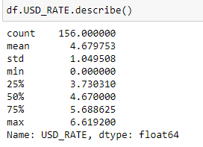
Understandıng the data(cont.)
One other problem was dealing with wrong value. Even there was not any null value in the dataset, there was some 0 values. At least one of them was in the USD_RATE which can not be. The other wasn’t make much sense such as there were huge Twitter_Impression values but at least one of them was 0. However no change done to them due to even it’s less possible it might have happened. For instance, there might be a problem occured about payment and on the given timeline no ads happened.

Slide 6
New columns
Since sales, impressions and investment values are huge, I considered that company is sector leading/huge company. Thus, such as other big company’s, this company should be working with much more strong and stable currency than Turkish Lira. In the result I added new columns with based on the USD_RATE’s.

Slide 7
Implementatıon
Implementations has done with OLS/from statsmodels, also there are some Ridge, Lasso, Elastic Net, Decision Tree implementations.
In the word file I made small descriptions of those algorithms.
Also there are some pdf files, which I can say at least l took a look on them.

Slide 8
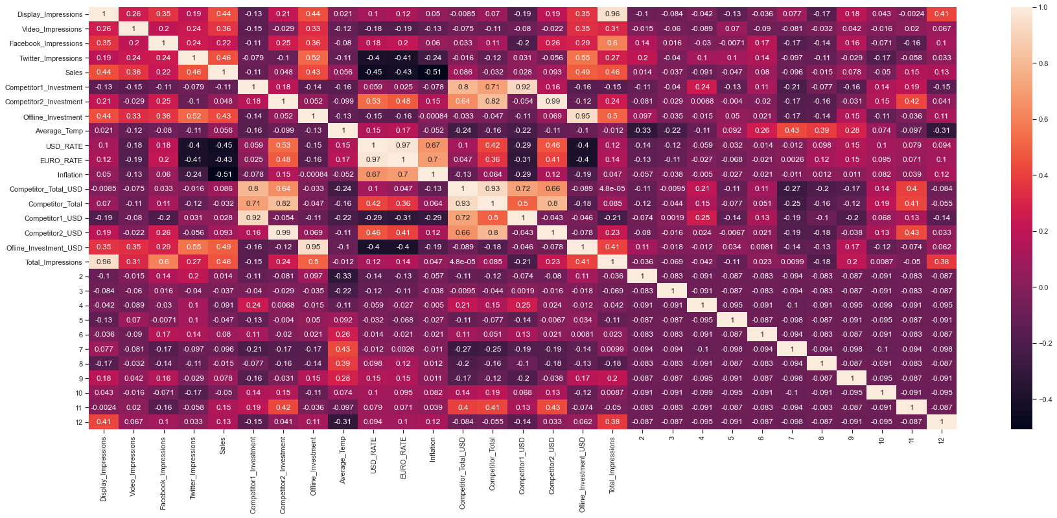
1:Right Proportion -1:Inverse Proportion

Slide 9
correlatıon Matrıx
Cor Matrix is a way of defining the feautures’ correlated or not.
It «might» give ideas of efectness, but doesn’t explain or offer causality.
Altough we can explain the causality with the significant results:
The impressions (one by one or total) has good ratio with sales.
We might say impressions make our sales higher.
USD/EURO/Inflation rates has negative corr. with sales.
We might say loss of power of TL results negative in our sales.

Slide 10
correlatıon Matrıx
There is not too much, but some positive corr. at winter months with sales.
Which results the sales are might higher in the beginning of winter.
Also when we look month corr. with other feautures (impressions, competitor investments): some products/sales might seasonal.(Fall/Winter)

Slide 11
Conclusıon
R SQUARE SCORE is the one of the best way to explain efectness of the created model.
In this case OLS R² resulted as 0.7, adj. R² resulted as 0.65.
(R² can be 1 as maximum value which means there is a overfitting issue.)
Especially Lasso and Ridge can be higher than OLS sometimes. (~0.72)

Slide 12
Conclusıon (cont.)
As result of the created regression model, coeff. and t values gives information about efectness/relatedness with the dependent value.
Next page is an example report of the OLS estimator’s by statsmodels; then I’ll cover it.

Slide 13
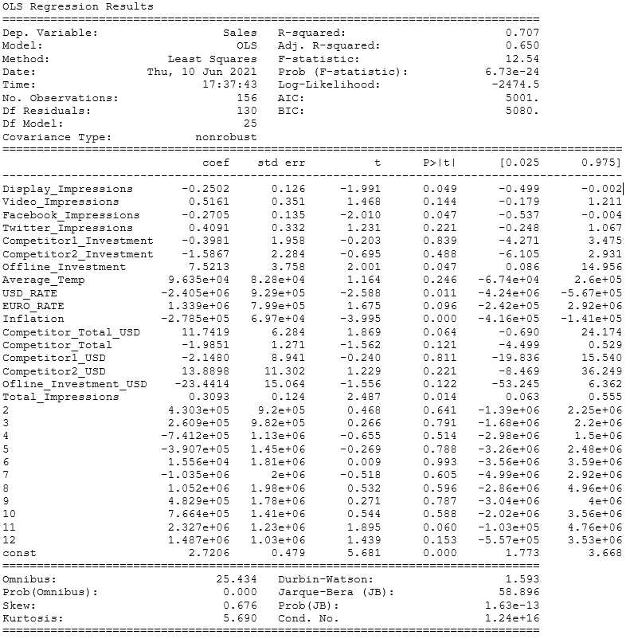

Slide 14
OLS Results sıgnıfıcant t values
Total (also spesificly Display, Twitter) Impressions and Offline Investment are sytatistically significant.
Currency changes and Inflation are also hugely sytatistically significant.
The constant value which is min. sales value is also sytatistically significant.
Spesificly 11. month (November) can be seen as sytatistically significant.

Slide 15
OLS Results sıgnıfıcant t values(cont.)
The competitors’ investments may seem to be efective for our sales.
My guess in this position is, there can be an efect to the market and it can efect to our sales relatively. For instance:
People may see an ad of Pepsi and desire cola. Then buy the Coca-Cola.

Slide 16
Decısıon tree
As given dataset isn’t such big (156 rows), decision tree generates much more efficient models to given dataset then OLS or others.
Since dec. tree algorithm based on learning from data and noises, trees can perform very well. Outlier’s used for a part of model. (when max_depth doesn’t spesified it ended as overfitting.)
With limited max_depth it generates pretty great models with high R² scores.
When generate the model with 6 max depth, most important future is Total Impression and R² score is 0.9.
It dismisses some features such as average temp, months etc.

Slide 17
Decısıon tree results feauture ımportances only > 0.01 valued feautures
max_depth=4, R² Score=0.78:
('Competitor1_Investment', 0.015576805322422305),
('Display_Impressions', 0.02034821539130228),
('Competitor2_Investment', 0.031850055928518764),
('USD_RATE', 0.039019794199632675),
('Competitor_Total_USD', 0.050805702178882736),
('Video_Impressions', 0.05514424765394785),
('Inflation', 0.38344724484817555),
('Total_Impressions', 0.3900740967060731)

Slide 18
Decısıon tree results feauture ımportances only > 0.01 valued feautures
max_depth=5, R² Score=0.84:
('Competitor1_Investment', 0.01453027721707756),
('Display_Impressions', 0.01898111996577169),
(11, 0.02752535499098546),
('Competitor2_Investment', 0.03032176177786037),
('USD_RATE', 0.036614146900977744),
('Video_Impressions', 0.0514393798185082),
('Competitor_Total', 0.060034480040125515),
('Inflation', 0.3576853308777299),
('Total_Impressions', 0.3580546522814518)

Slide 19
Outcome of ols and decısıon trees
Total impression (mostly video also display impressions) are great effective and should be kept on.
There is only one missing point on this advice: Since the given dataset has not any information of impressions’ cost, we can’t detect price/performance for impressions.
Inflation has some effect on the sales. We can’t control it but can expect parallelness with it.

Slide 20
Personal outcomes
The task had no null variables, which I had to work with before in other projects.
The task had some 0 values which didn’t have. It suprised me, because I have never worked with incorrect value.
While working on the task I have used stackoverflow/sckitlearn/statsmodels/towardsdatascience(medium) many times but besides that I have at least took a look at some essays which are in a folder.
In the code some lines commented out. For instance: date column can be changed into seasonal data, instead this monthly data gave better results so I used monthly.
Also visualization lines commented out due to take some time.

