Slide 1
Medical
Transcription NLP
Data Science Project
Arjit, Musaab, Michael, Bahadir

Slide 2
OVERVIEW
Table of Contents
Phase 1
Phase 2
01
EDA & NLP Foundations
02
Statistical Significance
Data cleaning, feature counts, n-gram frequency analysis
Chi-square tests, PMI collocation scores, TF-IDF analysis
Phase 3
Phase 4 & 5
03
ML & Classification
04
Semantic Search & Validation
Three models trained, evaluated with F1 + confusion matrix
Embeddings, ChromaDB, mini-RAG classifier, Precision@5
Notes:
Quick roadmap. Four phases. Phase 1 - clean the data, engineer features, analyze word frequencies.
Phase 2 - prove statistically which words define each specialty. Chi-square, PMI, TF-IDF.
Phase 3 - train three classifiers, evaluate with F1 scores and confusion matrices.
Phase 4 and 5 - build a semantic search engine with embeddings, test it against ground truth.
Each phase builds on the last. Let's start with Phase 1.

Slide 3
PHASE 1
Medical Transcription Analysis — The Challenge
Predict the medical specialty of a clinical note — from messy, real-world data.
4,999
medical transcription notes
40
labeled specialties
6
raw columns
Key challenges to address
Severe class imbalance - up to a 36:1 ratio between specialties
Overlapping vocabulary shared across many specialties
Non-medical labels - document formats posing as specialties
Cross-listed notes - the same text under multiple labels
Raw data snapshot
column | role
medical_specialty | target label
transcription | clinical text
description | short summary
keywords | not used
Notes:
Here's what we started with:
4,999 notes, 40 specialties, 6 columns. We predict specialty from the text alone." Four problems: 36-to-1 class imbalance, shared vocabulary blurring boundaries, fake labels that are document types, and cross-listed notes under multiple specialties." We only use two columns - specialty and transcription. Phase 1 fixes each problem."

Slide 4
PHASE 1
Phase 1 Goals — Clean the Noise, Find the Signal
Transform noisy raw data into a clean, classification-ready dataset.
1.1 Data Cleaning
Remove unusable rows (nulls, duplicates, too-short notes) and strip out cross-listed, non-specialty labels.
1.2 NLP Analysis
Engineer length features, build a clean-text column, and map each specialty's linguistic “fingerprint.”
The transformation
4,999
rows (raw)
→
2,586
rows (clean)
40
labels (raw)
→
26
specialties (clean)
Success criteria: only genuine specialties remain, each with enough examples to train on, and no duplicate or unusable transcriptions.
Notes:
Phase 1 has one job: turn noisy raw data into a clean, classification-ready dataset. It splits into two halves. Part 1.1 is data cleaning — removing unusable rows like nulls, duplicates, and notes too short to mean anything, and stripping out mislabeled, cross-listed entries. Part 1.2 is NLP analysis — building length features, cleaning the text itself, and mapping the vocabulary distinctive to each specialty. The headline transformation: 4,999 rows down to 2,586, and 40 labels down to 26 real specialties. Success means three things — only genuine specialties remain, each has enough examples to train on, and there are no duplicate or unusable notes.

Slide 5
PHASE 1
Initial Data Quality Check
What we found before touching anything — nulls and heavy duplication.
column | null % | duplicate % | note
medical_specialty | 0% | 99.2% | expected — ~40 categories
transcription | 0.66% | 52.8% | 33 nulls; dup = cross-listing?
description | — | 53% | short summaries repeat
keywords | 21.36% | — | not used for classification
⚠ Key insight
High transcription duplication (52.8%) is a red flag: the same clinical note appears under several specialty labels — i.e. cross-listing.
What this drives
• Drop the 33 null transcriptions
• Investigate duplicate text before trusting labels
Notes:
Before changing anything, we profiled the raw data. Good news first: the specialty label has zero missing values. The transcription text has 33 missing values — about two-thirds of a percent — which we'll drop. Keywords is 21% empty, but we don't use it. The number that jumps out is duplication: more than half the transcription texts are duplicated. For free-text clinical notes, identical text repeating is a red flag — it strongly suggests the same note was filed under multiple specialty labels. That's the cross-listing problem, and confirming it drives most of the cleaning that follows. Two immediate actions: drop the nulls, and investigate that duplicate text before trusting any label.

Slide 6
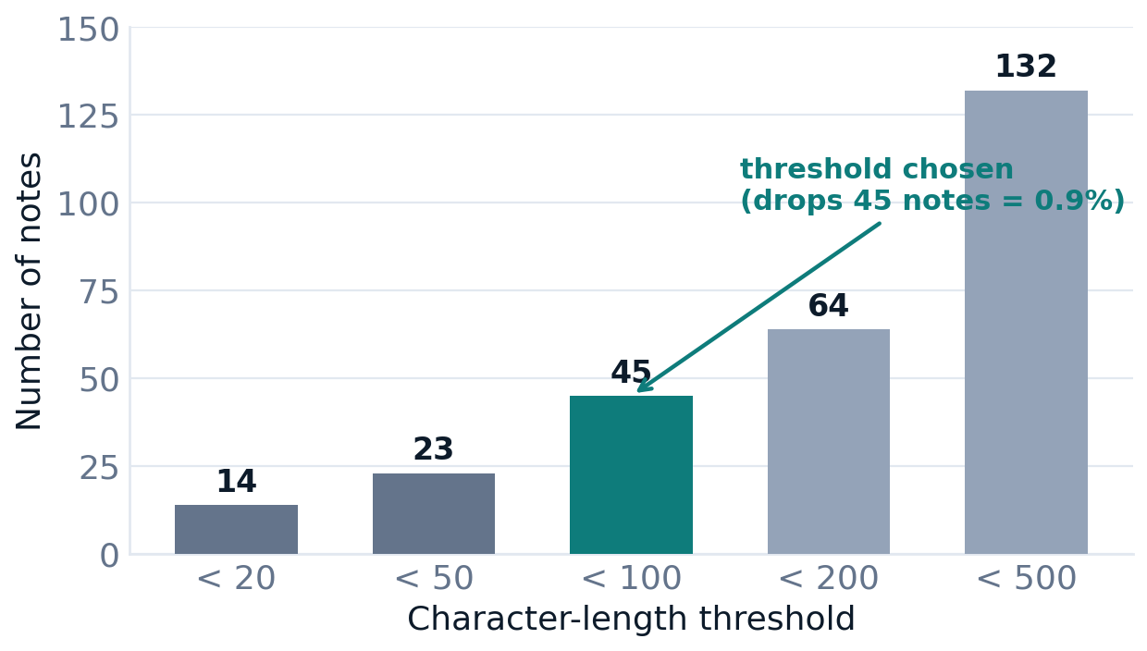
PHASE 1
How Short Is Too Short?
Setting a character-length threshold without throwing away usable notes.
The problem
Very short notes lack the context needed to identify a specialty.
"2-D M-Mode. Doppler."
# 18 chars — no clinical context
Decision: minimum 100 characters
Balances content quality against retention — drops only 45 notes (0.9% of the data).
Notes:
Some notes are simply too short to classify — there isn't enough text to tell which specialty they belong to. The example on the right is a note that's literally '2-D M-Mode. Doppler.' — eighteen characters, no real clinical content. So we need a minimum-length cutoff. The chart shows how many notes fall below each threshold: 14 under 20 characters, 45 under 100, and so on. We set the line at 100 characters — the sweet spot. It's long enough to guarantee real content, but only removes 45 notes, under one percent of the data. We keep almost everything while dropping the genuinely useless fragments.

Slide 7
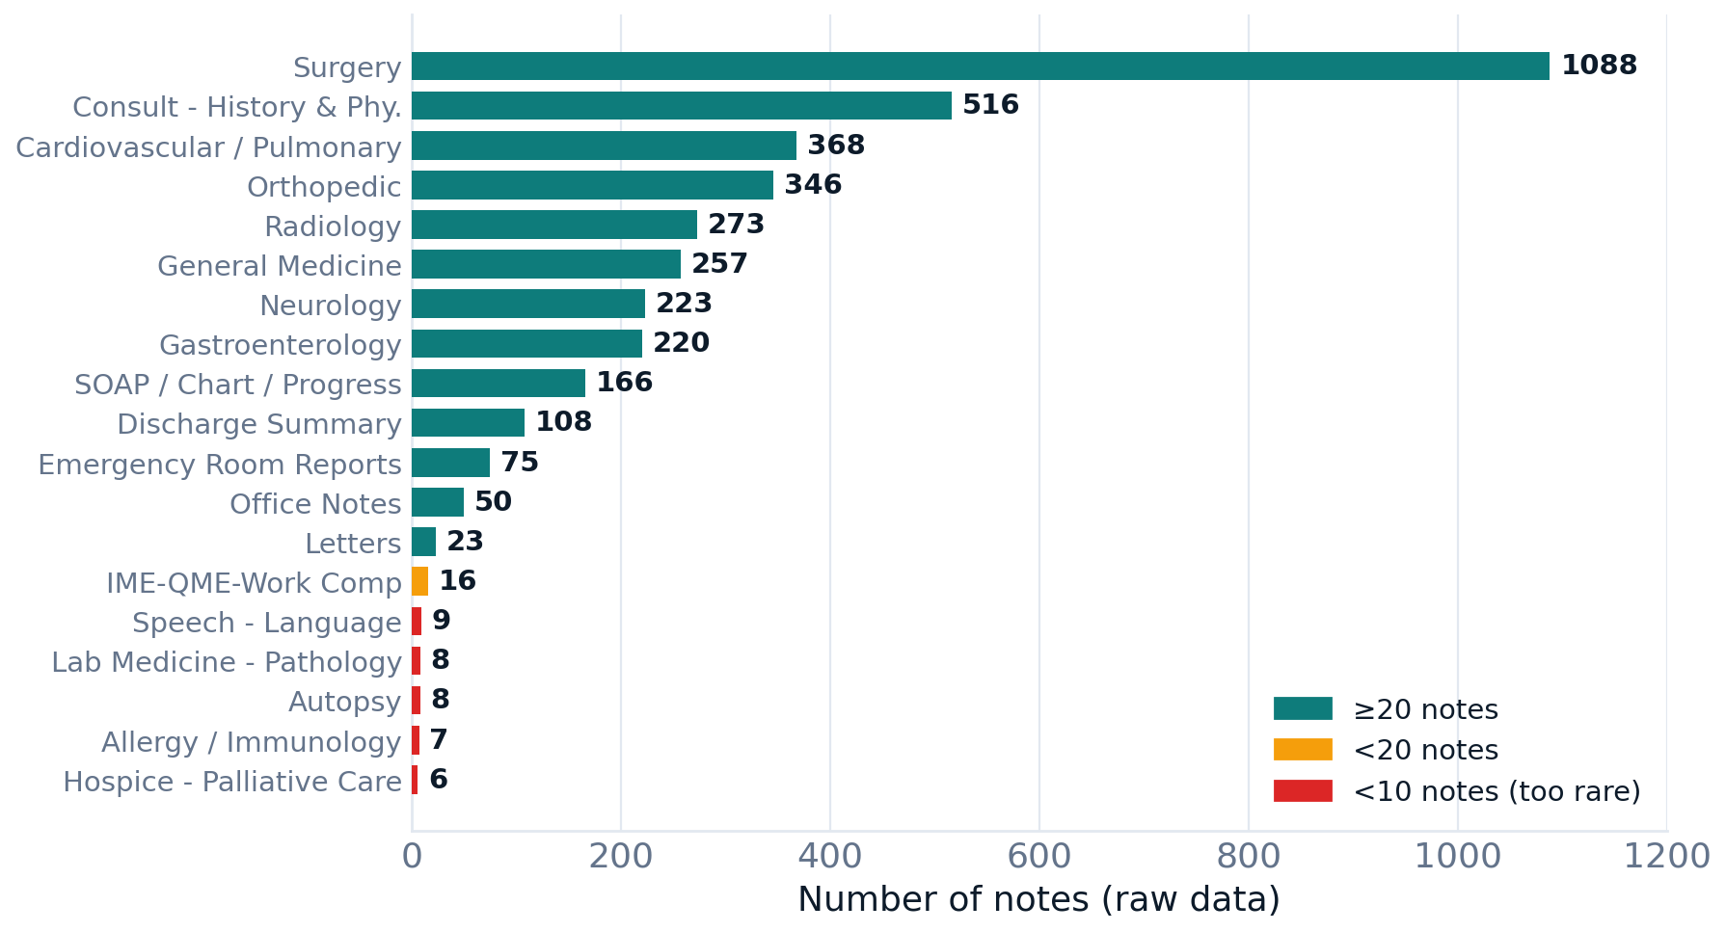
PHASE 1
Not All Specialties Are Created Equal
40 labels, extreme imbalance — and some aren't true specialties at all.
1,088
Surgery — largest (21.8%)
6
Hospice — smallest (0.1%)
Two problems surface
11 specialties have <20 notes; 5 have <10. And is “Surgery” even a specialty, or a procedure type?
Notes:
Now the distribution problem. Across the 40 raw labels the imbalance is extreme: the largest group, Surgery, has 1,088 notes — nearly 22% of everything — while the smallest, Hospice, has just 6. Eleven specialties have fewer than 20 notes; five have fewer than 10. Two issues fall out of this. First, classes with a handful of examples can't be learned reliably. Second, and bigger: is 'Surgery' even a specialty? It's really a type of procedure that cuts across many specialties. The same doubt applies to a few other labels. The next several slides investigate exactly that.

Slide 8
PHASE 1
Document Formats Masquerading as Specialties
Some labels describe the type of document, not a medical field.
non-specialty label | notes
Consult - History and Phy. | 516
SOAP / Chart / Progress Notes | 166
Discharge Summary | 108
Emergency Room Reports | 75
Office Notes | 50
Letters | 23
IME-QME-Work Comp etc. | 16
954
rows labeled with document formats, not specialties
The question
Are these transcriptions unique — or just duplicates of notes that already carry a real specialty label? (Next slide proves it.)
Notes:
Looking closely, several labels describe the kind of document, not a medical field — 'Consult, History and Physical,' 'SOAP / Progress Notes,' 'Discharge Summary,' 'Office Notes,' 'Letters,' and so on. Together that's 954 rows, almost a fifth of the dataset, tagged with a document format instead of a specialty. The obvious question: are these notes unique, or just copies of notes that already carry a real specialty label? If they're duplicates, we can drop the format label without losing anything. The next slide answers that with hard numbers.

Slide 9
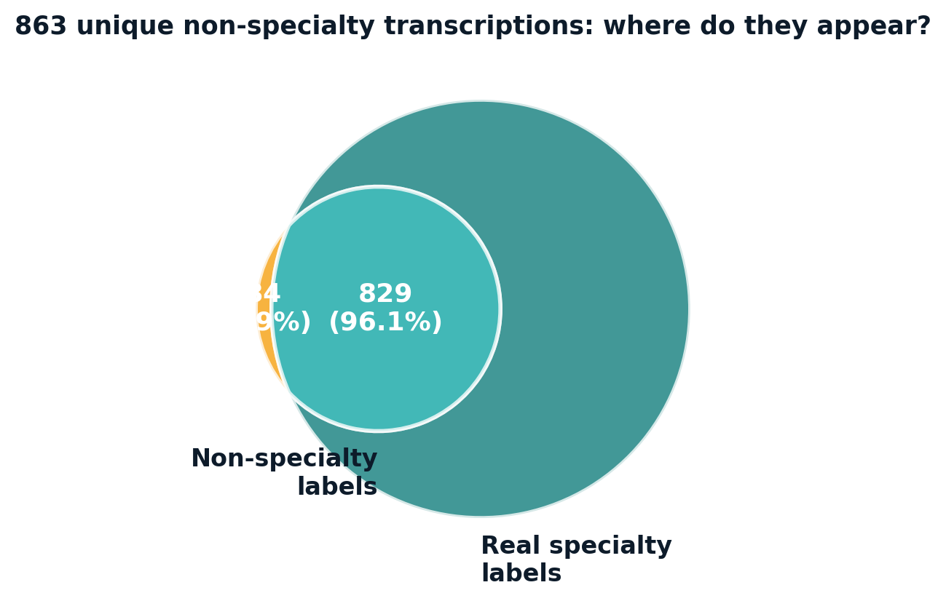
PHASE 1
Proof: Non-Specialty Labels Are Redundant
Compare unique transcription texts between non-specialty and real-specialty rows.
The result
863 unique transcriptions in non-specialty rows
829 (96.1%) also carry a real specialty label
Only 34 (3.9%) are non-specialty-only
Specialty | Transcription Note
Office Notes | Patient XYZ has joint pain
Orthopedic | Patient XYZ has joint pain
✓ Safe to drop
Dropping non-specialty labels removes only redundant labels — with 96% overlap confirmed, no unique clinical content is lost.
Notes:
Here's the proof. We took every unique transcription in those non-specialty rows — 863 of them — and checked whether the same text also appears under a real specialty. The answer: 829, just over 96%, do. Only 34 are unique to the non-specialty labels. The Venn diagram shows that overlap. So dropping the document-format labels removes redundancy, not content — for 96% of these notes the real specialty label is still there. This is the evidence-based green light to clean them out, rather than an assumption.

Slide 10
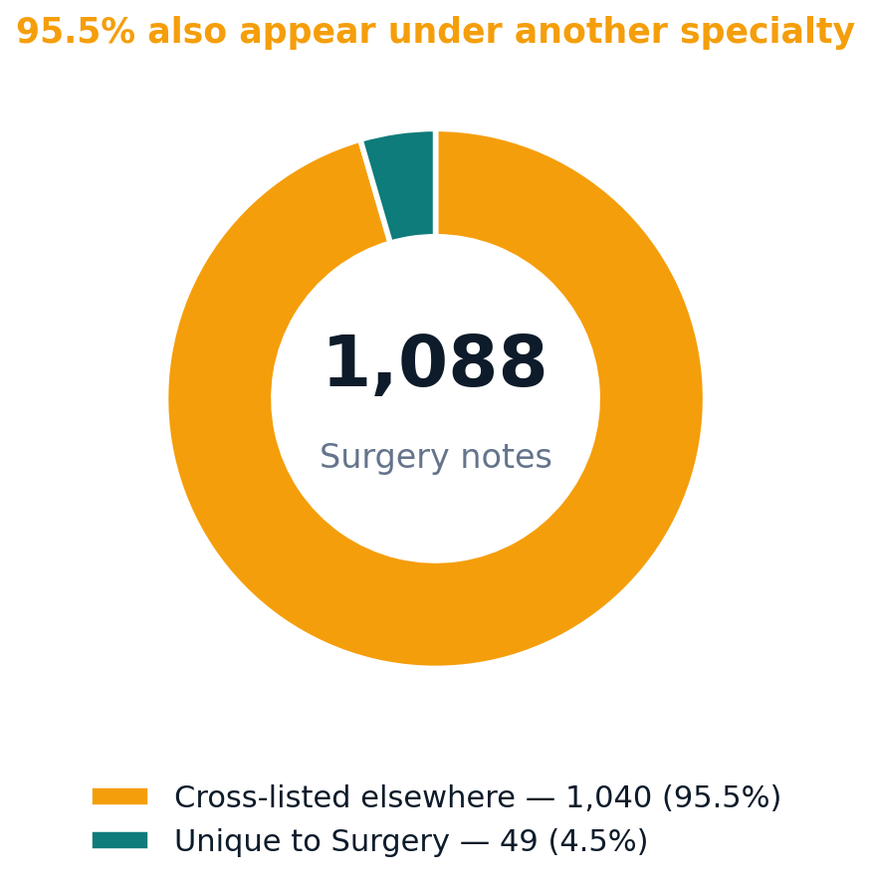
PHASE 1
Surgery: A Cross-Listed Category
“Surgery” is a procedure type, not a clinical specialty.
1,089 unique Surgery notes — 1,040 (95.5%) also appear under a more specific specialty.
"Arthroscopic knee surgery..."
labels: Surgery + Orthopedic
true specialty -> Orthopedic
Decision: drop “Surgery”
When a note exists under Surgery and a specific specialty, the specific specialty is the correct target.
Notes:
We ran the same test on 'Surgery.' Of its roughly 1,089 unique notes, 1,040 — over 95% — also appear under a more specific specialty. The example is a knee arthroscopy note labeled both 'Surgery' and 'Orthopedic.' When a note carries both, the specific specialty — Orthopedic — is the correct target; 'Surgery' just says a procedure happened. So we drop the Surgery label. Because the overlap is 95%, we're removing an ambiguous, redundant tag; the clinical content stays, attached to its real specialty.

Slide 11
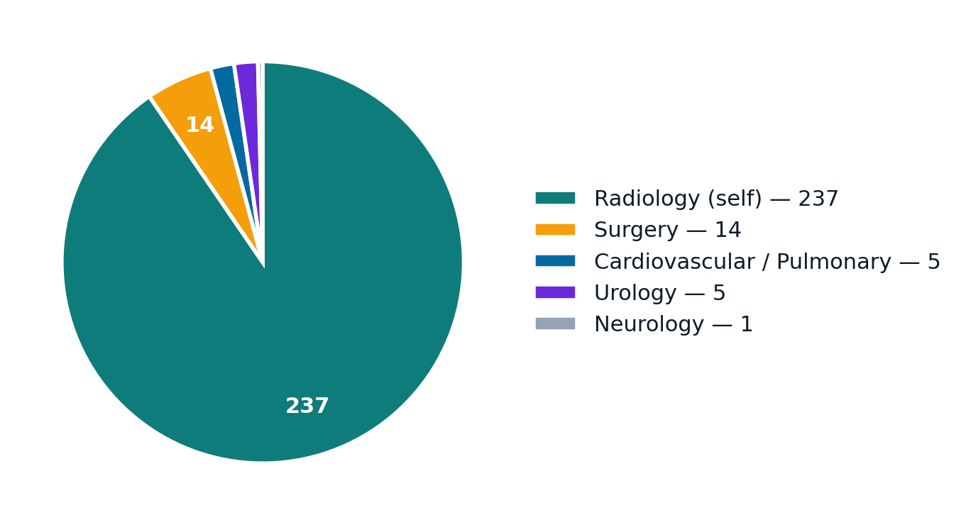
PHASE 1
Radiology: Another Cross-Listed Category
Radiology reports describe findings that belong to other specialties.
273 Radiology notes — 262 (96%) also appear under another specialty.
"Chest X-ray shows cardiac
enlargement..."
also: Cardiovascular / Pulmonary
Decision: drop Radiology
Removing it cuts label ambiguity — reports inherit the clinical context they describe.
Notes:
Radiology is the same story. Of 273 Radiology notes, 262 — about 96% — also appear under another specialty. That makes sense: a radiology report describes findings that belong to some other field. The example is a chest X-ray showing cardiac enlargement, which is really a cardiovascular note. So we drop Radiology too. Removing it cuts label ambiguity, because these reports inherit the clinical context they describe. That's the last of the cross-listed categories.

Slide 12
PHASE 1
Why Rare Specialties Must Be Dropped
Models need enough examples per class to learn anything reliable.
rare specialty (<10 notes) | notes
Speech - Language | 9
Autopsy | 8
Lab Medicine - Pathology | 8
Allergy / Immunology | 7
Hospice - Palliative Care | 6
Statistical problems
Stratified train/test split becomes unreliable
6–9 examples can't teach a generalizable pattern
Cross-validation is impossible at this size
80/20 split on 6 notes:
= 4.8 train / 1.2 test
model sees <=5 examples -> can't learn
Notes:
Now the rare specialties. A model needs enough examples per class to learn a pattern — and these don't have it. Speech-Language has 9 notes, Autopsy 8, Allergy 7, Hospice just 6. Three concrete problems: you can't reliably split so few notes into train and test sets; six to nine examples can't teach a generalizable pattern; and cross-validation is impossible at that size. The math makes it vivid — an 80/20 split on 6 notes gives 4.8 training and 1.2 test. You can't have fractions of a note, and the model effectively sees five or fewer examples. There's nothing to learn from that.

Slide 13
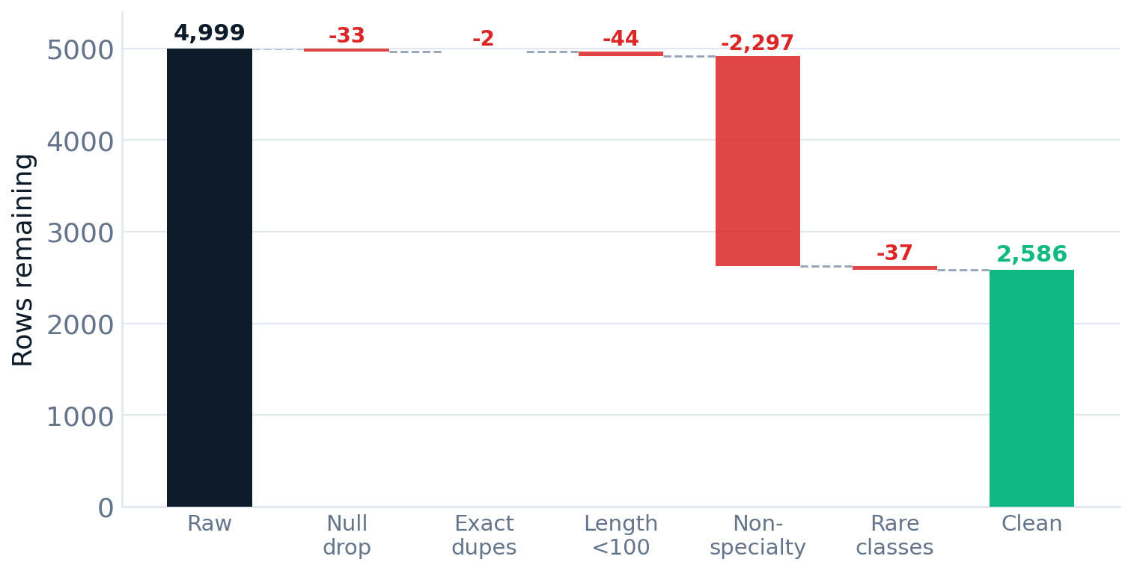
PHASE 1
Step-by-Step: How We Cleaned the Data
Six ordered filters take 4,999 rows down to 2,586.
1 Null removal
4,999 → 4,966
2 Whitespace normalize
consistent matching
3 Duplicate removal
4,966 → 4,964
4 Length filter (<100)
4,964 → 4,920
5 Non-specialty removal
4,920 → 2,623
6 Rare-class removal
2,623 → 2,586
Notes:
This slide puts the whole cleaning process in order — six steps, and the waterfall chart shows the row count dropping at each one. Step one, drop nulls, 33 rows. Step two, normalize whitespace so text matches consistently. Step three, remove exact duplicates, just 2. Step four, drop notes under 100 characters, 44 rows. Step five is the big one: remove the non-specialty, Surgery, and Radiology labels — about 2,300 cross-listed rows. Step six, drop the rare classes, 37 rows. We start at 4,999 and land at 2,586. The order matters: clean obvious junk first, then tackle the structural label problems.

Slide 14
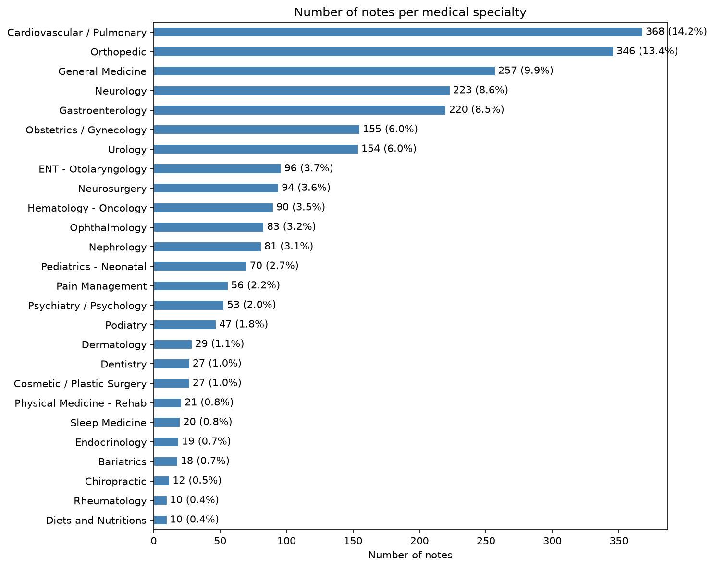
PHASE 1
What We Have Now: The Clean Dataset
2,586 notes across 26 trainable specialties.
Quality improvements
No nulls in key columns
No exact duplicates
All notes ≥ 100 characters
All specialties ≥ 10 notes
Only true medical specialties
Imbalance ratio: 36 : 1
Notes:
And here's the result — the clean dataset. 2,586 notes across 26 genuine specialties. Cardiovascular and Orthopedic lead at about 14 and 13 percent; the smallest kept specialties, like Rheumatology and Diets and Nutritions, sit right at our 10-note floor. On the right is the quality scorecard: no nulls in key columns, no exact duplicates, every note at least 100 characters, every specialty at least 10 notes, and only true specialties remaining. There's still imbalance — about 36 to 1 between largest and smallest — which we'll keep in mind for modeling, but every class is now trainable.

Slide 15
PHASE 1
Phase 1.1 Cleaning Outcomes
Every row dropped had a data-driven justification.
4,999
rows (raw)
→
2,586
rows (clean)
40
labels
→
26
specialties
48% fewer rows, 35% fewer labels — here's where they went:
removed | rows | reason
Null transcriptions | 33 | unusable
Too-short notes (<100) | 44 | insufficient context
Cross-listed labels (Surgery, Radiology, formats) | 2,297 | redundant labels
Rare-class notes | 37 | insufficient to train
Exact duplicates | 2 | data quality
Notes:
Quick recap of the cleaning. We cut the dataset by 48% — 4,999 to 2,586 rows — and reduced labels by 35%, from 40 to 26. The table breaks down where everything went: 33 null transcriptions, 44 too-short notes, about 2,300 cross-listed labels, 37 rare-class notes, and 2 exact duplicates. The key message: every single row we dropped had a documented, data-driven reason. We didn't guess — we proved, with overlap analysis and counts, that nothing valuable was lost.

Slide 16
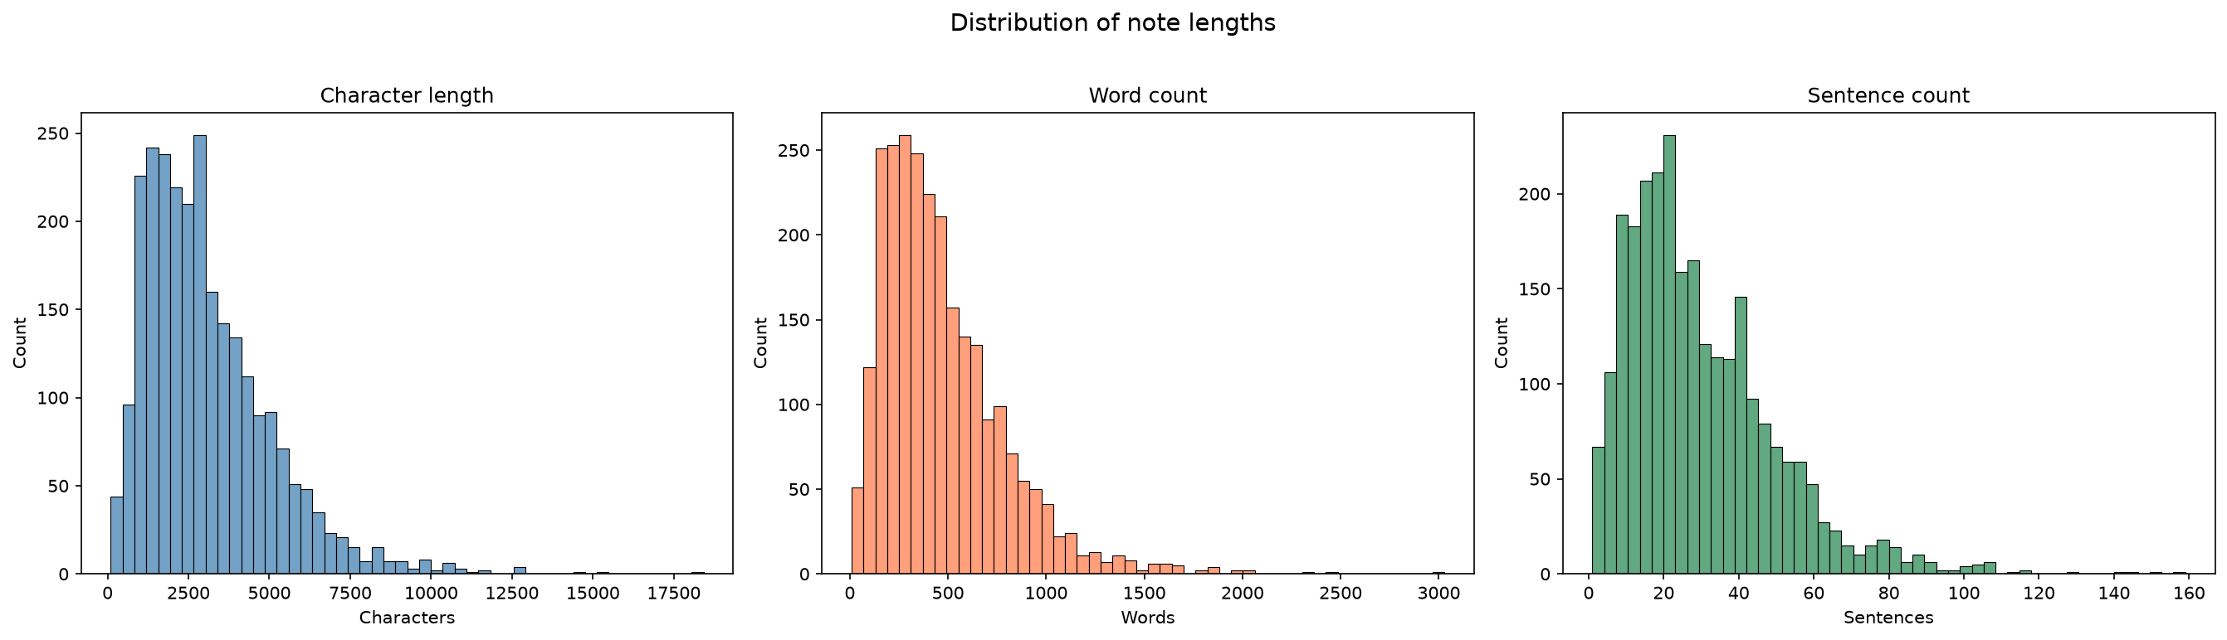
PHASE 1
Measuring Note Complexity — Three New Features
Length signals that may (weakly) separate specialties.
Character length
mean 3,077 — range 100–18,425
Word count
mean 469 — range 9–3,029
Sentence count
NLTK tokenizer — mean 30, range 1–159
Notes:
With clean data in hand we move to NLP analysis and engineer three simple features that capture how complex a note is. Character length — the raw size, averaging about 3,000 characters. Word count — averaging 469. And sentence count — averaging 30, using NLTK's sentence tokenizer rather than just splitting on periods, which matters for clinical text full of abbreviations like 'Dr.' These histograms show all three are right-skewed: most notes are short to medium, with a long tail of very long ones. The question is whether these length signals differ by specialty — that's the next slide.

Slide 17
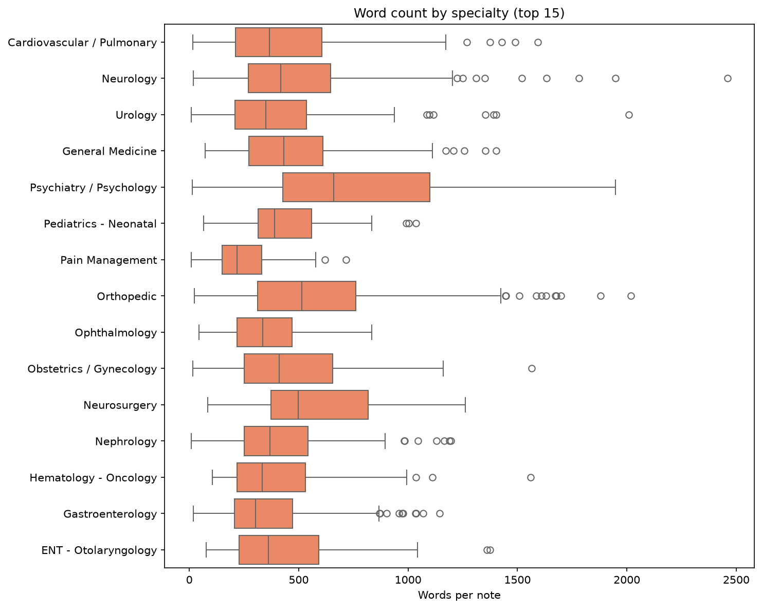
PHASE 1
Do Specialties Write Different-Length Notes?
Word-count distribution across specialties — a weak but real signal.
Observations
Psychiatry / Psychology writes the longest notes (median ~650 words) — narrative-heavy
Pain Management is the most concise (median ~220 words)
Every specialty has a long right tail — outliers stretch past 2,000 words
Length separates some specialties but overlaps heavily — useful, not decisive. Phase 1.2 adds word-level features.
Notes:
Here we break word count down by specialty. There is a real signal: Psychiatry and Psychology write the longest notes by far — a median around 650 words — because they're narrative-heavy. Pain Management is the most concise, around 220. But notice two things: every specialty has a long right tail of outliers, some past 2,000 words, and the boxes overlap heavily. So length helps a little, but it's nowhere near enough to classify on its own. That's why Phase 1.2 also extracts word-level features — which words actually appear — and that's where the real discriminating power is.

Slide 18
PHASE 1
From Raw Text to Analyzable Features
Strip the noise that hides specialty-specific patterns.
Before
"The patient’s blood pressure is 120/80. Heart sounds are normal."
After
"patient blood pressure heart sounds normal"
The noise we remove
Mixed case
“Heart” vs “heart”
Punctuation
“patient.” vs “patient”
Stopwords
the, and, of
Numbers / symbols
dates, 120/80
Notes:
To get word-level features we first have to clean the text, because raw clinical text is full of noise that hides the real patterns. The before-and-after shows it: 'The patient's blood pressure is 120 over 80. Heart sounds are normal.' becomes 'patient blood pressure heart sounds normal.' Four kinds of noise get removed: mixed case, where 'Heart' and 'heart' would count as different words; punctuation; stopwords like 'the,' 'and,' 'of' that appear everywhere and mean nothing; and numbers and symbols like dates and measurements. What's left is the medically meaningful content.

Slide 19
PHASE 1
Text Preprocessing Pipeline
Five steps turn raw clinical text into clean tokens.
1 Lowercase
one feature for “Heart” / “heart”
2 Strip punctuation & digits
replace with space, not empty — avoids word fusion
3 Tokenize on whitespace
split into a word list
4 Remove stopwords
drop the/and/of — high frequency, no meaning
5 Rejoin to a string
ready for vectorization
def clean(text):
text = text.lower()
# keep letters + spaces only
text = re.sub(r'[^a-z\s]', ' ', text)
tokens = text.split()
tokens = [w for w in tokens
if w not in stopwords]
return ' '.join(tokens)
Notes:
This is the actual function that does it, in five steps. One: lowercase everything, so 'Heart' and 'heart' become one feature. Two: strip punctuation and digits — and importantly replace them with a space, not nothing, so 'patient.The' becomes 'patient the' rather than fusing into one word. Three: split into individual words. Four: remove stopwords, the high-frequency grammatical filler. Five: rejoin into a clean string, ready to be turned into numbers for the model. Straightforward, but each step is deliberate.

Slide 20
PHASE 1
See the Transformation in Action
One real note through each stage of cleaning.
Original
past medical history:, he has difficulty climbing stairs, personal care, household chores, severe weight problem...
Lowercase
past medical history:, he has difficulty climbing stairs, personal care, household chores...
Remove punctuation
past medical history he has difficulty climbing stairs personal care household chores...
Remove stopwords
past medical history difficulty climbing stairs personal care household chores severe weight problem
82 words → 47 words (43% reduction) — medical terms preserved, grammatical filler dropped.
Notes:
Let's watch one real note go through the pipeline. It starts as a past-medical-history note with mixed case and punctuation. After lowercasing, the capitals are gone. After removing punctuation, commas and colons become spaces. After removing stopwords, the filler words drop out, leaving only content terms. The result: this note went from 82 words to 47 — a 43% reduction — but every medical term survived. We threw away grammar, not meaning.

Slide 21
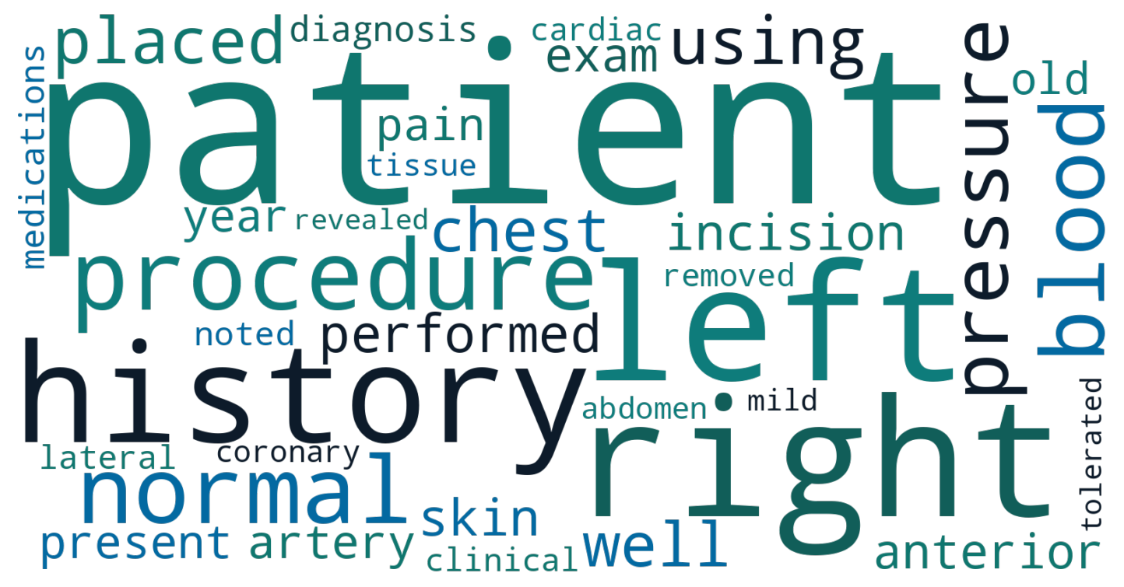
PHASE 1
Top Words After Cleaning
Medical vocabulary dominates — the cleaning worked.
word | count
patient | 12,598
right | 6,038
left | 5,883
history | 4,955
procedure | 3,935
Quality check passed
Output is medical terms, not grammar words. A few artifacts (c, x) remain — handled in TF-IDF.
Notes:
How do we know the cleaning worked? We counted the most common words afterward. The top ones are 'patient,' 'right,' 'left,' 'history,' 'procedure' — all genuine clinical vocabulary, not grammatical words like 'the' or 'and.' That's the quality check passing: the output is medical content. The word cloud visualizes it, sized by frequency. A couple of single-letter artifacts like 'c' and 'x' slip through, and we'll handle those later with a custom stopword list during vectorization. But overall, the text is now clean and meaningful.

Slide 22
PHASE 1
Specialties Have Signature Vocabulary
Top words per specialty — the foundation for classification.
Cardiovascular / Pulmonary
Orthopedic
General Medicine
Neurology
Gastroenterology
coronary
artery
catheter
chest
heart
pressure
knee
incision
lateral
medial
mm
fracture
history
medications
denies
past
blood
chest
motor
exam
mri
brain
mild
revealed
colon
abdomen
gallbladder
stomach
removed
bowel
Notes:
Now the payoff question: do different specialties actually use different words? Yes, clearly. For each specialty we pulled its most frequent terms. Cardiovascular is all 'coronary,' 'artery,' 'catheter,' 'heart.' Orthopedic is 'knee,' 'incision,' 'lateral,' 'fracture.' Gastroenterology is 'colon,' 'abdomen,' 'gallbladder.' Each specialty has a signature vocabulary — a linguistic fingerprint. This is the foundation that makes classification possible: if the words differ by specialty, a model can learn to tell them apart.

Slide 23
PHASE 1
Why Single Words Aren't Enough
Medical language is phrase-heavy — “blood pressure” is one concept.
top bigram | count
year old | 1,519
c c (artifact) | 1,188
operating room | 842
prepped draped | 788
blood pressure | 659
top trigram | count
patient year old | 681
past medical history | 554
history present illness | 545
tolerated procedure well | 537
Key finding: “internal” is generic, but “internal carotid” is a specific anatomical term — bigrams and trigrams carry specialty signal that single words miss.
Notes:
Single words aren't the whole story, because medical language is phrase-heavy. 'Blood pressure' is really one concept, not two separate words. So we also look at two-word and three-word sequences — bigrams and trigrams. Top bigrams include 'year old,' 'operating room,' 'blood pressure'; top trigrams include 'patient year old,' 'past medical history,' 'history present illness.' The point: 'internal' alone is generic, but 'internal carotid' is a specific anatomical term. Phrases carry specialty signal that single words miss. The one entry 'c c' is an artifact we filter out.

Slide 24
PHASE 1
Phase 1 Complete — Ready for Phase 2
A clean dataset and a confirmed linguistic foundation.
Deliverables
Clean dataset: 2,586 notes, 26 specialties
Features: char / word / sentence counts
clean_text column ready for vectorization
Vocabulary: top words, bigrams, trigrams
Saved: cleaned_medical_notes.csv
Decisions validated
Non-specialty labels removed (96% overlap)
Surgery / Radiology cross-listing eliminated
Rare classes dropped (insufficient data)
Length threshold set (≥100 chars)
Linguistic fingerprints confirmed
Every row dropped had a data-driven justification — we proved nothing valuable was lost.
Notes:
That completes Phase 1. On the left, what we delivered: a clean dataset of 2,586 notes across 26 specialties; three length features; a clean-text column ready for the model; and a full vocabulary analysis of top words, bigrams, and trigrams — all saved to a CSV. On the right, the decisions we validated with evidence: non-specialty labels removed with 96% overlap proven, Surgery and Radiology cross-listing eliminated, rare classes dropped for lack of data, and the length threshold set. The throughline of the whole phase: every row we dropped had a justification, and we proved nothing valuable was lost.

Slide 25
PHASE 2 -- CHI-SQUARE
Chi-Square Test for Term Independence
Tests whether a term is statistically bonded to a specialty or just appears by chance.
Highest Chi-Square Scores (most specialty-bonded)
Top Chi-Square Words per Specialty
eye
10,173
Cardiovascular
carbohydrate
9,279
artery, coronary, pulmonary, ventricular, aortic
Orthopedic
tooth
7,868
knee, fracture, tourniquet, tendon, joint
thyroid
7,350
Neurology
brain, mri, unremarkable, gait, sensory
teeth
6,075
Gastroenterology
sleep
6,024
colon, gallbladder, duct, esophagus, stomach
foot
4,872
Obstetrics/Gyn
uterus, uterine, cervix, fetal, vaginal
uterus
4,381
Urology
artery
4,137
bladder, prostate, penis, testis, urethra
renal
3,616
ENT
nasal, ear, tonsil, adenoid, palate
All top chi-square terms have p < 0.05. These are not coincidences -- they are statistically defining features.
Notes:
Open: "Phase 2 is where we move from counting words to proving statistically which words belong to a specialty."
Left table: "The chi-square test asks: is this word here by chance or is there a real bond? 'Eye' scored over 10,000 — its presence in Ophthalmology is
essentially guaranteed, not random."
Right side: "Per specialty: Cardiovascular gets artery, coronary. Orthopedic gets knee, fracture. Not surprising — but now we have mathematical proof. Every term here passed p less than 0.05."
Wrap: "This tells our models which features to trust. High chi-square = reliable signal. 'Patient' would score low — useless for classification."

Slide 26
PHASE 2 -- PMI
PMI Collocation Scoring
Pointwise Mutual Information ranks bigrams that co-occur more than random chance predicts.
Top 10 PMI Bigrams (genuine medical terms)
bigram_measures = BigramAssocMeasures()
words = ' '.join(df['clean_text']).split()
finder = BigramCollocationFinder.from_words(words)
finder.apply_freq_filter(5) # min 5 occurrences
top_pmi = finder.nbest(bigram_measures.pmi, 20)
amaurosis fugax
myasthenia gravis
radiometer hemoximeter
charcot marie
mononeuritis multiplex
cisterna magna
What PMI tells us
spina bifida
HIGH PMI: words that seek each other out
'myasthenia gravis' = real medical term
LOW PMI: random co-occurrence
'the patient' = grammatical filler
splenius capitis
leukocyte esterase
pseudotumor cerebri
PMI separates genuine clinical terminology from high-frequency noise that frequency counts alone cannot filter.
Notes:
Open: "Chi-square works on single words. But medicine speaks in phrases. PMI finds word pairs that stick together more than chance predicts."
Left list: "These are real clinical terms — amaurosis fugax, myasthenia gravis, spina bifida. The words seek each other out. You'd never see 'amaurosis' without 'fugax.'"
Right side: "High PMI = genuine medical term. Low PMI = random collision like 'the patient' — both common individually but not a meaningful phrase."
Wrap: "PMI filters our n-gram features. Instead of thousands of random pairs, we keep only ones with clinical meaning."

Slide 27
PHASE 2 -- TF-IDF
TF-IDF: The Uniqueness Metric
Scores each word by how unique it is to a document. Common words score near zero; rare distinctive words score high.
Lowest IDF (auto-downweighted as noise)
Highest IDF (boosted as distinctive features)
patient
IDF: 1.16
well
IDF: 1.51
erythema nodosum
IDF: 8.17
old
IDF: 1.60
nodosum
IDF: 8.17
left
IDF: 1.61
waves motor
IDF: 7.76
right
IDF: 1.62
core needle biopsy
IDF: 7.76
year
IDF: 1.64
positive waves
IDF: 7.76
procedure
IDF: 1.66
skin paddle
IDF: 7.76
history
IDF: 1.66
right metatarsal
IDF: 7.76
normal
IDF: 1.71
first left metatarsal
IDF: 7.76
tfidf = TfidfVectorizer(max_features=10000, ngram_range=(1,3), sublinear_tf=True)
# sublinear_tf=True: uses log(1 + tf) so words appearing 50x don't dominate words appearing 5x
TF-IDF automatically filters 'medical noise' -- no manual stopword list needed for domain-specific terms.
Notes:
Open: "TF-IDF is the most important preprocessing step. It answers: how unique is this word to this document?"
Left: "Lowest scores — patient at 1.16, basically zero signal. Well, old, left, right — all noise. TF-IDF downweights these automatically."
Right: "Highest scores — erythema nodosum at 8.17. Appears in maybe one or two notes, so when it shows up, it's an extremely strong signal."
Code: "We used log scaling so a word appearing 50 times doesn't get 50x the weight of one appearing once."
Wrap: "Bottom line: TF-IDF is our automatic noise filter. It kills 'patient’ and amplifies rare specialty-defining terms. This is what we feed into Phase 3."

Slide 28
PHASE 3
ML & Classification
TF-IDF vectorized text (ngrams 1-3, 10,000 features), then trained three classifiers on 2,068 training notes.
Logistic Regression
class_weight='balanced', max_iter=1000
X_train, X_test, y_train, y_test = train_test_split(
X, y, test_size=0.2, stratify=y, random_state=42)
tfidf = TfidfVectorizer(
max_features=10000, ngram_range=(1, 3),
sublinear_tf=True,
stop_words=['abc','xyz','mmddyyyy','yearold']
)
X_train_tfidf = tfidf.fit_transform(X_train)
X_test_tfidf = tfidf.transform(X_test)
Linear, fast, interpretable. Coefficients show which words drive each specialty prediction.
Multinomial Naive Bayes
default priors (no class weighting)
Probabilistic text specialist. Assumes word independence -- works well for bag-of-words despite this.
Random Forest
200 trees, class_weight='balanced', n_jobs=-1
Non-linear ensemble. Often underperforms on sparse TF-IDF -- too many zero-valued columns confuse tree splits.
Why stratify=y? Rare specialties (Rheumatology: 10 notes) must appear in both train and test. Without this, evaluation on rare classes is impossible.

Slide 29
PHASE 3 -- RESULTS
Model Evaluation
Results
Model
Accuracy
Macro F1
Weighted F1
Logistic Regression
0.701
0.657
0.703
Naive Bayes
0.527
0.227
0.471
Random Forest
0.614
0.563
0.612
Error Analysis
Top LR Coefficients
Accuracy alone misleads on imbalanced data
NB Macro F1 (0.227) vs Accuracy (0.527) = failing rare classes
LR gap is small (0.044) = consistent across specialties
Top error: Neurology -> Rehab at 77% confidence
Most 'errors' are medically cross-disciplinary notes
Cardiovascular: coronary (1.34), artery (1.17)
Gastroenterology: colon (1.46), esophagus (1.35)
Neurology: brain (1.19), mri (1.12)
Orthopedic: fracture (1.11), tourniquet (1.04)
Full-circle: matches Phase 2 chi-square results

Slide 30
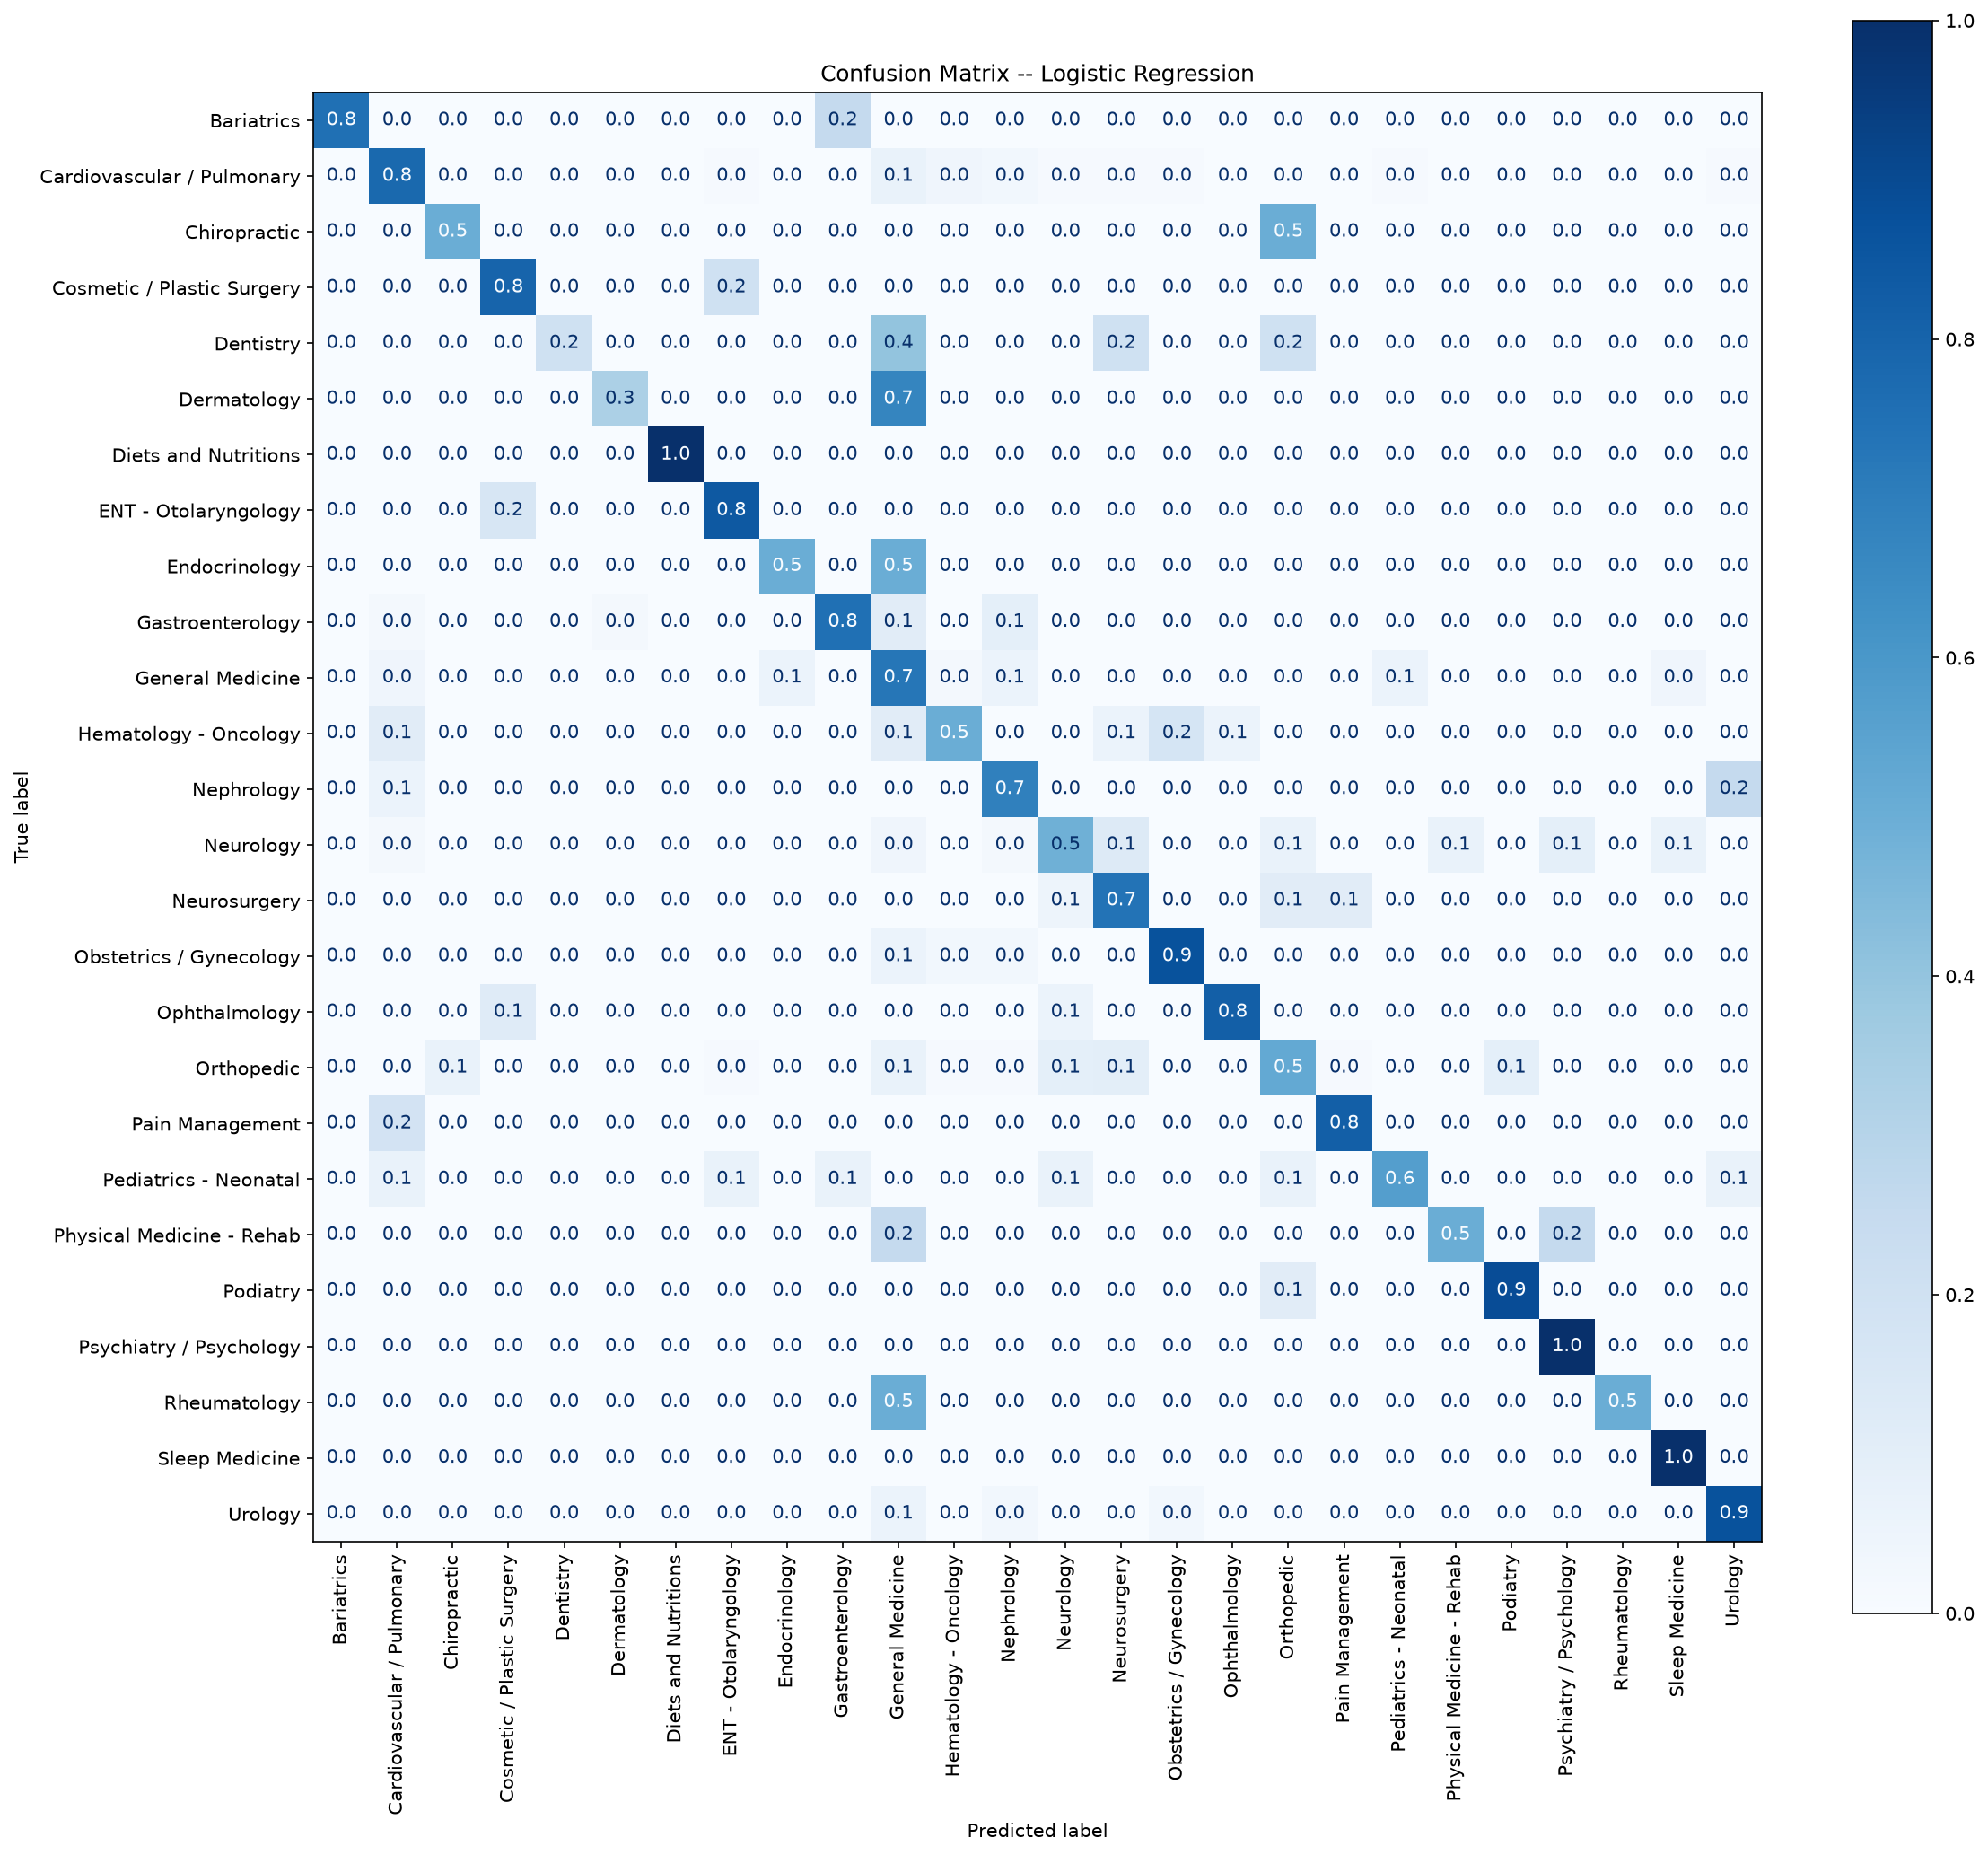
PHASE 3 -- CONFUSION
Confusion Matrix -- Logistic Regression
How to read this
Rows = true specialty
Columns = predicted specialty
Diagonal = correct predictions
Normalized: each row sums to 1.0
Key confusions:
Neurology <-> Physical Med/Rehab
Orthopedic <-> Podiatry
General Med <-> multiple specialties
These reflect genuine vocabulary
overlap, not model failure.

Slide 31
PHASE 4 & 5
Vector DBs & Semantic Search
TF-IDF treats 'Renal' and 'Kidney' as unrelated tokens. Embeddings place them side by side in meaning-space.
1
Chunking
chunk_text(text, chunk_size=200, overlap=20)
# 2,586 notes -> ~8,000 indexed chunks
Split each note into 200-word chunks with 20-word overlap. Each chunk carries specialty + note_id metadata.
2
Dense Vectors
model = SentenceTransformer('all-MiniLM-L6-v2')
vectors = model.encode(all_chunks) # 384-D
Encode every chunk with all-MiniLM-L6-v2. Each chunk becomes a 384-D float vector in meaning-space.
3
ChromaDB + Mini-RAG
collection.query(query_embeddings=qvec, n_results=5)
vote = Counter(specialties).most_common(1)[0][0]
Store vectors in ChromaDB. Query -> embed -> retrieve top-5 -> majority vote on specialties = prediction.
Notes:
"So in Phase 3 we built a keyword-based classifier using TF-IDF. The fundamental problem is that TF-IDF treats every word as a separate token with no understanding of meaning. 'Renal' and 'Kidney' are two completely unrelated columns in the matrix — it has no idea they're synonyms. So if a doctor writes 'kidney failure' and a stored note says 'renal insufficiency,' TF-IDF scores zero overlap and finds no match.
Embeddings fix this by representing text as coordinates in a 384-dimensional space, where semantically similar words land near each other. 'Renal' and 'Kidney' end up as neighboring points. Distance in this space equals dissimilarity of meaning.
The pipeline has three steps. First we chunk each note into 200-word pieces with a 20-word overlap — this is because embedding models have a limited attention span, and a 2,000-word note embedded whole produces a blurry, averaged vector. The overlap prevents sentences from being cut in half at the boundary.
Then we encode every chunk with all-MiniLM-L6-v2, which produces a 384-dimensional vector for each chunk. We end up with about 8,000 chunks from roughly 2,500 notes.
Finally we store those vectors in ChromaDB alongside their metadata — specialty and note ID. When a query comes in, we embed it with the same model, find the 5 nearest chunks by cosine similarity, and take a majority vote on their specialty labels. That's the prediction. No training, no learned parameters — it just looks things up."

Slide 32
PHASE 4 -- DEMO
Semantic Understanding in Action
Queries with ZERO exact medical keywords correctly routed -- something TF-IDF cannot do.
'my heart skips beats and races sometimes'
->
Cardiovascular / Pulmonary
No 'arrhythmia' or 'cardiac' in query
'trouble breathing and a whistling sound when I exhale'
->
Cardiovascular / Pulmonary
No 'asthma' or 'wheeze' in query
'the bone in my lower leg snapped'
->
Orthopedic
No 'fracture' or 'tibia' in query
'the patient's kidneys are not filtering properly'
->
Nephrology
No 'renal' in query -- synonym match
'child presents for routine vaccination and growth check'
->
Pediatrics - Neonatal
Everyday language, no clinical jargon
This is the headline result: semantic understanding beyond keyword matching. TF-IDF scores zero overlap for all of these.
Notes:
"This is the headline demonstration of Phase 4. Each of these queries contains zero exact medical keywords. I deliberately wrote them in everyday language — the kind of thing a patient might say, not a clinician.
'My heart skips beats and races sometimes' — no 'arrhythmia', no 'cardiac', no 'tachycardia'. The system still routes it to Cardiovascular / Pulmonary because it understands the meaning maps to heart conditions.
'Trouble breathing and a whistling sound when I exhale' — no 'asthma', no 'wheeze'. Still routes correctly.
'The bone in my lower leg snapped' — no 'fracture', no 'tibia'. Goes to Orthopedic.
'The patient's kidneys are not filtering properly' — no 'renal', no 'nephrology'. Goes to Nephrology. This is the synonym demonstration we built the whole system for.
A TF-IDF classifier would score zero word overlap on every single one of these and fail completely. The semantic search succeeds because it's matching on meaning rather than exact words. This is the core advantage of the embedding-based approach over Phase 3."

Slide 33
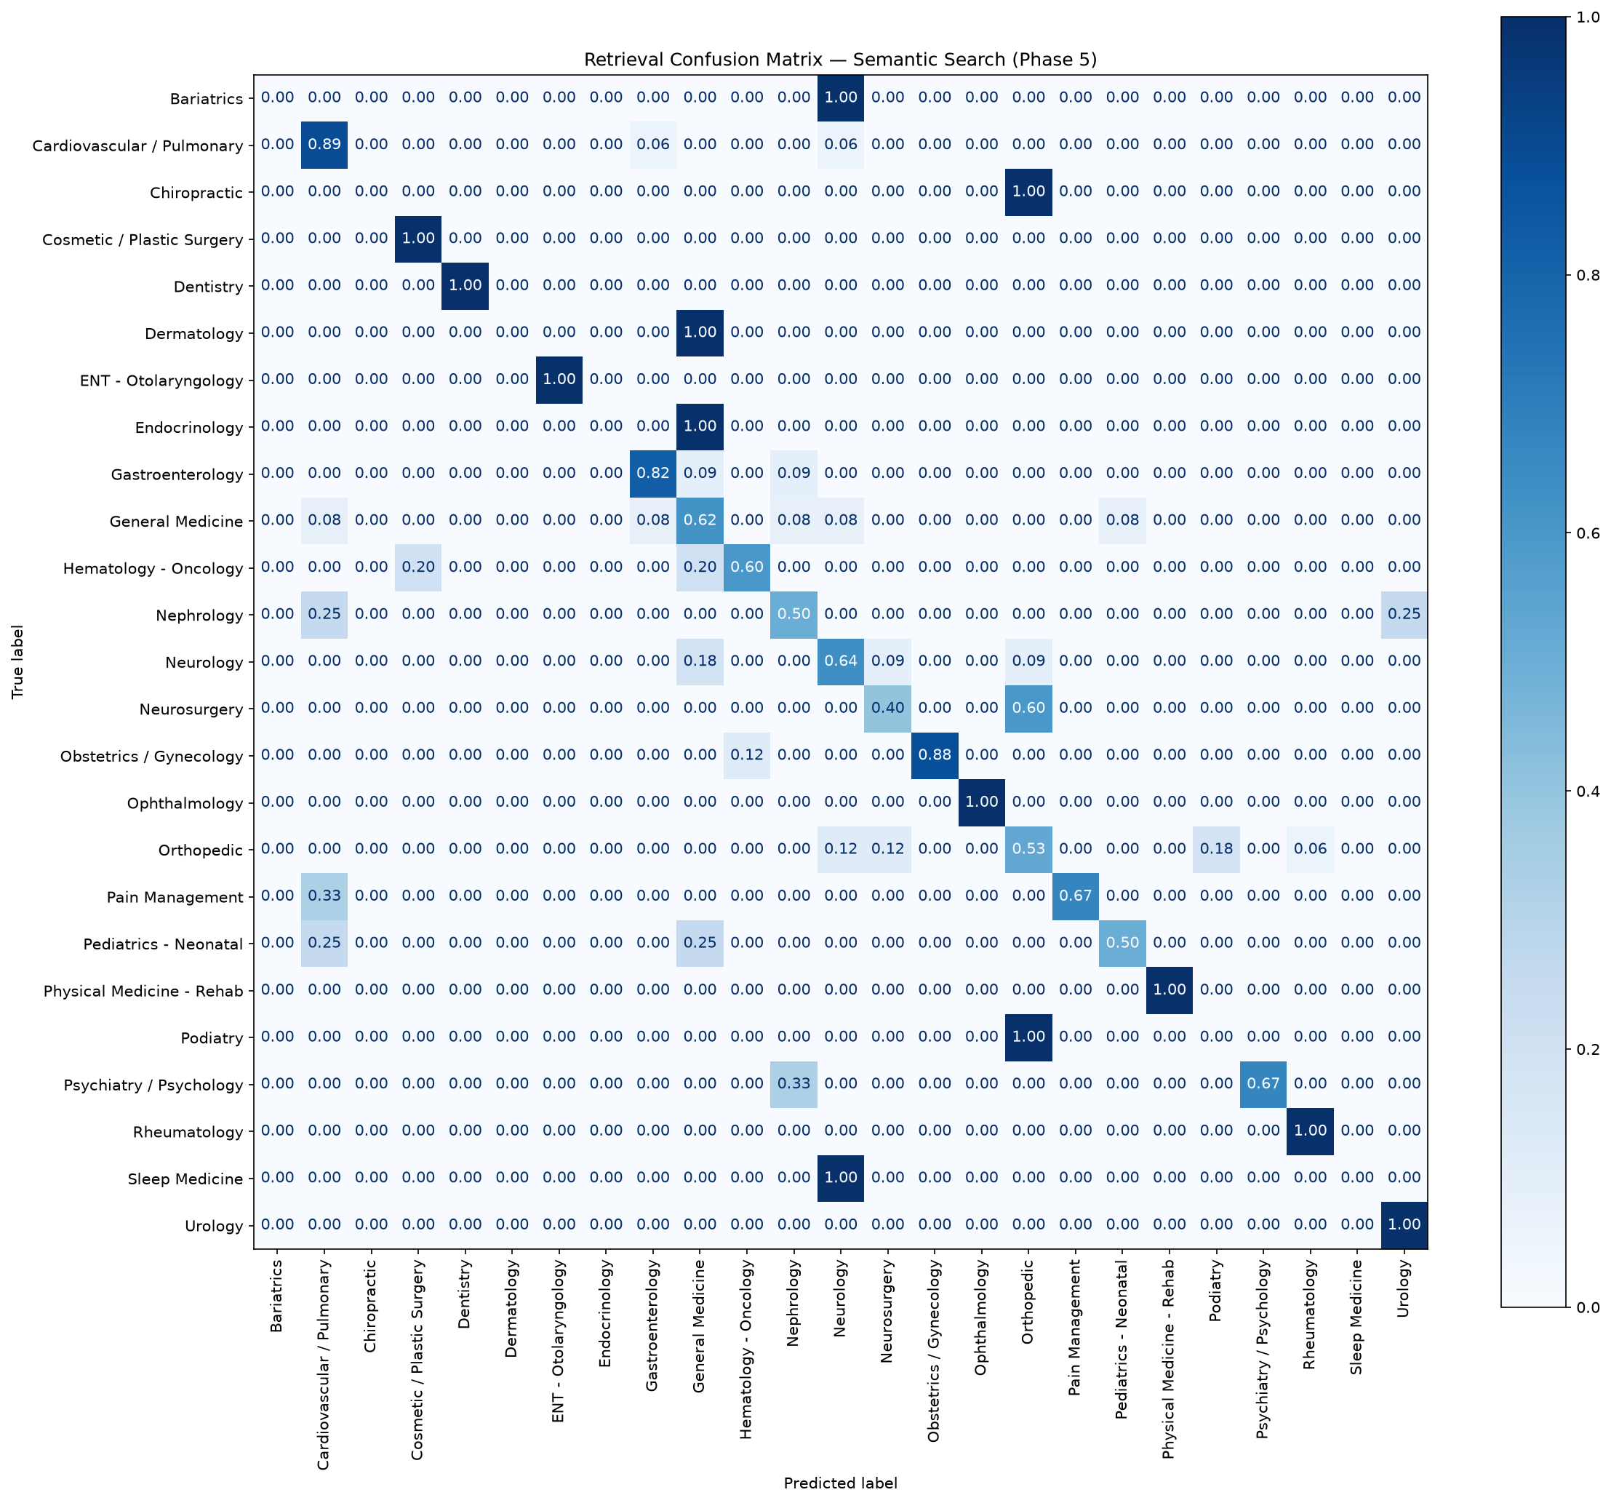
PHASE 5
Retrieval Validation
5% holdout notes (never indexed) used as ground-truth queries. Precision@5 = fraction of 5 retrieved chunks with correct label.
Precision@5 Results
Mean Precision@5: ~64%
Random baseline (26 classes): ~3.8%
Our system: ~16x better than chance
Well-represented specialties: near 100%
Rare/overlapping specialties: lower scores
Precision@5 uses exact-label matching. Medically reasonable neighbors (Neurology retrieving Neurosurgery) are counted as misses -- true clinical utility is higher.
Notes:
"For Phase 5 we need to actually measure whether the search engine works, not just show cherry-picked demos. To do that honestly we need ground truth — notes with known labels that the system has never seen.
So before building the index, we held out 5% of the notes — about 140 notes — that were never indexed. These are the query notes. If we had indexed everything and then queried with the same notes, the system would retrieve copies of itself and score perfectly — that's not a real test. The held-out set gives us genuine evaluation.
We ran each held-out note through the retrieval, retrieved 5 chunks, and measured Precision@5 — what fraction of those 5 carried the correct specialty label. The mean came out to about 64%, against a random baseline of 3.8% for 26 classes. That's roughly 16 times better than chance.
On the right is the actual retrieval confusion matrix from the notebook. You can see most specialties have a strong diagonal — well-represented specialties with distinctive vocabulary like Bariatrics, Dentistry, and Urology score near 1.0. The off-diagonal hotspots are the interesting part — Neurology retrieving Neurosurgery, General Medicine retrieving Neurology — and those are exactly the same pairs that confused the Phase 3 classifier.
That's actually the strongest finding: two completely different methods — one that trained on labels, one that trains nothing — confuse the same specialty pairs. That tells us the confusion isn't a model weakness, it's inherent to the data itself. These specialties genuinely share clinical vocabulary."

Slide 34
COMPARISON
Two Approaches, One Dataset
Same specialty pairs confuse both methods -- proving overlap is inherent to clinical data, not an artifact.
Parametric (Phase 3)
Non-Parametric (Phase 4)
Logistic Regression
Learns weights from labeled data
Can predict WITHOUT original notes
Fast inference after training
Accuracy: 70.1%
Macro F1: 0.657
Cannot handle synonyms or paraphrases
Mini-RAG (retrieve + vote)
Stores data, trains nothing
NEEDS notes at query time
Handles synonyms and layperson text
Precision@5: ~64%
16x better than random
Semantic understanding beyond keywords
Notes:
"The last slide ties everything together. We built two fundamentally different approaches to the same problem — classifying medical notes by specialty — and comparing them is more interesting than either result alone.
Phase 3 is parametric: the Logistic Regression model learned weights from labeled data, baked that knowledge into parameters, and can now predict without ever seeing the original notes again. It got 70% accuracy and a Macro F1 of 0.657. Its weakness: it's completely keyword-dependent. It cannot handle synonyms or paraphrasing.
Phase 4 is non-parametric: the Mini-RAG classifier stores the data and references it at query time. Remove the vector store and it has nothing — the data is the model. It got 64% Precision@5, which is 16 times the random baseline. Its strength: semantic understanding — it handles layperson phrasing and synonyms that Phase 3 completely misses.
The subtext at the top says it best: the same specialty pairs confuse both methods. Neurology and Neurosurgery, Cardiovascular and General Medicine — these confusions show up in both the classifier confusion matrix and the retrieval confusion matrix. That's our proof that the overlap is a property of the clinical data, not a failure of our methods. Real medicine is multi-disciplinary, and any single-label classification system is a simplification of that reality."

Slide 35
Key Takeaways
->
Full pipeline: raw CSV to working RAG classifier
5 phases, fully documented and reproducible. EDA -> statistics -> ML -> semantic search -> validation.
->
Logistic Regression wins on sparse text (70.1%)
Simpler models beat complex ones on high-dimensional TF-IDF. Complexity does not always improve performance.
->
Statistical + ML methods converge independently
Chi-square and LR coefficients identify the same specialty-defining vocabulary. Two independent validations.
->
Semantic search solves what keywords cannot
ChromaDB + embeddings handle synonyms and layperson language. 16x better than random on Precision@5.
->
Cross-specialty confusion is medical reality
Same pairs confuse trained classifiers AND untrained retrievers. This is inherent to multi-disciplinary medicine.
Questions?

